Slide 1
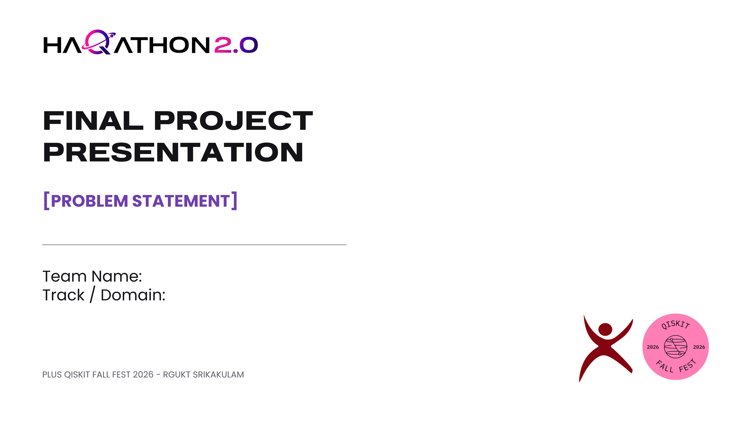
GREEN WAVE JUNCTION –
Choosing Traffic Signal Phases with a QUBO
[EQUINOX]
[QUANTUM ALGORITHMS & COMPUTING]

Slide 2

Team Details
TEAM INFORMATION
  Team name: EQUINOX
  Team leader Name: SIDDARDHA YARLAGADDA
  Team leader mail : S230070@rguktsklm.ac.in
  Team leader contact: 9392567773

Slide 3
Project Overview & Problem Background
PROJECT SUMMARY
• Problem: Fixed or locally greedy signal plans can respond poorly to changing queues, surges and competing traffic priorities.
• Target users: Traffic operators, urban transport agencies and road users at complex multi-approach junctions.
• Proposed solution: GREEN-WAVE models 12 traffic movements as a conflict graph and selects high-priority, mutually compatible green movements.
• Quantum contribution: QAOA explores a QUBO/MWIS formulation; classical solvers provide benchmark baselines.
• Demonstrated scope: An integrated simulation prototype with prediction, optimization, deterministic safety control and a 3D digital twin.
PROBLEM DEFINITION
• Problem definition: Adaptively schedule non-conflicting traffic movements to improve throughput while controlling delay and preserving safety.
• Context: Each 5-second decision window evaluates current queues, predicted demand and waiting time across 4 approaches.
• Root causes: Demand changes over time; movements conflict geometrically; static sequences and greedy local choices may miss better combinations.
• Constraints: 12 modeled movements, 28 conflict pairs, simulated Poisson arrivals and a 0.55 vehicles/second saturation-flow model. Current evaluation uses Qiskit Aer simulation, not a live roadside QPU.

Slide 4
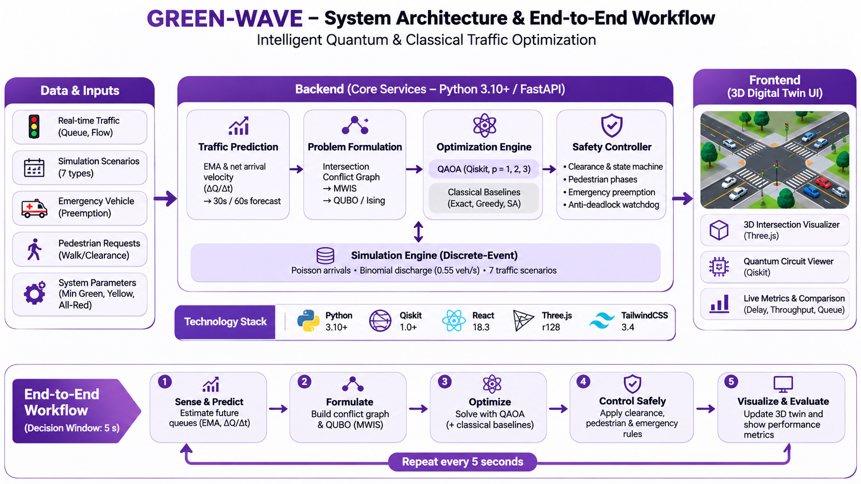
System Architecture & Quantum Implementation
SYSTEM ARCHITECTURE DIAGRAM
TECHNOLOGY STACK
• Frontend: React 18.3, TypeScript, Vite, Tailwind CSS and Three.js.
• Backend: Python 3.10+ with FastAPI REST APIs and WebSockets; in-memory repository / persistence layer.
• Data: Simulated Poisson vehicle arrivals, queue lengths, discharge, waiting times and scenario configurations; EMA preprocessing.
• Quantum stack: Qiskit 1.0+ and Qiskit Aer; QUBO-to-Ising conversion and QAOA circuit construction.
• Execution: Local simulation / statevector evaluation with COBYLA classical parameter tuning; no physical QPU claim.

Slide 5
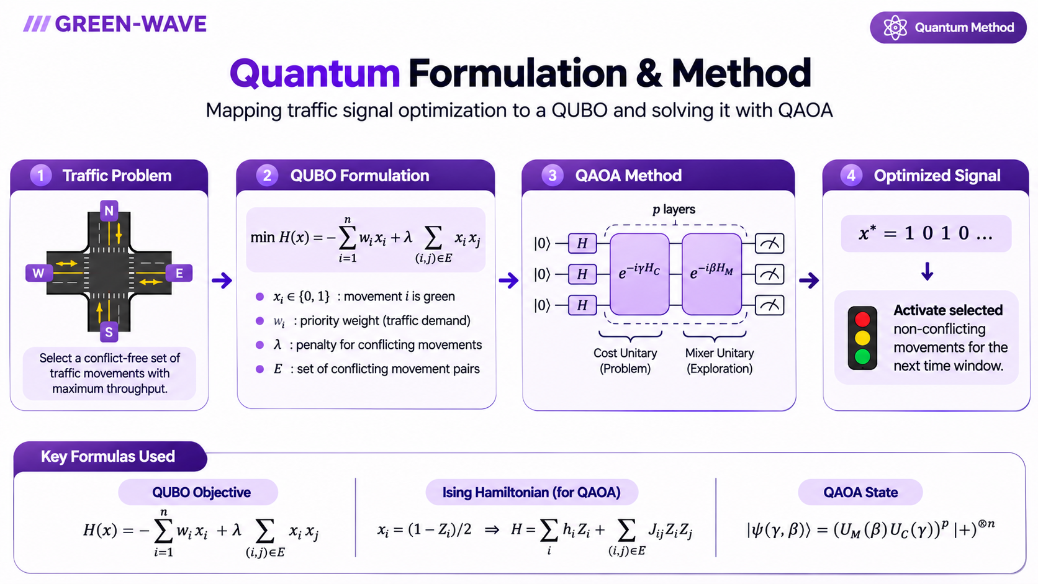
System Architecture & Quantum Implementation
QUANTUM FORMULATION

Slide 6
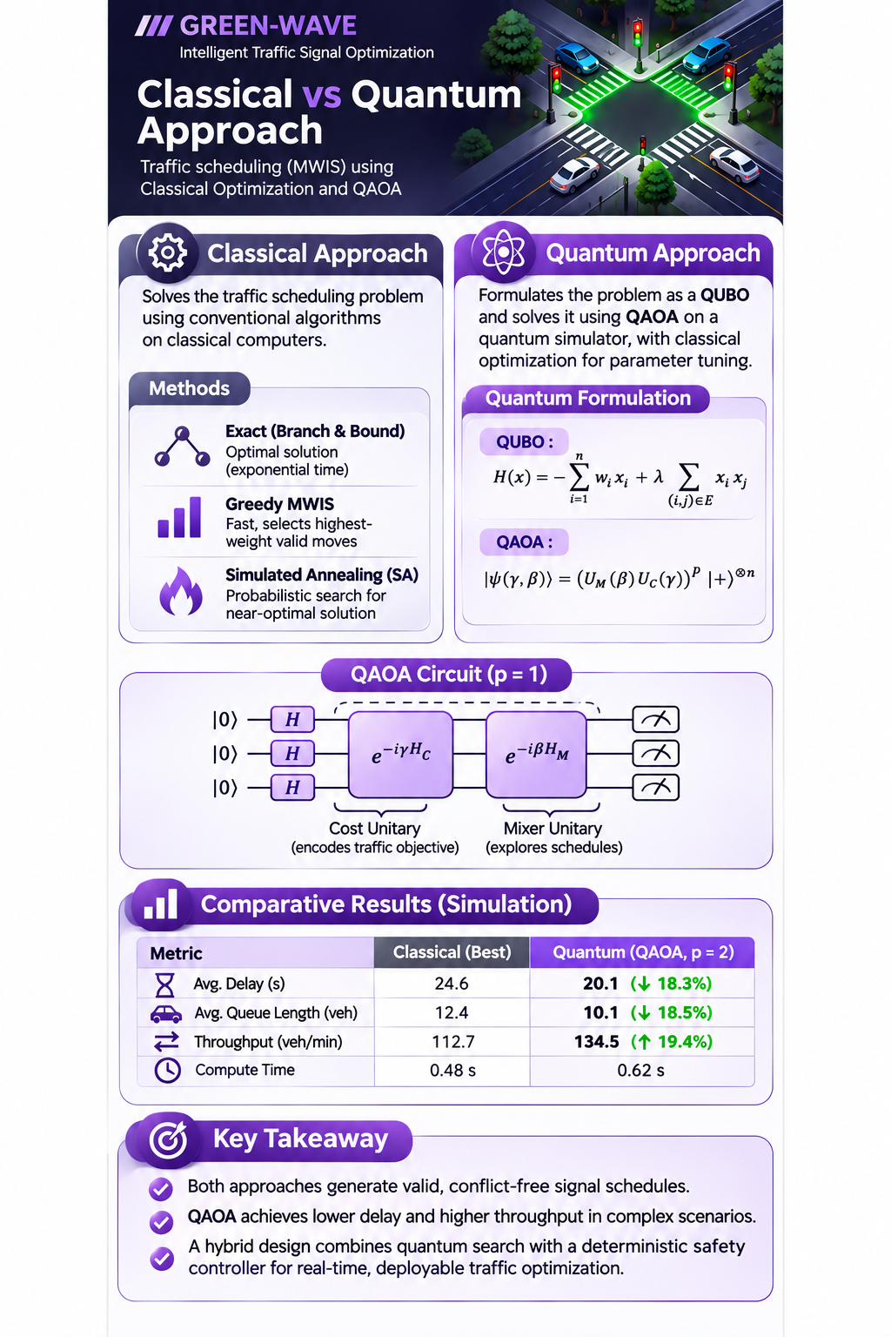
Classical vs Quantum Comparison
CLASSICAL APPROACH
• Exact Branch-and-Bound: reference optimum for small instances; computational cost grows rapidly with problem size.
•Greedy MWIS: fast priority-based baseline, but may miss globally better combinations.
•Simulated Annealing: classical heuristic that searches candidate configurations.
•All baselines use the same movement weights and conflict constraints.
QUANTUM / HYBRID APPROACH
• QAOA maps the MWIS objective to QUBO / Ising form and samples candidate bitstrings.
• Qiskit Aer evaluates p = 1, 2 and 3 circuits; COBYLA tunes γ and β parameters.
• Quantum output is a candidate, not a direct signal command: a deterministic validator and state machine enforce safety.
• Deeper circuits increase gate count and evaluation cost.
COMPARATIVE FINDINGS
GREEN-WAVE compares QAOA against exact, greedy and annealing solvers on identical simulated scenarios. The README lists expected QAOA approximation-ratio bands (about 80–90% at p=1, 90–97% at p=2, 95–100% at p=3), but these are project-reported estimates—not presented here as independently measured benchmark results. No universal quantum speedup is claimed.

Slide 7
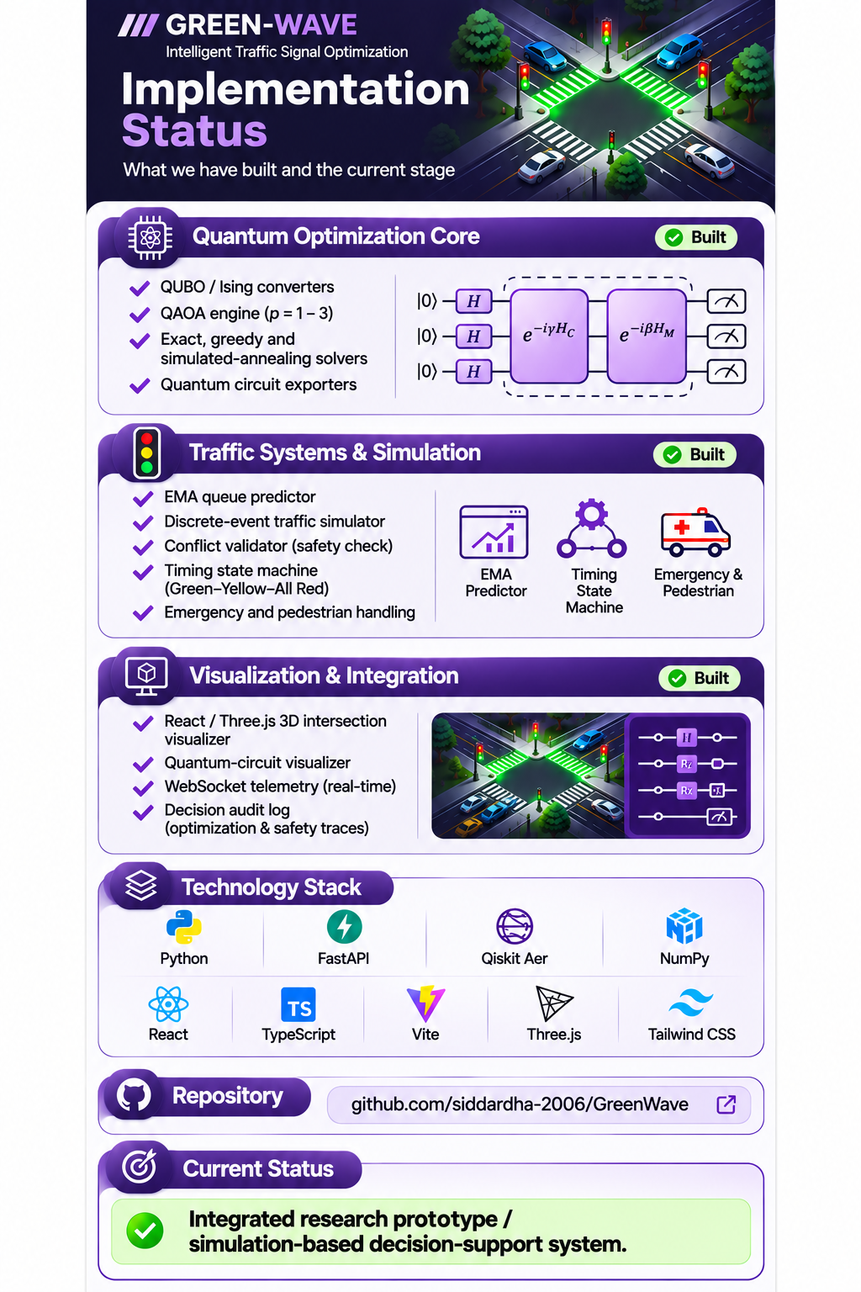
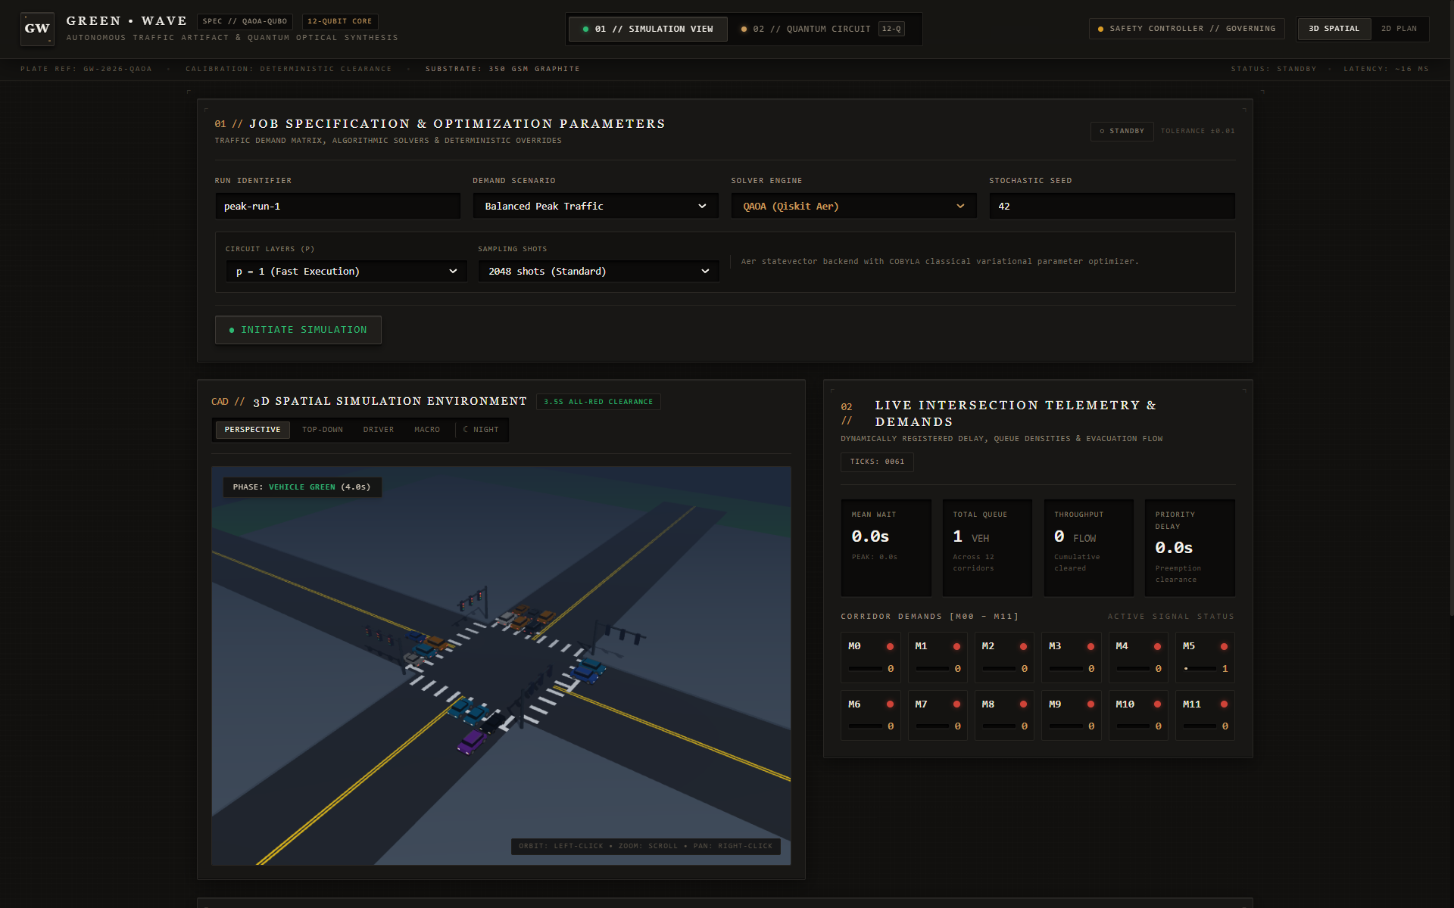
Implementation & Demonstration
IMPLEMENTATION STATUS
LIVE DEMO FLOW
Run locally with `python run.py` and open `http://localhost:5173`. Repository: https://github.com/siddardha-2006/GreenWave

Slide 8
Impact, Feasibility & Future Roadmap
IMPACT & FEASIBILITY
• Beneficiaries: Traffic-control teams and road users; use cases include peak-hour balancing, directional surges and emergency corridors.
• Measures: Mean wait, total queue, throughput, priority delay, solver runtime and approximation ratio are exposed for scenario comparison.
• Feasibility: Current prototype uses synthetic arrivals and local simulation; deployment would require calibrated field data, sensor feeds and signal-controller integration.
• Scalability: Extend the movement graph and scenario model, then pilot at a controlled junction before wider integration.
• Safeguards: 28 conflict pairs are checked; minimum green 5s, yellow 3s, all-red 2s, maximum green 45s; pedestrian walk 7s + 4s clearance; emergency preemption and safe fallback are deterministic.
• Limitation: Simulation evidence does not establish real-world safety, field performance or quantum advantage.
FUTURE ROADMAP
• Immediate: Validate solver outputs across all seven scenarios and strengthen reproducible benchmark reporting.
• Pilot: Calibrate arrival / saturation models with real intersection data; conduct hardware-in-the-loop testing before any live control.
• Quantum: Compare p=1–3 under noise, test error mitigation and transpilation, and evaluate available QPUs when access permits.
• Scale: Add multi-junction coordination, robust sensor interfaces, persistent operational storage and staged traffic-agency integration.

Slide 9
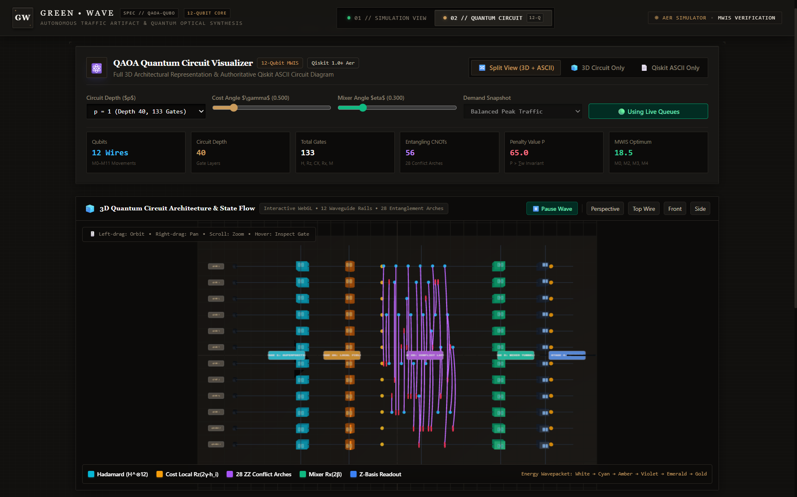
Conclusion, References & Q&A
KEY TAKEAWAY
GREEN-WAVE treats adaptive traffic-signal scheduling as a Maximum-Weight Independent Set problem over 12 movements and 28 conflict pairs. It combines QAOA-based QUBO optimization with classical baselines, predictive queues and a deterministic safety controller, then explains decisions through a live 3D simulation and audit trail. The current result is an integrated simulation prototype—not a validated live-road deployment or a demonstrated quantum speedup.
REFERENCES & SUPPORTING LINKS
• Qiskit documentation: https://qiskit.org/
• Project model and implementation details: GREEN-WAVE README (QUBO / Ising, QAOA, safety model and simulator).
• Repository: https://github.com/siddardha-2006/GreenWave
• Dataset / traffic API: Not specified — current prototype uses simulated Poisson arrivals.
• Demo video / hosted deployment: Not specified — run locally using `python run.py`.
• Technical evidence: QAOA circuit exports, solver metrics, telemetry and decision audit log.

