Slide 1

What is OOP?
OOP is a design philosophy. It stands for Object Oriented Programming. Object-Oriented Programming (OOP) uses a different set of programming languages than old procedural programming languages (C, Pascal, etc.). There is no hard and fast definition of what Object Oriented Programming (OOP) is, we can define. Object Oriented Programming (OOP) is a programming concept that treats functions and data as objects.

Slide 2
What is an Object?
An oject is a bunch of variables and functions all lumped into a single entity. The object can then be called rather than calling the variables or functions themselves. Within an object there are methods and properties. The methods are functions that manipulate data withing the object. The properties are variables that hold information about the object.
An object can be considered a "thing" that can perform a set of related activities. The set of activities that the object performs defines the object's behavior Example: A dog has states-color, name, breed as well as behaviors -wagging, barking, eating. An object is an instance of a class.

Slide 3
What is a Class?
A class is the blueprint/ plan/ template for your object. The class contains the methods and properties, or the charactaristics of the object. It defines the object.
Lets just start with some examples to see how it all pieces together. We will use a vehicle as our object. All vehicles share similar charactaristics, eg: number of doors, they are painted some color, they each have a price. All vehicles do similar things also, drive, turn left, turn right, stop etc. These can be described as functions, or in OOP parlance, methods. So, the class holds the definition, and the object holds the value.

Slide 4
Classes in PHP
// Class
class vehicle{
  // Properties
  public $color;
  public $num_doors;
  public $price;
  public $shape;
  public $brand;
  /*** the constructor ***/
  public function __construct(){
  echo 'About this Vehicle.<br />';
  }
}

Slide 5
//Methods
/*** Method to show the vehicle price ***/
public function showPrice(){
echo 'This vehicle costs '.$this->price.'.<br />';
}
/*** Method to show the number of doors ***/
public function numDoors(){
echo 'This vehicle has '.$this->num_doors.' doors.<br />';
}
/*** Method to drive the vehicle ***/
public function drive(){
echo 'VRRROOOOOOM';
}

Slide 6
The keyword $this is used to refer to properties or methods within the class itself. The $this keyword is reserved in PHP(every language), so it cannot be used as a variable or property name.
With this simple class definition we can now create one, or many, vehicle objects. Lets see how its done, then we will step through it all. To create a new object from the class definition we use the new keyword.

Slide 7
/*** create a new vehicle object ***/
$vehicle = new vehicle();
$vehicle->brand = 'Porsche'; //the brand of vehicle
$vehicle->shape = 'Coupe'; // the shape of vehicle
$vehicle->color = 'Red'; //the color of the vehicle
$vehicle->num_doors = 2; // number of doors
$vehicle->price = 100000; // cost of the vehicle
$vehicle->showPrice(); // call the showPrice method
$vehicle->numDoors(); // call the numDoors method
$vehicle->drive(); // drive the vehicle

Slide 8
//Using the combination of the two code boxes above, you should have something like..
About this vehicle.
This vehicle costs 100000.
This vehicle has 2 doors.

Slide 9
Constructor
The constructor method (function) is a special function that is executed every time a new object is created or "instantiated". If a class needs to do something before running some code, then this is the place to do it. It is often used to set properties within the class.
public function __construct() {
}

Slide 10
Destructor
The destructor methods are called as soon as all references to a particular object are removed or when the object is explicitly destroyed.
public function __destruct() {
}

Slide 11
class Person {
public $name = 'Bob'; // this is initialization
public $age;
public function __construct($name = '') {
if (!empty($name)) {
$this->name = $name;
}
}
public function introduce() {
echo "I'm {$this->name} and I'm {$this->age} years old<br/>";
}
public function __destruct() {
echo "Bye for now<br/>";
}
}
$person = new Person();
$person->age = 20;
$person->introduce();
//Output
I'm Bob and I'm 20 years old
Bye for now

Slide 12
Visibility
The visibility of class members, (properties, methods), relates to how that member may be manipulated within, or from outside the class. Three levels of visibilty exist for class members.
  Public
  Private
  Protected
By default, all class members are public. This means if you do not declare a property or method within the class, it will be public. It is good practice to declare the visibility of class members for the sake of readability for yourself and others. It is much easier for another programmer to see your intentions. This will also future proof your scripts should access modifiers be deprecated.
If declared using var, the property will be defined as public.

Slide 13
Public :- Public class members (properties and methods) are available through-out the script and may be accessed from outside the class.
Private :- Private properties and methods are only available within the class it self.
Protected :- To access a parent method or property from a child class you need to use the protected keyword. Like the private keyword, protetected methods and properties are available only to the class that created them. But unlike private, protected methods and properties are visible from a parent class.

Slide 14
Final
there are ways to protect your code from being used in an improper manner. Another way of protecting yourself is the Final keyword. Any method or class that is declared as Final cannot be overridden or inherited by another class.
final class mathematics{
}
class divide extends mathematics{
}

Slide 15
Fundamental OOP concepts
Encapsulation
Inheritance
Abstraction
polymorphism

Slide 16
Encapsulation
Encapsulation is one of the four fundamental OOP concepts.
Encapsulation is the technique of making the fields in a class private and providing access to the fields via public methods. If a field is declared private, it cannot be accessed by anyone outside the class, thereby hiding the fields within the class. For this reason, encapsulation is also referred to as data hiding.
Encapsulation can be described as a protective barrier that prevents the code and data being randomly accessed by other code defined outside the class. Access to the data and code is tightly controlled by an interface.
The main benefit of encapsulation is the ability to modify our implemented code without breaking the code of others who use our code. With this feature Encapsulation gives maintainability, flexibility and extensibility to our code.

Slide 17
public class Student{
  private $name;
  private $age;
public function getAge(){
  return $this->age;
  }
  public funciton setAge($value = “”){
  $this->age = $value;
  }
  public function getName(){
    return $this->name;
  }
  public function setName($value = “”){
    $this->name = $value;
  }
}

Slide 18
Benefits of Encapsulation
The fields of a class can be made read-only or write-only.
A class can have total control over what is stored in its fields.
The users of a class do not know how the class stores its data. A class can change the data type of a field, and users of the class do not need to change any of their code.
The public methods are the access points to this class's fields from the outside. Normally these methods are referred as getters and setters. Therefore any class that wants to access the variables should access them through these getters and setters.

Slide 19
Inheritance
Inheritance can be defined as the process where one object acquires the properties of another. With the use of inheritance the information is made manageable in a hierarchical order.
Ability of a new class to be created, from an existing class by extending it, is called inheritance.
With use of the extends keyword the subclasses will be able to inherit all the properties of the superclass except for the private properties of the superclass.
When we talk about inheritance the most commonly used keyword would be extends and implements. These words would determine whether one object IS-A type of another. By using these keywords we can make one object acquire the properties of another object.
A very important fact to remember is that PHP only supports only single inheritance. This means that a class cannot extend more than one class.

Slide 20
Inheritance - IS-A Relationship
IS-A is a way of saying : This object is a type of that object. Let us see how the extends keyword is used to achieve inheritance.
public class Animal{
}
public class Mammal extends Animal{
}
public class Reptile extends Animal{
}
public class Dog extends Mammal{
}

Slide 21
Now based on the above example, In Object Oriented terms following are true:
  Animal is the superclass of Mammal class.
  Animal is the superclass of Reptile class.
  Mammal and Reptile are sub classes of Animal class.
  Dog is the subclass of both Mammal and Animal classes.

Slide 22
Now if we consider the IS-A relationship we can say:
  Mammal IS-A Animal
  Reptile IS-A Animal
  Dog IS-A Mammal
  Hence : Dog IS-A Animal as well

Slide 23
Inheritance - HAS-A relationship
These relationships are mainly based on the usage. This determines whether a certain class HAS-A certain thing. This relationship helps to reduce duplication of code as well as bugs.
public class Vehicle{}
public class Speed{}
public class Van extends Vehicle{
  Speed $sp;
}
This shows that class Van HAS-A Speed. By having a separate class for Speed we do not have to put the entire code that belongs to speed inside the Van class., which makes it possible to reuse the Speed class in multiple applications.

Slide 24
What is Abstraction?
Abstraction refers to the ability to make a class abstract in OOP. An abstract class is one that cannot be instantiated. All other functionality of the class still exists, and its fields, methods, and constructors are all accessed in the same manner. You just cannot create an instance of the abstract class.
If a class is abstract and cannot be instantiated, the class does not have much use unless it is subclassed. This is typically how abstract classes come about during the design phase. A parent class contains the common functionality of a collection of child classes, but the parent class itself is too abstract to be used on its own.

Slide 25
Abstract - class and methods
An abstract class is a class that is declared abstract—it may or may not include abstract methods. Abstract classes cannot be instantiated, but they can be subclassed.
An abstract method is a method that is declared without an implementation (without braces, and followed by a semicolon), like this:
  abstract protected function getMessage();

Slide 26
An Abstract Class Example
In an object-oriented drawing application, you can draw circles, rectangles, lines, Bezier curves, and many other graphic objects. These objects all have certain states (for example: position, orientation, line color, fill color) and behaviors (for example: moveTo, rotate, resize, draw) in common. Some of these states and behaviors are the same for all graphic objects—
For example: position, fill color, and moveTo. Others require different implementations—for example, resize or draw.
All GraphicObjects must know how to draw or resize themselves; they just differ in how they do it. This is a perfect situation for an abstract superclass. You can take advantage of the similarities and declare all the graphic objects to inherit from the same abstract parent object—for example, GraphicObject, as shown in the following figure.

Slide 27


Slide 28
First, you declare an abstract class, GraphicObject, to provide member variables and methods that are wholly shared by all subclasses, such as the current position and the moveTo method. GraphicObject also declares abstract methods for methods, such as draw or resize, that need to be implemented by all subclasses but must be implemented in different ways. The GraphicObject class can look something like this:
abstract class GraphicObject {
public $x, $y;
public function moveTo($newX, $newY) {
}
abstract public function draw();
abstract public function resize();
}

Slide 29
Each non-abstract subclass of GraphicObject, such as Circle and Rectangle, must provide implementations for the draw and resize methods:
class Circle extends GraphicObject {
void draw() { }
void resize() { }
}
class Rectangle extends GraphicObject {
void draw() { }
void resize() { }
}

Slide 30
Interfaces
An interface is a collection of abstract methods. A class implements an interface, thereby inheriting the abstract methods of the interface.
An interface is not a class. Writing an interface is similar to writing a class, but they are two different concepts. A class describes the attributes and behaviors of an object. An interface contains behaviors that a class implements.
Unless the class that implements the interface is abstract, all the methods of the interface need to be defined in the class.
Generally speaking, interfaces are such contracts

Slide 31
Imagine a futuristic society where computer-controlled robotic cars transport passengers through city streets without a human operator. Automobile manufacturers write software (Java, of course) that operates the automobile—stop, start, accelerate, turn left, and so forth. Another industrial group, electronic guidance instrument manufacturers, make computer systems that receive GPS (Global Positioning System) position data and wireless transmission of traffic conditions and use that information to drive the car.
The auto manufacturers must publish an industry-standard interface that spells out in detail what methods can be invoked to make the car move (any car, from any manufacturer). The guidance manufacturers can then write software that invokes the methods described in the interface to command the car. Neither industrial group needs to know how the other group's software is implemented. In fact, each group considers its software highly proprietary and reserves the right to modify it at any time, as long as it continues to adhere to the published interface.

Slide 32
public interface OperateCar {
public function turn();
public function changeLanes();
public function signalTurn();
// more method signatures
}

Slide 33
class printerFax implements fax, printer{
public function dial(){ }
public function send(){ }
public function recieve(){ }
public function printBlack(){ }
public function printColor(){ }
public function printDraft(){ }
public function kick(){ }
}
$object = new printerFax;
interface fax{
public function dial();
public function send();
public function recieve();
}
interface printer{
public function printBlack();
public function printColor();
public function printDraft();
public function kick();
}

Slide 34
Polymorphism
Polymorphism is the ability of an object to take on many forms. The most common use of polymorphism in OOP occurs when a parent class reference is used to refer to a child class object.
It is important to know that the only possible way to access an object is through a reference variable. A reference variable can be of only one type. Once declared the type of a reference variable cannot be changed.
The reference variable can be reassigned to other objects provided that it is not declared final. The type of the reference variable would determine the methods that it can invoke on the object.
A reference variable can refer to any object of its declared type or any subtype of its declared type. A reference variable can be declared as a class or interface type.

Slide 35
Static Methods and Properties
The use of the static keyword allows class members (methods and properties) to be used without needing to instantiate a new instance of the class. The static declaratin must come after the visibility declaration, eg:
public static myClass{
Because there is no object created when using a static call, the keyword $this and the arrow operator, -> are not available. Static variables belong to the class itself and not to any object of that class. To access withing the class itself you need to use the self keyword along with the :: scope resolution operator.

Slide 36
class counter{
  private static $count = 0;
  function __construct() { self::$count++;}
  public static function getCount() { return self::$count; }
}
$count = new counter();
echo counter::getCount()
$next = new counter();
echo counter::getCount()
$third = new counter;
echo counter::getCount()

Slide 37
Overloading
The method overloading is the ability to define several methods all with the same name.
public class MyLogger
{
public void LogError(Exception e) { // Implementation goes here }
public bool LogError(Exception e, string message) { //Implementation goes here }
}

Slide 38
public class MyLogger
{
public void LogError(Exception e) { // Implementation goes here }
public bool LogError(Exception e, string message) { //Implementation goes here }
}

Slide 39
Overloading in PHP
PHP Overloading can be broken downinto two basic components
  Method overloading
  Property overloading
Simply put, Method Overloading is achieved by a special function named __call(). It is available as a sort of method wildcard for calls to undefined methods within a class. This special function is only called when the original method name does not exist. The __call() will only work when the class method you are trying to access does not exist. Lets take it for a spin..

Slide 40
class my_class{
public function foo() {return "This is the foo function"; }
public function __call($method, $arg){
echo $method.'<br />';
print_r($arg);
}
}
$obj = new my_class();
/*** call a non-existant method ***/
$obj->bar("arg1", "arg2");

Slide 41
Property Overloading
The second part of overloading refers to properties and the ability to be able to dynamically get and set object properties. The __get() function is called when reading the value of an undefined property, and __set() is called when trying to change that properties value.

Slide 42
class candy{
public $type='chocolate';
public function wrap(){
echo 'Its a wrap';
}
public function __set($index, $value){
echo 'The value of '.$index.' is '.$value;
}
}
$candy = new candy();
$candy->bar = 'Blue Smarties';

Slide 43
class candy{
public $type='chocolate';
public $choctype = array('milk'=>0, 'dark'=>1, 'plain'=>2);
public function wrap(){
echo 'Its a wrap';
}
public function __get($index){
echo 'Retrieving element of $choctype property with index of '.$index.'<br />';
return $this->choctype[$index];
}
}
$candy = new candy();
echo 'The value of the following element property is '.$candy->milk;

Slide 44
Class Constants
define('_ERROR_MSG', 'An Error has occured!');
echo _ERROR_MSG;
/*** define a constant in class***/
class my_class {
  const _ERROR_MSG = 'An Error has occured!';
  public function show(){
  echo self::_ERROR_MSG;
  }
}

Slide 45
Autoload
/*** include our class definitions ***/
include('classes/vehicle.class.php');
include('classes/motorcycle.class.php');
include('classes/printer.class.php');
$vehicle = new vehicle();
$bike = new motorcycle();
$printer = new printer();
As you can see, this is quite cumbersome. The solution to this sort of mess is __autoload().

Slide 46
The __autoload() function will internally search out the class and load its definition. So the above block of code could be reduced to this.
function __autoload($class){
require('classes/' . strtolower($class) . '.class.php');
}
$vehicle = new vehicle();
bike = new motorcycle();
$printer = new printer();

Slide 47
Serializing/Unserialize Objects
We have seen a lot of code above for the use of objects and how they can save us time (and $$$) by re-using them. But what if we needed to somehow store an object for later retrieval, perhaps in a database or in a session variable? PHP has given us the serialize() function to make this rather effortless. There are some limitations, but this can be a very useful tool for applications. Lets see how it performs with a little code.

Slide 48
class A {
public $one = 1;
public function show_one() {
echo $this->one;
}
}
$a = new A;
$s = serialize($a);
file_put_contents('store', $s);//Store is a file name
$s = file_get_contents('store');
$a = unserialize($s);
$a->show_one();

Slide 49
Object Cloning
Objects in PHP are assigned by reference, so copying an object with the = operator will result in a second variable referencing the same object and not an actual copy. Enter PHP's clone function which creates a shallow copy of the object.

Slide 50
Using = to copy an object copies the reference only
class foo { public $bar; }
$foo = new foo();
$foo->bar = 'baz';
$foo2 = $foo;
$foo2->bar = 'bat';
echo $foo->bar;
echo $foo2->bar;
Both echo lines at the end of the example will echo "bat" and not "baz" and "bat", because $foo2 is a reference to $foo and accessing properties and calling methods for $foo2 is actually referring to those properties and methods of $foo.

Slide 51
Using clone to copy and object copies the object
Using the same example, but using clone instead to copy the object will result in a copy of the original object. Changing properties and calling methods will do so to the copied object and not the original.
The only difference between the above example and this one is "=" becomes "clone" which is highlighted in red in both examples.
class foo { public $bar; }
$foo = new foo();
$foo->bar = 'baz';
$foo2 = clone $foo;
$foo2->bar = 'bat';
echo $foo->bar . "\n";
echo $foo2->bar . "\n";
outputs "baz" and then "bat".

Slide 52
Shallow copy
Cloning an object creates a "shallow" copy of the original object. What this means is that any properties that are references to other variables will remain references to those variables and not copies themselves.

Slide 53
The __clone method
If the object contains a __clone method it will be called when the object is cloned. It must be a publicly accessible function and cannot be called directly otherwise PHP will end with a fatal error. You wouldn't actualy echo output when cloning, but if the object was cloned in the example below, it would echo out "i've been cloned".
class foo {
public $bar;
public function __clone() { echo "i've been cloned"; }
}
If you attempt to call the __clone() method yourself, the following error will occur:

Slide 54
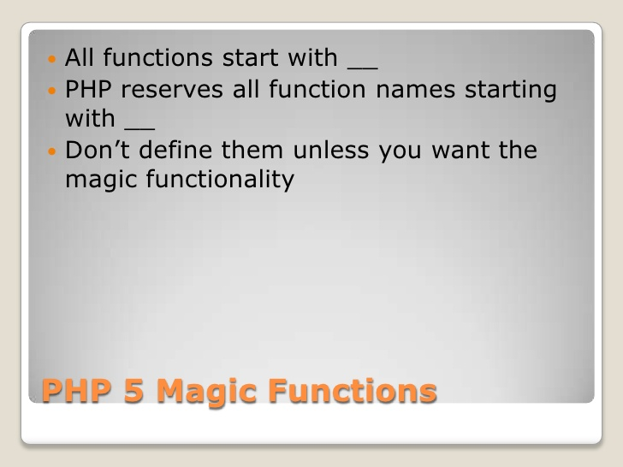
Magic Methods

Slide 55
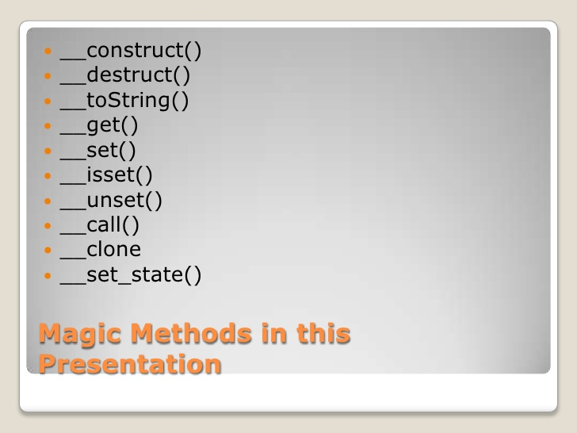

Slide 56
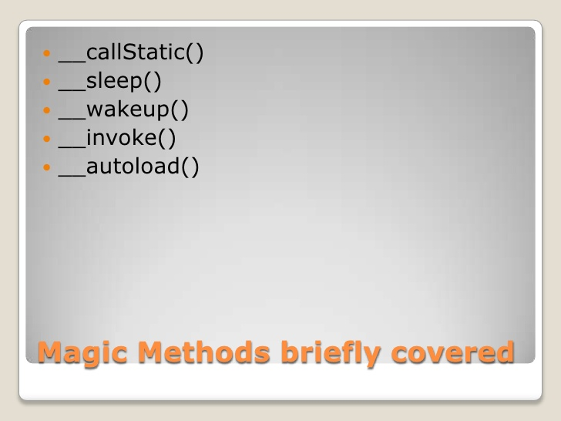

Slide 57
Namespaces
Namespaces — introduced in PHP V5.3 — are a way of giving your PHP classes, constants, and functions context so that elements with the same names can be understood as being unique. The unique names allow you to avoid naming collisions, which occur when two classes or functions of the same name exist. Sometimes, those PHP classes represent the same objects in your physical domain, but the behavior of the class is entirely different. Namespaces are a way of making sure you have the correct PHP class, constant, or function and that people using your PHP classes can be sure they're using the correct ones.

Slide 58
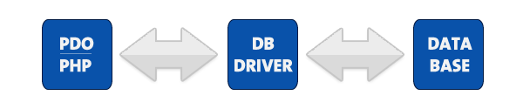
PDO Introduction
PDO – PHP Data Objects – is a database access layer providing a uniform method of access to multiple databases.
It doesn’t account for database-specific syntax, but can allow for the process of switching databases and platforms to be fairly painless, simply by switching the connection string in many instances.

Slide 59
Database Support
The extension can support any database that a PDO driver has been written for. At the time of this writing, the following database drivers are available:
PDO_DBLIB ( FreeTDS / Microsoft SQL Server / Sybase )
PDO_FIREBIRD ( Firebird/Interbase 6 )
PDO_IBM ( IBM DB2 )
PDO_INFORMIX ( IBM Informix Dynamic Server )
PDO_MYSQL ( MySQL 3.x/4.x/5.x )
PDO_OCI ( Oracle Call Interface )
PDO_ODBC ( ODBC v3 (IBM DB2, unixODBC and win32 ODBC) )
PDO_PGSQL ( PostgreSQL )
PDO_SQLITE ( SQLite 3 and SQLite 2 )

Slide 60
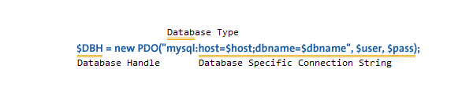
Connecting
Different databases may have slightly different connection methods. Below, the method to connect to some of the most popular databases are shown. You’ll notice that the first three are identical, other then the database type – and then SQLite has its own syntax.

Slide 61
try {
# MS SQL Server and Sybase with PDO_DBLIB
$DBH = new PDO("mssql:host=$host;dbname=$dbname, $user, $pass");
$DBH = new PDO("sybase:host=$host;dbname=$dbname, $user, $pass");
# MySQL with PDO_MYSQL
$DBH = new PDO("mysql:host=$host;dbname=$dbname", $user, $pass);
# SQLite Database
$DBH = new PDO("sqlite:my/database/path/database.db");
}
catch(PDOException $e) {
echo $e->getMessage();
}
# close the connection
$DBH = null;

Slide 62

Insert and Update
# STH means "Statement Handle"
$STH = $DBH->prepare("INSERT INTO folks ( first_name ) values ( 'Cathy' )");
$STH->execute();

Slide 63

Selecting Data

Slide 65
Design Pattern
Design patterns are optimized, reusable solutions to the programming problems that we encounter every day. A design pattern is not a class or a library that we can simply plug into our system; it’s much more than that. It is a template that has to be implemented in the correct situation. It’s not language-specific either. A good design pattern should be implementable in most—if not all—languages, depending on the capabilities of the language. Most importantly, any design pattern can be a double-edged sword— if implemented in the wrong place, it can be disastrous and create many problems for you. However, implemented in the right place, at the right time, it can be your savior.
Ref URL : http://www.oodesign.com/
  http://net.tutsplus.com/articles/general/a-beginners-guide-to-design-patterns/
  http://sourcemaking.com/design_patterns/f

Slide 66
What are Software Design Principles?
Software design principles represent a set of guidelines that helps us to avoid having a bad design.
There are 3 important characteristics of a bad design that should be avoided:
  Rigidity - It is hard to change because every change affects too many other parts of the system.
  Fragility - When you make a change, unexpected parts of the system break.
  Immobility - It is hard to reuse in another application because it cannot be disentangled from the current application.

Slide 67
Design Principles
Open Close Principle
Dependency Inversion Principle
Interface Segregation Principle
Single Responsibility Principle
Liskov's Substitution Principle

Slide 68
Open Close Principle
Software entities like classes, modules and functions should be open for extension but closed for modifications.
OPC is a generic principle. You can consider it when writing your classes to make sure that when you need to extend their behavior you don't have to change the class but to extend it. The same principle can be applied for modules, packages, libraries. If you have a library containing a set of classes there are many reasons for which you'll prefer to extend it without changing the code that was already written (backward compatibility, regression testing). This is why we have to make sure our modules follow Open Closed Principle.

Slide 69
Dependency Inversion Principle
High-level modules should not depend on low-level modules. Both should depend on abstractions.
Abstractions should not depend on details. Details should depend on abstractions.
Dependency Inversion Principle states that we should decouple high level modules from low level modules, introducing an abstraction layer between the high level classes and low level classes. Further more it inverts the dependency: instead of writing our abstractions based on details, the we should write the details based on abstractions.

Slide 70
Interface Segregation Principle
Clients should not be forced to depend upon interfaces that they don't use.
This principle teaches us to take care how we write our interfaces. When we write our interfaces we should take care to add only methods that should be there. If we add methods that should not be there the classes implementing the interface will have to implement those methods as well. For example if we create an interface called Worker and add a method lunch break, all the workers will have to implement it. What if the worker is a robot?
As a conclusion Interfaces containing methods that are not specific to it are called polluted or fat interfaces. We should avoid them.

Slide 71
Single Responsibility Principle
A class should have only one reason to change.
In this context a responsibility is considered to be one reason to change. This principle states that if we have 2 reasons to change for a class, we have to split the functionality in two classes. Each class will handle only one responsibility and on future if we need to make one change we are going to make it in the class which handle it. When we need to make a change in a class having more responsibilities the change might affect the other functionality of the classes.

Slide 72
Liskov's Substitution Principle
Derived types must be completely substitutable for their base types.
This principle is just an extension of the Open Close Principle in terms of behavior meaning that we must make sure that new derived classes are extending the base classes without changing their behavior. The new derived classes should be able to replace the base classes without any change in the code.

Slide 73
Design Pattern Type
Creational Patterns :- Creational design patterns are design patterns that deal with object creation mechanisms, trying to create objects in a manner suitable to the situation. The basic form of object creation could result in design problems or added complexity to the design. Creational design patterns solve this problem by somehow controlling this object creation.
Behavioral Patterns :- Behavioral design patterns are design patterns that identify common communication patterns between objects and realize these patterns. By doing so, these patterns increase flexibility in carrying out this communication.
Structural Patterns :- structural design patterns are design patterns that ease the design by identifying a simple way to realize relationships between entities.

Slide 74
Creational Pattern - Factory Method Pattern
The factory method pattern is a creational design pattern which does exactly as it sounds: it’s a class that acts as a factory of object instances.
The main goal of this pattern is to encapsulate the creational procedure that may span different classes into one single function. By providing the correct context to the factory method, it will be able to return the correct object.
The best time to use the factory method pattern is when you have multiple different variations of a single entity. Let’s say you have a button class; this class has different variations, such as ImageButton, InputButton and FlashButton. Depending on the place, you may need to create different buttons—this is where you can use a factory to create the buttons for you!

Slide 75
abstract class Button {
protected $_html;
  public function getHtml(){ return $this->_html; }
}
class ImageButton extends Button {
//This should be whatever HTML you want for your image-based button
  protected $_html = "...";
}
class InputButton extends Button { protected $_html = "..."; }
class FlashButton extends Button {protected $_html = "..."; }

Slide 76
class ButtonFactory {
public static function createButton($type)
{
$baseClass = 'Button';
$targetClass = ucfirst($type).$baseClass;
if (class_exists($targetClass) && is_subclass_of($targetClass, $baseClass)) {
return new $targetClass;
} else {
throw new Exception("The button type '$type' is not recognized.");
}
}
}

Slide 77
$buttons = array('image','input','flash');
foreach($buttons as $b) {
echo ButtonFactory::createButton($b)->getHtml()
}

Slide 78
Creational Pattern - Singleton Pattern
The singleton design pattern is a creational design pattern which makes sure that you have one single instance of a particular class in the duration of your runtime, and provides a global point of access to the single instance.
This makes it easier to set up a point of “coordination” for other objects that use the singleton instance as well, since the singleton’s variables will always be the same for anything that calls it.
If you need to pass a specific instance from one class to another, you can use the singleton pattern to avoid having to pass the instance via constructor or argument. Imagine that you have created a Session class, which simulates the $_SESSION global array. Since this class will only need to be instantiated once, we can implement a singleton pattern like so:

Slide 79
Check list
Define a private static attribute in the “single instance” class.
Define a public static accessor function in the class.
Do “lazy initialization” (creation on first use) in the accessor function.
Define all constructors to be protected or private.
Clients may only use the accessor function to manipulate the Singleton.

Slide 80
class DB{
  private static $instance;
  public static function getInstance(){
    if( is_null(self::$instance) ) {
      self::$instance = new self();
    }
    return self::$instance;
  }
  private function __construct() { }
  private function __clone() { }
  // any other DB methods we might use
}
// get a session instance
$db = DB::getInstance();

