Slide 1
PRANA
Policy for Robotic Action via Neural Architecture
Flow matching with correlated noise for low-data robot manipulation
Siddarth Dayasagar & Arpit Gandhi
3
123
10 Hz
8 GB
Northeastern University
Architectures
Episodes
Control rate
Single GPU

Slide 2
The Problem
Most robot learning methods require:
Hundreds of demonstrations
Large-scale pretraining on internet data
Multi-GPU clusters for training
We have:
123 teleoperation demos
One laptop GPU (RTX 5060, 8 GB)
A $300 SO-101 robot arm
Task
Pick up screwdriver
Place in box
Setup
SO-101 follower arm
Intel RealSense (table)
USB camera (wrist)
LeRobot v0.5.1
PRANA
2 / 12

Slide 3
Three Iterations
v1
v2
v3
Self-attention + L1
Flow matching
DINOv2 vision
Deterministic regression.
Action queries compete with
vision tokens in shared pool.
Unfrozen backbone overfits.
Dead language encoder.
Cross-attention decoder.
Correlated noise from data.
Frozen ViT-Tiny backbone.
Rolling inpainting for
smooth chunk transitions.
Same decoder as v2.
DINOv2 ViT-S/14 backbone.
384d spatial features.
256 tokens per camera.
Smoother, more precise.
PRANA
3 / 12

Slide 4
PRANA v1 — Baseline
All tokens concatenated into one self-attention transformer. L1 loss predicts average trajectory.
Result
Reaches for
screwdriver
What went wrong:
Action queries see each other before seeing the scene
No positional encoding — can't distinguish timesteps
L1 regression averages multimodal demos → invalid trajectories
Unfrozen ViT overfits on 83 episodes in ~2000 steps
Language encoder (262 MB) receives zeros — total waste
Can't grasp
consistently
Jittery motion
No box placement
PRANA
4 / 12

Slide 5
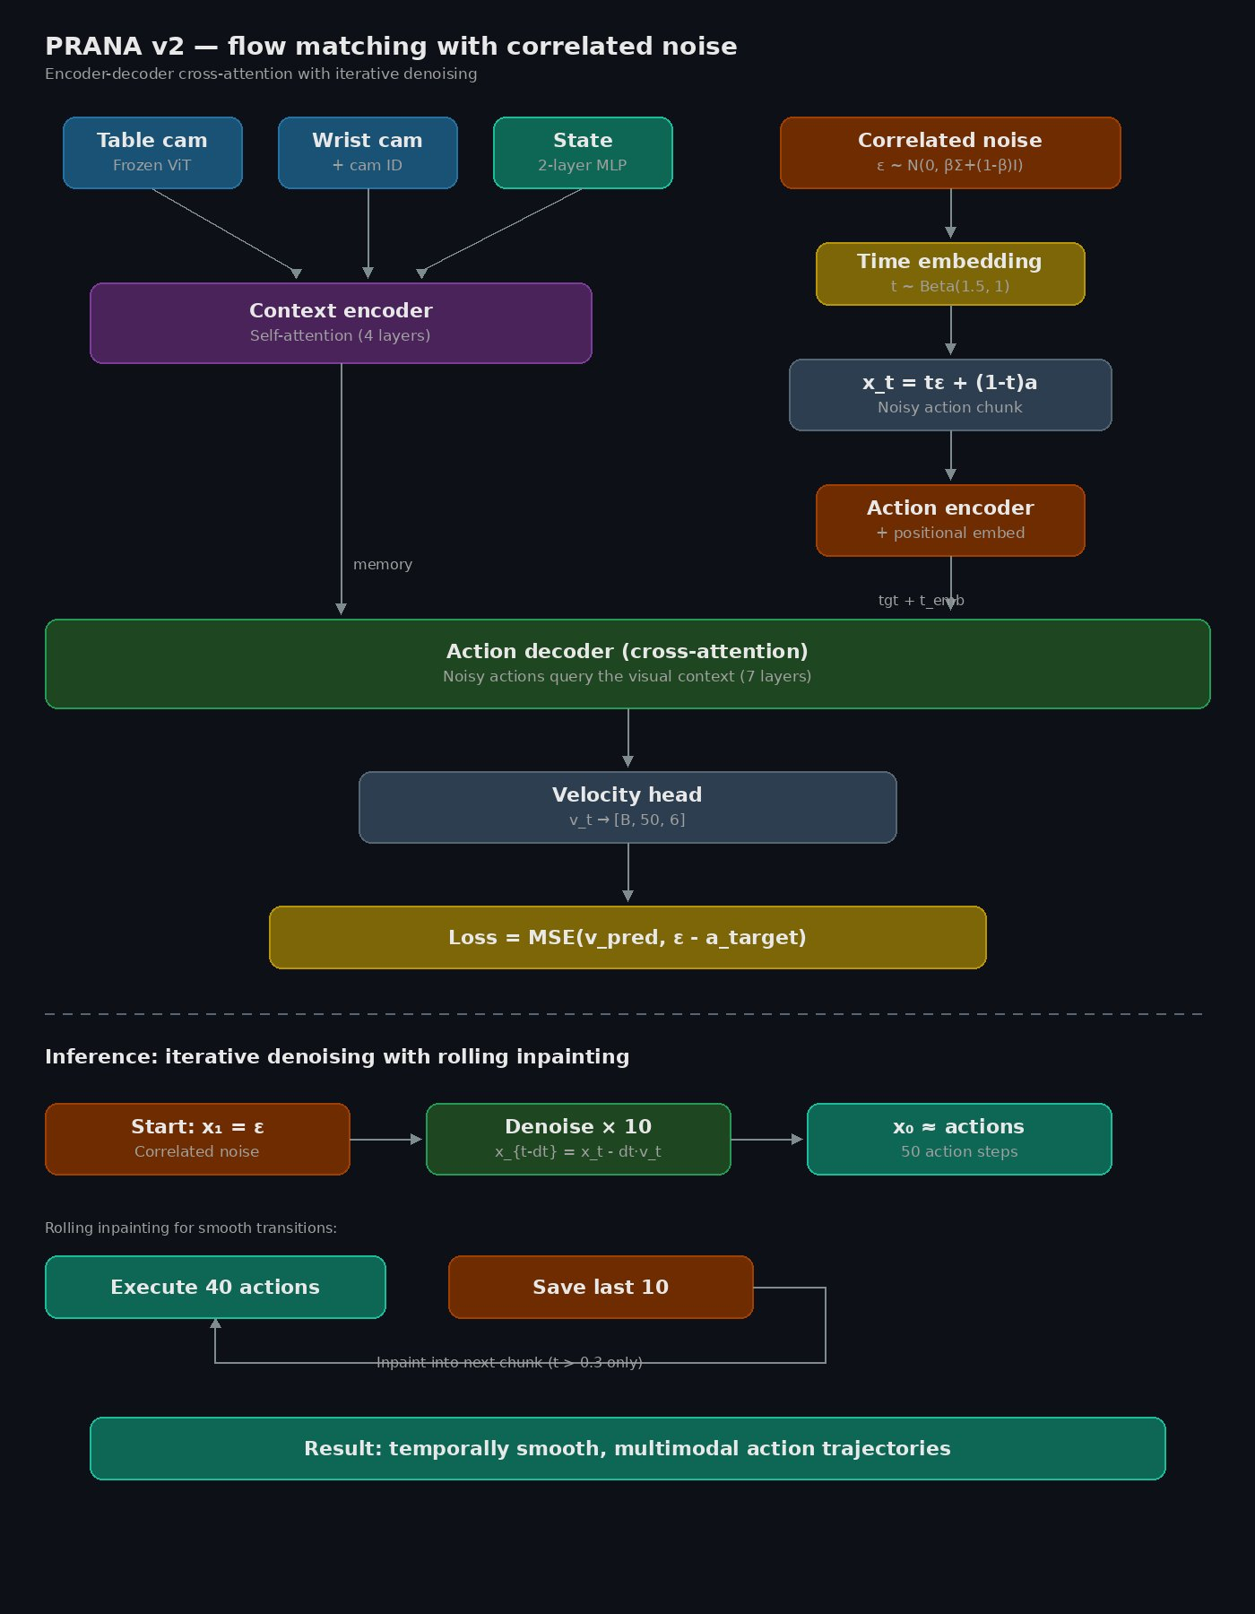
PRANA v2 — Architecture
PRANA
5 / 12

Slide 6
v2 — Key Innovations
Cross-attention decoder
Flow matching
Action queries attend to visual context
instead of competing with it. 7 decoder
layers cross-attend to 4-layer context
encoder output.
Learn velocity field: noise → actions.
10 Euler denoising steps at inference.
t ~ Beta(1.5, 1) biases toward harder
early steps during training.
Correlated noise
Rolling inpainting
Noise shaped like real trajectories via
Cholesky decomposition of action
covariance. β=0.5 shrinkage.
Critical for reducing deployment jitter.
Execute 40 of 50 actions, save last 10.
Soft-constrain next chunk's first 10
positions when t > 0.3.
Smooth chunk-boundary transitions.
PRANA
6 / 12

Slide 7
v2 — Flow Matching
Training
Inference
1. Sample t ~ Beta(1.5, 1)
2. Sample ε ~ N(0, βΣ + (1-β)I)
3. Interpolate: x_t = tε + (1-t)a
4. Predict velocity v_t
5. Loss = MSE(v_t, ε - a)
Correlated noise:
Σ_reg = 0.5·Σ + 0.5·I
L = cholesky(Σ_reg)
ε = L · z, z ~ N(0, I)
1. Start: x_1 = ε (correlated)
2. For k = 1 to 10:
t = 1 - k/10
v = model(x_t, t, context)
x_{t-dt} = x_t - dt·v_t
3. x_0 ≈ 50 predicted actions
Rolling inpainting:
Execute 40, save last 10
Soft-constrain next chunk (t>0.3)
PRANA
7 / 12

Slide 8
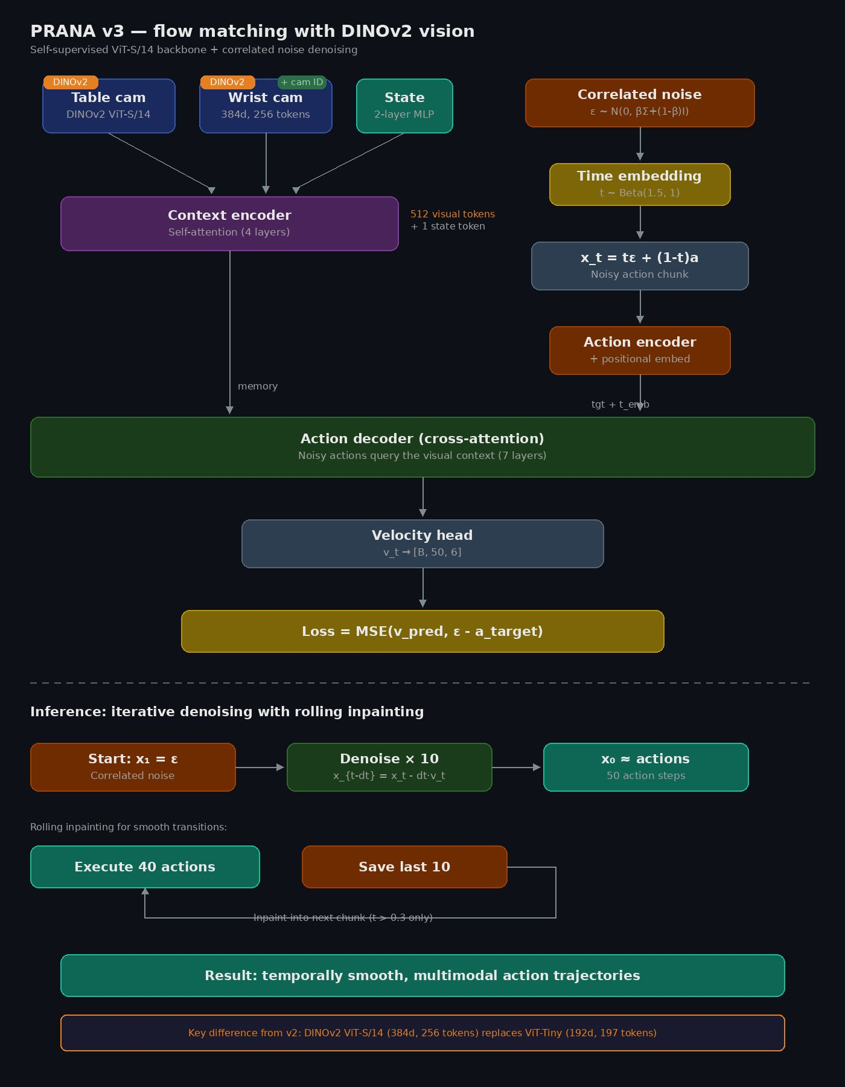
PRANA v3 — DINOv2 Vision
PRANA
8 / 12

Slide 9
Why DINOv2?
 | ViT-Tiny (v2) | DINOv2 ViT-S/14 (v3)
Pretraining | ImageNet supervised | Self-supervised (142M images)
What it encodes | 'This is a screwdriver' | 'Screwdriver at (x,y), angle θ'
Embed dim | 192 | 384 (2× richer)
Tokens / cam | 197 (patch16 + CLS) | 256 (patch14, no CLS)
Total context | 395 tokens | 513 tokens (+30%)
Backbone params | 5.7M (frozen) | 22M (frozen)
Same decoder, same flow matching, same correlated noise — only the eyes changed.
PRANA
9 / 12

Slide 10
Training
Configuration
v2 training loss + flow loss curves
(insert W&B screenshot)
123 episodes (83 + 40 focused)
83,966 frames at 30 Hz
Batch size 8, lr 1e-4
AdamW + cosine annealing
FP16 mixed precision
100K steps (~6-8 hours)
RTX 5060 Laptop (8 GB VRAM)
Post-training (critical):
Fit correlated noise sampler
Patches Cholesky factor into checkpoint
v3 training loss + flow loss curves
(insert W&B screenshot)
PRANA
10 / 12

Slide 11
Deployment Results
Metric | v1 | v2 | v3
Inference | ~5 ms | ~22 ms | ~30 ms
Reaches | Yes | Yes | Yes
Grasps | Assisted | Assisted | Yes
Places | No | Yes | Yes
Smoothness | Jittery | Smooth | Smoother
Accuracy | Low | Moderate | High
Camera capture (~100ms) is the bottleneck, not model inference (~22ms).
Correlated noise fitting is critical — without it, v2/v3 exhibit significant jitter.
PRANA
11 / 12

Slide 12
PRANA
123 demos. One GPU. A robot that grasps.
From deterministic regression to flow matching to DINOv2 —
each iteration fixed the failures of the last.
github.com/siddarth09/PRANA
huggingface.co/Siddarth09/PRANA_v2
Dataset on HuggingFace
Siddarth Dayasagar & Arpit Gandhi · Northeastern University

