Slide 1
TEAM 11 · IoT MINI PROJECT
Server and IT Infrastructure
Health Monitoring
4
simulated servers
Software-only sensing, MQTT communication, machine learning, forecasting and safe closed-loop action
80,640
one-minute readings
B.Tech CSE · Semester 7
99.33%
Team members and roll numbers: add before submission
selected-model accuracy

Slide 2
TEAM 11 · SERVER HEALTH MONITORING
Problem, goal and evaluation boundary
Server workloads fluctuate. Static thresholds alone cannot distinguish normal peaks, wasted capacity and true failure.
What this project proves
Observe
End-to-end IoT
CPU, memory, disk, network, temperature, service heartbeat and user activity at one-minute intervals.
Sensor replay → MQTT → Node-RED → analytics → decision → acknowledgement
Fair evaluation
Understand
Chronological train/validation/test split; labels and future targets excluded from features
Classify normal, underutilized, overloaded and anomalous states; forecast demand 15 minutes ahead.
Operational value
Health score, explanations, capacity headroom, drift and data-quality monitoring
Act safely
Honest boundary
Issue auditable recommendations with cooldowns, approval flags and a software digital-twin response.
Synthetic telemetry and simulated actions; no production server is modified
02

Slide 3
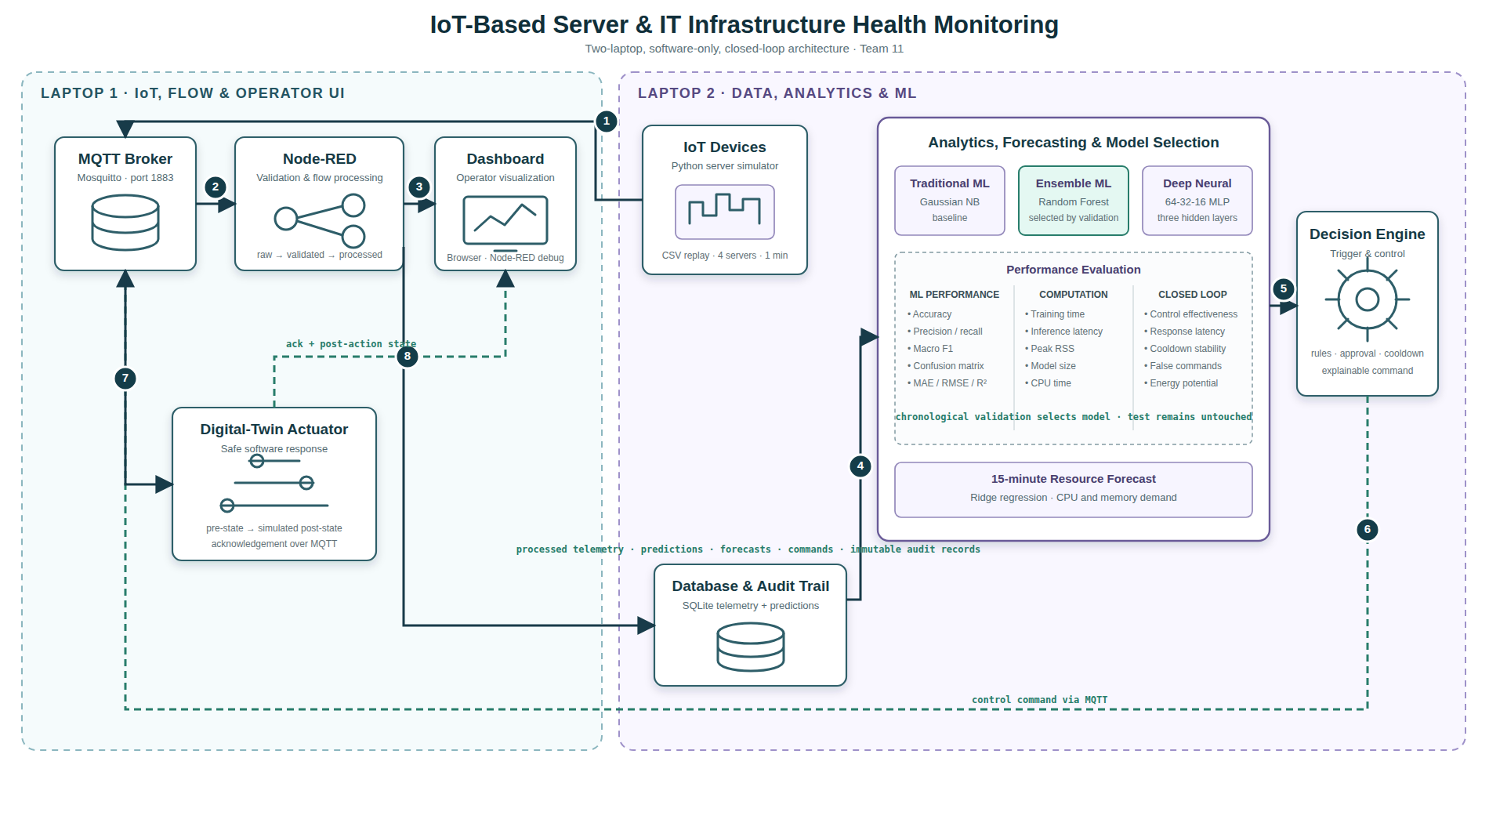
TEAM 11 · SERVER HEALTH MONITORING
Two-laptop closed-loop architecture
Other PC: Mosquitto + Node-RED + actuator
Main laptop: data + ML + database + dashboard
03

Slide 4
TEAM 11 · SERVER HEALTH MONITORING
Dataset design: reproducible, time-ordered and leakage-safe
80,640
4
14 days
60 sec
6
rows
servers
duration
sampling
fault families
Chronological split
TRAIN · days 1–10 · 57,600
VALIDATE
11,520
TEST
11,520
Model inputs
Offline-only truth
Future targets
Current telemetry + cyclic hour + weekday
Condition, fault, scenario and recommended action
CPU and memory at +15 min never enter classifier features
The CSV is synthetic and scenario-based; it must not be presented as production infrastructure data.
04

Slide 5
TEAM 11 · SERVER HEALTH MONITORING
Model selection: validation macro-F1 decides
Selected model
Random Forest
99.33%
test accuracy
0.947
test macro-F1
Why macro-F1? It gives equal weight to rare overload and anomaly classes; accuracy alone can hide weakness.
05

Slide 6
TEAM 11 · SERVER HEALTH MONITORING
Selected-model performance by operating condition
Read this honestly
Strong
Normal and underutilized states are almost perfectly separated.
Hardest class
Overloaded precision is 0.815 because some anomaly patterns overlap.
Safety layer
Deterministic rules still protect service, thermal, disk, network and error emergencies.
Test support: 2,967 underutilized · 7,927 normal · 244 overloaded · 382 anomalous
06

Slide 7
TEAM 11 · SERVER HEALTH MONITORING
Fifteen-minute resource forecasting
Forecast quality
0.870
CPU R²
0.939
Memory R²
Capacity headroom
100 − max(predicted CPU, predicted memory, current disk)
Ridge regression uses current telemetry and time features. The 15-minute targets are created only for forecast training and evaluation.
07

Slide 8
TEAM 11 · SERVER HEALTH MONITORING
Advanced operational intelligence
These features are deterministic or statistical monitors around the classifier—not extra hidden models.
100
Health score
0–100 auditable score from resource, thermal, service and error pressure.
TOP 3
Local explanation
Stores the strongest observed pressure factors with each prediction.
≥ 2.5
Concept drift
120-message rolling mean shift against a training-only baseline.
100%
Data quality
Completeness across critical telemetry, prediction and confidence fields.
Drift states: warming up (<20 messages) · stable (<1.5) · watch (1.5–2.5) · drift (≥2.5)
08

Slide 9
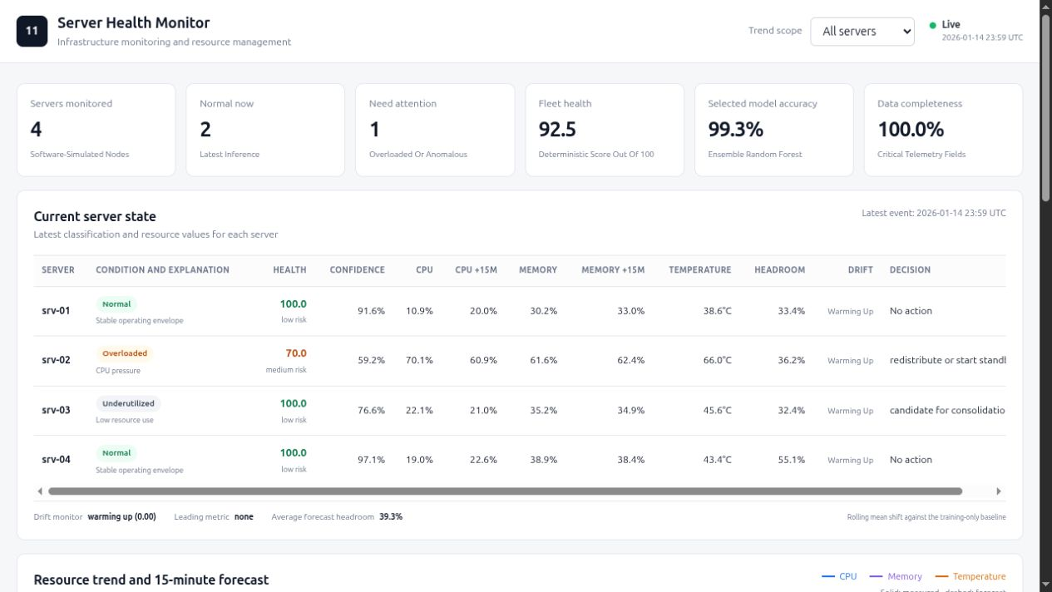
TEAM 11 · SERVER HEALTH MONITORING
Operator dashboard: mixed fleet state and evidence
Live view: measured + forecast trends · health · confidence · explanations · headroom · drift · decision
09

Slide 10
TEAM 11 · SERVER HEALTH MONITORING
Decision engine and safe control loop
1
2
3
4
5
→
→
→
→
Telemetry
Prediction
Policy
Command
Actuator
validated current state
class + confidence + forecast
rules override model when safety-critical
UUID + reason + approval + expected effect
simulated post-action state + acknowledgement
Cooldown
Human control
Audit trail
Five minutes per server and action suppresses repeated commands.
Disk cleanup and consolidation remain operator-approved.
Telemetry, predictions, explanations, commands and acknowledgements persist in SQLite.
Priority examples: service down → restart · temperature ≥82°C → cooling · disk ≥92% → operator cleanup · overload → redistribute/start standby
10

Slide 11
TEAM 11 · SERVER HEALTH MONITORING
Closed-loop evaluation and verification
Untouched test replay
11,520
746
messages
commands
6 / 6
2,296
fault families found
cooldown suppressions
Mean policy latency: 0.017 ms
9 automated tests pass
Energy potential: 2.25 kWh under a documented simulation assumption—not a production claim.
11

Slide 12
TEAM 11 · SERVER HEALTH MONITORING
Live demonstration: two commands, one backup plan
OTHER PC · run first
MAIN LAPTOP · training + evaluation + demo
./team11.sh edge
./team11.sh main OTHER_PC_IP
Mosquitto · Node-RED · digital-twin actuator
Dataset checks · analysis · models · tests · dashboard · balanced stream
What to demonstrate
1 · Architecture
2 · Analytics
3 · Closed loop
Show Node-RED processing and MQTT topics on the other PC.
Show model metrics, 15-minute forecast, health score and explanation.
Replay mixed states; point out command, cooldown and actuator acknowledgement.
Backup on one laptop: ./team11.sh local Dashboard: http://127.0.0.1:8080
12

