Slide 1



Gesture-Based Emergency Detection & Sensor-Fused Emergency Alert System
Powered by QNX Neutrino RTOS – Q-eHACK 2026
TEAM: TEAM IGNITE
KVN Sai Siddartha , K Vishnu Varshith
B V Raju Institute of Technology

Slide 2
Team Name: Team Ignite
Project Title: Gesture-Based Emergency Detection & Sensor- Fused Emergency Alert System
Project ID: 50
College Name: B V Raju Institute of Technology (BVRIT), Hyderabad
Team Details:
1. KVN Sai Siddartha – Roll No: 23211A04B5
2. K Vishnu Varshith – Roll No: 23211A0498

Slide 3
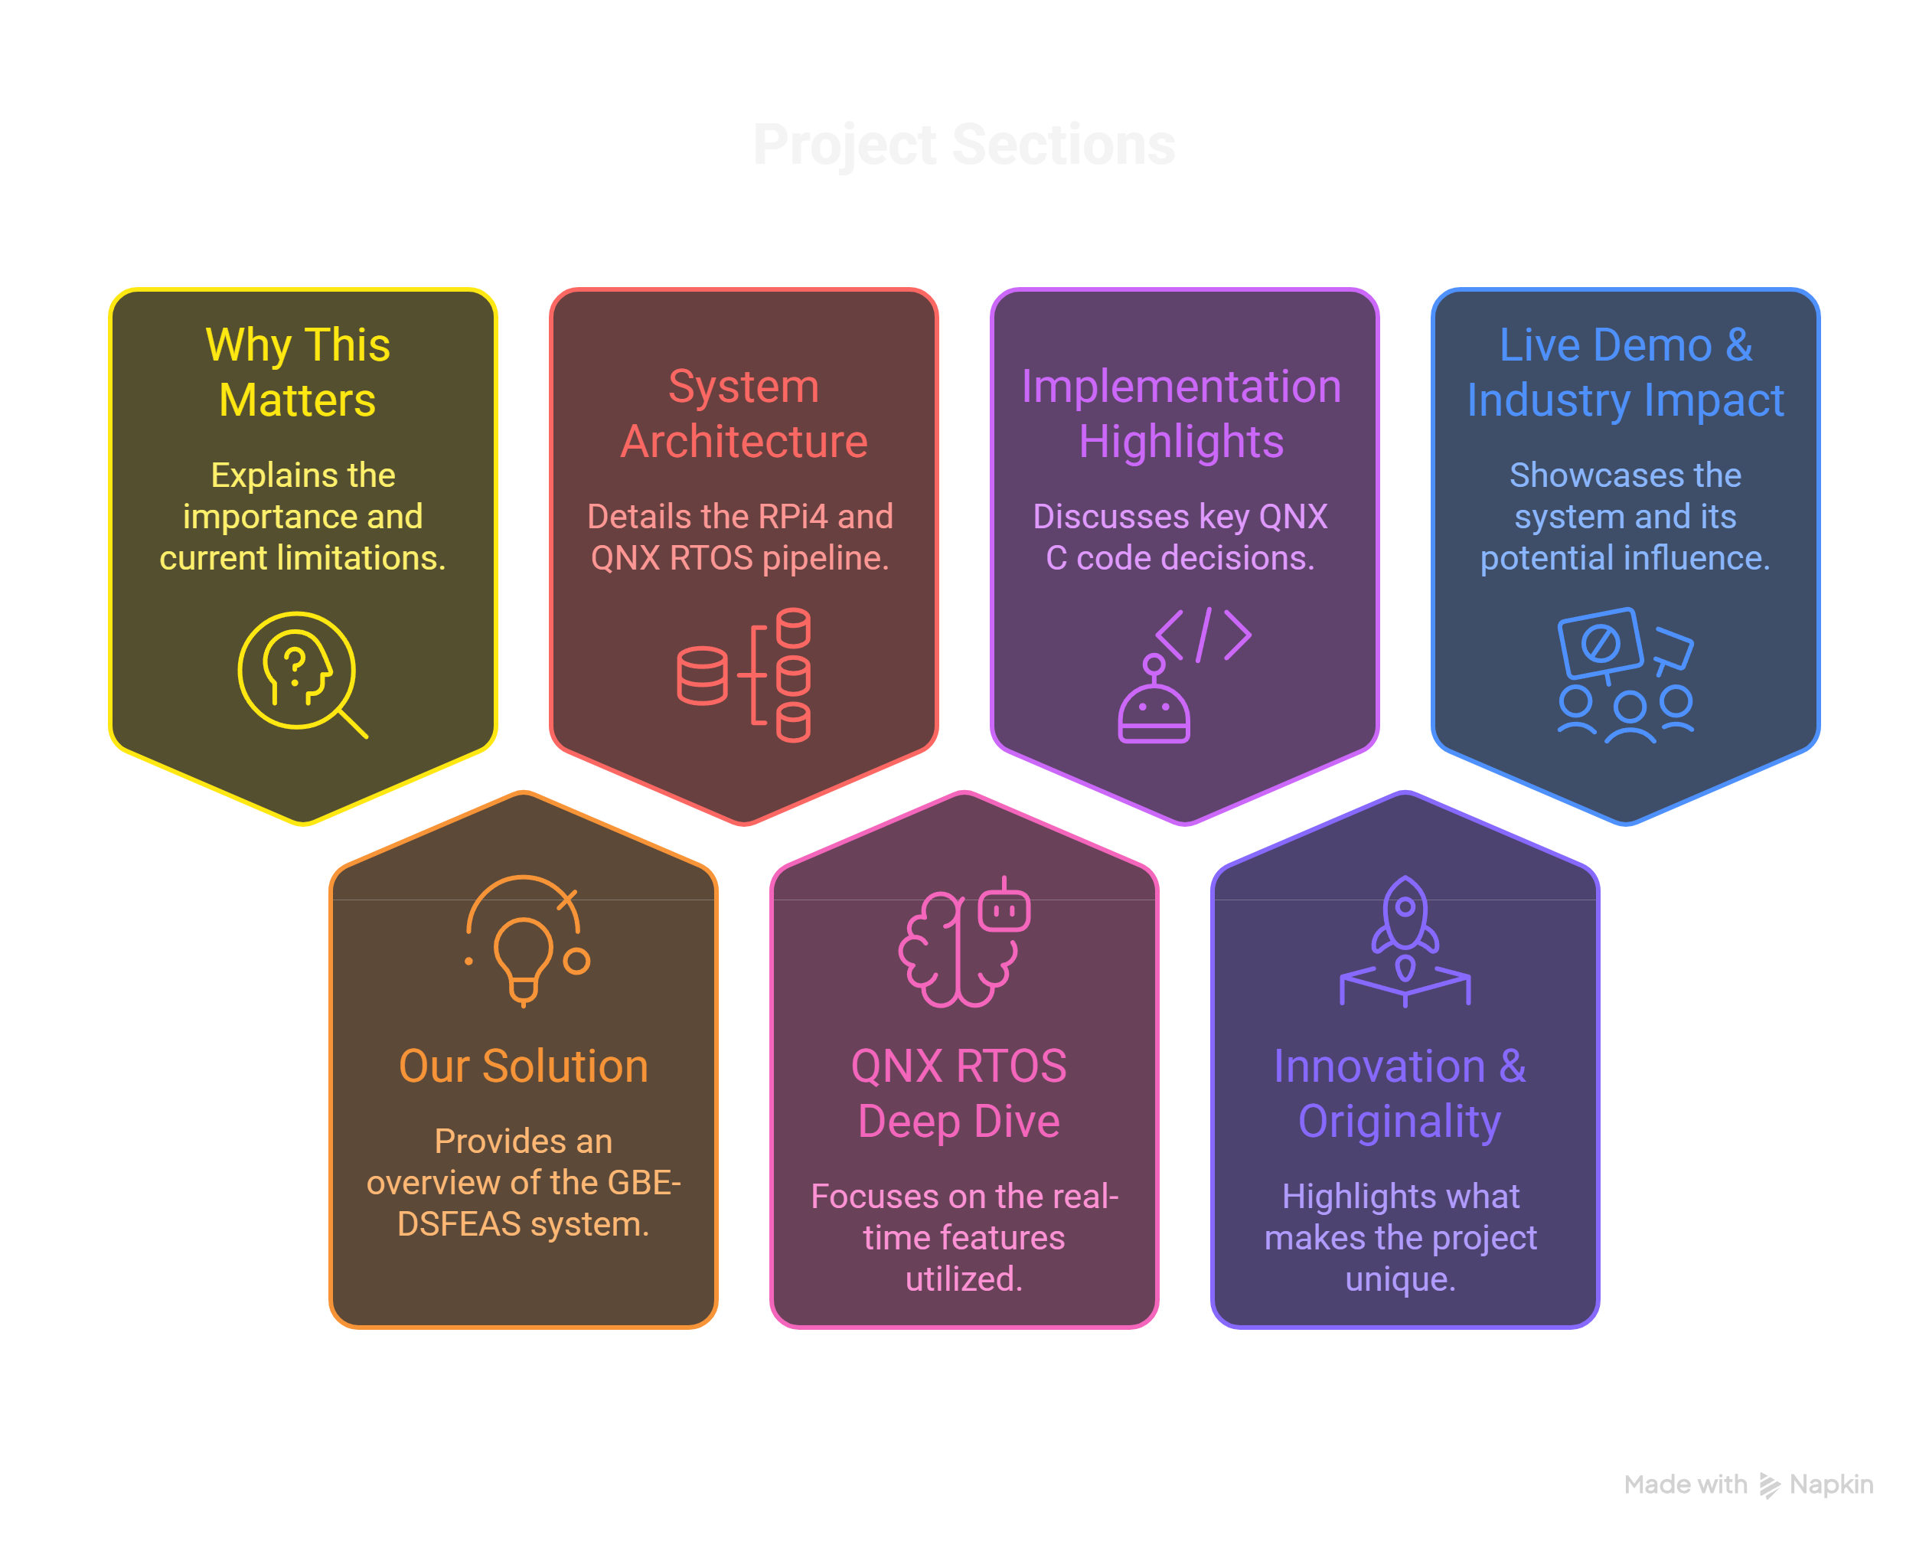
AGENDA

Slide 4
The Real-World Problem
There is NO reliable real-time embedded system that detects distress gestures and automatically routes emergency alerts to the correct department – Police, Ambulance, Fire, or Rescue.
Root Cause 1: No intelligent detection – manual calls and panic buttons fail in crowds, darkness, or when a person is incapacitated.
Root Cause 2: No sensor validation – false alarms waste emergency resources with no environmental context (gas, temperature).
Root Cause 3: No real-time guarantees – standard OS (Linux) has non-deterministic scheduling; emergency response cannot tolerate latency spikes.
Root Cause 4: No auto-routing – no existing system dispatches to the correct department (Police vs Fire vs Ambulance) based on gesture type.

Slide 5
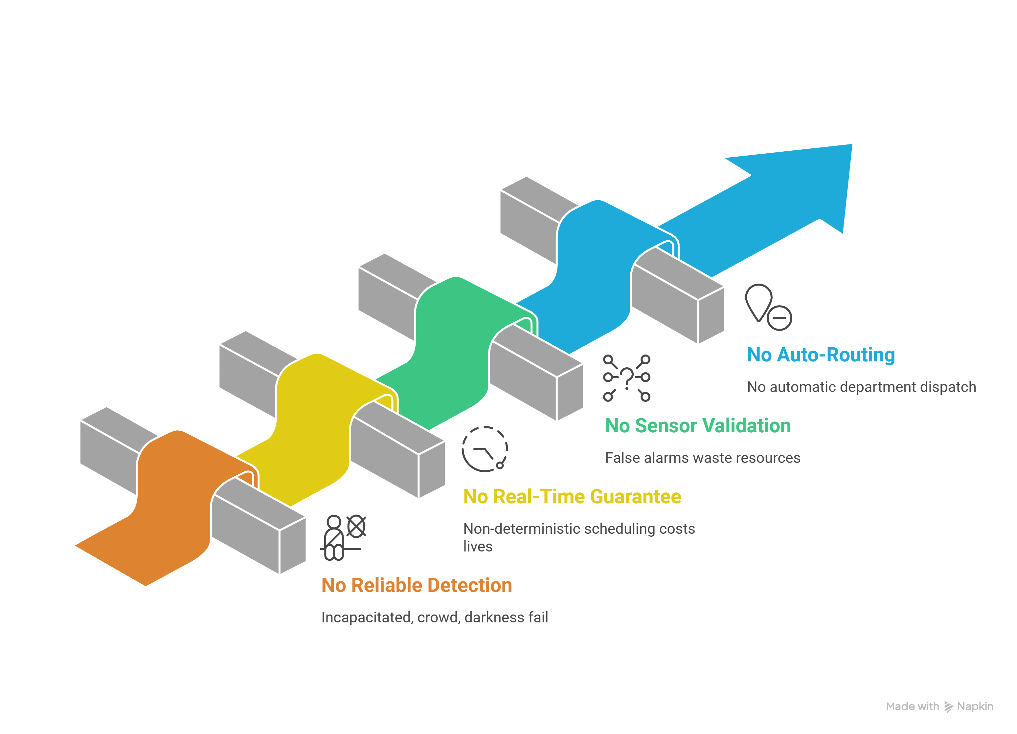
Why This Matters & Challenges

Slide 6
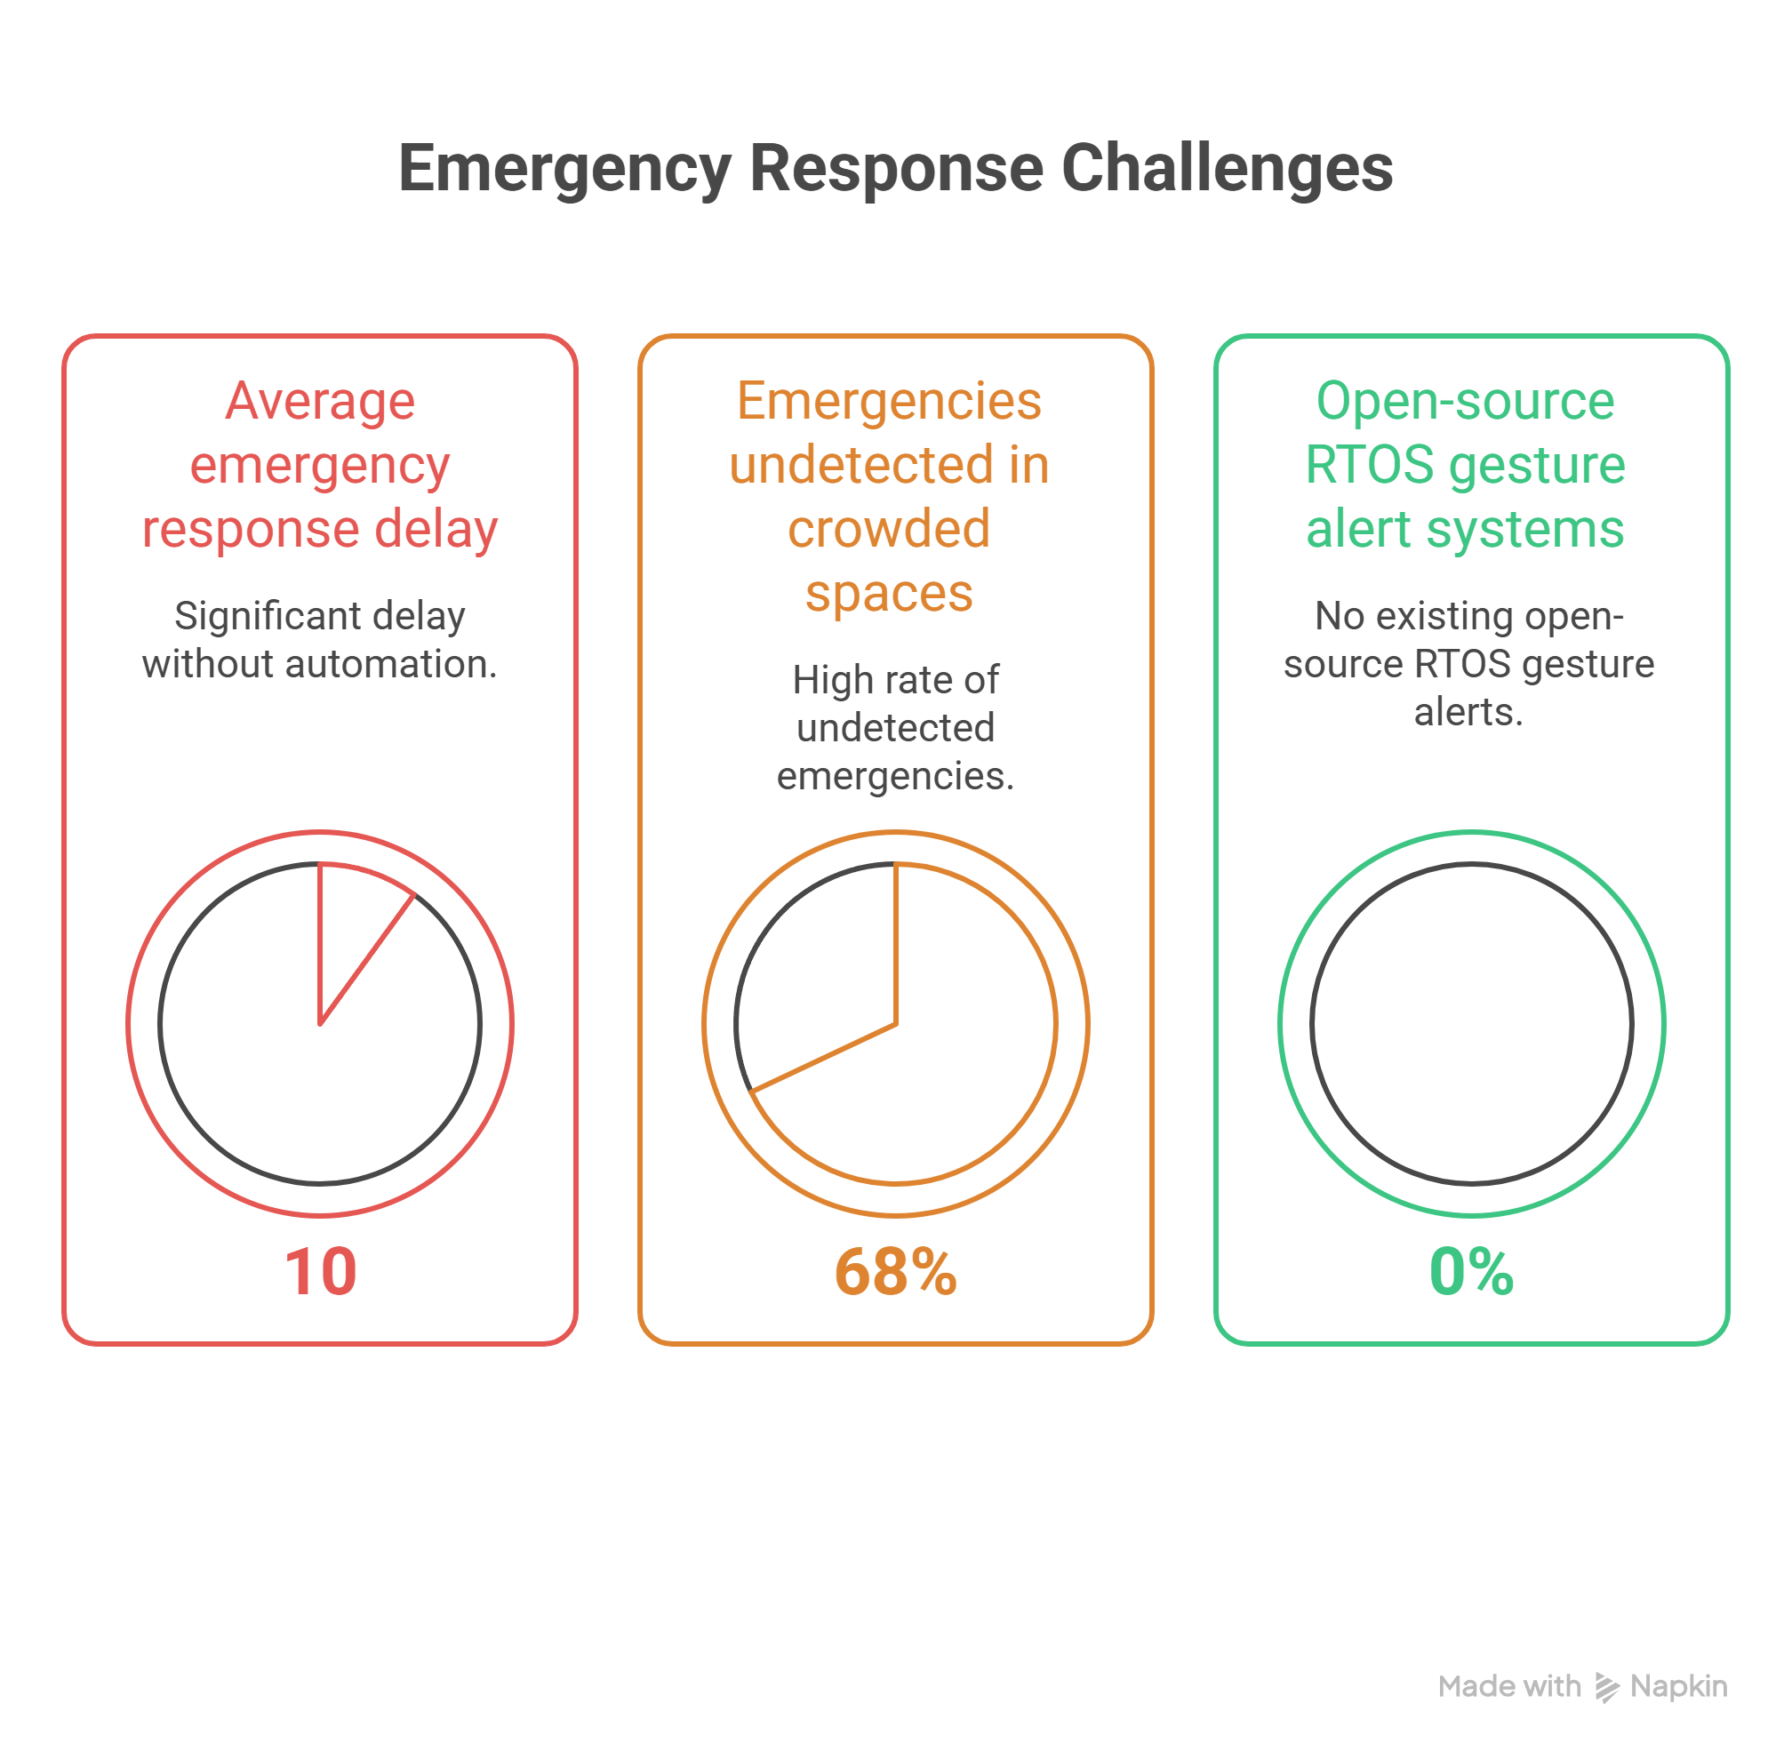

Slide 7
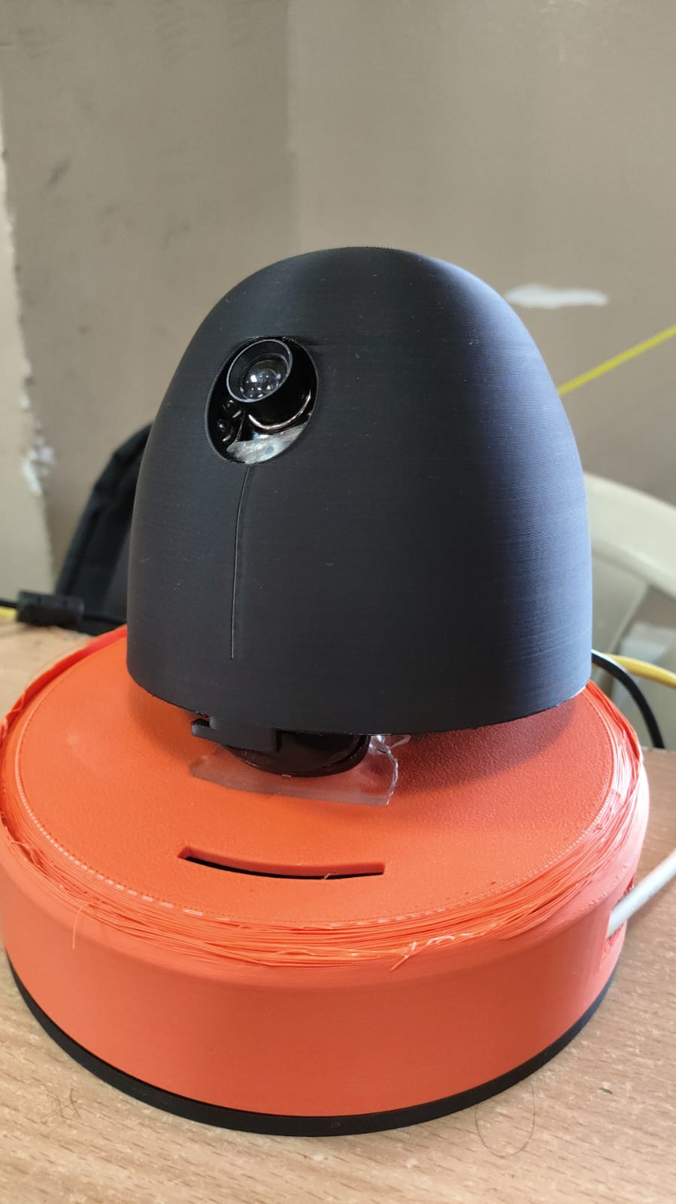
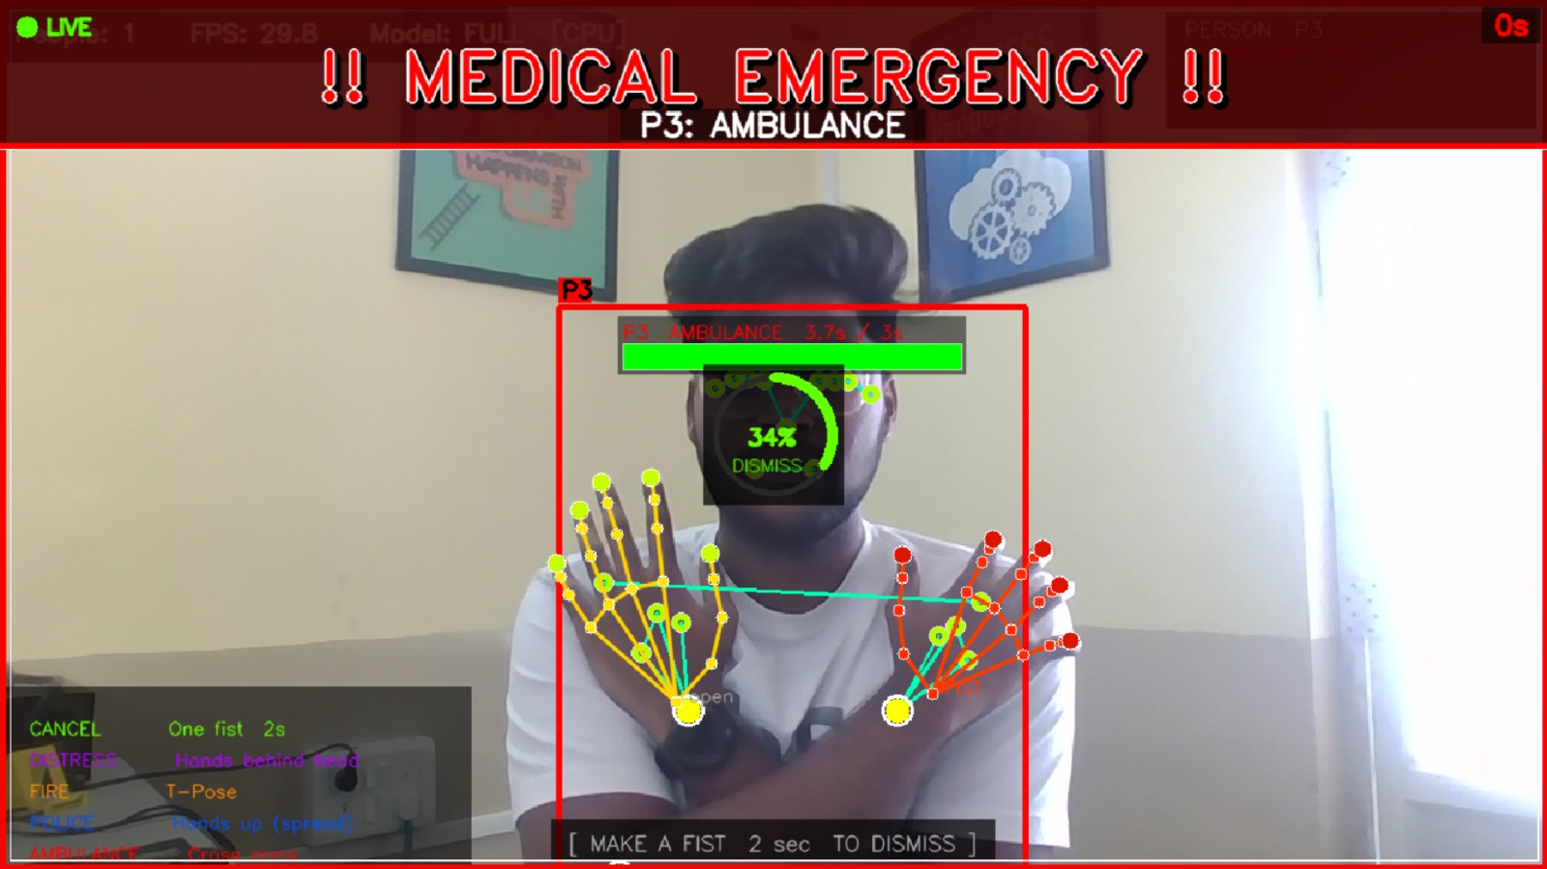
Our Solution – Gesture-Based Emergency Detection & Sensor-Fused Alert System
“A Raspberry Pi 4 running QNX Neutrino RTOS detects human distress gestures via live camera feed using an on-device AI model, and instantly alerts the correct emergency department – all in real-time.”
Core Feature 1: Real-time AI Pose Detection on RPi4 – MediaPipe PoseLandmarker classifies 4 emergency gesture types with 2.5 s hold-timer to eliminate false triggers.
Core Feature 2: QNX Neutrino RTOS Core – pthreads handle UDP alerts, BME688 sensor reads, and GPIO outputs concurrently with deterministic guarantees.
Core Feature 3: BME688 Sensor Fusion – Temperature, humidity, and gas resistance cross-validate gesture intent (e.g., T-Pose + high temp = confirmed Fire alert).
Core Feature 4: Multi-channel Alert Output – Gesture-specific buzzer patterns + LED blink modes + GSM SMS with GNSS coordinates sent to Police / Ambulance / Fire / Rescue.

Slide 8
INPUTS
RPi4 PROCESSING PIPELINE (QNX Neutrino RTOS)
OUTPUTS
📷 Camera Feed
Live video 30fps
Camera Frame Capture
cv2.VideoCapture 30 fps
AI Pose Detection
MediaPipe PoseLandmarker Lite
Gesture Classifier
4 types 2.5 s hold timer
🔊 Buzzer Alert
Gesture-specific beep (GPIO 19)
🌡 BME688 Sensor
Temp / Gas / Humidity (I2C)
💡 LED Indicator
4 blink modes (GPIO 17/27)
Hardware I/O Driver
GPIO + I2C + GSM dispatch
Alert Decision Engine
Per-person state · 5s cooldown
🔌 UDP Network
Alert trigger port 5005
📱 GSM + GNSS SMS
GPS coords to dept number

Slide 9
Leveraging QNX RTOS Capabilities
Microkernel Architecture → GPIO, I2C (BME688), GSM, and alert logic run as isolated processes. A crash in one cannot bring down the system – critical for life-safety applications.
POSIX pthreads + Priority Preemption → UDP listener, alert executor, and LED heartbeat run as concurrent threads. QNX’s preemptive scheduler guarantees alerts fire without starvation.
POSIX UDP Socket Stack → QNX’s POSIX-compliant networking receives alert triggers with deterministic latency. SO_RCVTIMEO prevents indefinite blocking.
Direct Register I/O via mmap_device_io() → BCM2711 GPIO registers mapped directly. Buzzer + LED driven in microseconds via in32/out32 – zero OS abstraction overhead.
Signal-Based Clean Shutdown → SIGINT/SIGTERM handlers close sockets, free mmap, and reset all GPIO cleanly – essential in RTOS where resource leaks are catastrophic.
Safety-Certifiable Pedigree → QNX Neutrino is ISO 26262 / IEC 61508 certifiable. Our architecture is designed to scale to ASIL-B medical and industrial deployments.

Slide 10
Implementation Highlights
3 Concurrent pthreads: udp_receiver_thread (alert listener) + alert_thread (spawned per event) + heartbeat_thread (idle LED blink) – fully isolated, no blocking between tasks.
Alert Thread Flow: mutex_lock → set alert_active=1 → bme688_read() → buzzer_run(on_ms, off_ms, repeat) → led_pattern(mode, 5000ms) → mutex_unlock → ready.
Bind Retry Loop: 10-attempt UDP bind loop; on attempt 1 calls slay gestsense_qnx + reads PID file. Zero manual intervention needed on process restart.
Gesture Profile Fallback Table: Built-in C struct table maps any gesture string to correct buzz_on_ms, buzz_off_ms, buzz_repeat, led_mode, and department if JSON fields are missing.
QNX-specific fix – struct timeval: Added #include <sys/time.h> (QNX does not pull it via <time.h>) and replaced C99 designated initialisers with plain assignment to resolve compile error.
Alert Thread Flow (QNX C)
UDP Packet Received
mutex_lock()
set alert_active = 1
bme688_read() → env data
buzzer_run(on, off, repeat)
led_pattern(mode, 5000ms)
mutex_unlock() → READY

Slide 11
GESTURE
BODY POSE
ALERTS DEPT.
BUZZER PATTERN
LED MODE
GPIO
AMBULANCE
Cross Arms
Hospital / Ambulance
5 × 200ms beeps
Red slow blink
GPIO 19 (Buzzer)
POLICE
Hands Up Spread
Police Station
8 × 100ms rapid
Both LEDs alternate
GPIO 17/27 (LED)
FIRE
T-Pose (arms out)
Fire Station
3 × 500ms long
Red fast blink
GPIO 17/27 (LED)
DISTRESS
Hands Behind Head
Rescue / Disaster
6 × 300ms SOS
Red steady ON
GPIO 17/27 (LED)
⚡ Anti-False-Alarm: 2.5s sustained hold • 5s per-person cooldown • Multi-person tracking (up to 4) • Min visibility 0.18

Slide 12
What Makes This Unique – Innovation & Originality
AI + RTOS on One Device: Runs AI pose detection AND real-time hardware control on a single RPi4 with QNX – no cloud, no laptop dependency. Everything edge-computed on the device.
Sensor-Validated Alerts: BME688 cross-validates gesture intent – T-Pose + elevated temperature = confirmed fire. Drastically reduces false positives in real deployments.
4-Department Auto-Routing: Each gesture uniquely maps to a department with distinct buzzer + LED signature. Response teams know the emergency type before arrival at scene.
Zero-Dependency C Driver Stack: QNX C code uses only POSIX sockets + pthreads + direct BCM2711 register I/O. No third-party libraries – maximally portable to any QNX deployment.
Differs from standard solutions: Thread isolation, signal-based shutdown, bind retry loops, mutex-protected state, and PID-file process management make this production-grade – not a prototype.

Slide 13
01
02
03
04
BOOT
GESTURE
HARDWARE RESPONSE
GSM DISPATCH
• QNX Neutrino boots
• Camera initialises
• AI model loads
• Green LED heartbeat → System online
• Hold pose for 2.5 s
• T-Pose → Fire
• Cross Arms → Ambulance
• Hands Up → Police
• Hands Behind Head → Distress
• BME688 reads env
• Buzzer fires pattern
• LED drives blink mode
• Console logs alert
• SMS + GNSS coords
• Auto-sent to dept.
• Response team gets
• location pre-dispatch

Slide 14
Real-World Impact & Applications
Healthcare: Silent patient distress detection in ICUs and elderly care. BME688 detects anaesthetic gas leaks as a secondary safety layer alongside gesture alerts.
Smart Cities: CCTV gesture alerting in malls, airports, and metro stations. Replaces panic buttons with contactless, camera-based gesture detection – always available, zero hardware installation at point-of-need.
Industrial IoT: Worker distress in hazardous environments. BME688 adds chemical gas hazard detection to every emergency trigger, enabling dual-channel safety validation.
Disaster Response: Trapped persons signal DISTRESS gesture. GNSS coordinates embedded in GSM SMS direct rescue teams to exact location instantly – no voice call required.
Certification Path: QNX Neutrino is ISO 26262 / IEC 61508 certifiable. This system’s architecture is designed to scale to ASIL-B safety-critical deployments in medical and automotive domains.

Slide 15
Thank You!
“A QNX-powered real-time embedded system that detects human distress gestures and instantly routes sensor-validated emergency alerts to the correct response department – Police, Ambulance, Fire, or Rescue.”
Team Ignite | B V Raju Institute of Technology
KVN Sai Siddartha – 23211A04B5
K Vishnu Varshith – 23211A0498
One Gesture. Every Sensor. Instant Alert.
Questions?

