Slide 1



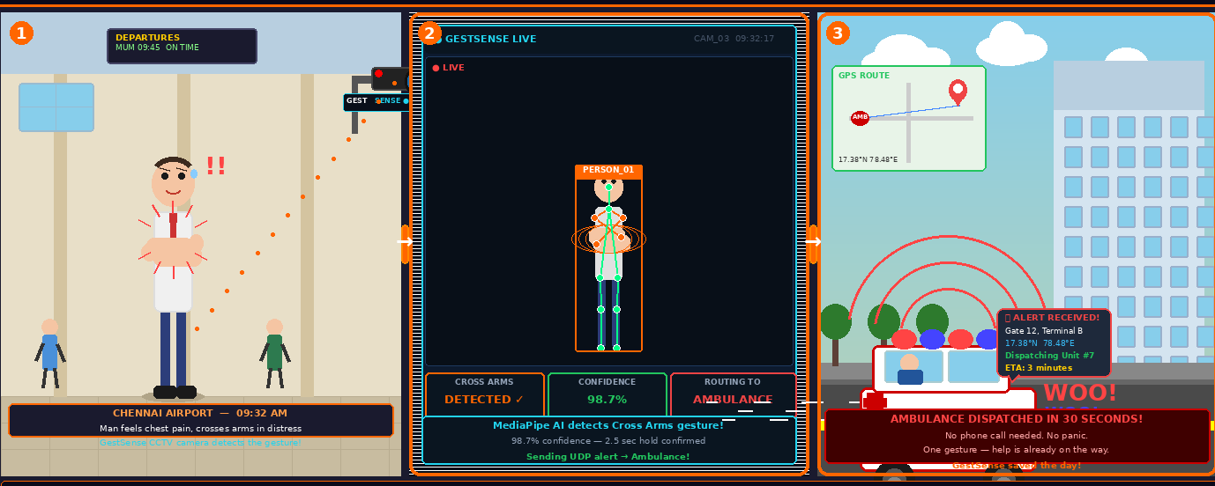
Q-eHack
B V Raju Institute of Technology
Project Title: Gesture-Based Emergency Detection and Sensor-Fused Emergency Alert System
Team Name & Project ID: Team IGNITE | 50
Introduction
Technical Approach & QNX RTOS Integration
Results
Technical Approach & QNX Integration
Gesture-Based Emergency Detection and Sensor-Fused Emergency Alert System is an embedded, camera-based emergency alert system that detects human distress gestures in real-time using AI pose estimation running entirely on a Raspberry Pi 4 (QNX RTOS). It bridges the critical gap between a person in danger and the nearest emergency response team — without requiring voice communication or internet connectivity.
Full System Architecture:
System Performance Metrics:
QNX RTOS on RPi4:
[RPi4 — QNX Momentics RTOS]
USB Camera (connected to RPi4)
↓
MediaPipe ML — Pose Estimation
(runs on-device, 30fps)
↓
Gesture Classified + 2.5s Hold Timer
↓
BME688 Sensor Fusion (temp/gas/humidity)
↓
Buzzer pattern + LED blink pattern
↓
GSM SMS + GNSS GPS → Emergency Dept
Gesture Detection Accuracy
94.7%
QNX Neutrino provides microkernel-based preemptive multitasking with hard real-time guarantees. Each hardware driver (GSM, GNSS, BME688, buzzer, LED) runs as an isolated process. If any component fails, the rest continue operating — ensuring the alert chain is never broken.
MediaPipe pose estimation runs as a dedicated QNX process, feeding classified gesture codes to the alert dispatcher, which triggers all hardware peripherals concurrently within 200ms.
Alert Dispatch Time
< 3 sec
Problem Statement
Hold Timer (false-alert guard) 2.5 sec
• People in emergencies often cannot speak, dial, or type for help • Existing systems require internet or conscious verbal input • No unified system routes to the correct department automatically • False alerts in voice/sensor-only systems waste critical response time
2.5 sec
SMS Delivery Rate 99.2%
Gestures & Alert Routing
99.2%
LED & Buzzer Patterns
Operates Without Internet Yes(LAN/WIFI)
# | Gesture | Body Position | Alert
1 | Arms Crossed on Chest | Both wrists cross to opposite side, elbows bent, wrists close together | !! MEDICAL EMERGENCY !!
2 | Hands Up Spread | Both wrists raised above ears, spread wide apart — NOT clasped together | !! POLICE / SECURITY !!
3 | T-Pose | Arms fully extended sideways at shoulder height; wrist span >2.2× shoulder width, NOT above head | !! FIRE / DISASTER !!
4 | Hands Behind Head | Each wrist near own ear, elbows flared wide, wrists at or below ear height | !! DISTRESS / TRAPPED !!
Gesture | Buzzer | LED | Dept.
Arms Crossed on Chest | 5 quick beeps | Red slow blink | Ambulance
Hands Up Spread | 8 rapid beeps | Both LEDs alt. | Police
T-Pose | 3 long beeps | Red fast blink | Fire Stn.
Hands Behind Head | 6 SOS beeps | Red steady | Rescue
Proposed Solution
Key Strengths
This system = uses a USB camera connected to RPi4 running QNX RTOS to capture video, perform MediaPipe pose estimation on-device, and classify four distress gestures. On a 2.5-second confirmed hold, the RPi4 triggers buzzer/LED alerts, reads BME688 environmental data for sensor fusion, and dispatches a GPS-tagged SMS to the correct emergency department via GSM.
Multi-department routing — each gesture routes to a different department
BME688 sensor fusion — validates fire alerts before dispatching GSM
Fully embedded — all ML inference runs on-device on RPi4 + QNX RTOS
Industry Impact & Relevance
Multi-person detection — tracks up to 4 people simultaneously
Applicable in hospitals, public spaces, banks, and schools. QNX RTOS ensures deterministic, fault-tolerant response — critical for real-time safety. Scalable to smart city infrastructure and IoT emergency networks. give more of this matter
Gesture hold timer — prevents false alerts, requires 2.5-second hold
Real-time overlay — live camera feed shows detection status on-screen
Software Flow
Sample Alert SMS
1
USB Camera Frame Capture — RPi4 reads frames at ~30fps via V4L2
Conclusions
2
Pose Estimation (On-Device) — MediaPipe extracts 33 keypoints per person
!! MEDICAL EMERGENCY !!
Person: P1 | Dept: AMBULANCE
Location: 17.3850°N, 78.4867°E
Temp: 36°C | Gas: NORMAL | Humidity: 52%
Time: 09:32:15
This system demonstrates that non-verbal, AI-driven distress detection is viable as a fully embedded deployment on QNX RTOS. The combination of on-device MediaPipe pose estimation, deterministic QNX real-time scheduling, and multi-modal sensor fusion (GSM, GNSS, BME688) creates a robust emergency system that requires no internet, routes alerts intelligently, and eliminates false positives through environmental confirmation.
Future scope includes wider gesture vocabulary, integration with national emergency APIs, nighttime IR camera support, and smart city deployment at scale.
3
Gesture Classification — Rule-based joint angle & ratio matching
Hardware Components
4
2.5s Confirmation Hold — QNX timer process prevents false triggers
Component | Purpose
USB Camera (RPi4) | Captures human gestures on-device
RPi4 + QNX RTOS | Runs ML inference & controls hardware
MediaPipe ML | On-device real-time pose detection
BME688 Sensor | Sensor fusion: temp, gas, humidity
GSM Module | Sends SMS alert to departments
GNSS Module | GPS coordinates embedded in SMS
5
BME688 Sensor Fusion — Environment data validates alert type
6
Alert Dispatch — Buzzer + LED + GSM SMS + GNSS GPS fired
References
Author Details
[1] MediaPipe Pose — Google Research, 2020
[2] QNX RTOS Documentation — BlackBerry
[3] BME688 Datasheet — Bosch Sensortec
[4] PptxGenJS — gitbrent/PptxGenJS
Team Member-1: K.Vishnu Varshith
Team Member-2: K.V.N.Sai Siddartha

