Slide 1
Device Compliance with Microsoft Entra Id & Jamf Pro

Slide 2
Introduction
What is Device compliance?
Why Device Compliance Matter?
What is Microsoft Entra Id?
Implementation in Jamf Pro and Entra Id.

Slide 3
What is Device Compliance?
Device compliance is the state of the devices meeting the standards and regulations of the organization
Microsoft Entra Id integrates with Jamf Proto evaluate device compliance
Device must register with Microsoft Entra Id via the company portal.

Slide 4
Why Device Compliance Matter?
Data Security
Risk Mitigation
Standardization and control
Support for remote work

Slide 5
What is Microsoft Entra Id?
A cloud based identity and management service.
Allows employees to access external resources like Microsoft 365, Azure portal and other SaaS applications.
Manage all identities in one place, whether cloud or on-premise.
Enhance security with features like conditional access and identity protection

Slide 6
Implementation in Jamf pro and Entra Id
Configure Jamf Pro
Connect Jamf Pro to Intune
Configure Microsoft Entra Id
User registration

Slide 7
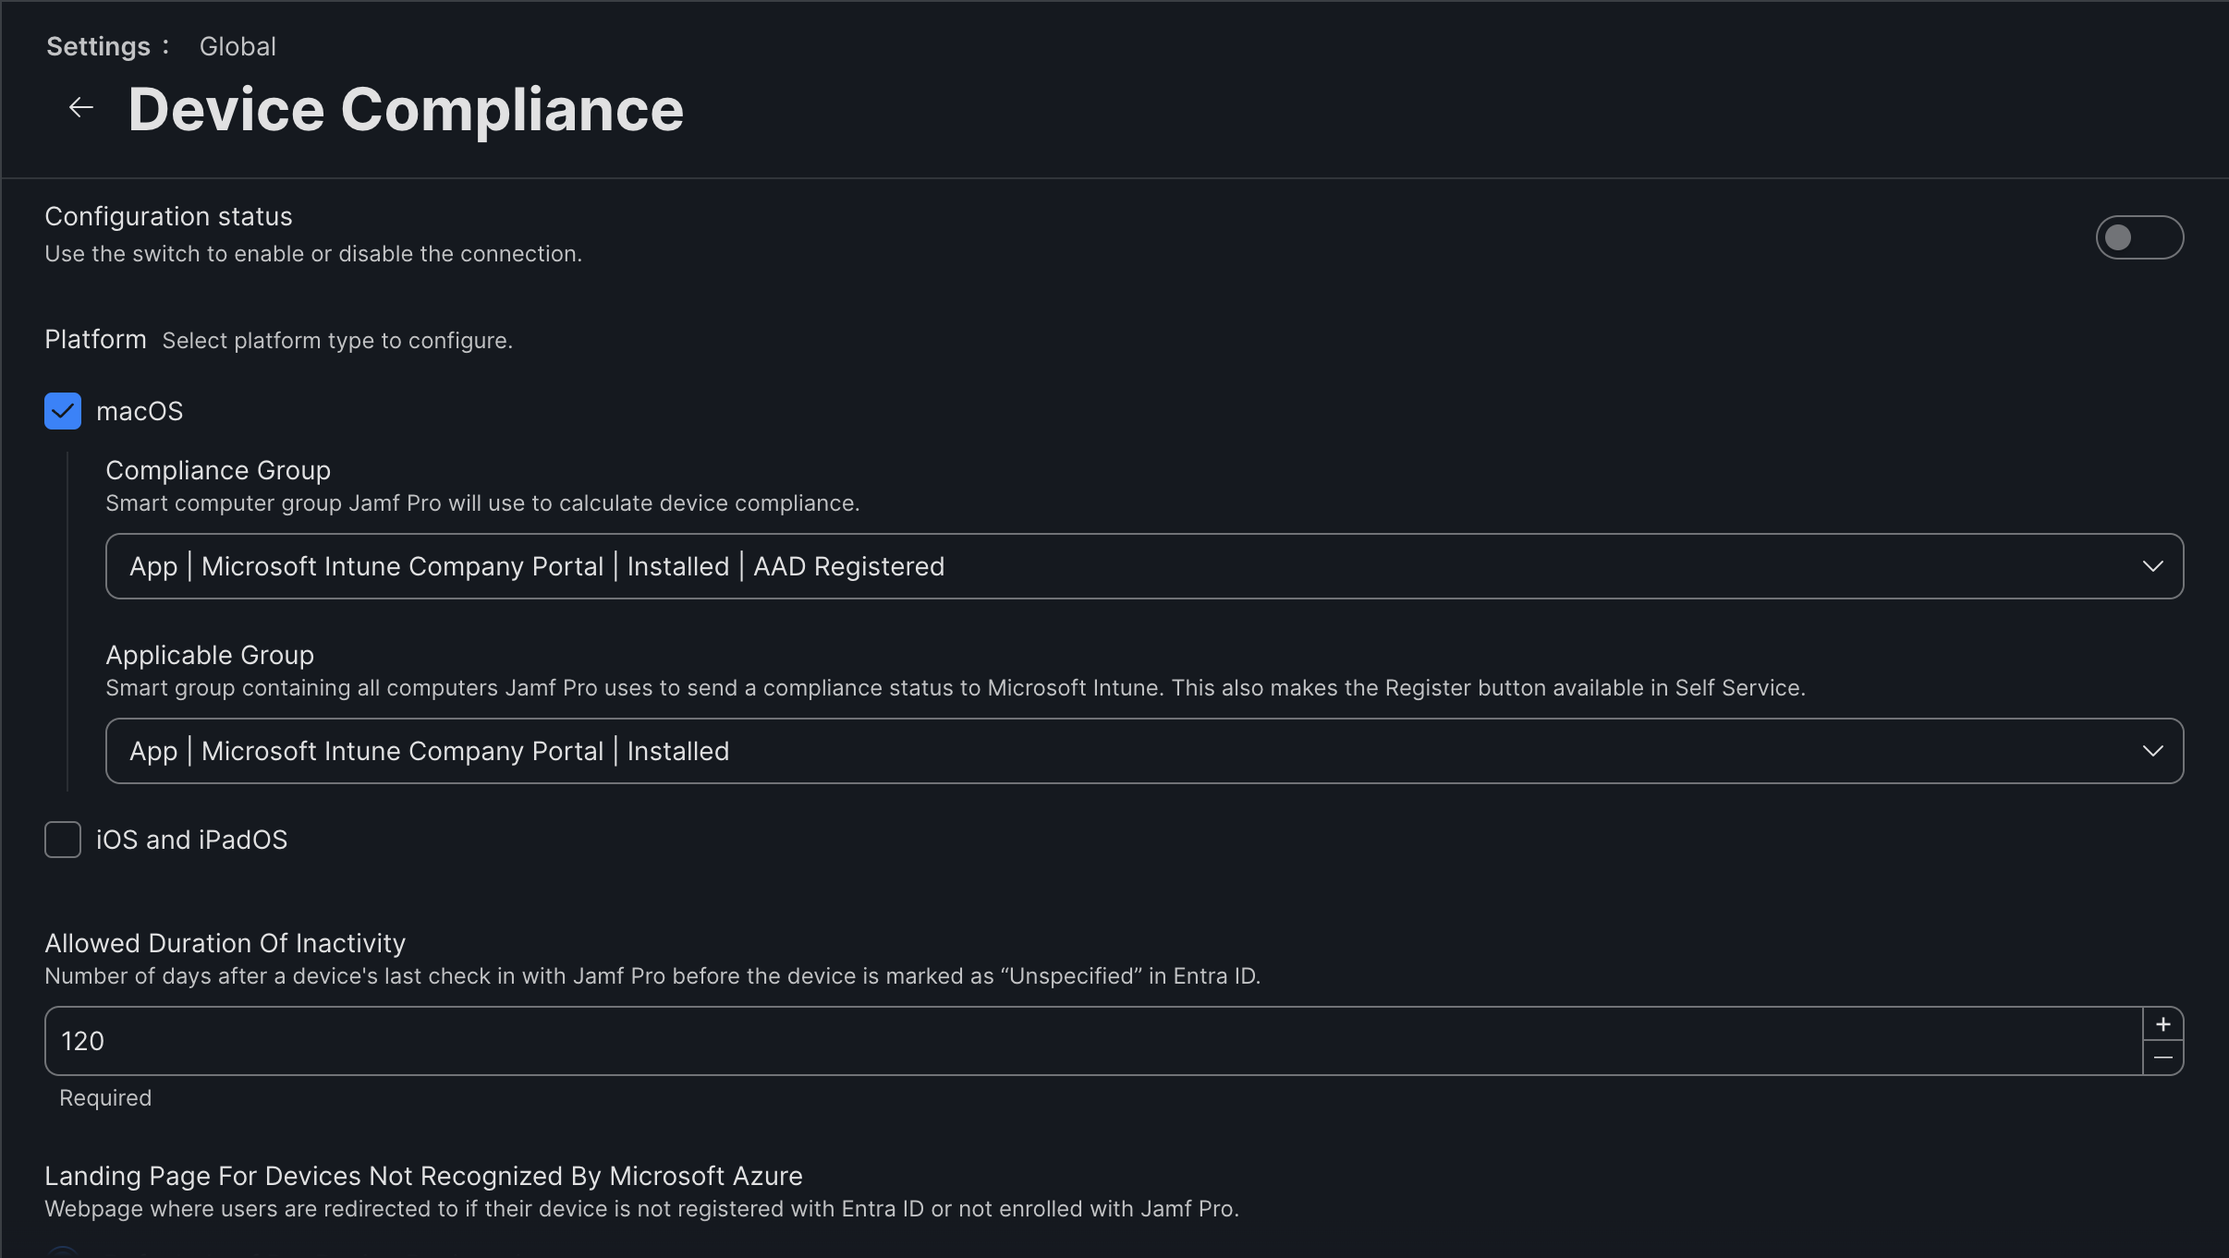
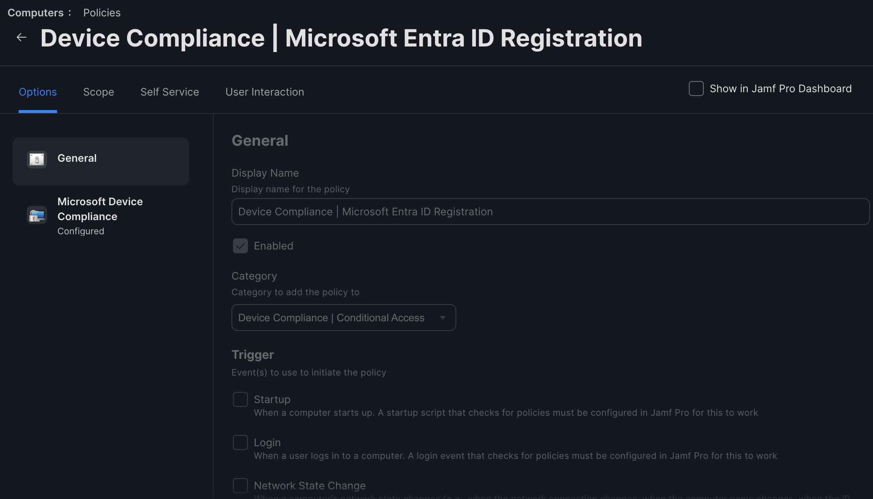
Configure Jamf Pro Policies

Slide 8
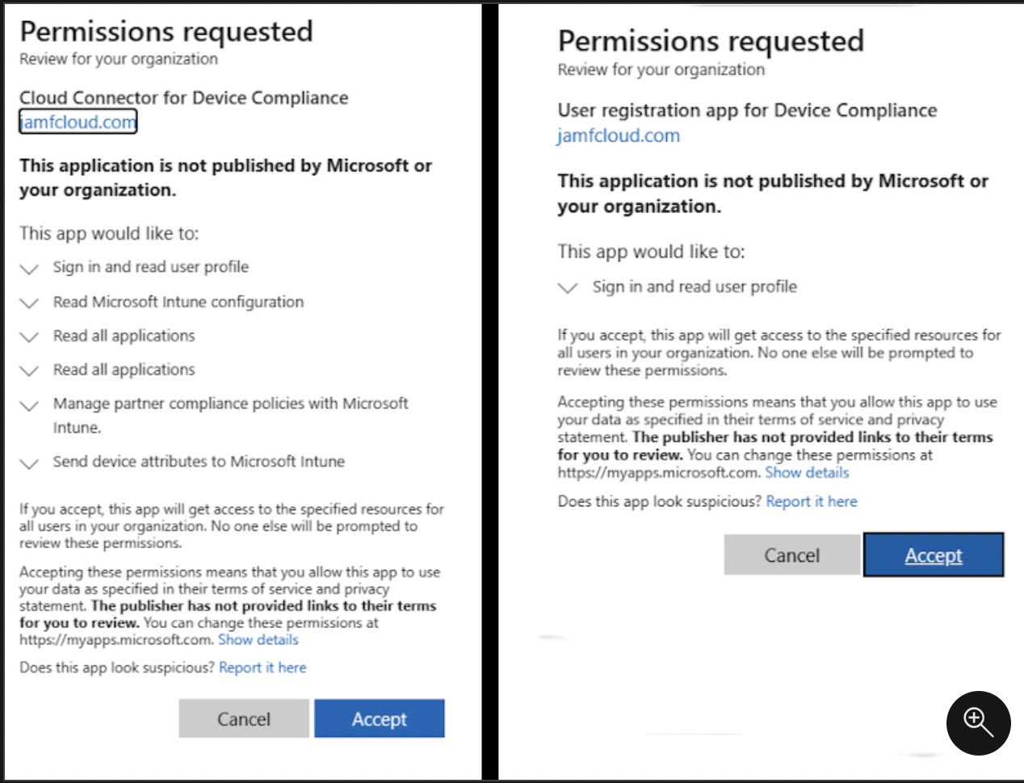
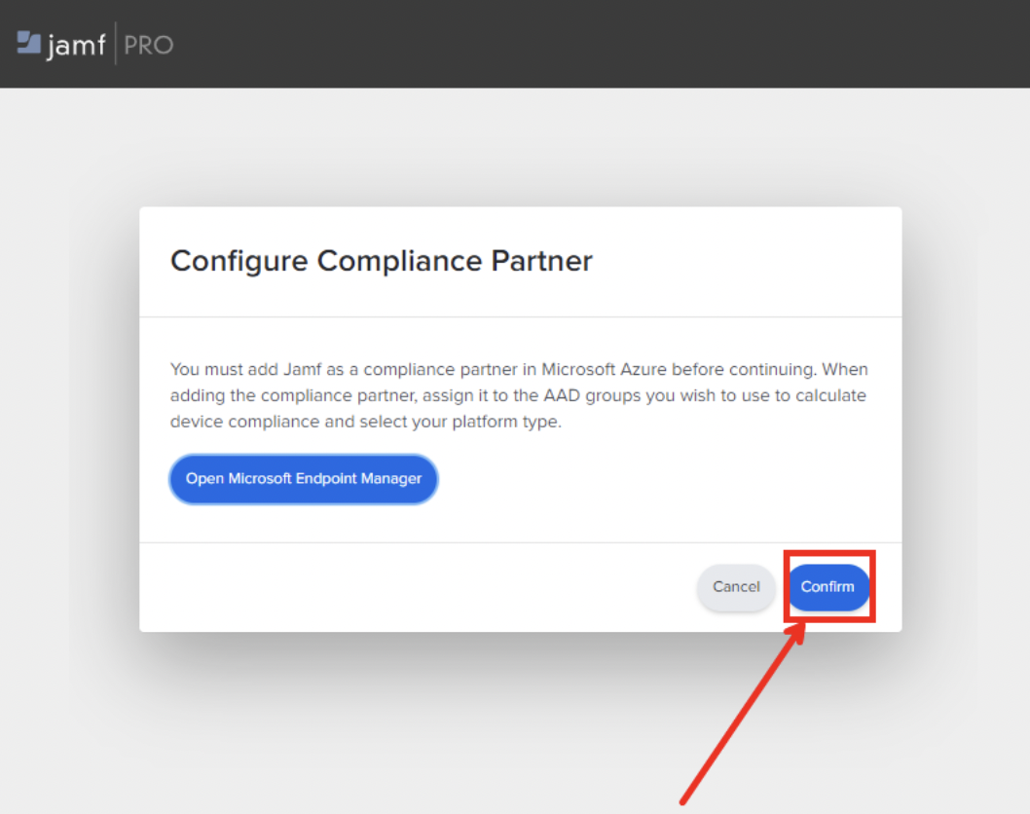
Connect Jamf Pro & Intune

Slide 9
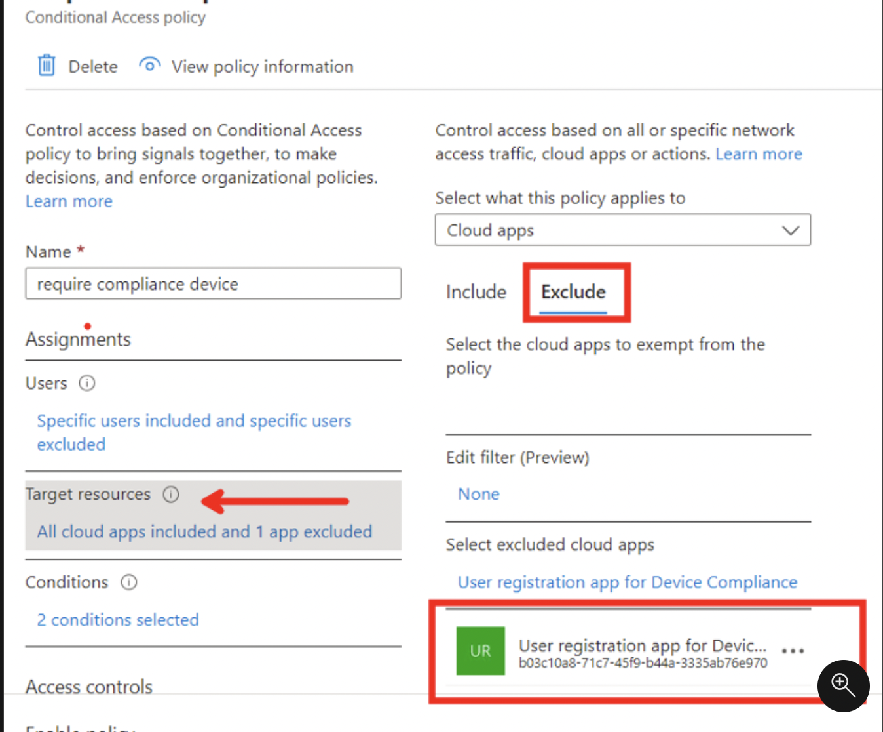
Configure Microsoft Entra Id

Slide 10
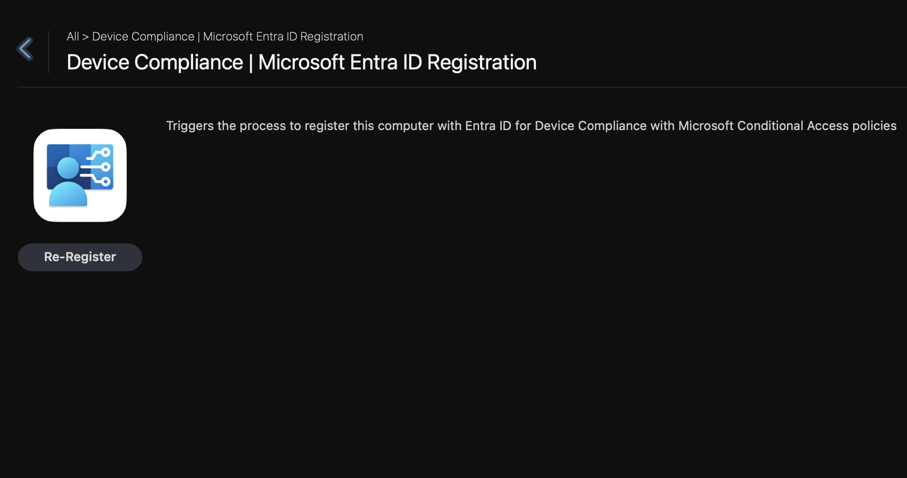
User Registration
https://youtu.be/rT47hMDIxwo?si=-CD4PE3BTvdOnsjE&t=1575

Slide 11
Thank you

