Slide 1

Minor Project 1 on Comparative Study and Analysis of Uninformed Search Algorithms
NAME | ENROLLMENT NO. | BRANCH
Priya Bansal | R970217030 | CSE-OGI
Shristi Katiyar | R970217039 | CSE-OGI
Siddarth Kumar Jha | R970217040 | CSE-OGI
Rahul Yadav | R970217051 | CSE-OGI
Under the guidance of : Dr. Kingshuk Srivastava

Slide 2
introduction
Addressing the aspect of a problem-solving approach, one is under a particular situation and wants to be in the desired situation, so what comes out as the task is to make a series of decisions or the series of moves which will transform the given situation into the desired situation.
A search can be performed in many different spaces as the given state and the goal state likewise, several other states lying in between the two, the given and the goal state.
Search is performed over the state spaces to end up at the desired solution when the series of decision is not known. There are two types of state-space searches, informed search and uninformed search.
Area of interest of this project lies around uninformed search under state-space search, which is also known as Blind search as it is unaware of the search space and can only distinguish between a goal state or a non-goal state.
Various algorithms come under uninformed searches like Breadth First Search, Depth First Search, Depth-Limited Search, Depth First Iterative Deepening Search, Random Walks, and Bidirectional Search. This Project takes into consideration, four major algorithms that are Breadth First Search, Depth First Search, Depth-Limited Search, and Depth First search with Iterative Deepening.

Slide 3

Objective
To perform a comparative study of different performance parameters in Uninformed Search Algorithms listed below to identify and implement the best search approach under different parametric conditions.
1. Breadth First Search
2. Depth First Search
3. Depth-Limited Search
4. Iterative Deepening Depth First Search

Slide 4

Problem Statement
Searching is carried out to retrieve information stored within the massive data structures, here efficiency becomes a major issue. There exist certain problems which tend to hinder the efficiency of the search algorithms which are taken under consideration in this project. These Problems are: -
The searching of a node in DFS algorithm works well but when the target lies on the right side of the tree the result will not be optimal.
The searching of a node in the BFS algorithm overcomes the problem faced in the DFS algorithm but its memory consumption is much greater than DFS.
The searching of a node in DLS algorithm overcomes the problem which is faced in both DFS and BFS algorithm by introducing a limit on the level of search but to find that limit the tree should be solved manually.

Slide 5
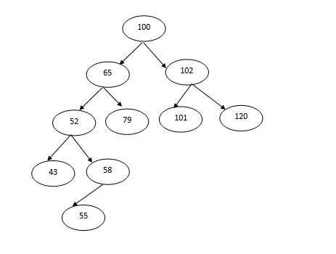
Depth first search
Depth First Search is a simple search algorithm based on stack implementation.
This starts traversing from root explores a path all the way to leaf before backtracking and exploring another path.
The solution is optimal in most of the cases.
Figure 1.1

Slide 6
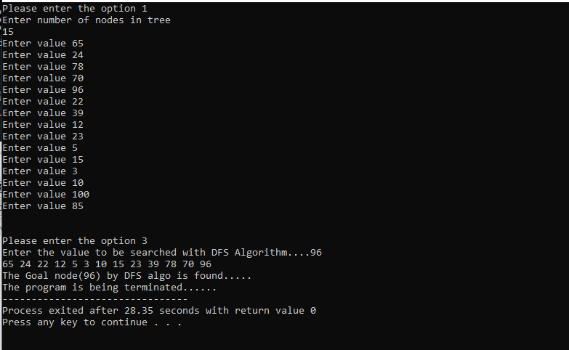
Output: (windows x32)

Slide 7
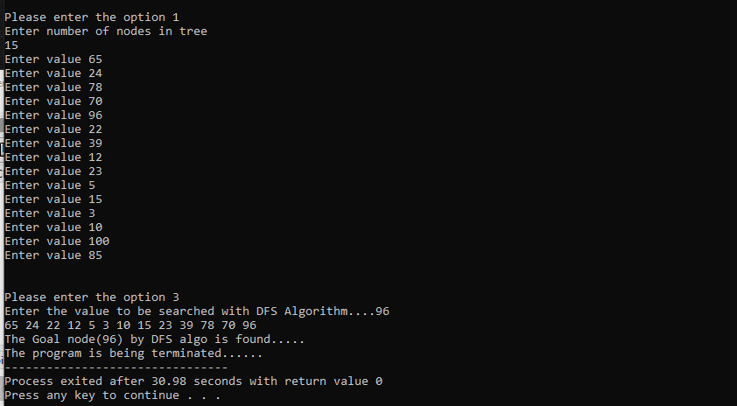
OUTPUT: (windows x64)

Slide 8
Breadth first search
Breadth First Search is a simple search algorithm based on queue implementation with different logic than depth first search.
This traverses the tree depth by depth. It starts traversing from root explores the neighbor nodes first, before moving to the next node.
The number of nodes to be stored in the queue data structure depends on the branching factor of the tree on a particular tree level. It consumes more memory than depth first search.

Slide 9
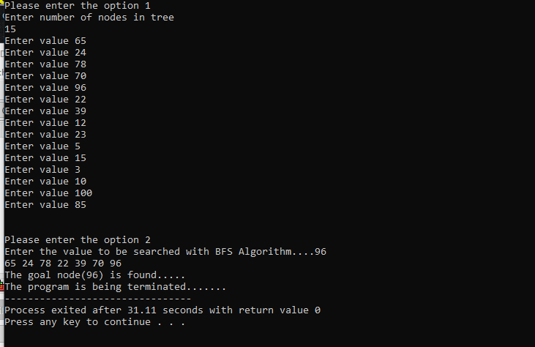
OUTPUT: (windows x32)

Slide 10
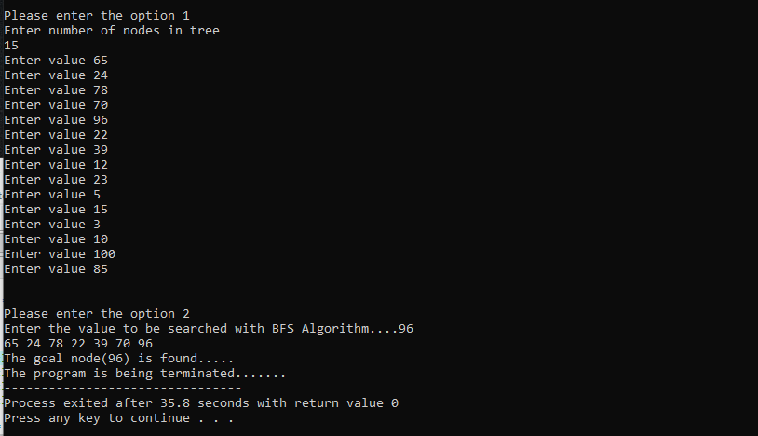
OUTPUT: (windows x64)

Slide 11
Depth limit search
Depth limit search algorithm is an extension of depth first search.
This algorithm is implemented in a similar way of depth first search with a slight difference which is, this will be asking the level of the tree along with the destination.
With introducing level, it limits the number of comparisons in a tree which is given in limit.

Slide 12
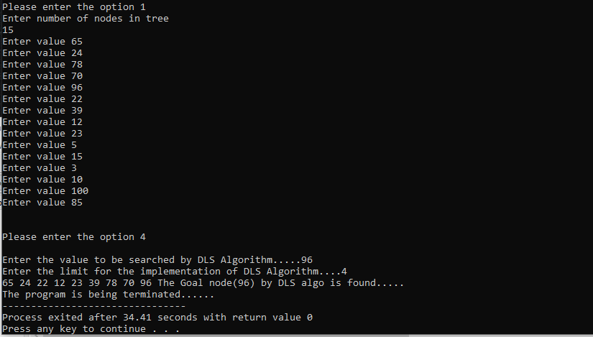
OUTPUT: (windows x32)

Slide 13
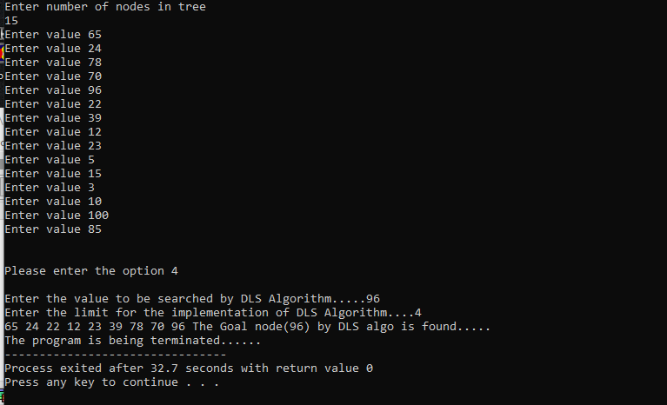
OUTPUT: (windows x64)

Slide 14
Iterative deepening depth first search
Iterative deepening depth first search is a combination of depth first search and breadth-first search.
It selects the benefits of both the algorithms and gives out the best solution compared to previous algorithms.

Slide 15
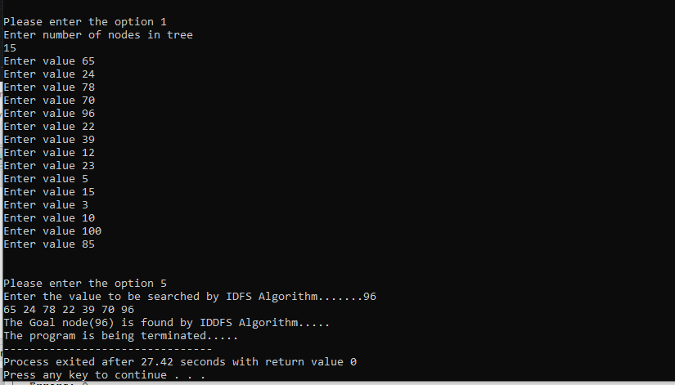
OUTPUT: (windows x32)

Slide 16
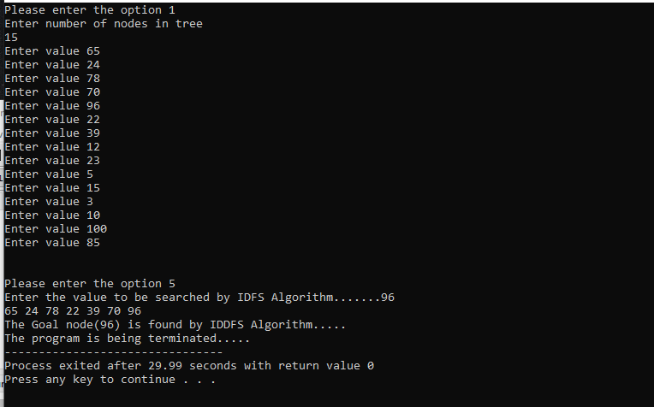
OUTPUT: (windows x64)

Slide 17
motivation
Suppose informed search is the optimized search algorithm but the question here is why is it so?
It is because there might be some drawbacks of uninformed search that makes informed search a better way. We choose this topic to understand the drawbacks by executing the uninformed search algorithms , so that we can conclude about the informed search.

Slide 18

Methodology
Literature Review.
Detailed study of different search algorithms under Uninformed Search.
Detailed study of the selected Optimization algorithm.
Designing process of flow diagram and algorithms
Development and Implementation.
Testing
Comparative analysis of algorithms on different environments like, windows-x32 and x64 bit.
Report writing

Slide 19
Result analysis
Case 1: -When the search algorithms are executed in x64 bits of windows the first set of the result are obtained.
For the total 15 entered values if the value to be searched is ‘96’ the time taken by respective algorithm decreases
as we move from BFS to DLS to DFS and finally to IDDFS.

Slide 20
Result analysis
Case 2: - When the same search algorithms are executed in x32 bits of windows the second set of the result are obtained. For the total 15 entered values if the value to be searched is same as case 1 i.e ‘96’ to provide the same parameter the time taken by respective algorithm again decreases as we move from DLS to BFS to DFS and finally to IDDFS.

Slide 21
conclusion
We achieved optimization from Depth-First search to Iterative Deepening Depth-First search while taking consideration each algorithm time complexities and found the minimum time search algorithm. This algorithm can be used in many places like: -
The algorithm can be used effectively for crawlers in the search engine.
The algorithm can also be applied in peer to peer networks (Minimum spanning tree).
They can be used for Broadcasting in networks.
The algorithm can be used for social websites and GPS systems.

Slide 22

References
[1] Artificial Intelligence by Saroj Kaushik, Cengage.
[2] nptel.ac.in/courses/106106126.
[3] http://intelligence.worldofcomputing.net/ai-search/depth-first-search.html#.XWJcZOgzbIU
[4] Artificial Intelligence, spring 2013, Peter Ljungl of; based on AIMA Slides c Stuart Russel and Peter Norvig, 2004.
[5] Columbia University, New York / CS /lectures /Uninformed search.

Slide 23
THANK YOU!!
ANY QUESTIONS??

