Slide 1
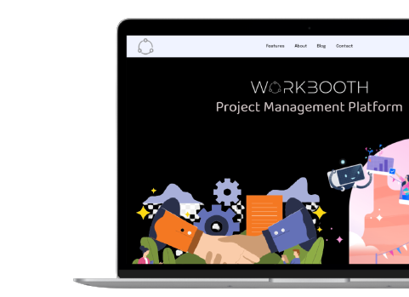

Human Computer
Interaction

Slide 2
Team members:
Maddi Siddart (PES1201800269)
Prajwal k Naik
(PES1201801455)
Siva Raja ganesh A
(PES1201801968)

Slide 3
Outline
Problem Statement
Existing Solution
Our solution
Low Fidelity Prototype
Heuristic Evaluation
Empathy Map
High Fidelity Prototype

Slide 4
Problem statement
Students often face an issue of finding teammates or collaborators for the projects that they want to work on.
Sometimes, a student finds it a hurdle to find projects that suit her/his skill set or interests.
With the ongoing pandemic, the situation has worsened with every academic/professional activity moving online. Students have no interaction with the world outside and hence no ways to find collaborators with the same interest.

Slide 5
What students do today
Presently, to find others with similar interests in order to form “teams”, students
put up posts on social media sites/applications asking for people to join them.
make many calls to known contacts asking if they’re interested in joining them.

Slide 6
Solution Proposal

Slide 7
Solution description
Now, we present to you, Workbooth, a collaborative project management platform which allows you to
Create your own projects and invite collaborators to contribute.
Join existing projects and collaborate with people from various institutions.
Create study rooms for group studies.
Find and join new study rooms to broaden your knowledge.

Slide 8
Requirements for Usage
Basic internet connection.
Any electronic mobile device.
Willingness to work in a team for a project, in case the user is planning on working on an existing project.
Project idea, in case the user is planning on starting a new project.

Slide 9
Low-fidelity Prototypes

Slide 10
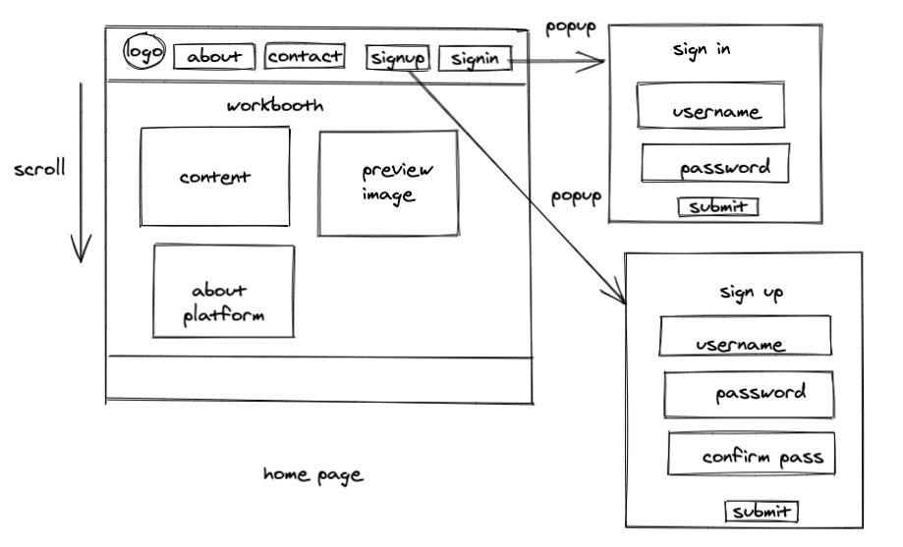
Landing Page

Slide 11
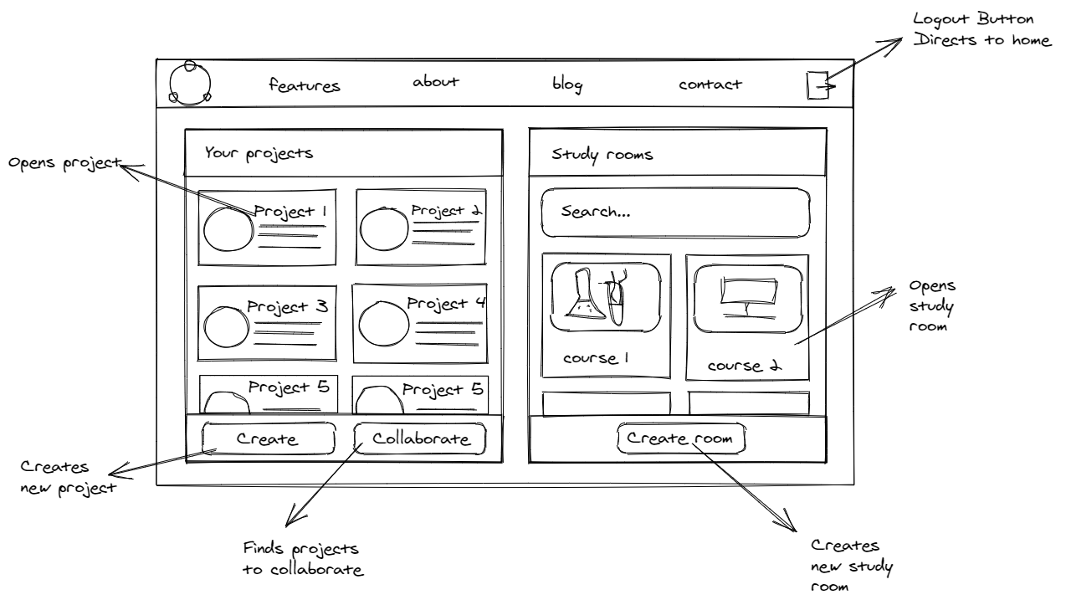
Home Page

Slide 12
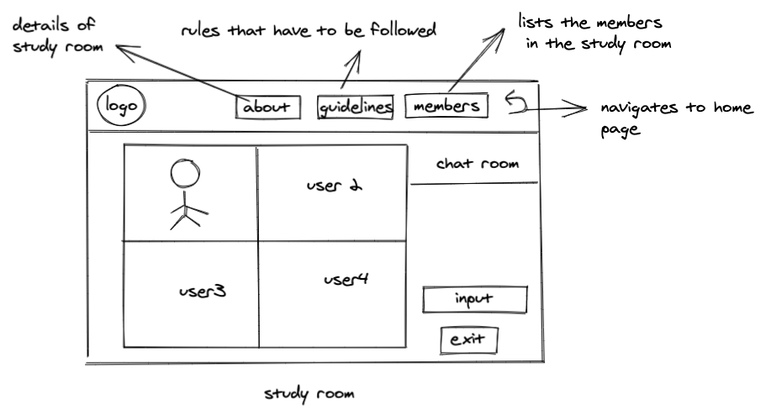
Study Room

Slide 13
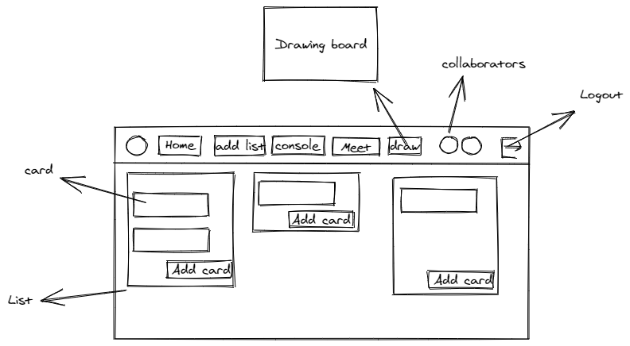
Project Page

Slide 14
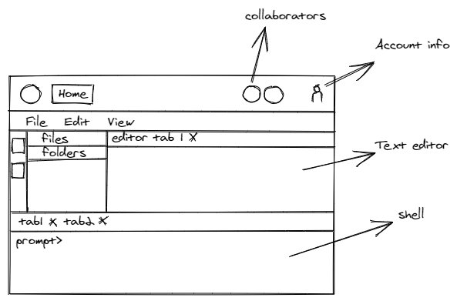
Collaborative Editor

Slide 15
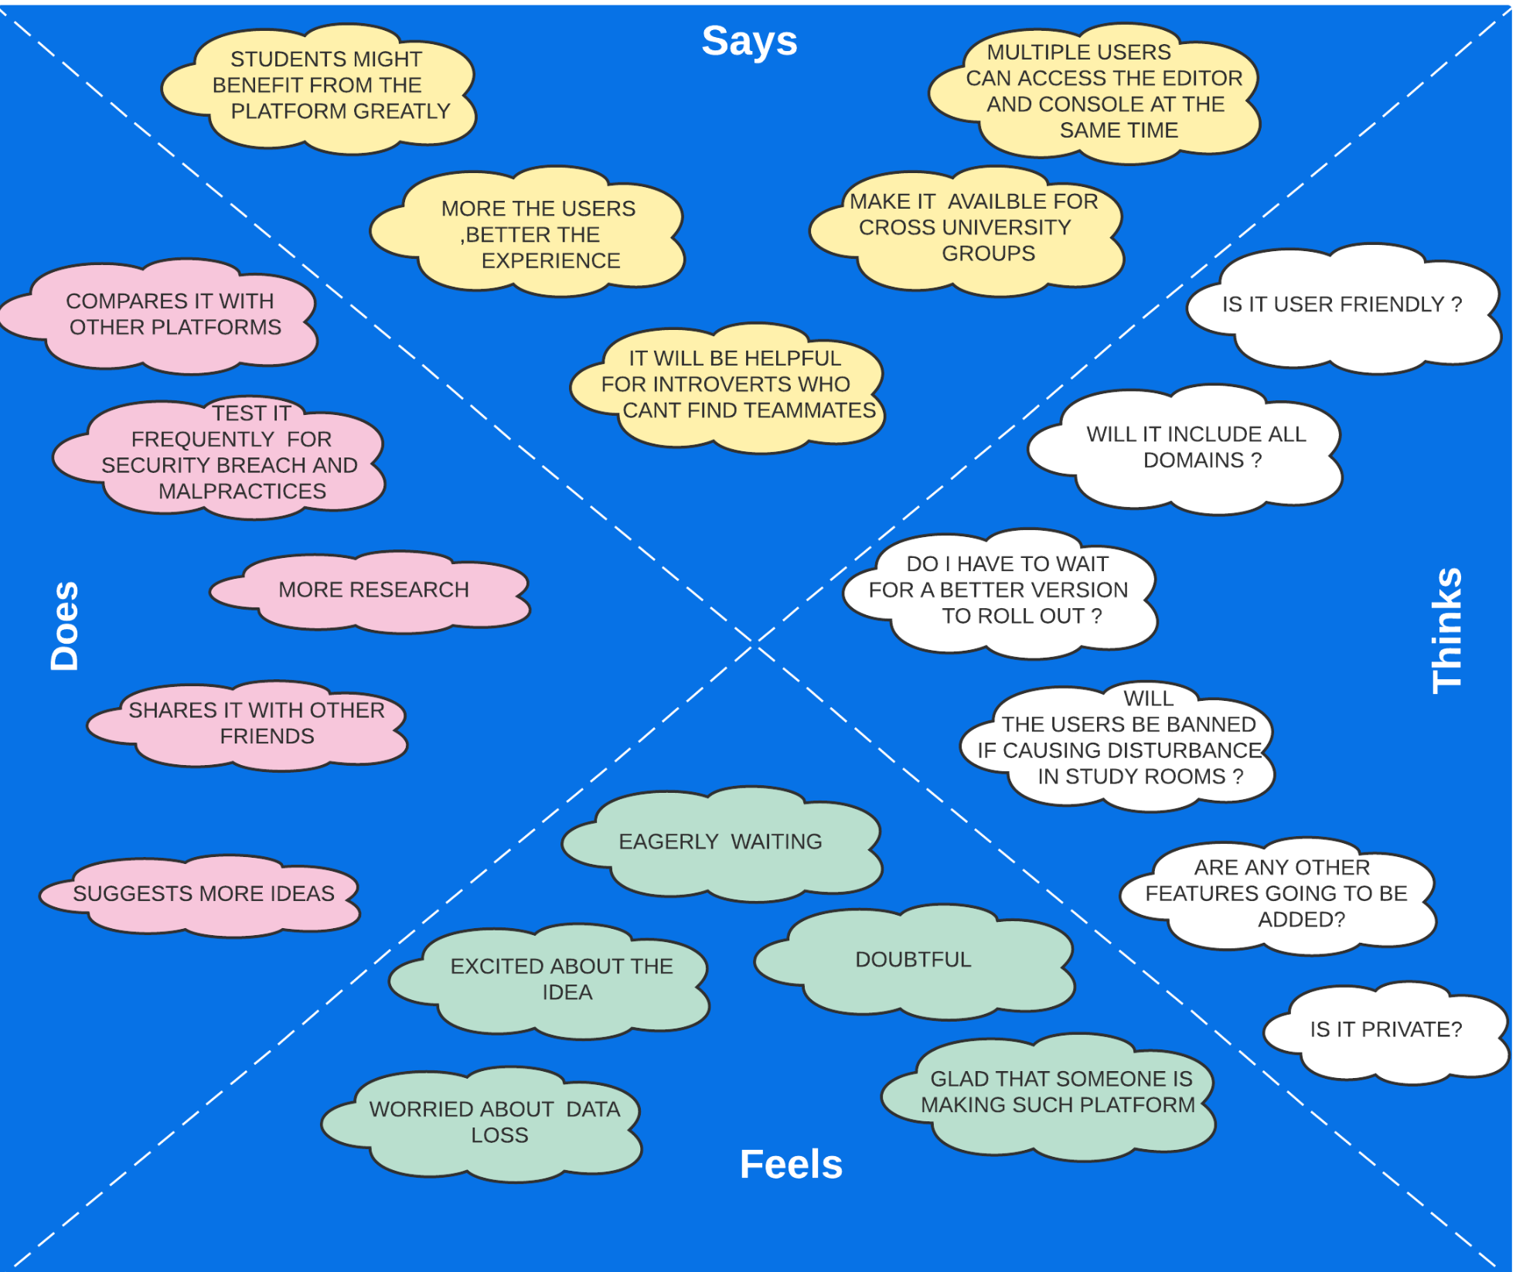
Empathy Map

Slide 16
Heuristic Evaluation

Slide 17
Strive for Consistency
Similar terms like create and collaborate are used throughout the design so that the user of the application is familiar with what the button might do.
All the generic buttons for the application are colour coded black and buttons pertaining a particular website are in grey.
There is a navigation bar at the top of every page which has functionalities like about, features and contact details for the application.
The user login, logout and user menu is provided at the top right corner of every page.

Slide 18
Enable frequent users to use shortcuts
All the projects and study rooms the user is part of are displayed as cards in the dashboard which display their details concisely.
The user can create a project, collaborate on a project and create a study room all from the dashboard.
The user can logout and access account details by clicking on the account or logout icons on the top right corner.
All the tools related to project management are all on the same project page.
The user can access the home page directly by clicking the home button.

Slide 19
Offer informative feedback
When users create project postings or collaborate in a project, it appears in their dashboard and the collaborate page.
Every submission of forms like sign in, sign up, create project and create study room give users success or failure messages.

Slide 20
Design dialog to yield closure
When the user logs into the application, a successful login message is shown.
When the user submits forms like create project, create study room and sign up, the user is shown a success message on submission.
When a user’s collaborate request is accepted, they are notified.

Slide 21
Offer simple error handling
When the user fills up forms like sign up or project creation, the mandatory input which the user fails to give is marked red for the user to fill up.
When the user doesn’t enter the right credentials for login, they are prompted for entering the correct details once again.
When the user doesn’t give the right details like an invalid email-id, the input area is marked red and the user is asked to fill in those details again.
Other errors that happen during accessing the console or using the meeting tool, are handled by the respective tools.

Slide 22
Permit easy reversal of actions
Users can delete project postings and study rooms if they have submitted entries that don’t seem appropriate.
Users can change profile details by accessing the user details using the account icon.
Users can delete cards and lists on the project management page.
Other options given in the console and meeting tool can be reversed by the respective tools.

Slide 23
Support internal locus of control
Users have few number of pages to navigate around and all buttons pertaining a given page is given in that page itself in the navigation bar and cards.
Familiar buttons and controls make the user navigate back to the home page safely instead of getting lost in pages.
User is provided with prompts to confirm and show success messages to give the user a feel of control over the application.

Slide 24
Reduce short-term memory load
The dashboard is designed to show the users projects and study rooms all in one place for easier access.
There are few pages to navigate to and all features are given as buttons in the navigation bar.

Slide 25
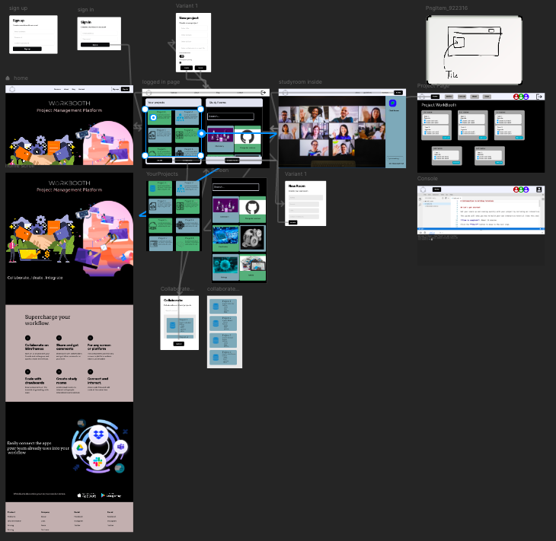
High Fidelity Prototype

Slide 26


