Slide 1
6AMB Python Workshop

Slide 2
Who am I?
I’m CPL Siddhartha Bose from 62FMD
Received my bachelor degrees in Computer Science and Economics in 2019 from UCLA
Never coded before 2015
Failed my first programming course and wanted to quit
At the very least my journey should show you that programming may seem daunting but it’s a level playing field, and anyone can succeed with time

Slide 3
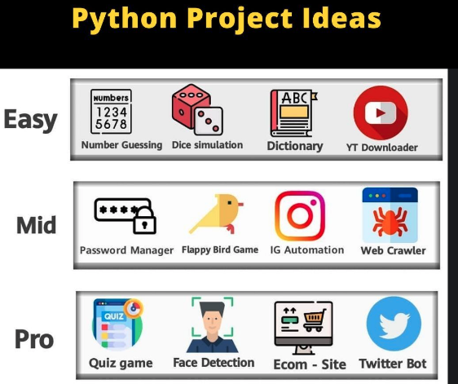
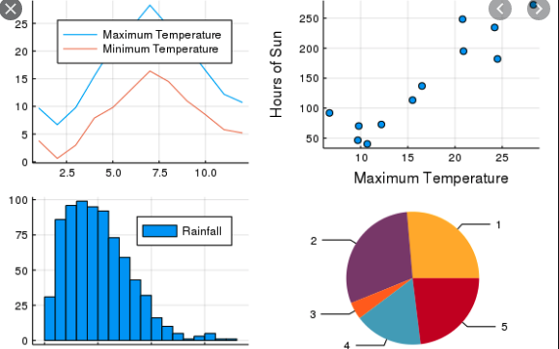
Why Python?
Python has syntax similar to English and is more forgiving
Python code is significantly more concise than other languages (doing a similar task in C++ or Java tends to take more lines)
Its applications are universal
Machine Learning
Web Development
Data Mining
Etc.

Slide 4
Workshop Objectives
By the end of today none of us will be experts but we will all have a working understanding of python basics
The goal is to dip our feet in the water and allow for further investigation in the future
Today we’ll go through a few basic topic and by the end of the workshop we will have a few small projects and hopefully a fun one for you to play with at home
Programming is a skill you can develop remotely and in your free time and there are a ton of resources online which will allow you to be successful provided you put in the time

Slide 5
Syllabus
Understanding Command Line Interface (CLI) and installing python
Python syntax, variables and comments
Python data types
Logical operators
Numbers, Randomness and Type Conversion

Slide 6
Syllabus Continued
Strings
Booleans
Lists
Conditional Statements and Loops
Functions
Final Project

Slide 7
How to Download Python
https://realpython.com/installing-python/
This is the best link on how to download the newest version of python for macOS, Windows or Linux
Today we will be using an online compiler, so this is not necessary but in your own time feel free
After downloading python, you can use a text editor like ”Visual Studio Code” to actually write your code
Since we will not be downloading Python, for today we will skip over the next 3 slides

Slide 8
Understanding Command Line Interface (CLI)
So let’s assume you have not downloaded python yet, this is how you would do so:
If you have a Mac, it is probably preinstalled, but you can check by going to the terminal app and typing in “python --version” and it should be after 3.7
In a newer windows PC it is also probably preinstalled and you can check in cmd.exe by typing in “python --version” and it should be after 3.7
If it is not installed, go to python.org and download python

Slide 9
Understanding CLI contd.
Command Line Interface is essentially a window into the heart of your computer. It allows you to manipulate files and directories through simple text.
Some useful commands include:
cd – change directory: you can move into and out of folders like this
cd Documents: this will move you into your documents folder
mkdir – make directory: you can create folders like this
touch [filename] – you can create files like this

Slide 10
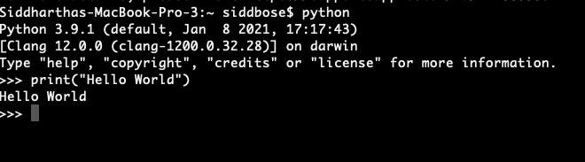
Hello World
So, to start we will create a “hello world” program in python
Type in “python” into your CLI
Then type in print(“hello world”)

Slide 11
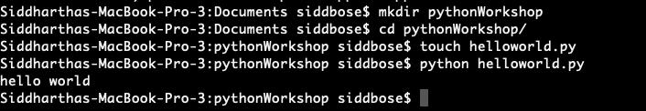
Hello World Contd
Another way to do this is to create a file and edit it using a text editor
So we will first mkdir pythonWorkshop
Then we will cd pythonWorkshop
Then touch helloworld.py
We will then open our text editor and open the hello world file
Then we will type in print(”hello world”)
Lastly we will type the command python helloworld.py and see what happens

Slide 12
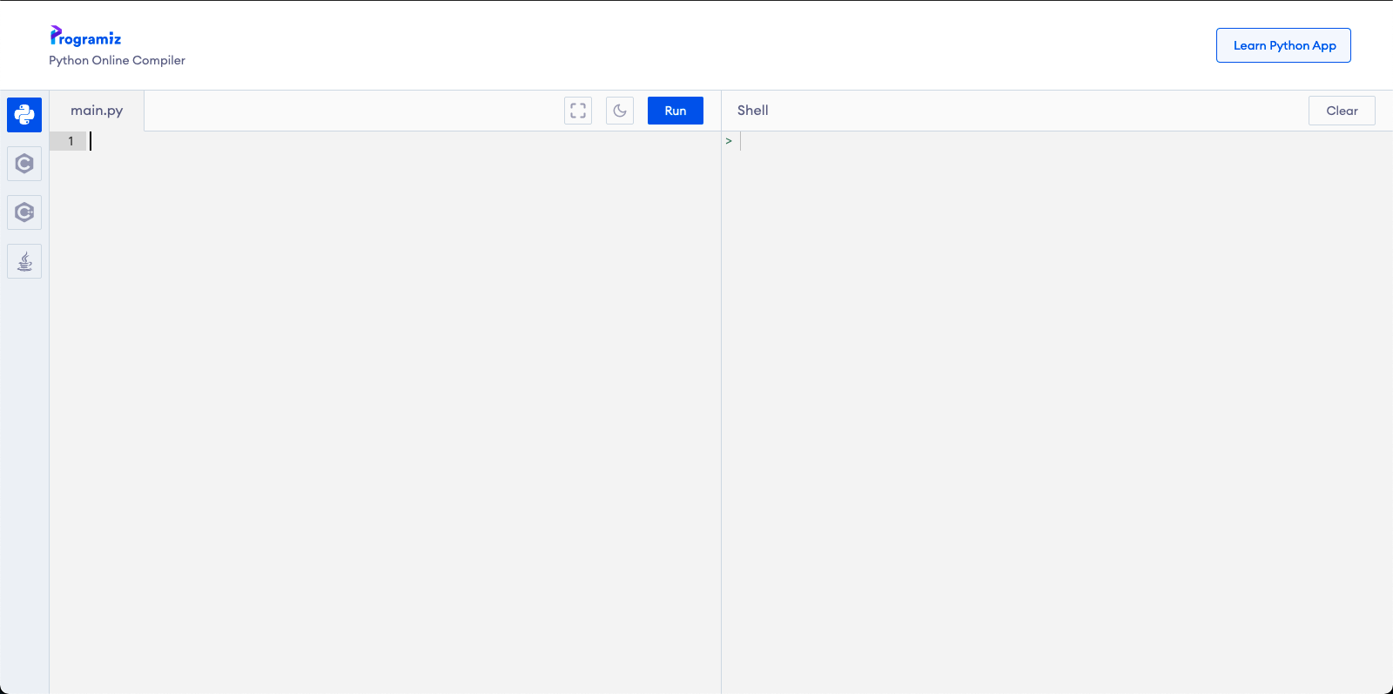
Using the Online Compiler
https://www.programiz.com/python-programming/online-compiler/

Slide 13
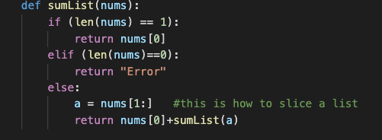
Python Syntax, Variables and Comments
Python has syntax most similar to English in the programming world
Many languages use semicolons and braces like {} to denote where logic is confined but in python we do away with these extra things
Instead the emphasis is on tabs and indentation
Code in the same indentation are often related just like bullets and sub-bullets are
For example:
In this function, the outer indentation defines the function while the logic and the return statements are further in. We will discuss this in detail later

Slide 14


Indentation
As we emphasized on the last slide, indentation is key in python
Correct:
Incorrect:

Slide 15

Variables
Variables are essentially pieces of data that can be used and manipulated throughout a piece of code
Unlike some other languages, python allows for “dynamic typing”
This means that variables are defined more freely and simply
When the program runs, it will define x to be an integer (int), y to be a string (str) and z to be a float (float)

Slide 16


Variables Contd
Variables can be dynamically assigned as we saw before, or we can “cast” them
For example:
It is important to note that most variables can also have their type changed throughout the code

Slide 17
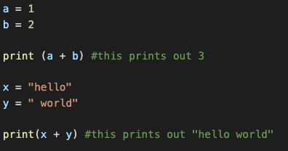
Outputting Variables
As we saw earlier, we can use the print() command to output values
In addition we can even add variables while printing

Slide 18
Naming Variables
Python has a few rules about how to name variables
1. the name must start with a letter or the underscore character
Like x or _x
2. the name cannot start with a number
2var or 2000 are not valid
3. A variable name can only contain alpha-numeric characters and underscores (A-z, 0-9, and _ )
camelCamelCamel1919, and variable_200 are valid
4. Case matters
Variable and variable are different

Slide 19

Comments
On the side of the lines of code you probably saw the “code” in green
These are called comments
A comment is basically any code that is NOT read by the computer as it runs the program
In python it is designated as a “#” symbol followed by text

Slide 20
Variables Quiz
1. create a variable named fruit and assign it the value “durian”
2. create a variable name amb and assign it the value 6
3. display 5 + 10 (integers) using 2 variables x and y
4. Make this variable name valid: 2my-first_name

Slide 21
Data Types
We saw in the previous section how variables can be different kinds of data
Here we will go through the most common data types
1. Text
String (str): “hello”
2. Numeric
Integer (int): 1000, 0, -5
Float (float): 1.5, 3.1415,

Slide 22
Data Types Contd
3. Sequences
List (list): [1, 2, 3]
Tuple (tuple): (1, 2, 3) → a tuple looks like a list but the elements cannot be changed separately
4. Mapping
Dictionary (dict): {“name”: “Sidd Bose”, “rank”: ”CPL”}
5. Boolean
Boolean (bool): True, False (the capital letters matter here)

Slide 23
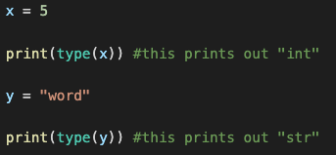
Checking data types
Whether we are debugging or using this information in our code itself, it can be helpful to actually know the type of a variable at any given time
We do this by using the type() function as follows

Slide 24
Data Type Quiz
Name the data type:
one = 5
two = “hello world”
three = 5.0
four = [“apple”, “banana”]
five = (“apple”, ”banana”)
six = {“fruit”: “banana”, ”price”: 3}
seven = True

Slide 25
Logical Operators
Often in programming we need to compare the values of two variables
This shows up most often in conditional statements (we will see these later on)
These operators can be segmented into the following
Arithmetic
Comparison
Logical and Identity

Slide 26
Arithmetic Operators
Most of these should be very intuitive for all of us
These operators work between two numeric values
Addition (+), for example x+y
Subtraction (-), for example x-y
Multiplication (*), for example x*y
Division (/), for example x/y
Modulus (%), for example x % y (where x % y gives the remainder)
Exponentiation (**) for example x**y (which is x^{y})

Slide 27
Comparison Operators
These are also intuitive, but the syntax is key
Equal (==), for example 5 == 5 is True
Not equal (!=), for example 5 != 5 is False
Greater than (>), for example 8 > 7 is True
Greater than or equal to (>=), for example 6 >= 7 is False
Lesser than (<), for example 7 < 8 is True
Lesser than or equal to (<=), for example 7 <= 6 is False
In each case, the result of this operator will tell you if the comparison is True or False
For example, x = 2, y = 3, then x == y returns False and y >= x returns True

Slide 28
Logical Operators
These operators show how python leverages English
and, for example x < 5 and x < 10
Returns True if both statements are True, False otherwise
or, for example x < 5 or x < 4
Returns True if either statement is True, False if both are False
not, for example not(x < 5)
Returns True if the inside statement is False, True otherwise

Slide 29
Identity and Membership Operators
Very simple operators but as we have seen, these concepts build to bigger and better things
Is, for example x is y
Returns True if x and y are the same object
Is not, for example x is not y
Returns True if x and y are not the same object
In, for example x in y
Returns True if x can be found in y
Not In, for example x not in y
Returns True is x cannot be found in y

Slide 30
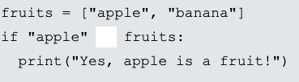

Operators Quiz
1. Print the result of 10 times 5
2. Print the result of 10 divided by 2
3. Enter the correct operator to check if ”apple” is in the fruits list
4. How do we check if x is not equal to y?
5. How do we check if at least one of these statements is correct?

Slide 31
Numbers and Numerical Types
There two numerical types used most often
Integer (int) - 5
Float (float) - 5.0
Ints and floats can be converted to any numerical type

Slide 32
Numbers Quiz
1. Can you cast an int to a float? If so, what is float(5)
2. Can you cast a float to an int? If so, what is int(5.5)

Slide 33


Random Numbers
An interesting module in python is used to randomize numbers
We will use this function to create a fun little project now

Slide 34
Dice Project
Now let’s assume you want to play Monopoly but damn, no one has any dice
Let’s write a program to let you roll as many dice as you want!
Project Guidelines
1. You must be able to roll how ever many dice you want to roll
2. You must be able to set a limit on how many sides the dice have

Slide 35

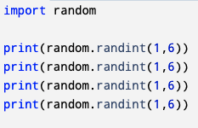
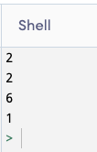
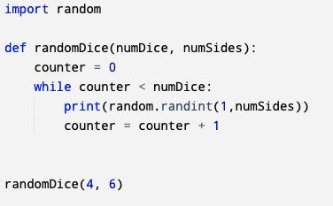
Sample Code and Output
Sample Code 1:
Sample Code 2 (more advanced, you will be able to do this by the end of the day):

Slide 36
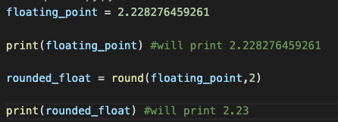
Rounding in Floats
A common theme is displaying decimal values
Often floats will print as numbers with several floating-point values
We can use the round function as follows to truncate the result
Round(value, number of decimals)

Slide 37
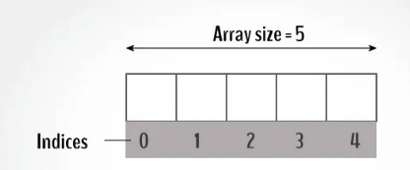
Strings and Modifying Strings
A string is basically a word or character in either single or double quotes
X = ”hello” or ‘hello’
A string is basically an “array” of characters
This means that you can index, or choose characters, into a string
For example, if x = “hello”, then x[0] is “h”

Slide 38
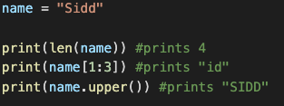

String Methods
1. Length: using the len() function we can get a string length
2. Slicing: to slice a string we can do
string[first character index: last character index + 1]
3. To make a string upper or lower case we can use .upper() and .lower()

Slide 39
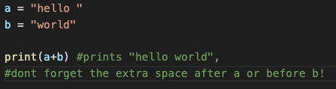
String Concatenation
Concatenation is a fancy word for saying joining
We can join two strings simply by using the “+” operator

Slide 40
More String Methods
Capitalize() – converts first character to capital
Isupper() – returns true if all characters are upper case
Islower() – returns true is all characters are lower case
Realize that any string method will return a new string not modifying the current one
More methods:
https://www.w3schools.com/python/python_strings_methods.asp

Slide 41
Second Mini Project: Bio Document
Although not as fun, this project will allow us to showcase a lot of what we have learned thus far
Project Requirements:
1. Must have 1 variable for first name and 1 for last name
1a. Must print first and last name in same line
1b. Must print initials without using extra variables
2. Must have age variable as a decimal and then print as an integer
3. Must have country of birth variable and then print in all capitals

Slide 42
Mini Project Code Review
Let’s see how everyone worked on their project’s again

Slide 43
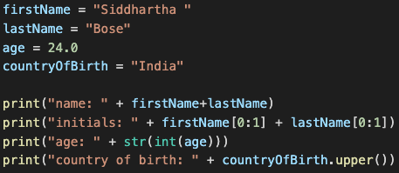

Bio Document Example

Slide 44
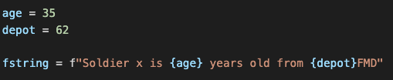
F Strings
In Python F Strings allow us to insert variables into a string
The syntax is as follows: f”string {var} string”
This allows us to concatenate a string more naturally

Slide 45

Booleans, is it true?
So Booleans refer to True and False variables
Booleans are instantiated or referred to as bool
It is important to remember that True is a Boolean while “true” is nothing. Same is for False and “false”
You can evaluate statements and have them print out as True or False

Slide 46
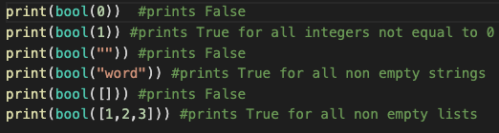
Booleans for Types
Booleans can also evaluate for different variables but almost always evaluate as True
This is often useful if you want to ensure that a data type has a value or not.
For example, if you ask for the input of a name and the input is empty, we can simply bool(input) and find out

Slide 47
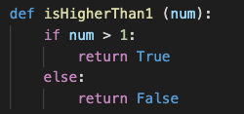
Returning Values in Functions
We will get to functions later in the workshop, but this is key
All the data types we mentioned can be used as return types
Functions can return (output) all different data types and Booleans are one of them
For example: This function returns True if the input is more than 1, and False otherwise

Slide 48
List Data Types
Python has several data types which represent sets of data in one place
The data types are lists, sets, tuples and dictionaries
Lists (list): x = [1, 2, 3]
Each item in the list can be accessed using indexing and duplicates are allowed.
Lists can have any combination of data types
Using the len() function you can find out the length of a list
.sort() will sort items alphanumerically ascending, and .sort(reverse=True) will sort items in descending alphanumeric order

Slide 49
Set Data Types
Sets, unlike lists, are unordered and therefore unindexed
A set is declared as follows: x = {1, 2, 3}
A set has no duplicate members (duplicate members will be ignored)
Sets can have any combination of data types
Items can only be added not removed
len() function can be used to determine how many members in a set
Go to https://www.w3schools.com/python/python_sets_methods.asp for more set methods

Slide 50
Tuples
A tuple is an ordered but unchangeable data type
Tuples are declared as follows: x = (1, 2, 3)
Since tuples are ordered you can access items by indexing
Tuples can hold any combination of data types and allows for duplicates
Importantly Tuples can be instantiated with only 1 item but must be declared as follows: x = (1,)
Tuples have a couple of interesting methods to use
len() tells you the length of a tuple
count() tells you how many times an item shows up in a tuple
index() tells you where an item shows up in a tuple

Slide 51
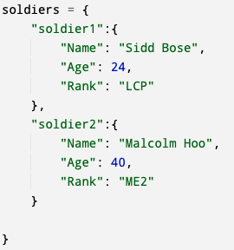
Dictionaries
Perhaps the most powerful data type mentioned thus far, dictionaries use ‘keys’ to index into them
For example, a dictionary could be instantiated as follows:
This is an example of a nested dictionary
Essentially the dictionary ”soldiers” contains:
Dictionaries for each soldier and those contain:
Name, age, rank
Soldier1’s rank can be obtained as such
soldiers[“soldier1”][“Rank”]

Slide 52
Dictionaries Continued
Dictionaries can contain any data types and are ordered
Since dictionaries rely on “keys” we cannot have duplicate keys
Like the others, we can use len() to find the number of elements in a dictionary

Slide 53
List, Set, Tuple, Dictionary Quiz
1. What is the difference between a list and set?
2. How many times can you see the same key in a dictionary?
3. Can tuples contain more than 1 data type?
A. Print the department you are from in the following list:
company = [“1”, “2”, “3”, ”34”, “HQ”]
B. Print the third item in the following tuple:
X = (1, 2, 3)
C. Declare a dictionary called bio with 3 keys: “firstName”, “lastName” and “age”
Print out age using bio

Slide 54
Control Flow: Conditional Statements and Loops
Now that much of the foundation is out of the way we can now concentrate on some interesting things
Conditional statements are part of a concept known as “control flow”
Essentially, they all the program to make decisions based on different information being passed into it
The main forms of control flow (in python) are:
If…then…else blocks
While loops
For loops

Slide 55
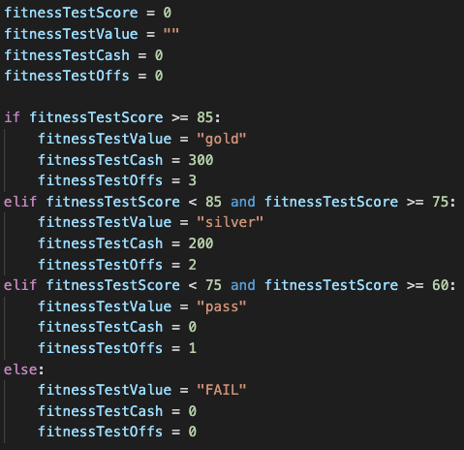
If…Else Statements
If…else statements take a condition and run some code if that condition is met
In English for example we say “if you score highly on IPPT then you will get some cash and a few days off”
In python that can be represented as shown
We also see the “elif” keyword here which is basically shorthand for “else if” which is indicating that if one condition fails, go to the next and the next in order

Slide 56

If…Else contd.
If…Else statements like most things in python rely heavily on indentation
If code is not indented properly, it will not function as intended as represented by these red lines (which warn us in advance sometimes)
Another concept is the nested if, where you can have if statements within if statements

Slide 57
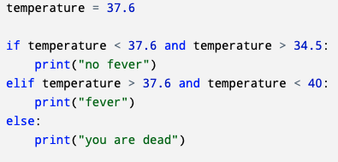

Pitfalls in If…else
Not having good enough conditions
Not having a solid enough final else condition
Poor indentation

Slide 58

While Loops
Looping is critical in control flow because it allows us to do the same set of tasks repeatedly without having to explicitly write them out
A while loop is much like it sounds
While a certain condition is met do a job
For example, in English we might say:
While you are in school, study hard and get good grades
The following is an example (in fake python) of this sentiment

Slide 59
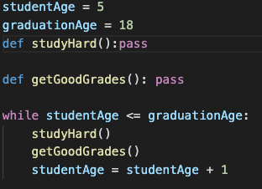
While Loops Contd
Using the fake python as an example we see a few problems
We are in an infinite loop unless we can determine when the student is out of school!
So, this leads to the concept of an “iterator”
Essentially, somehow, we must progress and get out of the loop at some point
We can fix this code as such:
Every loop of this while loop we add 1, and eventually the student age will surpass graduationAge and we will exit the loop

Slide 60
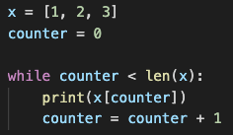
Uses for While loops
While loops allow us to do several tasks again and again or could let us go through lists and arrays as well
For example, if we have a list x = [1, 2, 3] we could use a while loop to print out every item

Slide 61
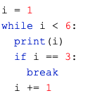
Break and Continue Statements
Break statements allow us to ensure that the loop breaks at some point
It can give us a sense of security that we will not have a loop go on forever
For example, here we see a break statement when i equals 3
Similar to break statements, continue statements essentially tell the code skip any remaining code and to go to the next iteration
What would the code output if the break was replaced with a continue?

Slide 62
Pitfalls of While Loops
Initial condition weak so we never exit the loop
No iterator so stuck in an infinite loop
Initial condition wrong so we never enter the loop
Poor indentation so logic is incorrect

Slide 63


For Loops
For loops are very similar to while loops but in python they allow you to write code in a more concise manner
For example, if we want to print out the list from the previous section, we would write it as such
You can obviously also use for loops just like while loops where you manually iterate (the range function iterates through values for you):

Slide 64
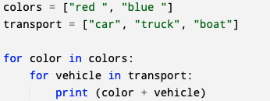
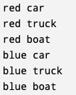
Nested For Loops
For loops, much like dictionaries can be useful when nested
For example, we can have the following:

Slide 65
Conditions and Loops Quiz
1. Given a = 10, b = 20, if a equals to b print “equal” , and otherwise print “not equal”
2. Using a while loop, print all the values from 1 to 10 except 8
3. Using a for loop, print all the elements from a list

Slide 66
Functions
So, this is the final topic for today’s workshop and in terms of coding overall it might be the most useful
Functions allow for a task, or a block of code to be encapsulated
This code is only run when it is ”called”
Functions can take inputs, usually as ”parameters” and can output either as print statements or as return values as we mentioned earlier

Slide 67
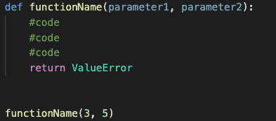
Functions Contd.
In order to declare a function the syntax is as follows:
A function can have zero or more arguments/parameters
This information can then be used or manipulated and then returned
In order to ”call” a function, we simply type the name of the function with the relevant parameters as shown above

Slide 68
Functions Quiz
1. Create a function named “function1” and make it print your name
2. Call function 1 and run the code
3. Create a function named “function2” and pass 2 parameters. Make the function print the first parameter
4. Create a function called “plus5” and pass it 1 integer as a parameter. Make the function return the integer plus 5
5. Create roll Dice functionality from earlier as a function that takes number of Sides and number of Dice as parameters

Slide 69

Inputs
Although inputting isn’t always the most important or glamorous activity, it will help us do our final project
In python, in order to accept input from the keyboard we use the input(prompt) function

Slide 70
Final Project – Rock, Paper, Scissors
Project Guidelines:
1. The game will keep score
2. The game will let you stop whenever you want to
3. The game will prompt the player for a choice and respond with the computer’s choice randomly
The user input must be a string
The code must use a dictionary to map strings to ints
4. If the player inputs a bad input, the game will warn the player and continue
5. The entire game must be a function

Slide 71
Final Project – Savings Calculator
Project Guidelines:
Function 1: Total Savings Calculator
Inputs: Age, Monthly savings amount
Output: Total amount saved at age 60 (at 5%, 7% and 10% yield)
Function 2: Monthly Savings Calculator
Inputs: Age, Total Saving Goal
Output: Monthly savings amount (at 5%, 7% and 10% yield)
The two functions should be called by a “master” function that allows the user to choose what they want to calculate

Slide 72
Thank you for attending
I have been working with python and other languages for years now and I always feel like I’m learning something
Coding and programming can become as normal for us as maths and English, and I think going forward it is only going to become more important
6AMB has a fantastic reference book “Beginning Programming with Python For Dummies” and it can be found in the Innovation room
https://singapore.kinokuniya.com/bw/9781119457893

Slide 73
Closing Remarks and Further Resources
Python is very accessible and truly is universal in applications
Using packages and libraries you have the power to do millions of tasks with only a few keystrokes
If you want to keep going with python after some further practice you could explore some of the following packages
Data visualization: matplotlib
HTTP and Network Stuff: Requests
Data Analysis and ML: Pandas
If you need any guidance or help, please email me at siddbose97@gmail.com

