Slide 1

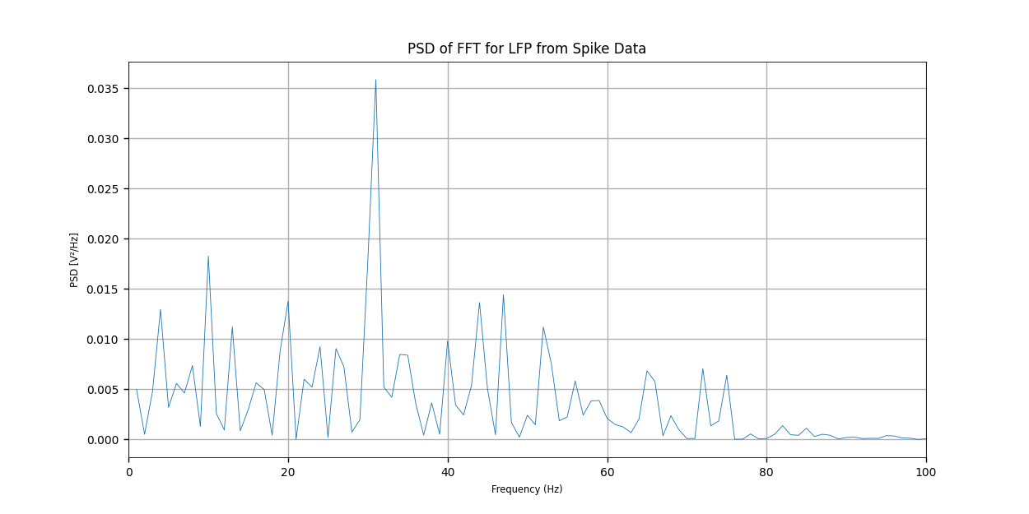
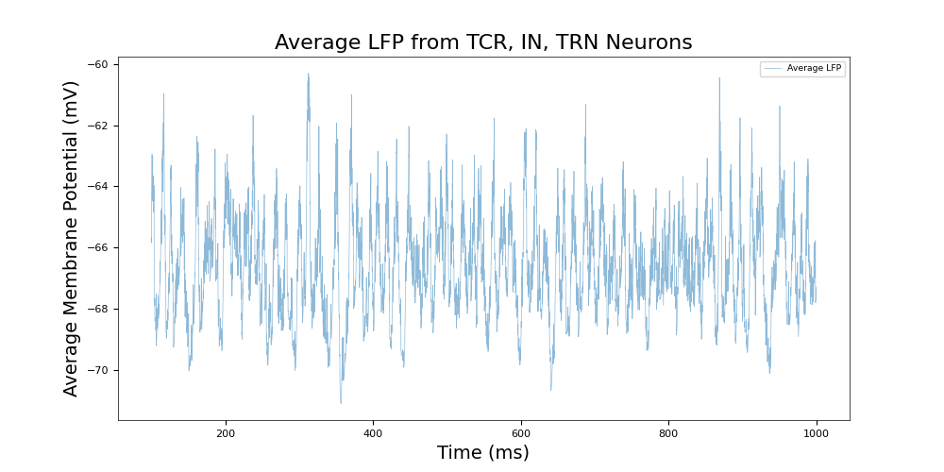

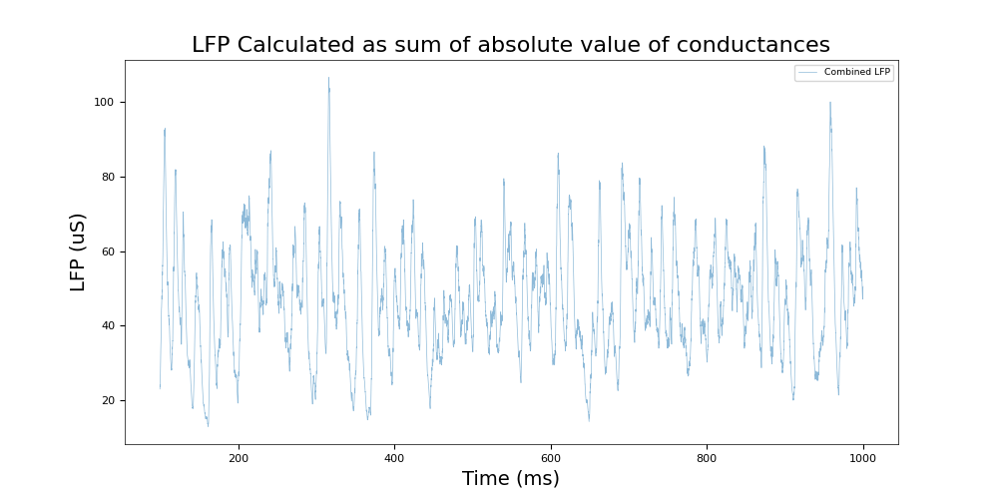
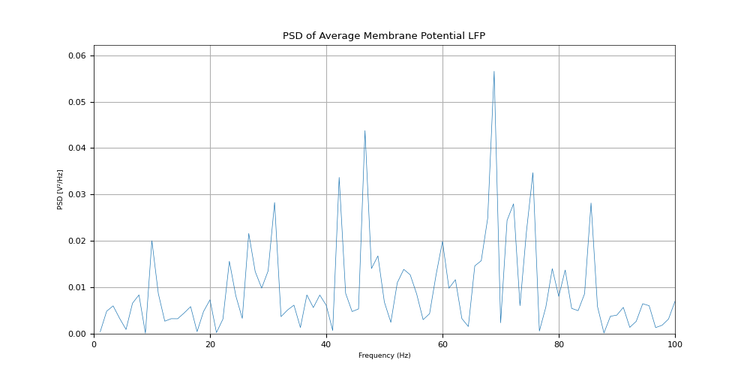
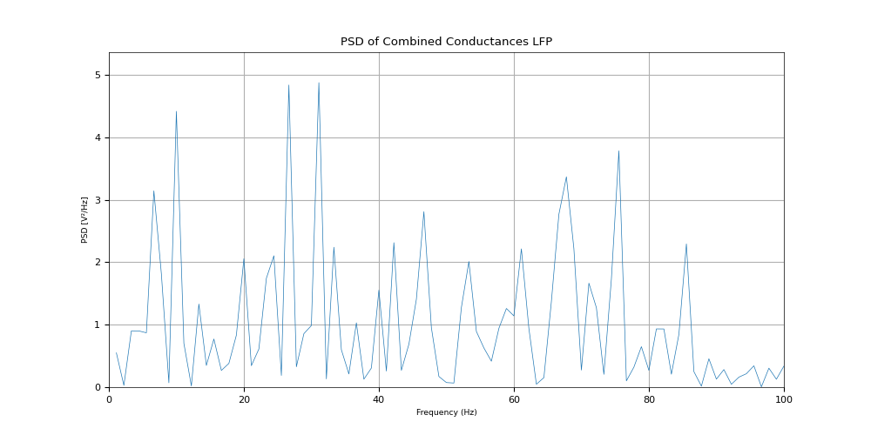
A biophysical observation model for field potentials of networks of LIF neurons
Ameya Kasture, Shaunak Damle, Siddhant Kulkarni, Sharwin Neema
{f20212058, f20212607, f20212606, f20211442}@goa.bits-pilani.ac.in
Introduction and Objectives
When both inhibitory and excitatory synapses are active at the same time, pyramidal cells behave like microscopic dipoles giving rise to dendritic field potential.
When densely packed, pyramidal cells give rise to local field potential (LFP) this eventually give rise to EEG signals which we can measure
Our Objective: By simulating Izhikevich’s Conductance neurons we want to observe the two estimates of LFP provided by Graben et al. (2013). We also want to observe the correlation between the LFP signals and the observed output spikes
Two estimates for LFP signal:
LFP expressed as average membrane potentials of the thalamocortical relay cells, thalamic interneurons and thalamic reticular nucleus cells.
LFP as sum of absolute excitatory and inhibitory conductance, since conductance is an indirect measure of membrane current.
We analysed and observed the resemblance between the various graphs in terms of peaks and troughs in LFP. We seek to prove the hypothesis that the LFPs produced above show similar properties in their plots.
Figure 5
Methodology
We have used the SpiNNaker platform to perform this simulation
We implemented the spiking neural network model of the Lateral Geniculate Nucleus (LGN)
The simulation was for 1000 milliseconds with the equations being solved at a time-step of 0.1 milliseconds.
We have used 80 thalamocortical relay cells, 20 thalamic interneurons and 40 thalamic reticular nucleus cells with the basic unit being the Izhikevich’s model of a spiking neuron
We use the Erdős–Rényi random graph to define the neural connections with specific synaptic weights
Each neuron type receives regular spikes at varying frequencies that simulate natural brain activity and random firing patterns. This setup helps to mimic real-life sensory inputs and the brain's spontaneous activity.
Plots
Results & Conclusion
Figure 1
The plot shown in Figure 1 shows the LFP calculated as the Average Membrane potential and Figure 2 shows LFP calculated as the absolute sum of excitatory and inhibitory conductances.
It can be seen that similar crests and troughs are present through time, which shows the similarly between the LFP calculated in both the scenarios.
A Fast Fourier Transform is further performed on the calculated LFP values to further analyse the similarity between the two quantities using frequency analysis.We can see from Figures 3 and 4 that the frequencies match upto some extent showing further evidence to our claim if the two quantities showing similarity.
Further, Figure 5 shows the FFT obtained from the LFP calculated from the spike data for each neuron which was made continuous using a Gaussian Kernel. We can see the similarity between this plot and the previously mentioned two FFT plots which established a positive correlation between the timings of neuronal spikes and peaks of the LFP data.
Results & Conclusion
Figure 2
Acknowledgement
A special thanks to Dr. Basabdatta Sen Bhattacharya for her invaluable guidance and mentorship throughout this assignment. We are grateful for her insights, which have enhanced our understanding and contributed to the successful completion of this assignment.
References
Figure 3
B. Sen-Bhattacharya, T. Serrano-Gotarredona, L. Balassa, A. Bhattacharya, A.B. Stokes, A. Rowley, I. Sugiarto, S.B. Furber, "A spiking neural network model of the Lateral Geniculate Nucleus on the SpiNNaker machine", Frontiers in Neuroscience, vol. 11 (454), 2017.
Graben P., & Rodrigues, S. (2013). A biophysical observation model for field potentials of networks of leaky integrate-and-fire neurons. Frontiers in Computational Neuroscience, 6, 100.
Mazzoni, A., Panzeri, S., Logothetis, N. K., & Brunel, N. (2008). Encoding of naturalistic stimuli by local field potential spectra in networks of excitatory and inhibitory neurons. PLoS computational biology, 4(12), e1000239.
Aditya Agarwal (2023). Linking Local Field Potential with Spikes [Unpublished bachelor’s thesis]. Birla Institute of Technology and Science, Pilani K.K. Birla Goa Campus.
Figure 4

