Slide 1
STEP2SCREEN
By SIDDESH

Slide 2

See the video for better understanding

Slide 3
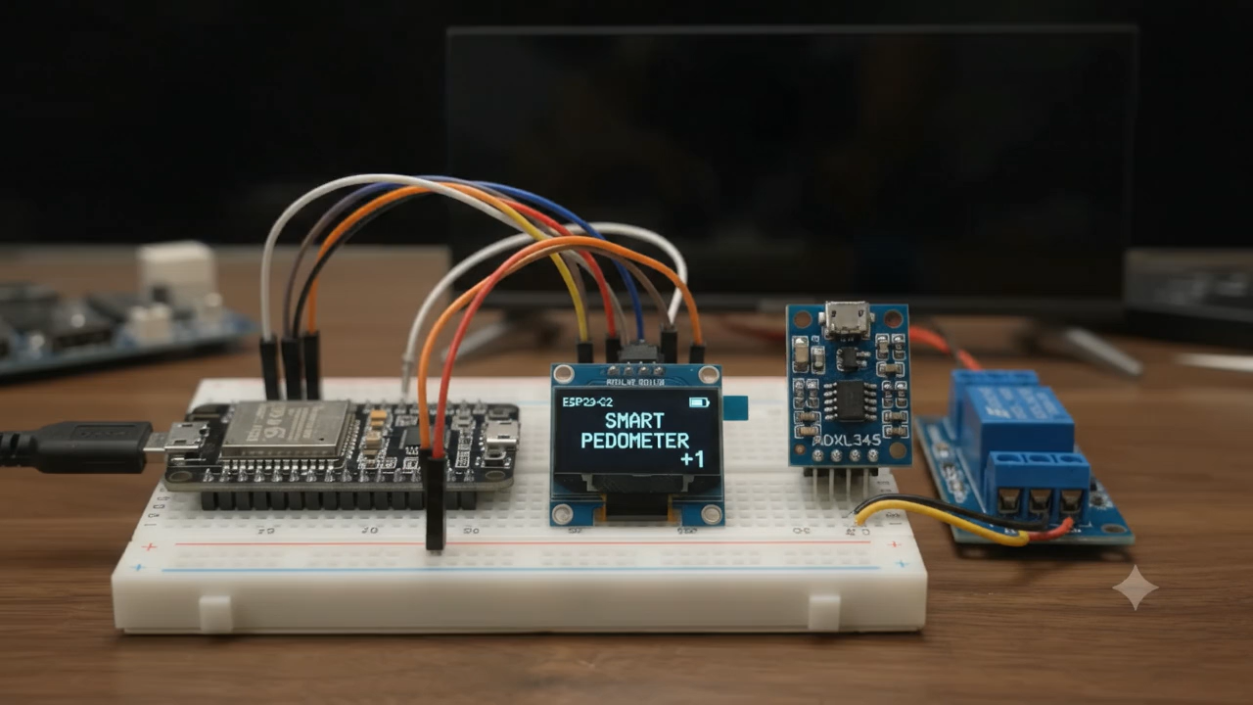

Slide 4
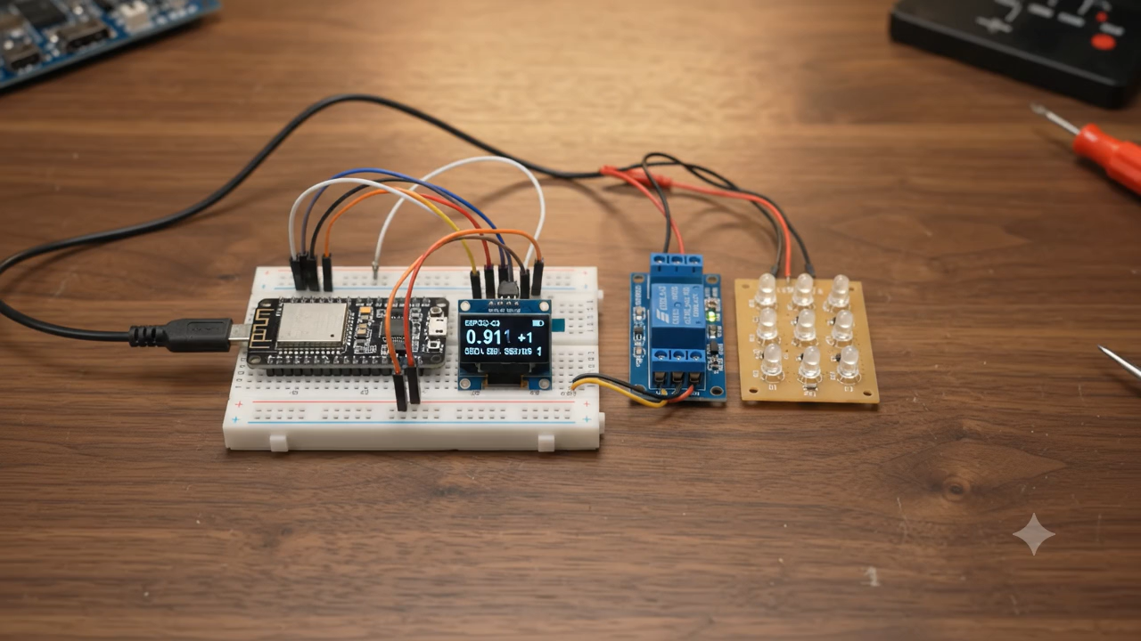

Slide 5
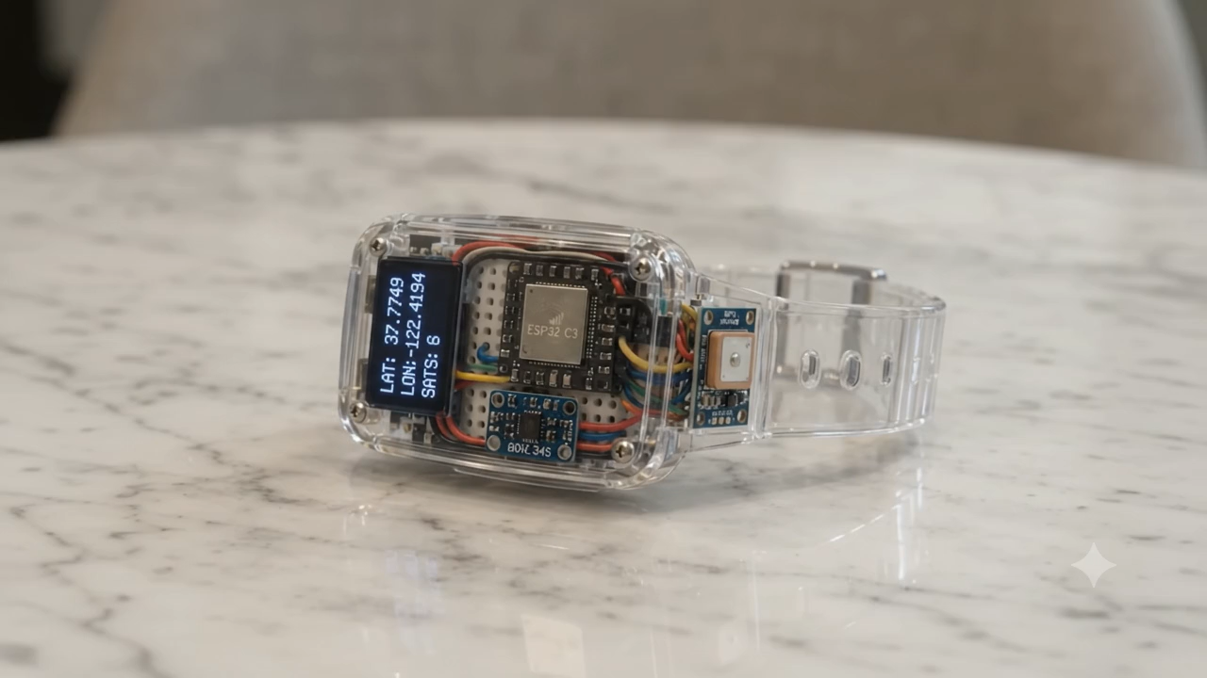

Slide 6
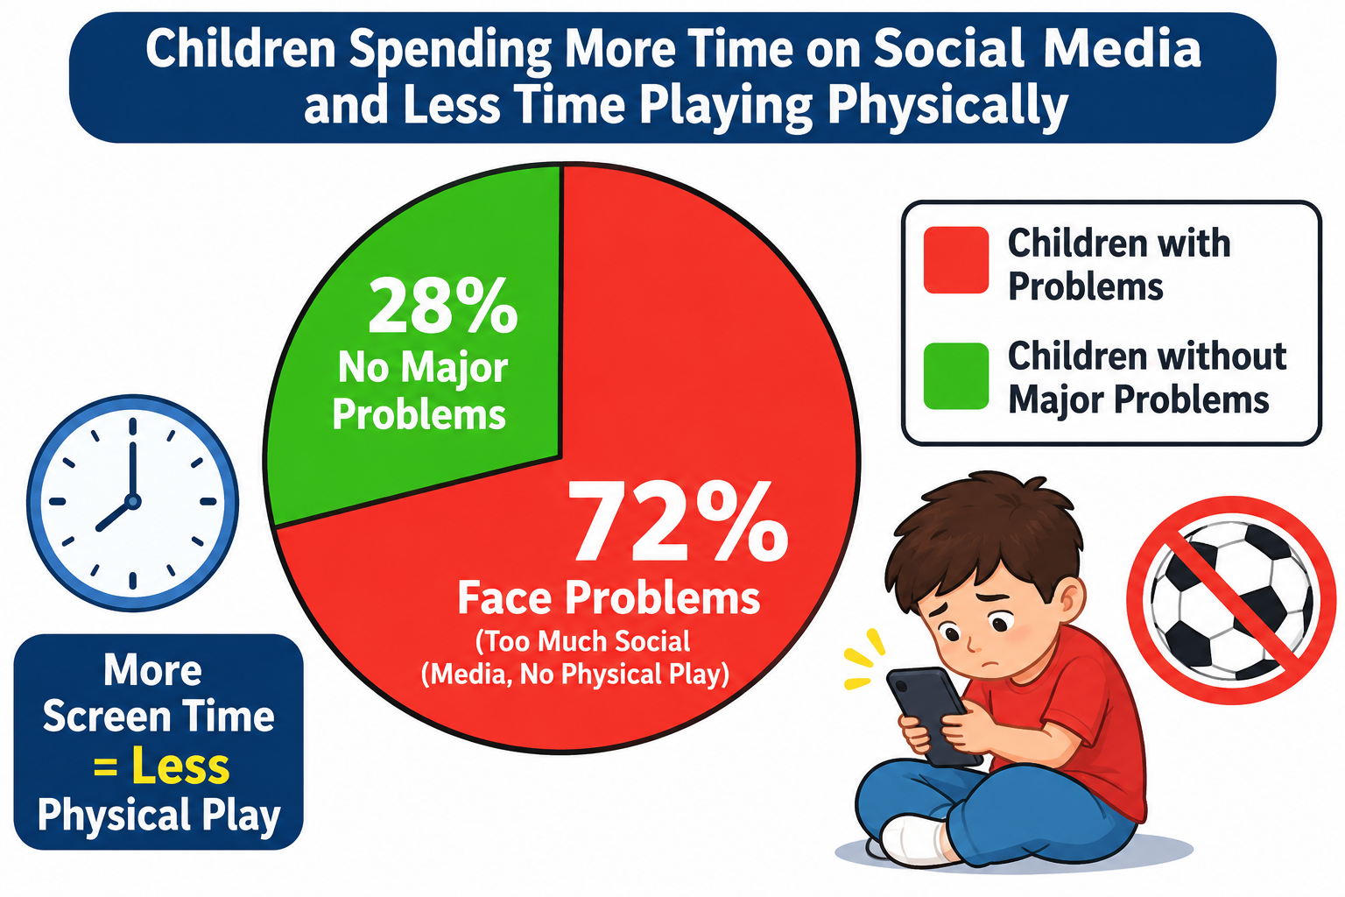
OBJECTIVE

Slide 7
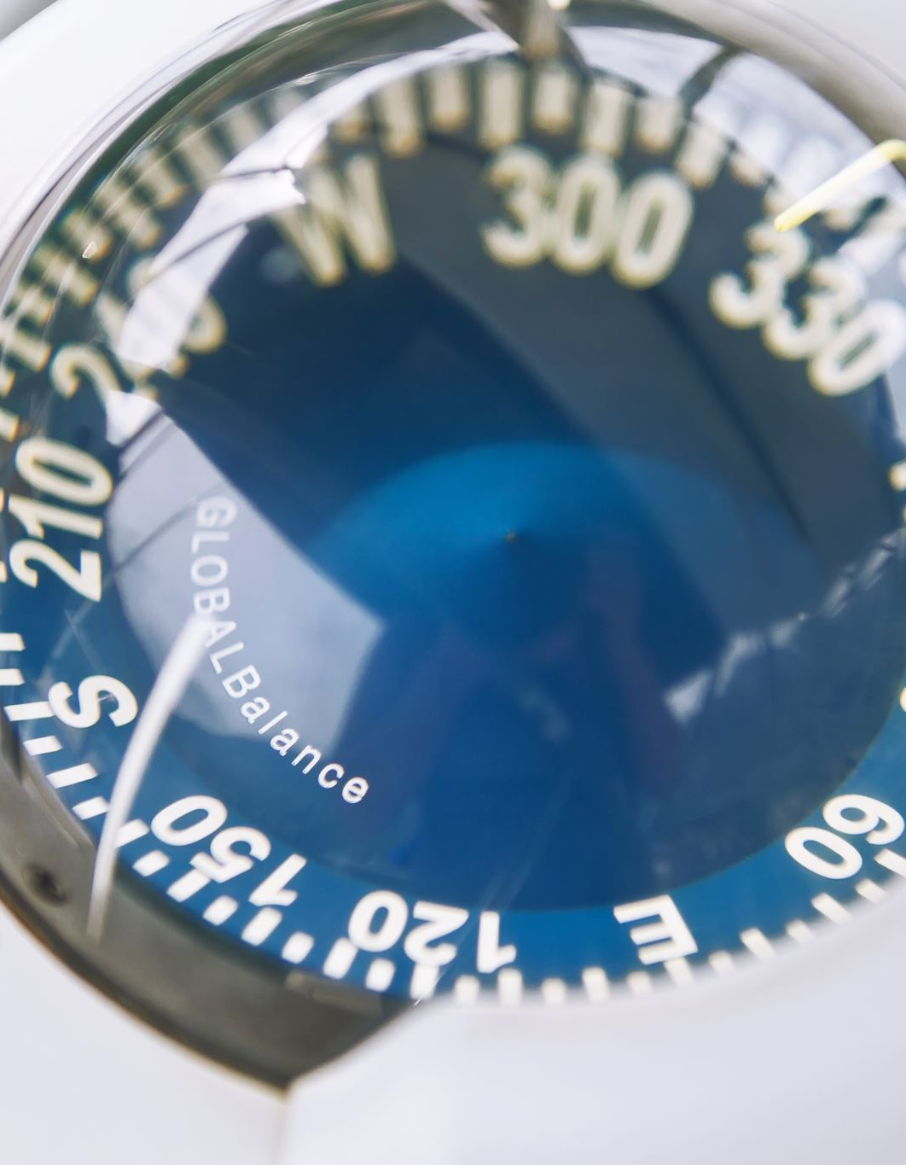
OBJECTIVE
..To design and develop a smart wearable watch using an ESP32-C3 microcontroller.
To use the ADXL345 accelerometer to detect wrist movements and shaking.
To display the shake count in real time on a 0.91-inch OLED display.
To encourage children to take breaks from prolonged TV, mobile and computer usage.
To promote physical movement and healthier daily habits through a simple counting system.
To connect a relay module to demonstrate controlling a TV through the watch.
To develop an affordable, simple and user-friendly prototype that can encourage children to balance screen time with physical activity.

Slide 8
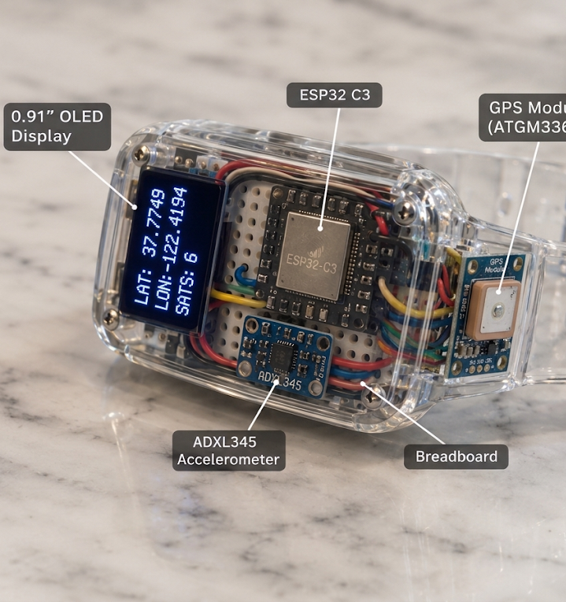

Planed Prototype

Slide 9
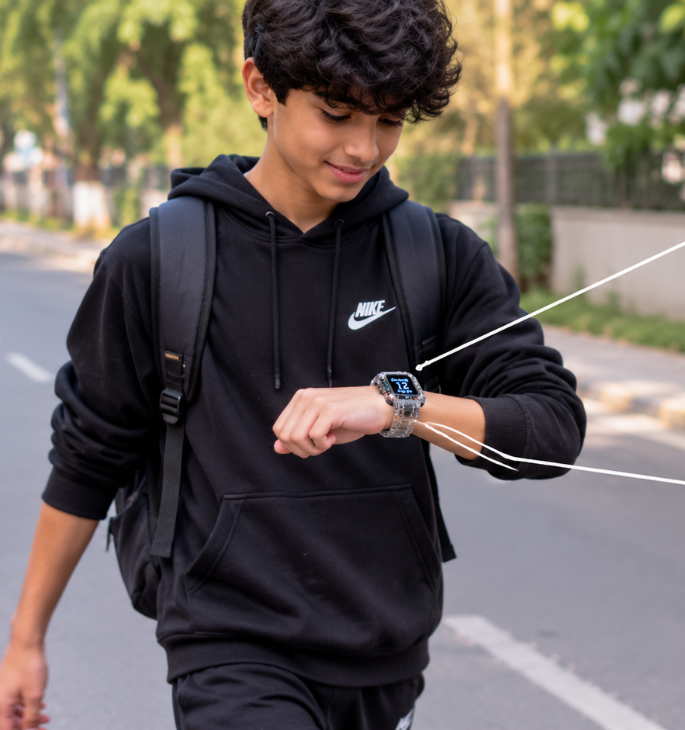
First, it records the steps and physical activites of us

Slide 10
And memorizes the steps in its chip

Slide 11
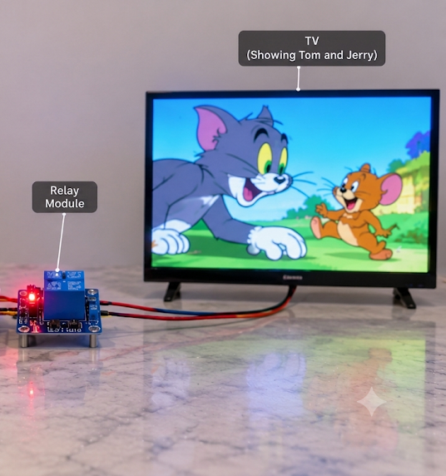
Then when we connect it to a tv like the follg

Slide 12

Enjoy time
Then as much steps we took we can use the tv for that much time

Slide 13
EXPECTED OUTCOME
The expected outcome is a functional wearable prototype that counts detected wrist movements, displays the count in real time and demonstrates relay-based TV switching.
The project is intended to promote awareness of physical activity and balanced screen habits. It is an educational prototype, not a medical device or an automatic treatment for screen-related health problems.

Slide 14
ImprovemTIMRRRRPeOOOOOnt going to happen

Slide 15

Thank you
Respected

