Slide 1


QueryLayer
AI generated backends in minutes
Build your backend without writing backend code.
DEVELOPER TOOL

Slide 2

The Backend Is Still a Time Sink
Days Lost on Infrastructure
Repetitive by Design
Authentication, permissions, and CRUD endpoints are boilerplate but every project rebuilds them from scratch.
Developers spend days wiring up APIs, auth, and database schemas before writing a single line of product logic.
Innovation Blocked
Time spent on infrastructure is time not spent on features, users, and product-market fit.

Slide 3

THE SOLUTION
Describe Your App. Get a Backend.
QueryLayer generates a complete, production ready backend from plain English. No schema design. No endpoint wiring. No auth boilerplate.

Slide 4
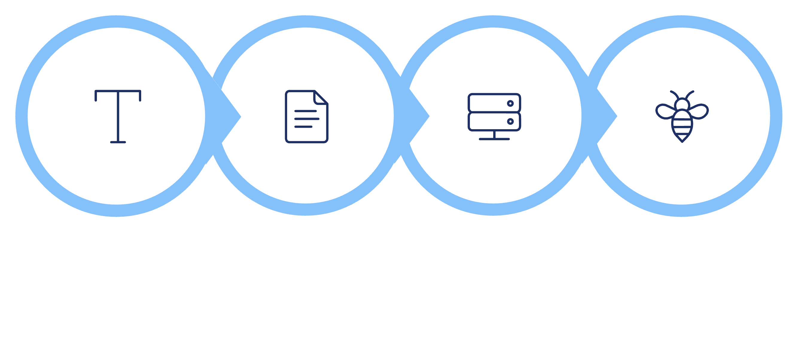




How It Works
Four steps from idea to live backend, no manual setup required.
Generate Spec
Create Backend
Natural Input
Live APIs
From a sentence to a fully functional backend in under a minute.

Slide 5


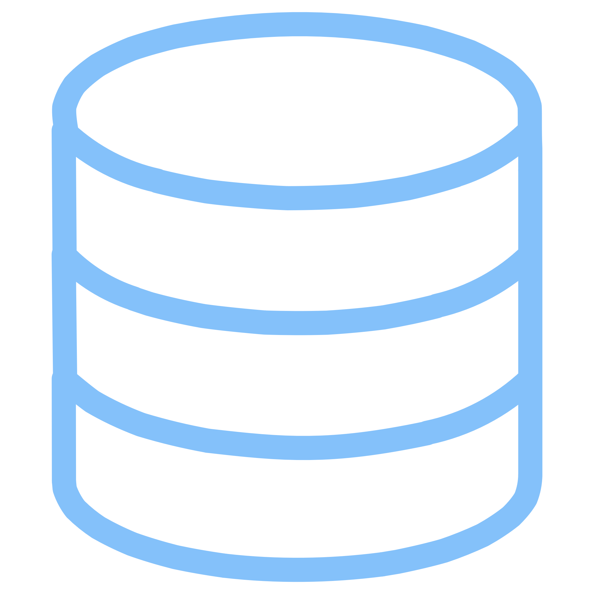

Everything You Need, Nothing You Don't
REST APIs
Auth & JWT
Fully documented endpoints generated and live from the first request.
Built-in authentication with secure token management no third-party deps.
Database Schema
Access Control
Entities and relations inferred from your description. Migrations handled automatically.
Role based permissions baked in. Define who can read, write, and delete.

Slide 6

Why Now
AI Can Finally Design Systems
LLMs now understand structured system design well enough to generate accurate, consistent backend specs.
Developers Demand Speed
Ship faster or lose. The iteration cycle is the competitive advantage backend setup is a bottleneck.
Existing Tools Fall Short
Supabase, Firebase, and Hasura still require manual schema work and configuration. QueryLayer skips all of it.

Slide 7



The Vision
Backend as a Thought
Make backend development invisible. Let developers focus entirely on product and user experience not infrastructure plumbing.
Describe it. It exists.
The Infrastructure Layer
INFRASTRUCTURE FOR AI-NATIVE APPS
QueryLayer becomes the default backend for AI native applications.
Every Developer, Every Stack
Frontend only teams ship full-stack products.

Slide 8
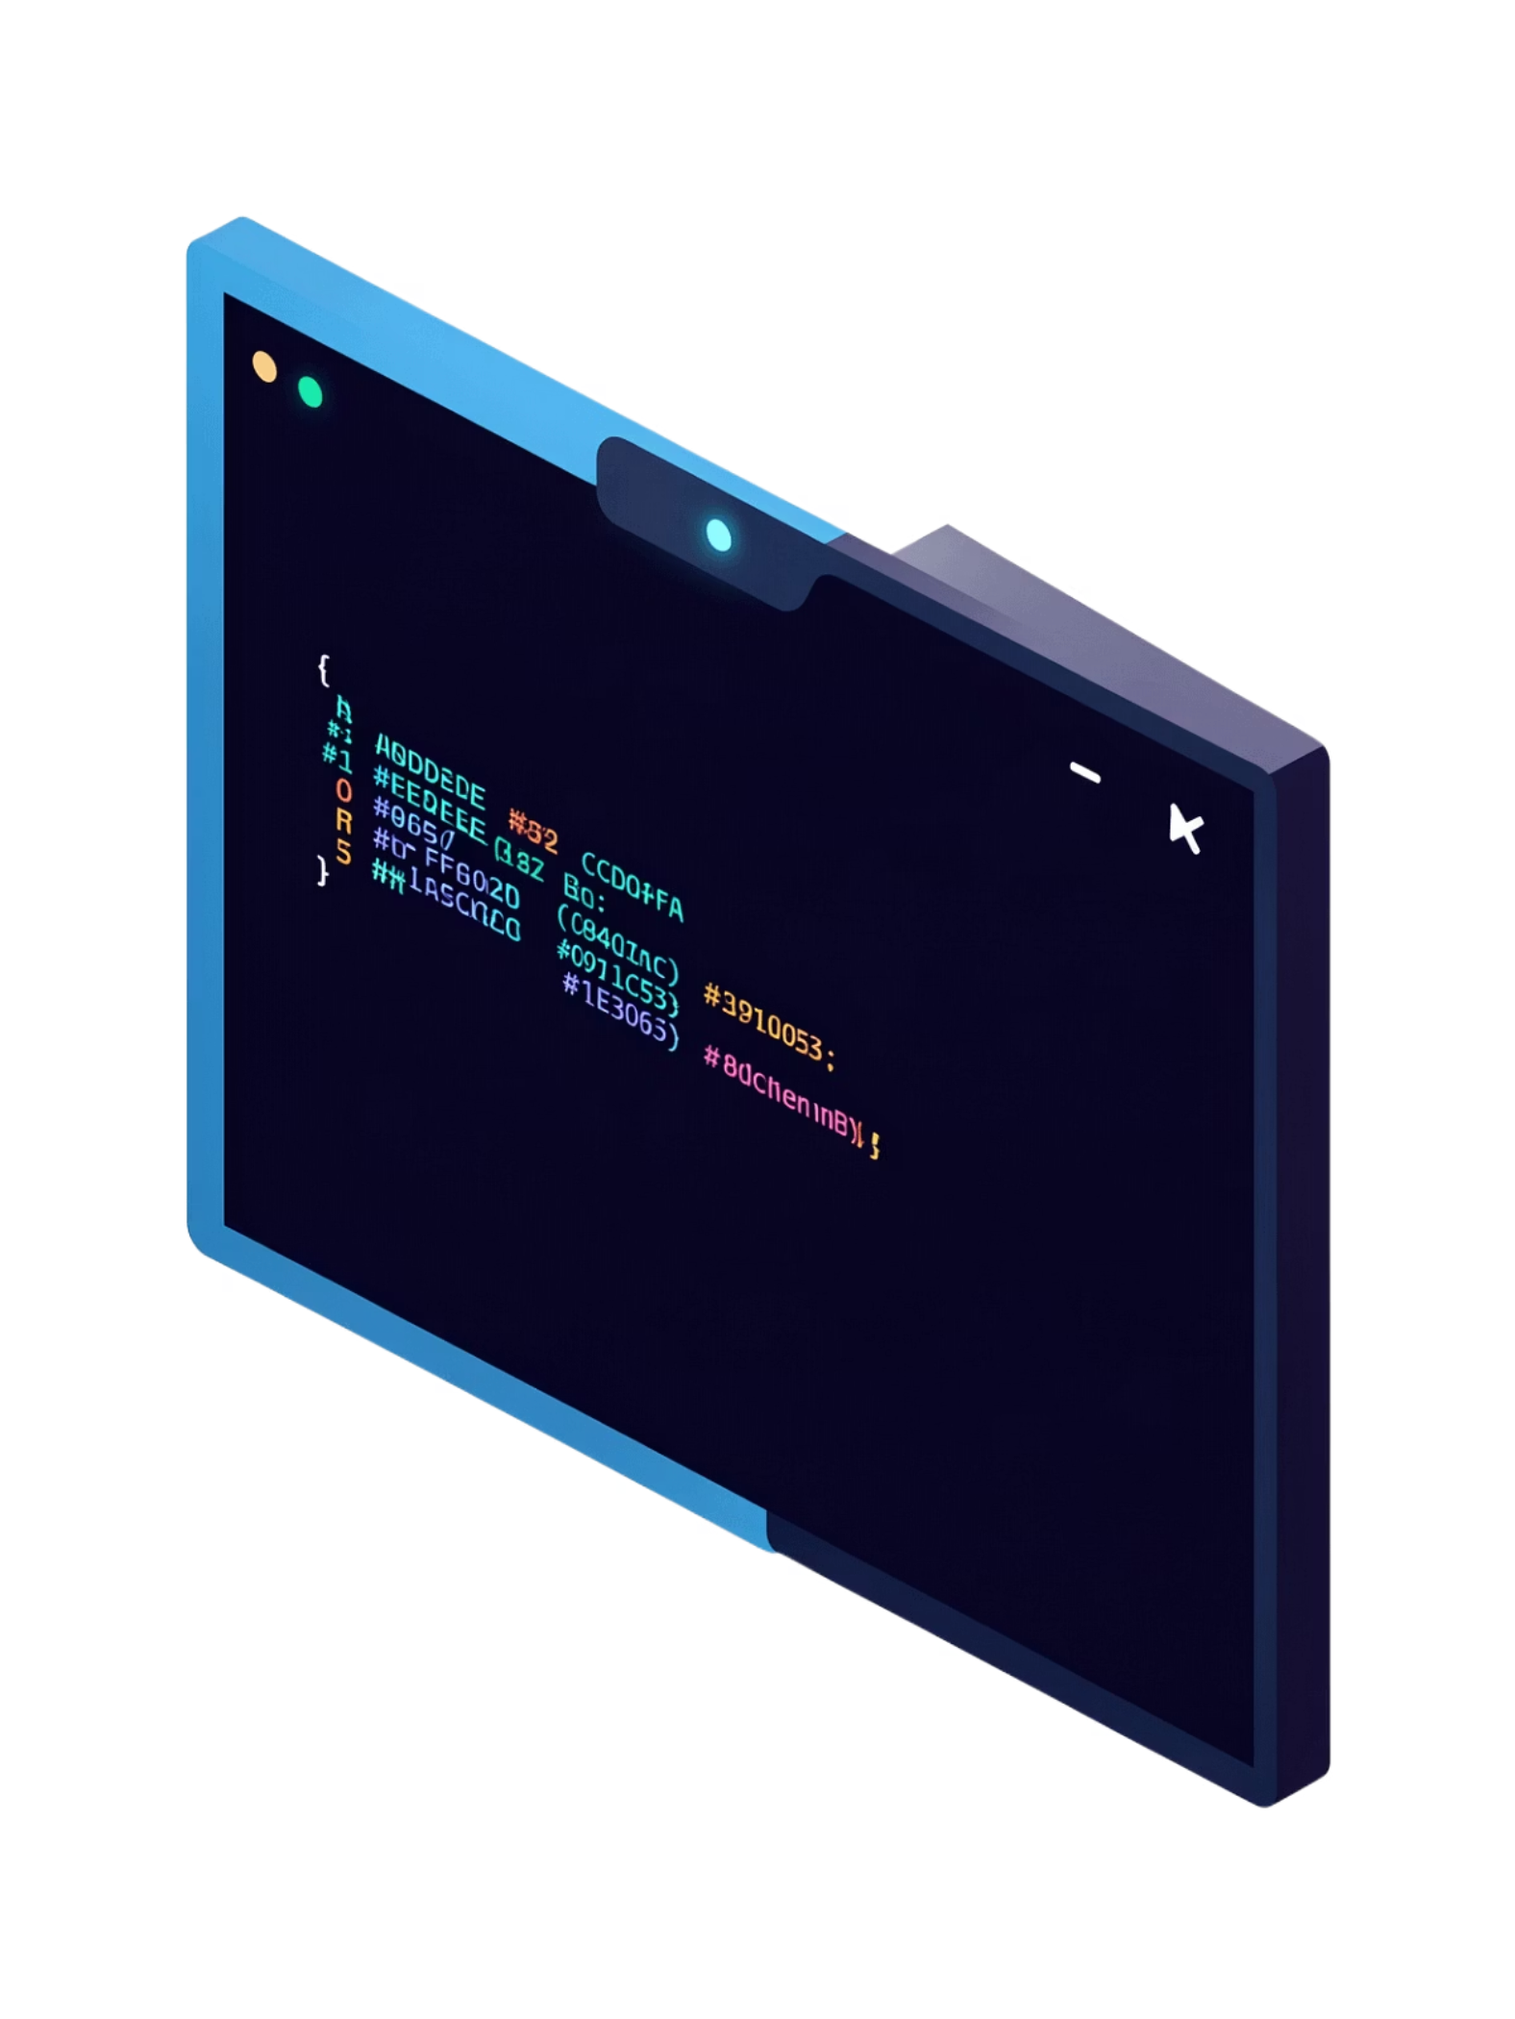

Start Building in Minutes
QueryLayer is in early access. Join the waitlist and be among the first to ship without a backend.
🌐 Try the Demo
📄 Read the Docs
See a backend generated from a single sentence.
Full API reference and integration guides.
✉️ Get Early Access
Limited spots for founding users.
QueryLayer an AI-generated backends in minutes. querylayer.ai

