Slide 1


THE AIRBNB CLASSIFICATION PROJECT

Slide 2



Chenyu Tian
Priyanka Batavia
Siddharth Mandgi

Slide 3

Introduction
A‌i‌r‌b‌n‌b‌, ‌headquartered in San Francisco, operates a global online marketplace and hospitality service accessible via its websites and mobile apps. Members can use the service to arrange or offer lodging, primarily homestays, or tourism experiences
Airbnb is an online marketplace which lets people rent out their properties or spare rooms to guests. Airbnb takes 3% commission of every booking from hosts, and between 6% and 12% from guests
New users on Airbnb can book a place to stay in 34,000+ cities across 190+ countries. By accurately predicting where a new user will book their first travel experience, Airbnb can share more personalized content with their community, decrease the average time to first booking, and better forecast demand.

Slide 4
Data
Our dataset is taken from Kaggle
The dataset is taken from a recruiting competition, Airbnb challenges the participants to predict in which country a new user will make his or her first booking
There are 19 variable's in our dataset
For the destination country there are 12 outcomes
The test dataset consists of various attributes like ID, gender, age, date_first_booking, signup_method, signup_flow, language, affiliate_channel, country_destination (which is the target variable to be predicted)
,

Slide 5
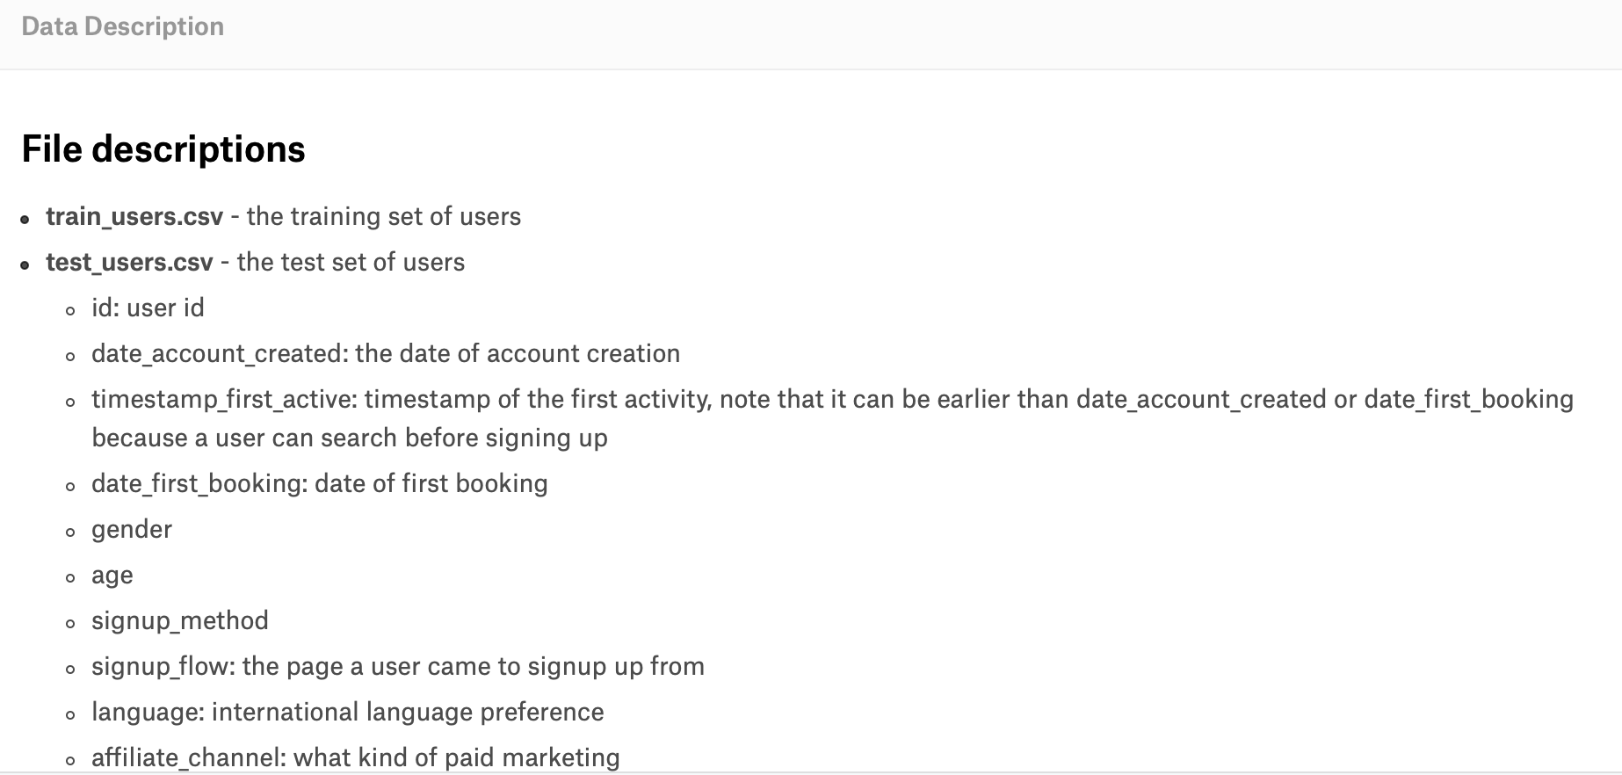

Slide 6
Details and Main features in our data.
id: | Value Type: Char | Gender | Value Type: Char | first_device_type | Value Type: Char
date_account_created | Int | Age | Int | first_browser | Char
timestamp_first_active: | float | signup_method | Char | affiliate_provider | Char
date_first_booking: | Int | signup_app | Char | affiliate_channel | Char

Slide 7
Stages of Our project
Our Project is Divided into Four Stages.
Data Analysis and Visualisation
Data Preprocessing
Binary Classification
Multi-Classification

Slide 8
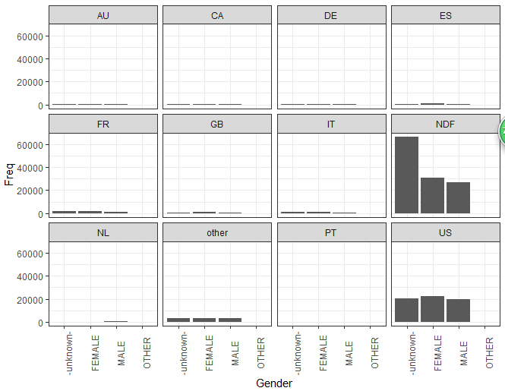
Data Visualization and Analysis
Notes:
The first Visualization gives us the frequency count of gender wise for every country. We can see that the highest count is for the US. (NDF means no destination found and there wasn’t a booking)

Slide 9
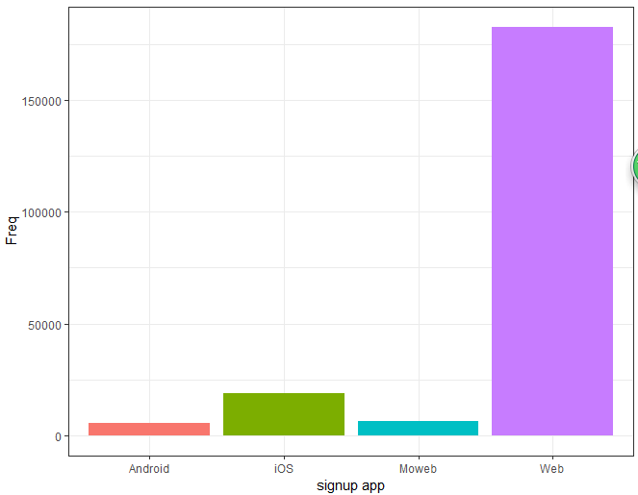
Data Visualization and Analysis
Notes:
In the second visualization we can see the sign up method every user uses to book an Airbnb. Most of the users use their web browser to book the Airbnb

Slide 10
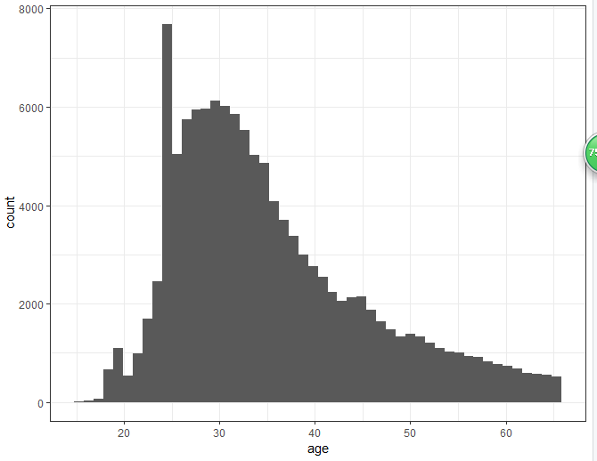
Data Visualization and Analysis
Notes:
The last Visualization gives us the distribution of count categorized by age of all the users. The mean age for an average user is between 35-40

Slide 11
Data Analysis for Visualization
The packages used for our visualizations were tidyverse, ggplot and data.table
The first Visualization gives us the frequency count of gender wise for every country. We can see that the highest count is for the US. (NDF means no destination found and there wasn’t a booking)
In the second visualization we can see the sign up method every user uses to book an Airbnb. Most of the users use their web browser to book the Airbnb
The last Visualization gives us the distribution of count categorized by age of all the users. The mean age for an average user is between 35-40

Slide 12
Data Preprocessing.
Removing columns which adds minimal value e.g: - date_first_booking
Replacing the missing values with mean for numerical columns.
Omitting the missing values which affect the categorical data
We have then split some columns to increase its relevance and meaning e.g :- splitting date_account_created in year, month and day and split timestamp_first_active in year, month and day

Slide 13
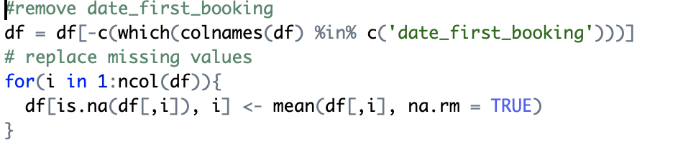
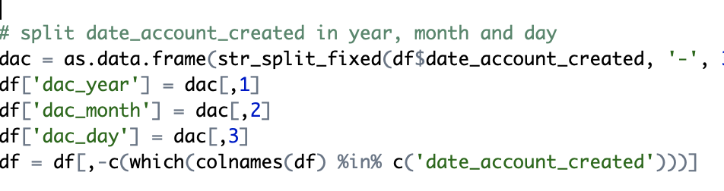
Data Preprocessing.

Slide 14
Data Preprocessing
ONE HOT ENCODING.
One hot encoding is a process by which categorical variables are converted into a form that could be provided to ML algorithms to do a better job in prediction.
We use one hot encoder to perform “binarization” of the category and include it as a feature to train the model.
In Our project we have created binary labels for our target variable country_destination and split them into several target variables i.e - each country has a label ‘1’ or ‘0’.

Slide 15
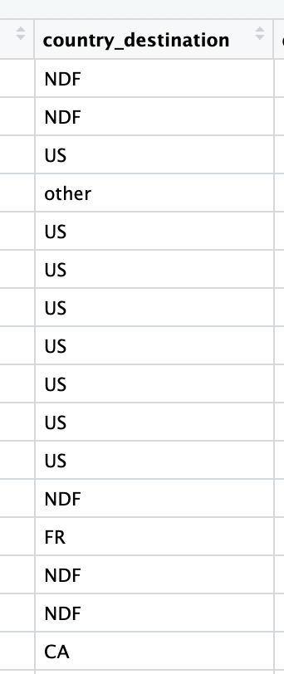
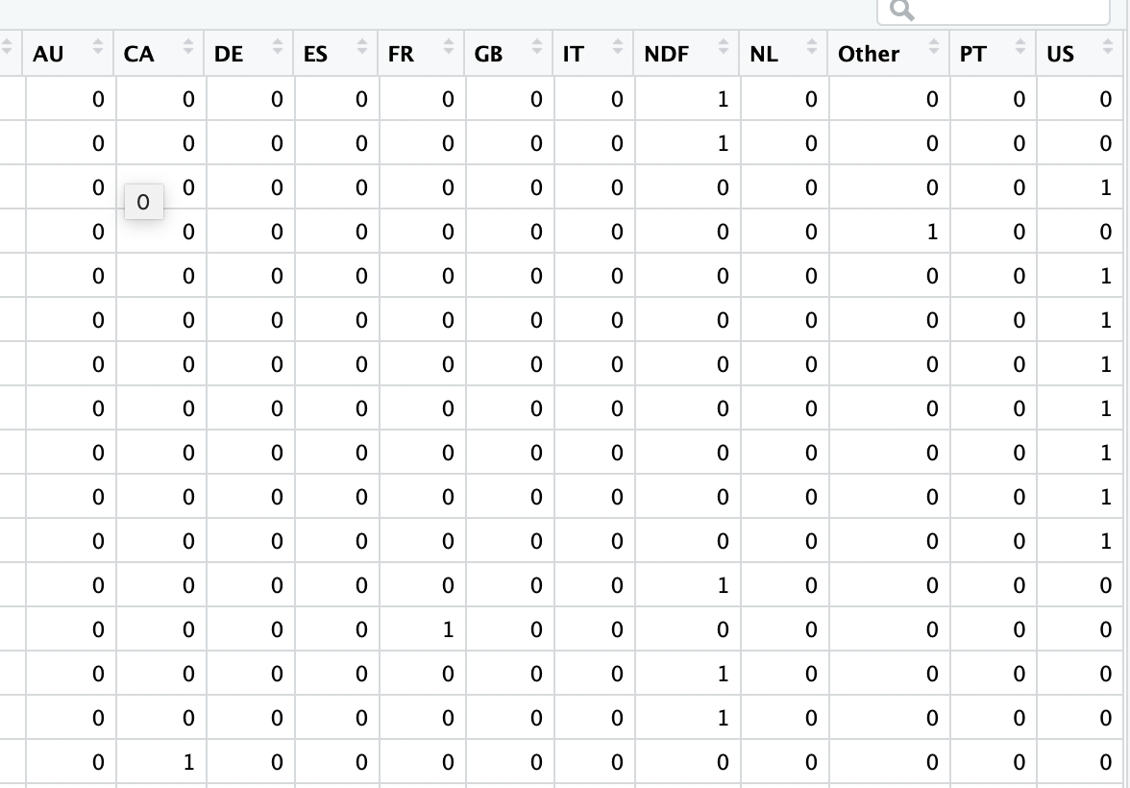
Data Preprocessing
ONE HOT ENCODING

Slide 16
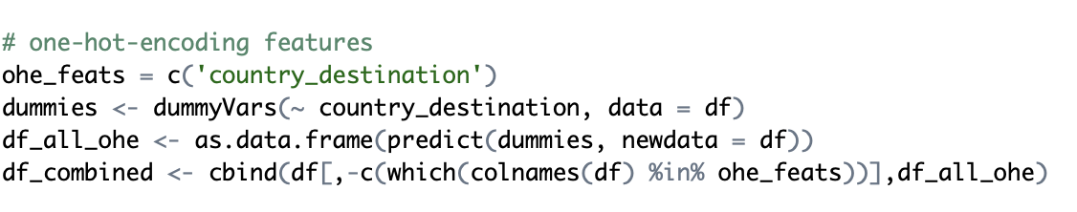
Data Preprocessing
ONE HOT ENCODING

Slide 17
Models used for Analysis
NAIVE BAYES
KNN
ARTIFICIAL NEURAL NETWORKS (ANN)
RANDOM FOREST
C50
MULTI-CLASSIFICATION

Slide 18
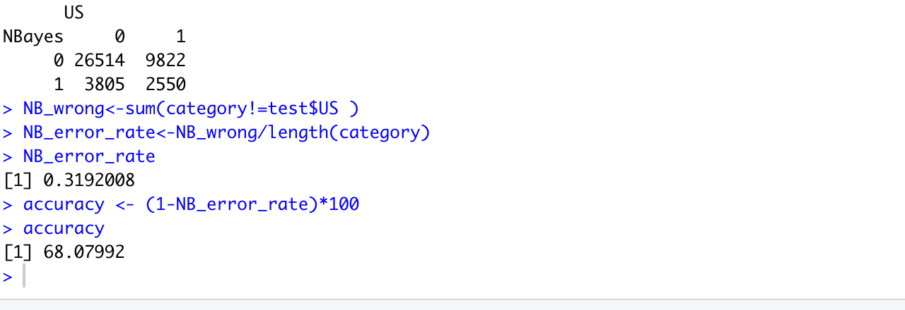
NAIVE BAYES
We have used 100% of our data while applying this model

Slide 19
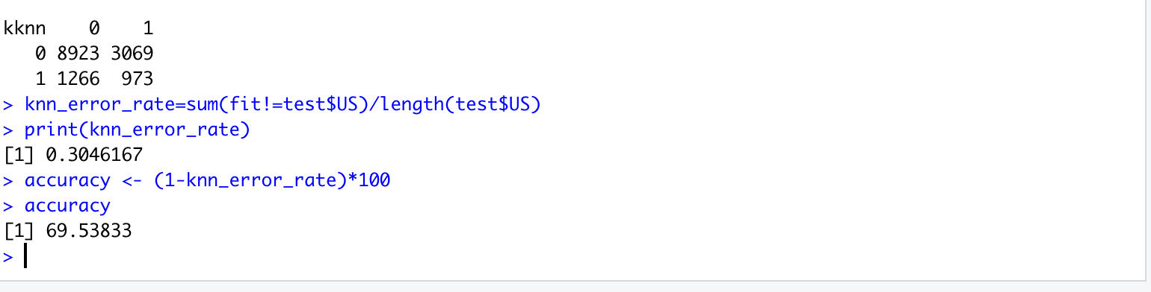
KNN
We have used 33% of our data while applying KNN
The main attributes considered were: Gender, Age, dae_year,tfa_year

Slide 20
ANN
We have used 50% of the data while applying this model
The main attributes considered were: Gender, Age, dae_year,tfa_year

Slide 21
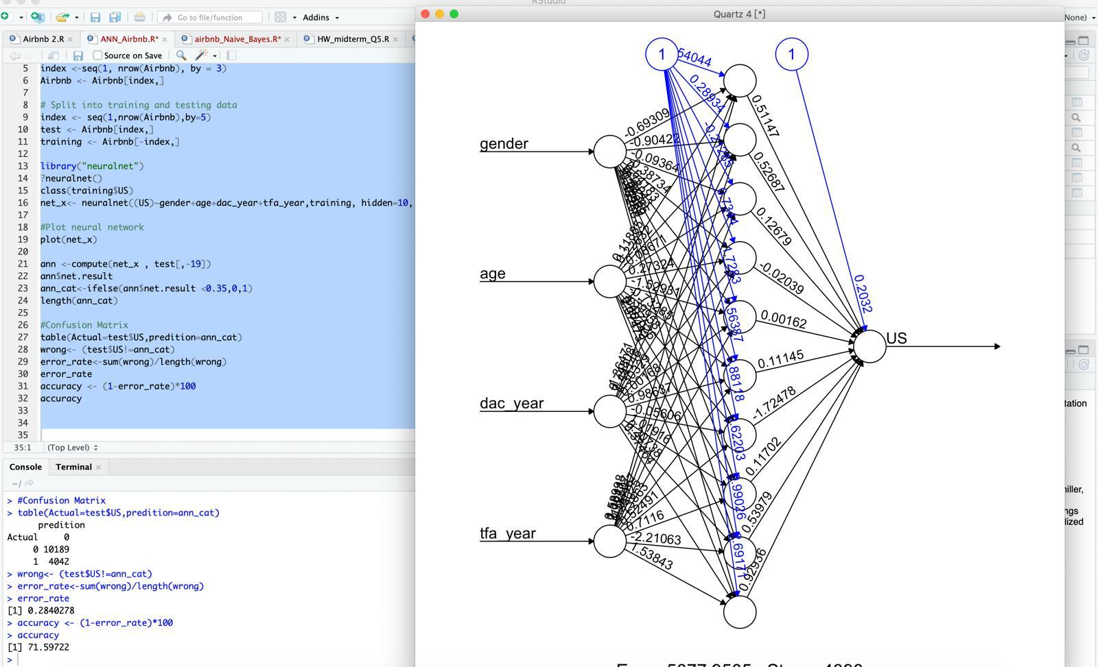
ANN

Slide 22
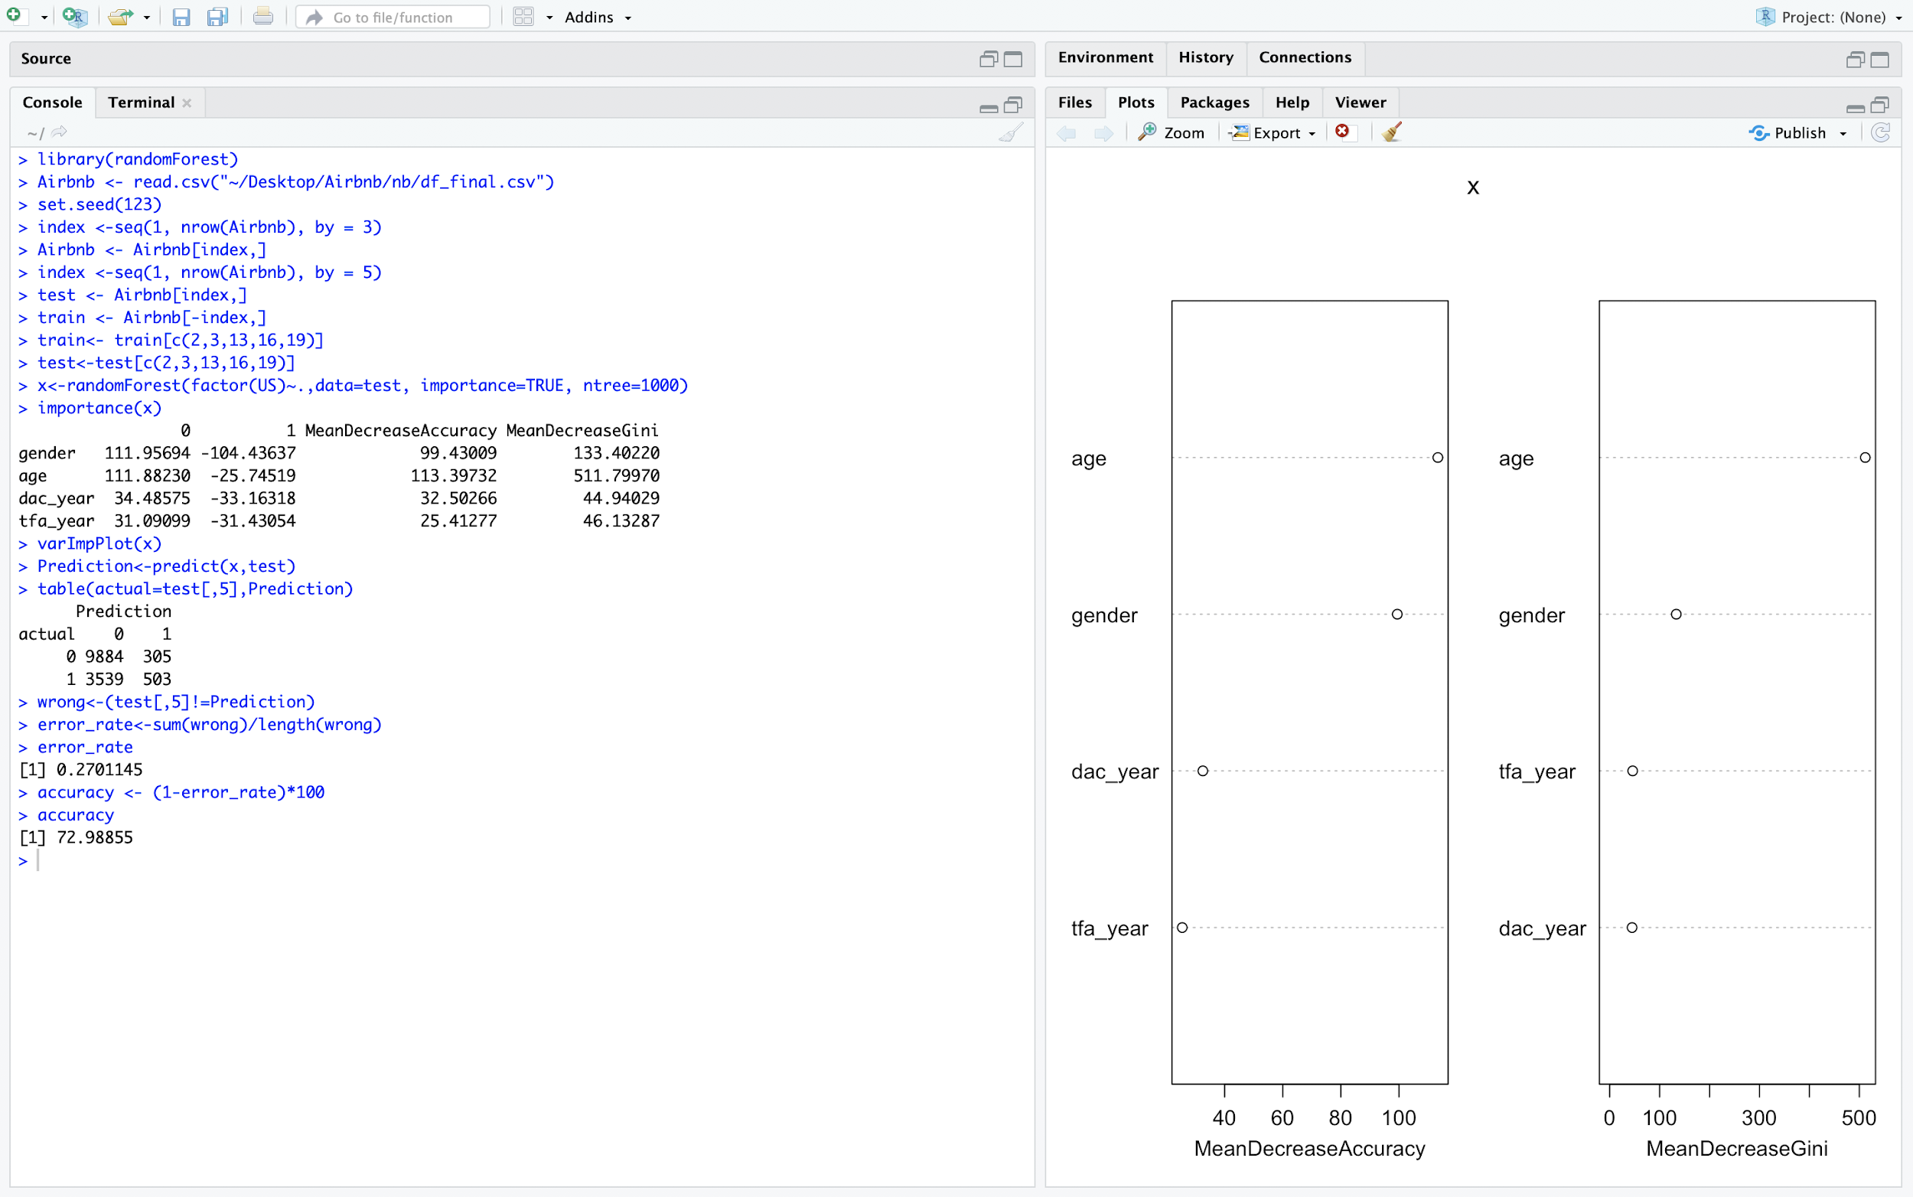
RANDOM FOREST

Slide 23
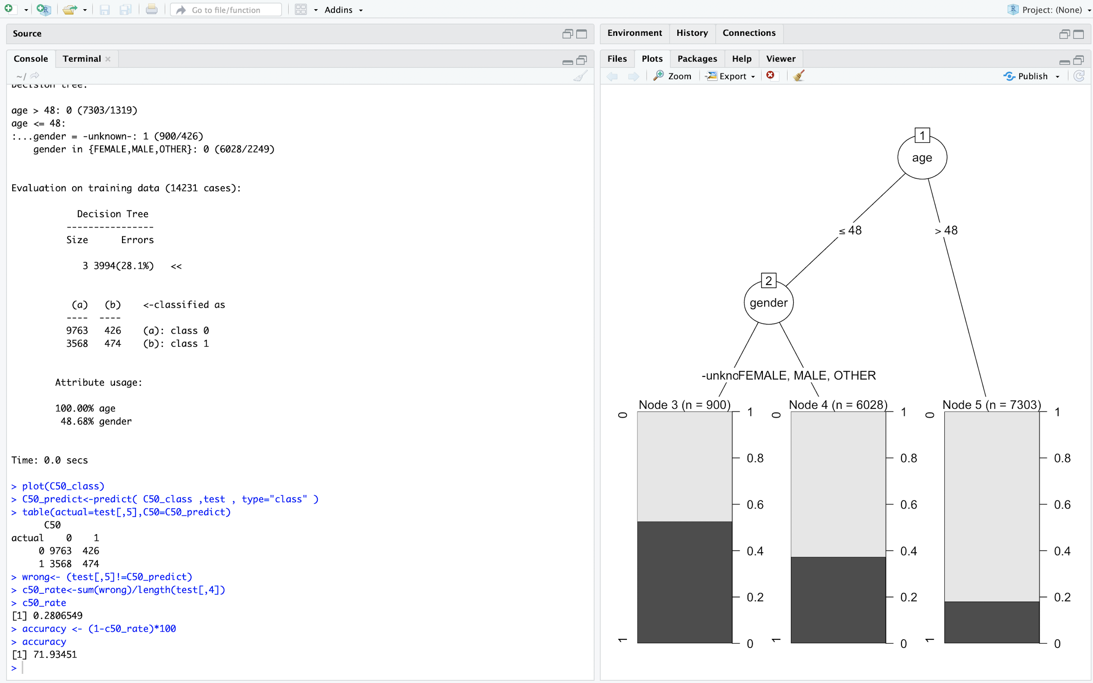
C50

Slide 24
Comparing accuracies of different models
MODELS | ACCURACIES
NAIVE BAYES | 68.07992
KNN | 69.53833
ANN | 71.59772
RANDOM FOREST | 72.98855
C50 | 71.93415

Slide 25
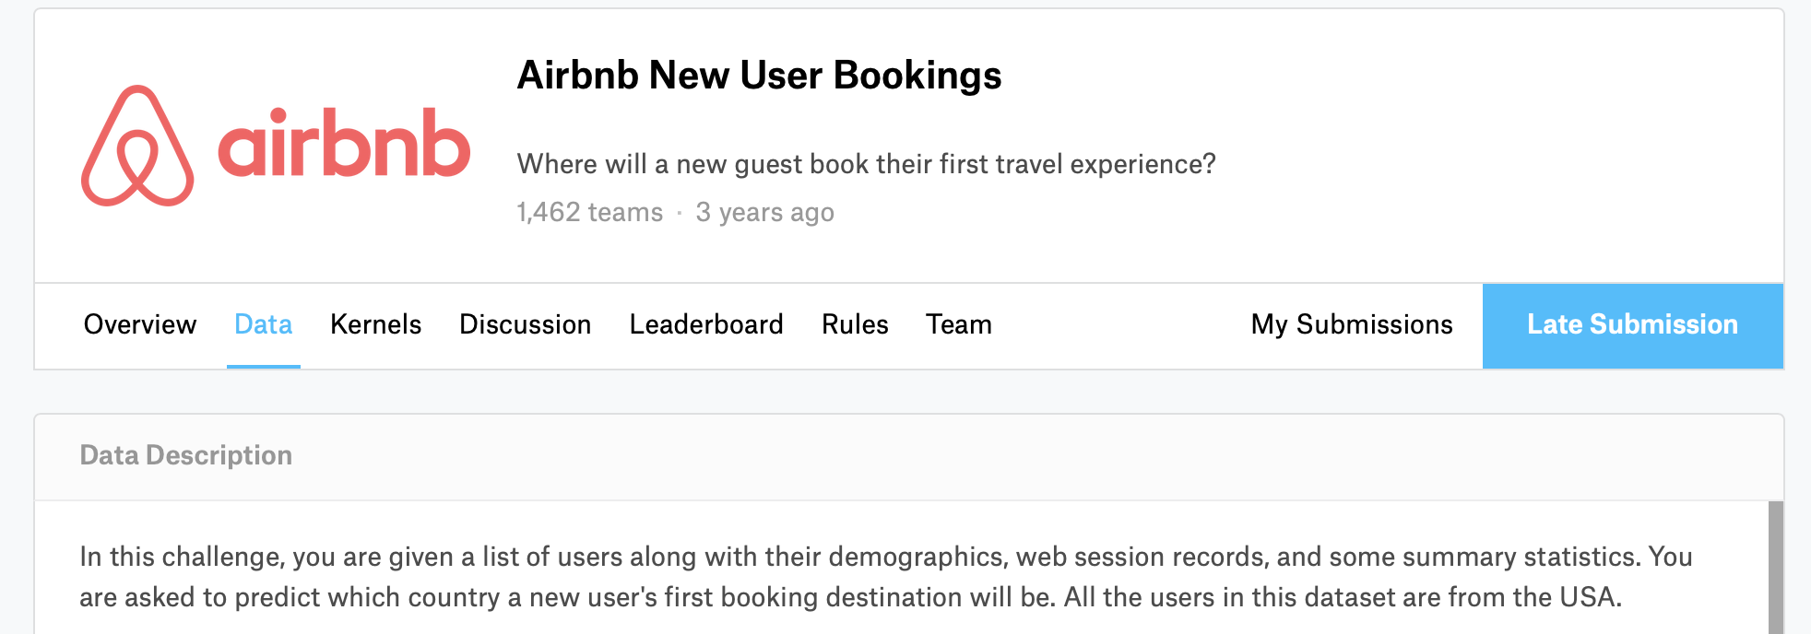
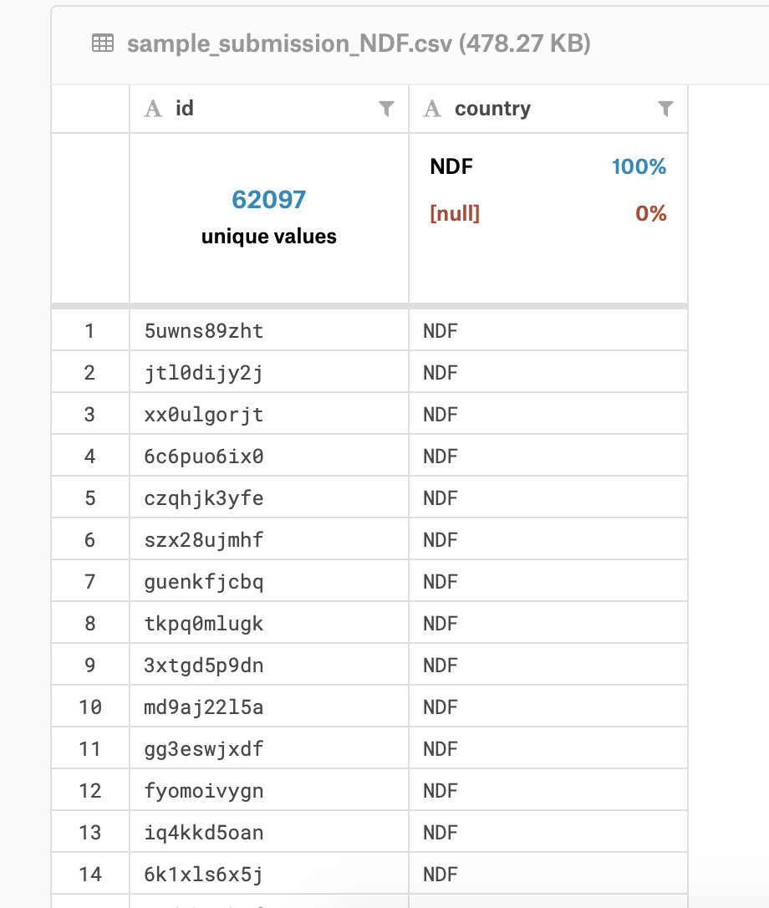
Multi-Classification
A classification task with more than two classes; e.g., classify a set of images of fruits which may be oranges, apples, or pears. Multi-class classification makes the assumption that each sample is assigned to one and only one label: a fruit can be either an apple or a pear but not both at the same time.
The challenge in Kaggle was to classify the destination for each particular user.

Slide 26
Multi-Classification
We have used the library Xgboost for this purpose
XGBoost is an algorithm that has recently been dominating applied machine learning and Kaggle competitions for structured or tabular data. XGBoost is an implementation of gradient boosted decision trees designed for speed and performance
We have used XGBoost because it is way more faster than the existing gradient boosting applications and supports various objective functions including classification and ranking

Slide 27
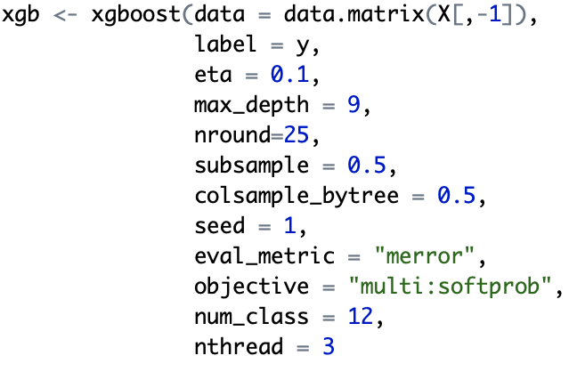

Multi-Classification

Slide 28
Conclusion
Data Visualisation :-
There are more number of females booking an Airbnb
The Average age people booking ranges from 30 - 40 years
The most used signup platform is a Web Browser (Safari , Chrome etc.)
From binary classification we can conclude that Random Forest Classifier works the best.

Slide 29
THANK YOU-(enjoy the summer. Book your Airbnb soon…)

