Slide 1
IBM University Engagement Project Submission
“Exploring the Power of Agentic AI with IBM Granite and IBM watsonx.ai”

Slide 2

FinSaathi-Digital Financial Literacy Assistant
Domain of Project – [ Finance ]
Student Name | Recent Passport Photo | Email ID | Mobile number [WhatsApp]
S J Siddhaantha Gowda |  | siddhaanthag@gmail.com | 6361738351
Recommended font style and size:
Font Style: Arial
Font Size (Heading): 28
Font Size (Content): 20

Slide 3
Problem Statement -
Problem Statement No. 7 : AI Agent for Digital Financial Literacy
The Challenge
Many first-time and non-English users struggle to use digital payments safely. Trusted information is scattered and online scams keep rising, leaving users exposed to fraud and poor money decisions.
The Objective
Build a RAG-based AI Agent with IBM Granite that teaches digital finance in the user's own language:
Trusted RAG answers on UPI, loans and budgeting
Fraud alerts for OTP / PIN / scam queries
Multilingual chat in 12 languages
IBM Granite on watsonx.ai (IBM Cloud Lite)

Slide 4
Proposed Solution -
FinSaathi – Digital Financial Literacy Assistant
A multilingual RAG assistant built with IBM Granite (ibm/granite-4-h-small) on watsonx.ai, FastAPI and ChromaDB.
Answers are grounded in a curated knowledge base of 12 documents (RBI, NPCI, SEBI, IRDAI), embedded with multilingual-e5-base.
Four cooperating modules:
Language – detects language, translates to/from English
Safety – scans for OTP / PIN / scam keywords
Retrieval – fetches top-3 passages from ChromaDB
Generation – IBM Granite writes the grounded answer
A FastAPI backend serves a chat UI supporting 12 languages.

Slide 5
Technology Used
IBM Granite model – ibm/granite-4-h-small for answer generation
IBM watsonx.ai – hosts and serves Granite via API
IBM Cloud Lite – free-tier platform for the watsonx.ai project
RAG – retrieve trusted data first, then generate grounded answers
ChromaDB + multilingual-e5-base – vector store and embeddings
FastAPI + Uvicorn – REST backend
langdetect + deep-translator – 12-language support
HTML / CSS / JS – lightweight chat UI

Slide 6
Components Used -
1) Chat UI (HTML/CSS/JS) – question input, topic chips, answers with source pills
2) FastAPI Backend (main.py) – orchestrates language, safety, RAG and response
3) Language Module – langdetect + Unicode script check + deep-translator
4) Fraud Safety Scanner – regex scan for OTP, PIN, scam keywords
5) Embedding Model – intfloat/multilingual-e5-base (query / passage vectors)
6) ChromaDB Vector Store – top-3 passages by cosine similarity
7) IBM Granite (ibm/granite-4-h-small) – grounded answers via watsonx.ai
8) Knowledge Base – 12 curated docs, 6 categories (RBI, NPCI, SEBI, IRDAI)

Slide 7
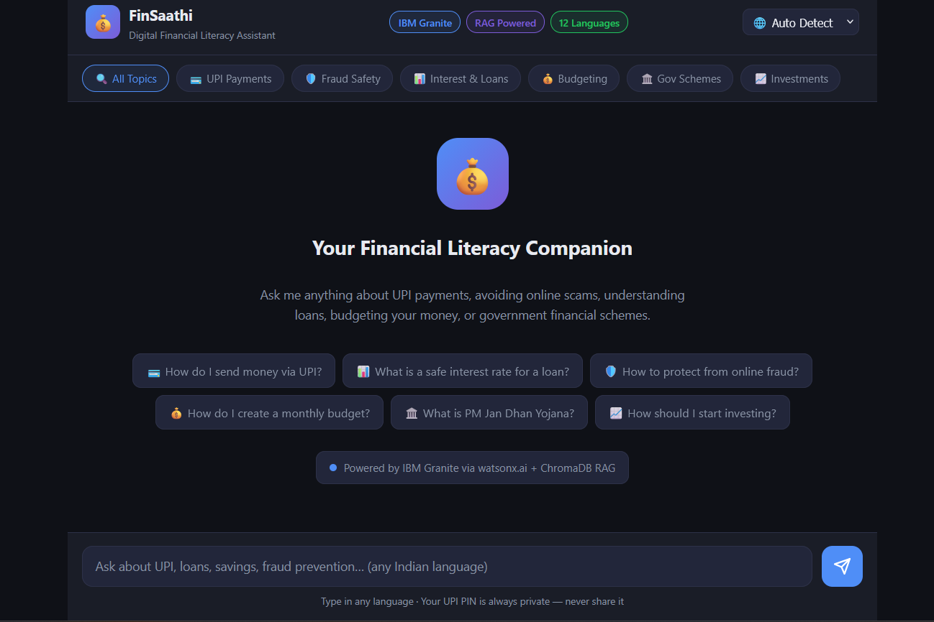
Application workflow -
Request flow
1. User asks in any language
2. Detect language, translate to English
3. Fraud keyword scan
4. Embed query, retrieve top-3 from ChromaDB
5. Granite generates the answer
6. Translate back to user's language
7. Show answer + source pills

Slide 8
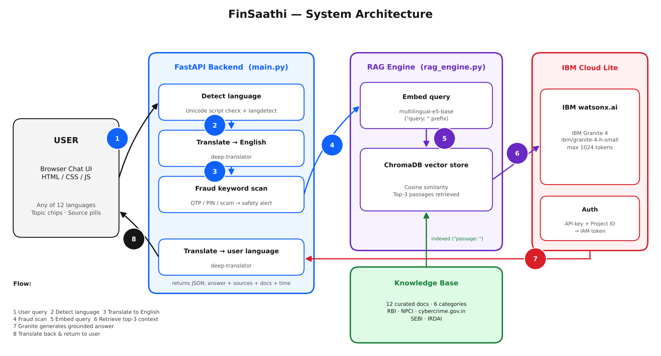
Architecture blueprint

Slide 9

Role of Agentic AI in the solution
Agentic AI makes FinSaathi a multi-step system, not a simple chatbot. With IBM Granite on watsonx.ai, cooperating agents handle each query.
Language agent detects and translates; Safety agent flags scams; Retrieval agent finds trusted passages; Generation agent writes the answer.
It adapts to the user's language and topic and raises fraud alerts autonomously.
Answers grounded in RBI, NPCI, SEBI and IRDAI content stay accurate and trustworthy.

Slide 10
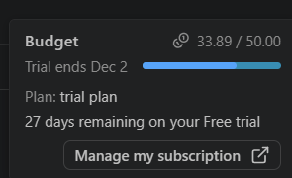
Token Usage
IBM Bob budget used: 33.89 / 50.00 (trial plan)

Slide 11
Novelty and Uniqueness
FinSaathi combines RAG, multilingual AI and fraud-safety checks in one lightweight IBM Granite system.
Multilingual by Design – 12 languages, two-way translation
Grounded RAG Answers – Granite answers from retrieved trusted content
Built-in Fraud Safety – scam queries trigger an alert first
Transparent Sources – source pills show the documents used
Inclusive & Simple – plain language, topic chips, follow-ups
IBM-Native & Lightweight – watsonx.ai Granite, local ChromaDB
A trusted, inclusive and safe digital-finance companion, not just a chatbot.

Slide 12
Git Hub Link
GitHub Repository URL – https://github.com/siddhaantha/Digital-Financial-Literature
Repository contents:
1) app.json 2) Problem statement PDF 3) Project presentation (PPTX) 4) Source code (FastAPI backend, RAG engine, knowledge base, chat UI), requirements.txt, README

Slide 13
Future Scope
1. Voice Input & Output
Add speech-to-text and text-to-speech so low-literacy users can ask and hear answers.
2. Larger, Live Knowledge Base
Auto-ingest official RBI and scheme PDFs and refresh them so rates stay current.
3. Personalization & Scam Alerts
User profiles for tailored budgeting advice and real-time scam alerts via mobile or WhatsApp.

Slide 14
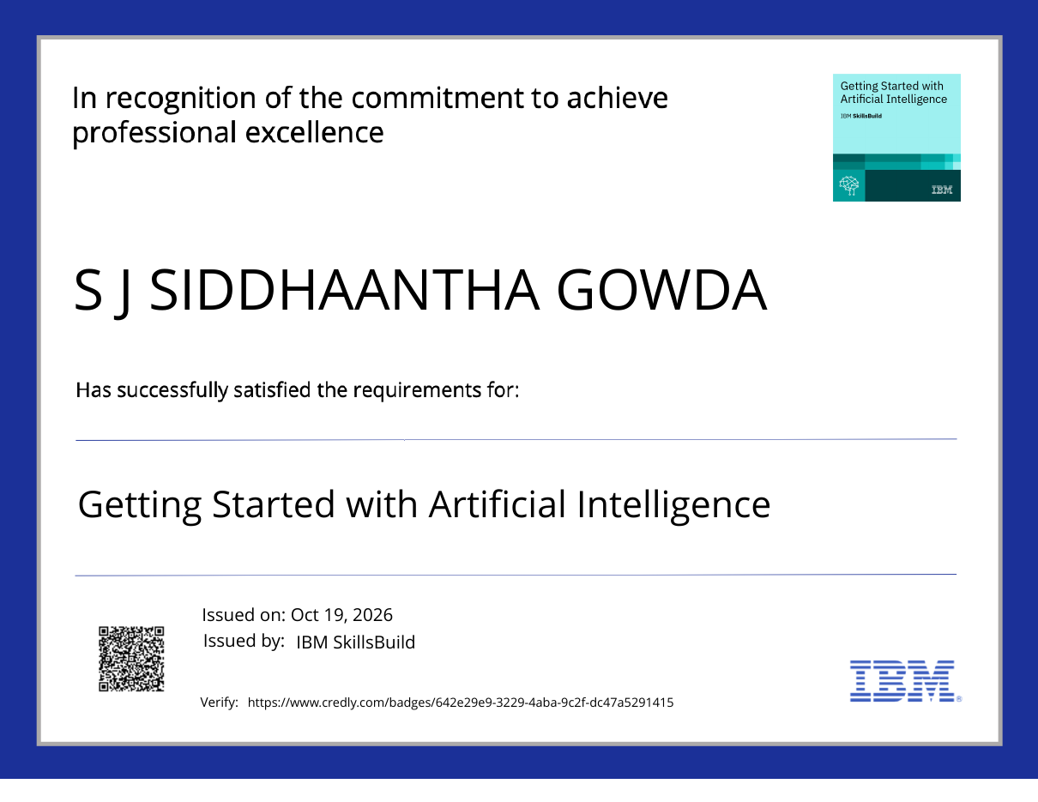
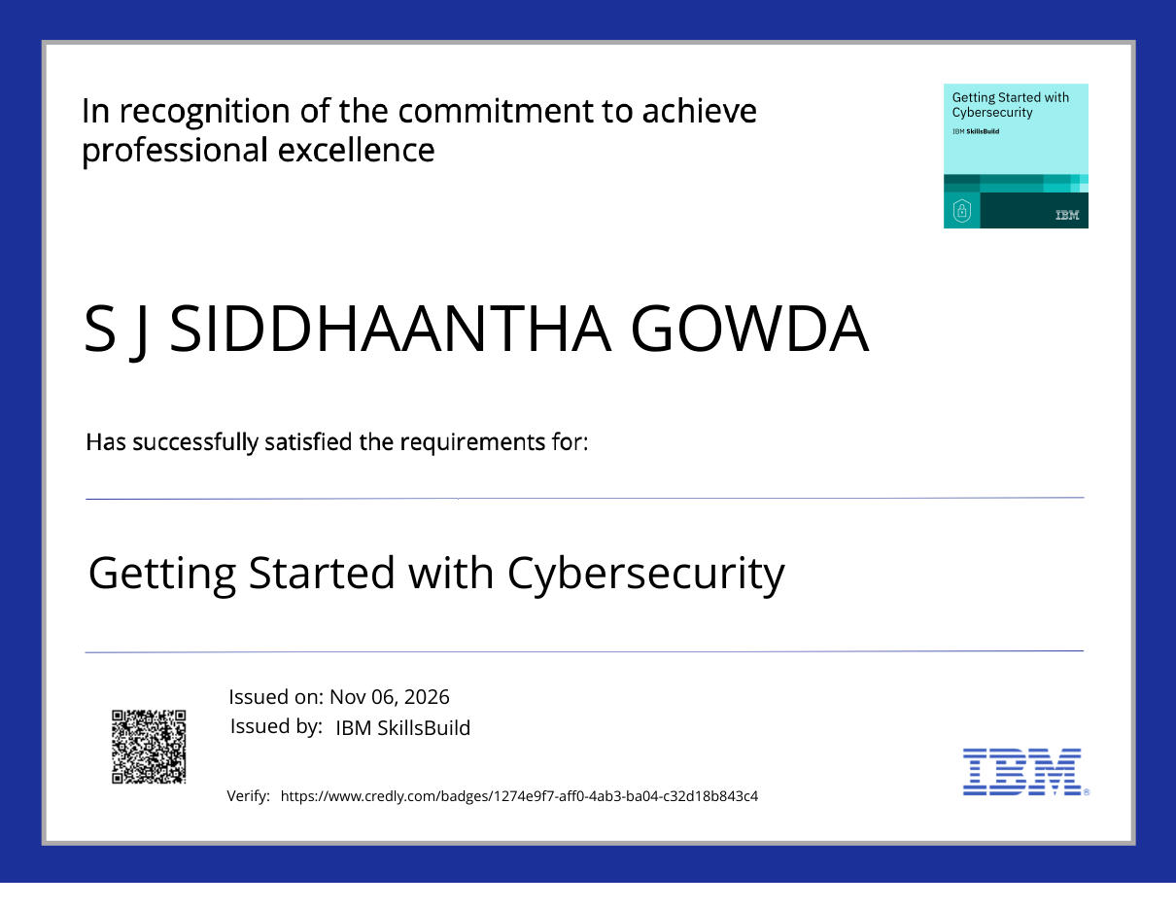
Certificates Earned:
IBM SkillsBuild certificates (Credly)

Slide 15
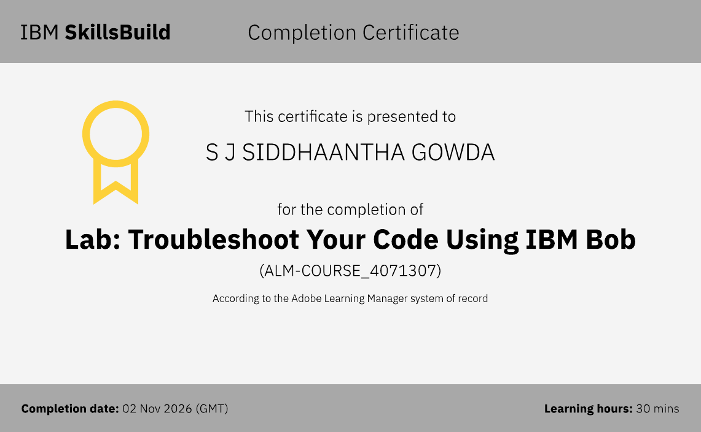
Certificates Earned:​
IBM Bob – Lab: Troubleshoot Your Code Using IBM Bob

Slide 16


