Slide 1







Manipal Hackathon 2026
Problem Statement P05 · Cascading Failure
ONE BRIDGE, TRACED THROUGH OUR ENGINE
When one bridge fails,
what breaks next?
Bridge B07 fails
89% can still reach help
Coastal road N2
jumps to 1.3× capacity
Hospital & fire routes
DOMINO
87% of them use that road
Tower T-04 is down
Explainable Infrastructure Cascade & Intervention Engine
no signal on the coast
Find the next domino. Stop the cascade. Protect the dark zones.
Malpe ward, 5,200 people
no road, no signal: dark
TEAM NAME
TRACK
PROBLEM STATEMENT
SOLUTION TITLE
mossad.exe
[Track]
P05 · Cascading Failure
DOMINO
TEAM MEMBERS
[Member 1] · [Member 2] · [Member 3] · [Member 4] · [Member 5]
Notes:
Open on the question, not the technology. One bridge goes down, everyone can picture that bridge, almost nobody can picture what happens three steps later. Read the chain on the right out loud, because those are our engine's real numbers, not an illustration. Forty seconds, then move.

Slide 2



DOMINO
Solution
TODAY
What gets affected?
DOMINO
Where can we intervene before the cascade grows?
ONE FAILURE, WALKED THROUGH BY OUR ENGINE
1
Bridge B07 fails
2
Traffic reroutes
3
Four actions tested
4
Now break B12
89% can still reach a hospital or fire station. On an ordinary damage map nothing looks wrong.
Coastal road N2 is suddenly at 1.3× the traffic it was built for. That is the next domino.
Three fail. Reopening a closed crossing holds the chain, and it takes 60 minutes.
Same engine, different answer. Nothing holds it. 17,794 people lose their route to help.
NOTHING VISIBLE YET
DOMINO FOUND
CASCADE STOPPED
ONLY HARDENING HELPS
Why that road, and not another
Dark zones: both, never either
Overloaded right now
Network runs through it
Ambulance routes use it
People living behind it
No road to help AND no phone signal. Malpe goes dark at once, Kadiyali 25 minutes later.
89%
33%
87%
27%
T dark = max ( T phys , T comm )
THE ENGINE BEHIND IT, IN ORDER
Map the city
Break one asset
Reassign traffic
Score what breaks next
Test every action
Stop, or repeat
M#26 · P05 · TEAM MOSSAD.EXE
Everything above is computed, not illustrated.
02
Notes:
This slide is the whole idea in one worked example. Walk the four panels left to right: the bridge fails and nothing looks wrong, the traffic moves and a road hits 1.3 times capacity, we test four actions and one of them holds in sixty minutes, and then the same engine on a different bridge says nothing holds at all. That last panel is the point. Same tool, two completely different kinds of decision: one you make in ninety minutes, one you make years earlier with capital. Then the score breakdown, so they know it is never a black box, and the dark zone AND.

Slide 3
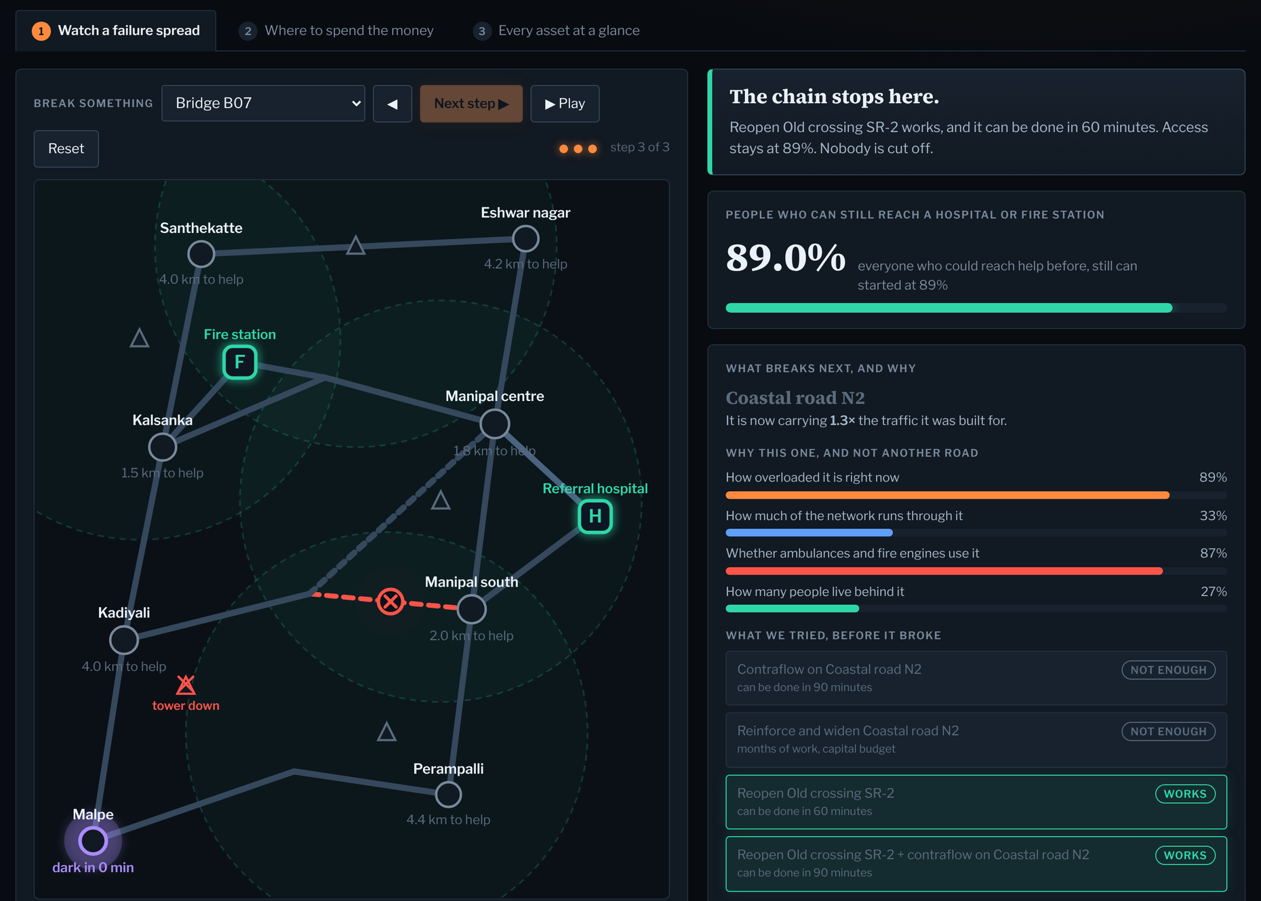







DOMINO
Technical Implementation
OUR PROTOTYPE, RUNNING — NOT A MOCK-UP
THE STACK
WorldPop + OpenStreetMap
data
PostGIS
spatial store
NetworkX + Dijkstra
routing and reassignment
Domino detector
four-part score
Intervention engine
counterfactual re-runs
Dark-zone engine
isolation and countdowns
React map and alerts
what an operator sees
Real, and honestly scoped
Real: routing, reassignment, the score, the counterfactuals, 17 failures and 5 budgets precomputed. Synthetic: the corridor itself. A live OSM extract replaces one loader function.
M#26 · P05 · TEAM MOSSAD.EXE
Open it, click any road, and it recomputes.
03
Notes:
Thirty seconds. The stack is deliberately ordinary. What matters is the screenshot: this runs, you can click any road in it and it recomputes. Be first to say the corridor is synthetic and that swapping in real OpenStreetMap geometry replaces one function.

Slide 4
DOMINO
Feasibility
EVIDENCE 1 — REAL POPULATION DATA
EVIDENCE 2 — OUR ENGINE, RUNNING
Remove a hospital, then put one action back
Same budget, two ways to spend it
570,509 people in the study area, WorldPop plus mapped service locations
The standard method
81.1%
68.3%
83.3%
reinforce the most central roads
1,993 people · ₹7.6 cr
reach a critical service
after the hospital is lost
after our intervention
DOMINO
buy back the most service per rupee
4,092 people · ₹8.9 cr
83.3% is above the 81.1% we started from, so the action that contains the cascade was worth taking anyway. 47.2% of the newly cut-off population is recovered, against 26.2% for random placement.
2.05× more people protected, for less money — and DOMINO stops at ₹8.9 crore because nothing else it could buy wins back another person. Corridor resilience goes 82.7 → 91.3 out of 100.
What ships first
What we do not claim
How we will test it
Roads, bridges, services, towers and population on one graph, with the next-domino detector, the explainable score and the dark-zone clock.
Access, not treatment. Topology and capacity, not human behaviour. Modelled population, not a building-level census. Costs are indicative rates.
Replay the Udupi–Manipal road closure of 20 May 2025 and check whether the roads DOMINO ranks next are the ones traffic actually moved onto.
M#26 · P05 · TEAM MOSSAD.EXE
Two separate evidence bases, kept apart on purpose.
04
Notes:
Two separate evidence bases, and say that out loud so nobody thinks we blurred them. First, real population data: remove a hospital, access falls to 68.3, our action takes it to 83.3, which is above where we started. Second, our engine on the prototype corridor answering the budget question: twice the people protected, for less money, and it tells the city to stop spending at 8.9 crore. Then name our own limits before a judge finds them.

Slide 5



DOMINO
Business Strategy
“We have a fixed budget. Where do we spend it?”
WHAT WE SELL THEM
A resilience score, per corridor
82.7 → 91.3 out of 100
WHO BUYS IT, AND HOW
ROADMAP, ONE LAYER AT A TIME
Municipal authorities
District disaster management
Live traffic
observed load, not modelled reroute
Emergency services
Infrastructure operators
Tower telemetry
real coverage state during an event
B2G / B2B SaaS, plus deployment and integration
Peer-to-peer relay
store-and-forward between nearby devices
THE ASK
WHY THEY KEEP PAYING
One corridor, one monsoon season, with the Udupi city municipal council and the district disaster management authority, replaying last year's closures.
The horizon changes every time the city builds something. A resilience score has to be recomputed each year, which turns a one-off disaster purchase into a line in the annual capital budget.
Don’t just predict the cascade.
Find where it can still be stopped.
DOMINO
M#26 · P05 · TEAM MOSSAD.EXE
One corridor, one season, one number a city can act on.
05
Notes:
Lead with the buyer's question. What we actually sell is a number they can put in a report and watch move. Keep the ask small and checkable. Then read the last line and stop.

