Slide 1


Time Series Performance Metrics for LSTM Model
Dr. Siddhaling Urolagin
PhD, Post Doc

Slide 2

Mean Absolute Error
MAE
from sklearn.metrics import mean_absolute_error as mae

Slide 3



Mean Squared Error
MSE
from sklearn.metrics import mean_squared_error as mse

Slide 4


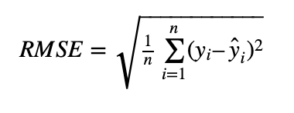
Root Mean Square Error
RMSE
rmse=sqrt(mse)

Slide 5


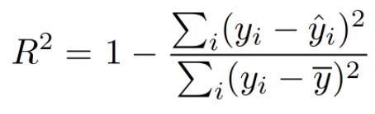
R² Score
from sklearn.metrics import r2_score as r2s

Slide 6

Adjusted R²
n is number of observations
k is number of independent variables
R² is R² score

