Slide 1
Milestone 4
SEMI-FUNCTIONAL PROTOTYPE

Slide 2

Home Page
The home page for the U-Park application

Slide 3
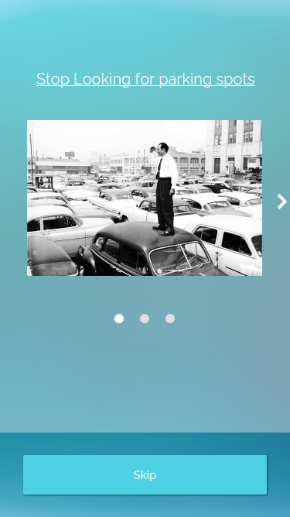
Landing page
The Landing page of the application, advising
the user of the features of the applications.

Slide 4
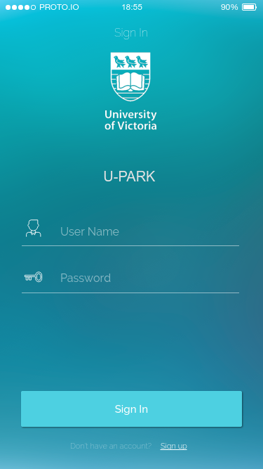
Sign in
The sign in page for the application. Also consists of
the link for sign up page for the first time user.

Slide 5
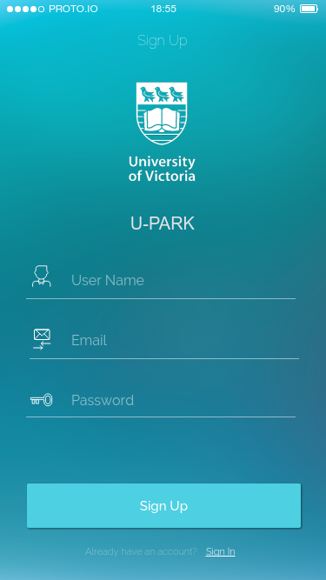
Sign up
Sign up page for new users

Slide 6
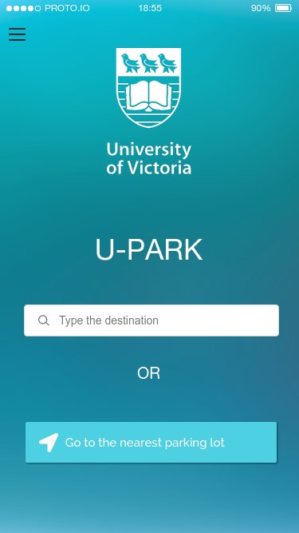
Method of navigation
Two methods of finding a parking spot.
First consists of manually entering the destination.
Second consists of using current location, to go to
the nearest parking lot.

Slide 7
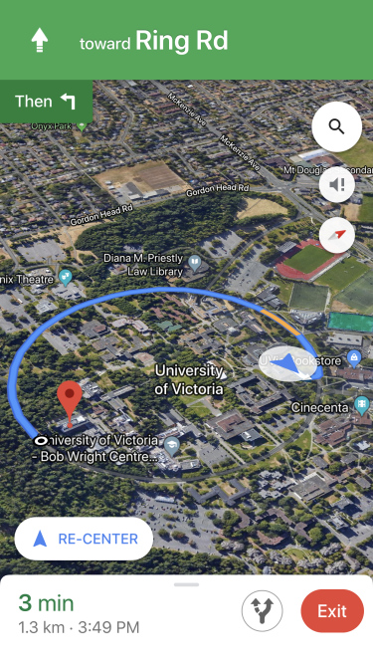
Navigation
Navigation, using Google’s Map API,
to take the user to the desired location

Slide 8
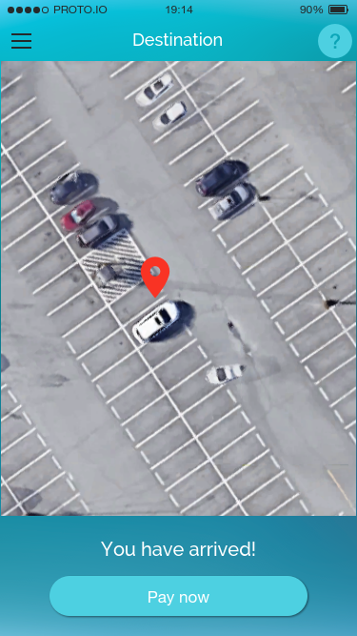
Arrival Confirmation
Confirms the arrival at the desired parking spot.

Slide 9
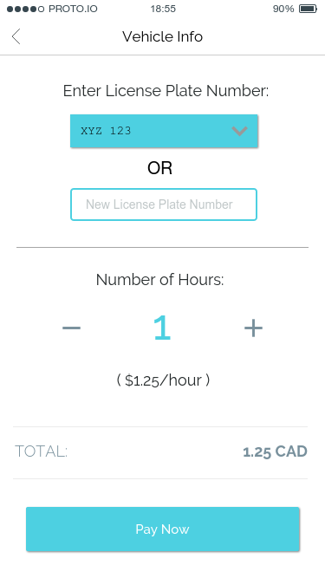
Vehicle Details
Enter the number plate of the vehicle and choose
the number of hours for parking.

Slide 10
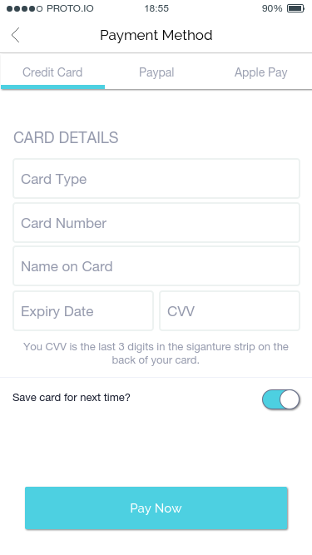
Payment method
Choosing the payment method, consisting of
Credit card, PayPal and Apple pay

Slide 11
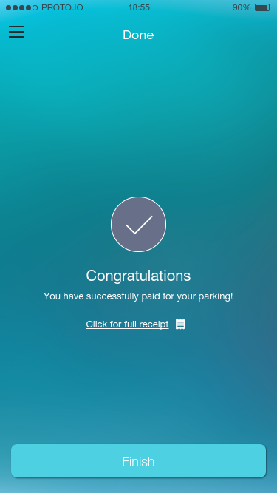
Payment confirmation
Payment confirmation page

Slide 12
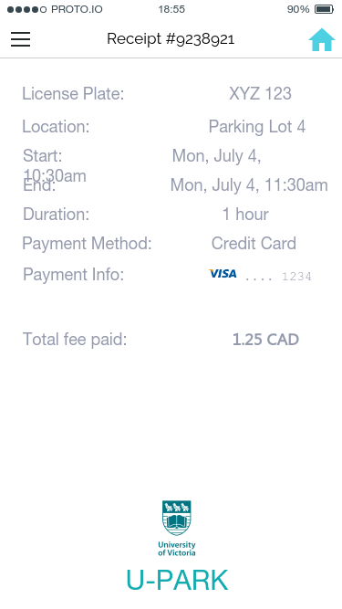
Receipt
Receipt page, indicating the lot number, time
and fees paid for the parking

Slide 13
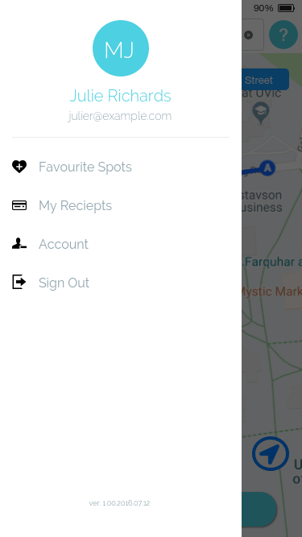
Pop Up menu for user
Pop up menu for the user, consisting of user settings
and preferences.

Slide 14
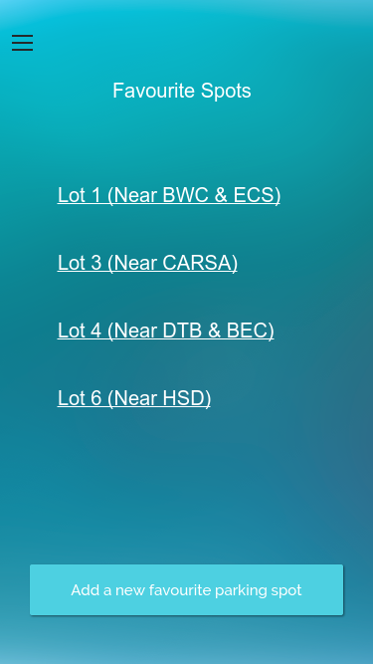
Favorite spots
List of favorite parking spots, to avoid manually
entering location each time the app is used.

Slide 15
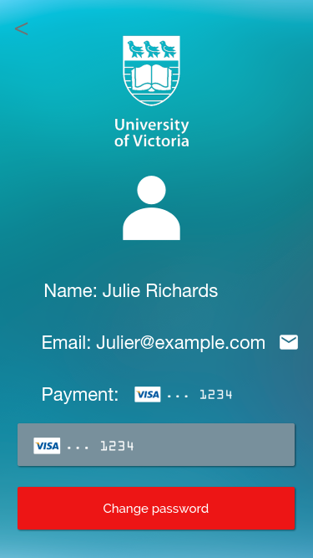
Account settings
Page for user settings and information

