Slide 1

How to HA/DR Your SQL Jobs
Eitan Blumin

Slide 2

Copyright © 2020 Madeira Ltd
All Rights Reserved
Full rights, including copyrights, belong exclusively to Madeira Ltd
No use of the materials, in any form, is allowed,
unless receiving a prior written permission from Madeira Ltd

Slide 3






A Few Words about Me…
Name: Eitan Blumin
Email Address: eitan@madeiradata.com
Twitter: @EitanBlumin
Blog: www.eitanblumin.com
Podcast: www.sqlserverradio.com

Slide 4

How to HA/DR Your SQL Jobs

Slide 5

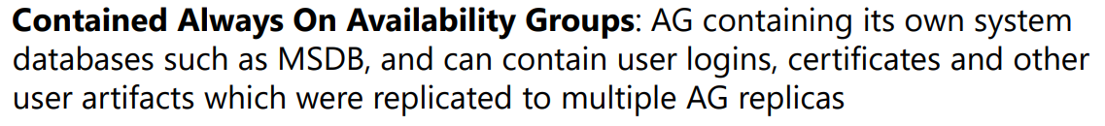

SQL Server 2022 Contained AG!
https://docs.microsoft.com/sql/database-engine/availability-groups/windows/contained-availability-groups-overview
Notes:
Pedro Lopes announced during SQLBits 2022 about new upcoming feature in SQL Server 2022:
Contained AlwaysOn Availability Groups – which should resolve the issue discussed in this issue

Slide 6
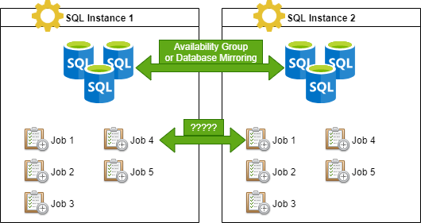
Background
Her Der en Jerbs!
Notes:
https://eitanblumin.com/2018/11/06/automatically-enable-or-disable-jobs-based-on-hadr-role/
Use case: PRIMARY + SECONDARY / PRINCIPLE + MIRROR servers with Failover
Both have identical jobs which can only work on the writeable database

Slide 7
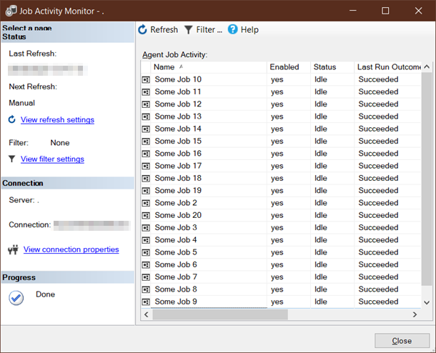
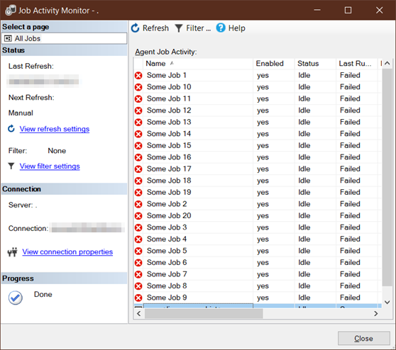
Solution 1: None
NOTE:
This is relevant to DB Mirroring as well
SQL Instance 1 (Primary)
SQL Instance 2 (Secondary)
Dey Failed Er Jerbs!
Notes:
Sometimes people even neglect creating the same jobs on both replicas

Slide 8

Solution 2: Validation Step
SQL Instance 1 (Primary)
SQL Instance 2 (Secondary)
Dey Ren Er Jerbs?

Slide 9
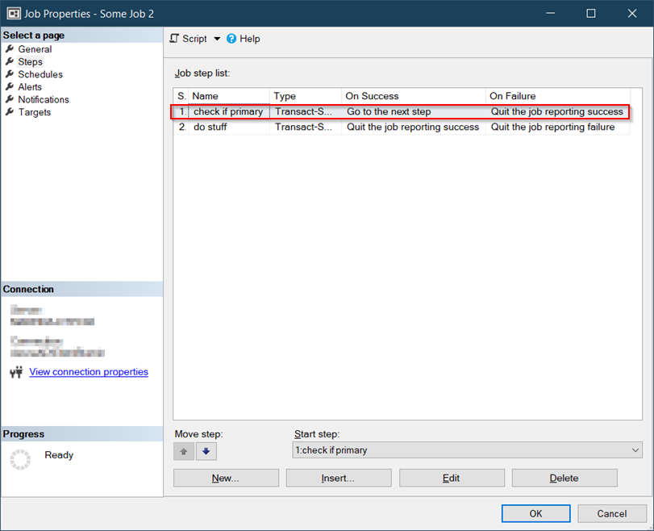
Solution 2: Validation Step
Fail Sterp en Jerb!

Slide 10
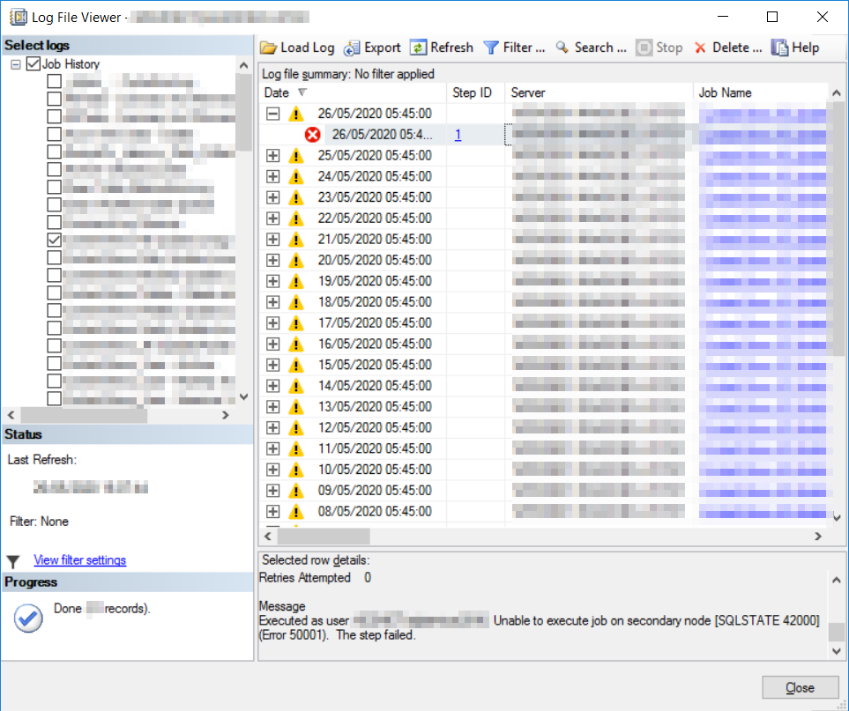
Solution 2: Validation Step
It Wern Er Jerbs!

Slide 11
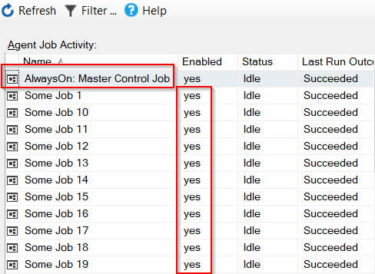
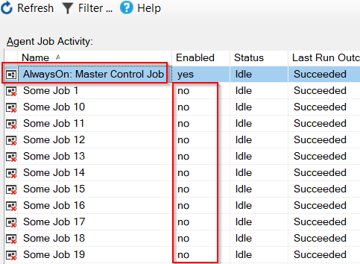
Solution 3: Master Control Job
SQL Instance 1 (Primary)
SQL Instance 2 (Secondary)
Mestur Fer Jerbs!

Slide 12

Master Control Job: Implementation
IF ( /* <current server is PRIMARY> */ )
BEGIN
/* <enable all jobs> */
END
ELSE
BEGIN
/* <disable all jobs> */
END
Notes:
Basic algorithm/logic of the master control job

Slide 13

Master Control Job: Implementation
IF ( /* <current server is PRIMARY> */ )
BEGIN
/* <enable all jobs> */
END
ELSE
BEGIN
/* <disable all jobs> */
END
Instance?
AG?
Mirroring?
Database?
Which one?
???
Notes:
Issue 1: what am I supposed to check? The instance? The availability group / mirroring session? The DB? Which DB?
Answer: Based on DB Role

Slide 14

Master Control Job: Implementation
IF ( /* <DB Role is PRIMARY> */ )
BEGIN
/* <enable all jobs> */
END
ELSE
BEGIN
/* <disable all jobs> */
END
All of the jobs?
List of jobs?
Based on name?
Based on category?
Based on DB context?
???
???
Notes:
Issue 2: Which jobs are we supposed to enable/disable? How would we know? What if a job is without a DB context (SSIS/CmdExec/PS)?
Answer: Based on DB Context where possible, manually configure where no DB context is possible (based on either name or category)

Slide 15

Master Control Job: Implementation
IF ( /* <DB Role is PRIMARY> */ )
BEGIN
/* <enable relevant jobs> */
END
ELSE
BEGIN
/* <disable relevant jobs> */
END
What about…
Secondary only?
Both?
None???
???
Notes:
Issue 3: What if I want jobs to run on SECONDARY? Or on both replicas? Or to never run?
Answer: Configure based on job name / step name / category name

Slide 16

Master Control Job: Implementation
IF (/* <job | step | category> name is X */)
BEGIN
IF (/* <DB role> is <PRIMARY | SECONDARY | EITHER> */)
BEGIN
/* enable */
END
ELSE
BEGIN
/* disable */
END
END
[ , …n ]
Notes:
Settle on a default (DB Context defines DB Role – enabled on PRIMARY).
The rest needs to be configured per use case.

Slide 17
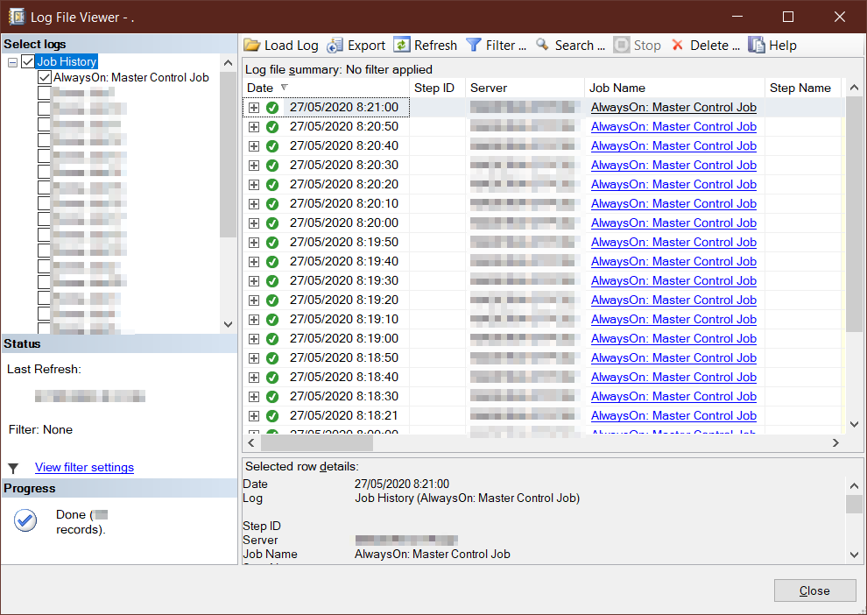

Master Control Job: Scheduling
???
Notes:
How to schedule the Master Control Job?
How often should it run?
If too often – can cause too much “noise” and take up unnecessary storage in msdb.
If too rarely – other jobs that run more frequently may miss their executions.

Slide 18
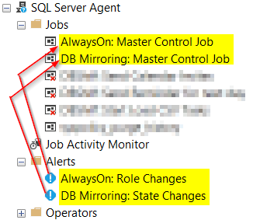

Master Control Job: Scheduling / Alerting
Oh and also on SQL Agent startup!
Oh and also scheduled! (just in case)
Notes:
Run the job based on alert(s) for state/role-change events, and also on SQL Agent startup.
And also some kind of schedule just in case (i.e. once per hour or something like that).

Slide 19

Sounds like a plan!
Notes:
Looks like we have everything we need for a proper solution

Slide 20

Oh wait, we need to implement this now?
Nope!

Slide 21


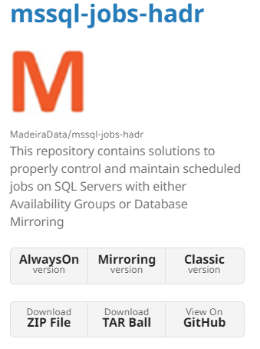

Already Done!
bit.ly/HADRMyJobs
madeiradata.github.io/mssql-jobs-hadr
github.com/MadeiraData/mssql-jobs-hadr

Slide 22
Example
SET @MasterControlJobName = N'AlwaysOn: Master Control Job'
SET @AlertName = N'AlwaysOn: Role Changes'
SET @SpecialConfigurations = N'<config>
<item type="job" enablewhen="secondary">Contoso %</item>
<item type="category" enablewhen="both">Database Maintenance</item>
<item type="step" enablewhen="secondary">Generate BI Report</item>
<item type="category" enablewhen="ignore">SQL Sentry Jobs</item>
<item type="job" enablewhen="primary" dbname=“WWILT">WWI ETL</item>
<item type=“category" enablewhen="never">DisabledJobs</item>
</config>'
Notes:
Configure the job and alert names

Slide 23
Example
SET @MasterControlJobName = N'AlwaysOn: Master Control Job'
SET @AlertName = N'AlwaysOn: Role Changes'
SET @SpecialConfigurations = N'<config>
<item type="job" enablewhen="secondary">Contoso %</item>
<item type="category" enablewhen="both">Database Maintenance</item>
<item type="step" enablewhen="secondary">Generate BI Report</item>
<item type="category" enablewhen="ignore">SQL Sentry Jobs</item>
<item type="job" enablewhen="primary" dbname=“WWILT">WWI ETL</item>
<item type=“category" enablewhen="never">DisabledJobs</item>
</config>'
SET @SpecialConfigurations = NULL
My Job 1
Step 1 [AdventureWorks]
Step 2 [pubs]
Step 3 [Northwind]
Default Behavior:
Check the current role of the database context for all T-SQL job steps.
If at least one step should be enabled based on DB role
-> Enable whole job
Notes:
What is the default behavior of the script when no specific configurations are set?
What if a job has multiple steps, each with a different database context with different (contradicting) roles?

Slide 24
Example
SET @MasterControlJobName = N'AlwaysOn: Master Control Job'
SET @AlertName = N'AlwaysOn: Role Changes'
SET @SpecialConfigurations = N'<config>
<item type="job" enablewhen="secondary">Contoso %</item>
<item type="category" enablewhen="both">Database Maintenance</item>
<item type="step" enablewhen="secondary">Generate BI Report</item>
<item type="category" enablewhen="ignore">SQL Sentry Jobs</item>
<item type="job" enablewhen="primary" dbname=“WWILT">WWI ETL</item>
<item type=“category" enablewhen="never">DisabledJobs</item>
</config>'

Slide 25
Example
SET @MasterControlJobName = N'AlwaysOn: Master Control Job'
SET @AlertName = N'AlwaysOn: Role Changes'
SET @SpecialConfigurations = N'<config>
<item type="job" enablewhen="secondary">Contoso %</item>
<item type="category" enablewhen="both">Database Maintenance</item>
<item type="step" enablewhen="secondary">Generate BI Report</item>
<item type="category" enablewhen="ignore">SQL Sentry Jobs</item>
<item type="job" enablewhen="primary" dbname=“WWILT">WWI ETL</item>
<item type=“category" enablewhen="never">DisabledJobs</item>
</config>'

Slide 26
Example
SET @MasterControlJobName = N'AlwaysOn: Master Control Job'
SET @AlertName = N'AlwaysOn: Role Changes'
SET @SpecialConfigurations = N'<config>
<item type="job" enablewhen="secondary">Contoso %</item>
<item type="category" enablewhen="both">Database Maintenance</item>
<item type="step" enablewhen="secondary">Generate BI Report</item>
<item type="category" enablewhen="ignore">SQL Sentry Jobs</item>
<item type="job" enablewhen="primary" dbname=“WWILT">WWI ETL</item>
<item type=“category" enablewhen="never">DisabledJobs</item>
</config>'

Slide 27
Example
SET @MasterControlJobName = N'AlwaysOn: Master Control Job'
SET @AlertName = N'AlwaysOn: Role Changes'
SET @SpecialConfigurations = N'<config>
<item type="job" enablewhen="secondary">Contoso %</item>
<item type="category" enablewhen="both">Database Maintenance</item>
<item type="step" enablewhen="secondary">Generate BI Report</item>
<item type="category" enablewhen="ignore">SQL Sentry Jobs</item>
<item type="job" enablewhen="primary" dbname=“WWILT">WWI ETL</item>
<item type=“category" enablewhen="never">DisabledJobs</item>
</config>'

Slide 28
Example
SET @MasterControlJobName = N'AlwaysOn: Master Control Job'
SET @AlertName = N'AlwaysOn: Role Changes'
SET @SpecialConfigurations = N'<config>
<item type="job" enablewhen="secondary">Contoso %</item>
<item type="category" enablewhen="both">Database Maintenance</item>
<item type="step" enablewhen="secondary">Generate BI Report</item>
<item type="category" enablewhen="ignore">SQL Sentry Jobs</item>
<item type="job" enablewhen="primary" dbname=“WWILT">WWI ETL</item>
<item type=“category" enablewhen="never">DisabledJobs</item>
</config>'

Slide 29
Example
SET @MasterControlJobName = N'AlwaysOn: Master Control Job'
SET @AlertName = N'AlwaysOn: Role Changes'
SET @SpecialConfigurations = N'<config>
<item type="job" enablewhen="secondary">Contoso %</item>
<item type="category" enablewhen="both">Database Maintenance</item>
<item type="step" enablewhen="secondary">Generate BI Report</item>
<item type="category" enablewhen="ignore">SQL Sentry Jobs</item>
<item type="job" enablewhen="primary" dbname=“WWILT">WWI ETL</item>
<item type=“category" enablewhen="never">DisabledJobs</item>
</config>'

Slide 30

Questions?
👈 Robbin Higgins
(Pixabay | Instagram | Facebook)

Slide 31

Bonus
https://bit.ly/Compare-AGReplicaJobs
Notes:
Compare-AGReplicaJobs as a recommended solution for making sure that jobs are identical on AG replicas.

Slide 32
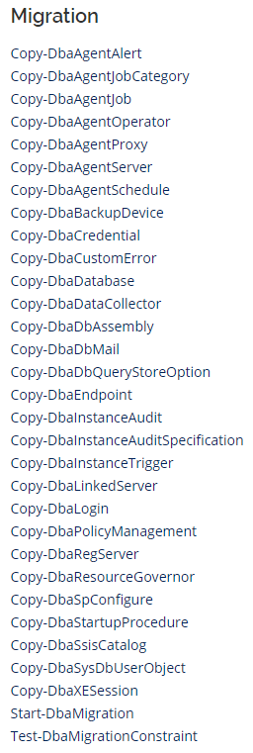

Bonus
https://dbatools.io
Sync-DbaAvailabilityGroup
Notes:
DbaTools as a recommended solution for synchronizing server-level objects such as jobs, logins, linked servers, and more.

Slide 33
SQL Server 2022 Contained AG!
https://docs.microsoft.com/sql/database-engine/availability-groups/windows/contained-availability-groups-overview
Notes:
Pedro Lopes announced during SQLBits 2022 about new upcoming feature in SQL Server 2022:
Contained AlwaysOn Availability Groups – which should resolve the issue discussed in this issue

Slide 34

eitanblumin.com
bit.ly/HADRMyJobs

Slide 35
How to stay in touch…
Name: Eitan Blumin
Email: eitan@madeiradata.com
Twitter: @EitanBlumin
LinkedIn: linkedin.com/in/eitanblumin
Blog: eitanblumin.com
GitHub: github.com/EitanBlumin
github.com/MadeiraData
www.madeiradata.com

