Slide 1
Modernize Your SQL Server the Right Way
Pam Lahoud, Sr. Program Manager, Microsoft

Slide 4

Pam Lahoud
Program Manager in SQL Server engineering, focus on Storage Engine
Sr. Program Manager, Microsoft
Microsoft Certified Master
/pam_lahoud
@SQLGoddess

Slide 5


PASS Summit Learning Pathway: Modernizing with SQL Server 2019
SQL Server and Azure Data: What to Use When
Bob Ward & Anna Thomas
Wednesday November 06, 10:45 AM
Room 6E
SQL Server 2019: Your Next Modern Data Platform
Bob Ward
Wednesday November 06, 1:30 PM
Tahoma 3-4
Modernizing Your SQL Server the Right Way
Pam Lahoud
Thursday November 07, 1:30 PM
Tahoma 3-4
SQL Server Migration: The Last Mile
Pedro Lopes
Thursday, November 07, 4:45 PM
Room 3AB
Inside SQL Server on Kubernetes
Bob Ward
Friday, November 08, 8:00 AM
Room 612

Slide 6
Why upgrade?

Slide 7
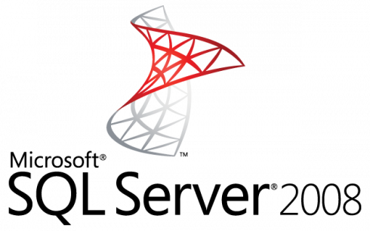
Winter is coming here…
July 9, 2019
Notes:
July 9, 2019 – End of Support for SQL Server 2008 and 2008 R2
January 14, 2020 – End of Support for Windows Server 2008 and 2008 R2
https://www.microsoft.com/en-US/sql-server/sql-server-2008
For ESU on-premises offerings, see Customer FAQ and Internal Addendum on the EOS Learning site. Contact: esu2008@microsoft.com

Slide 8
Is it the right time to modernize?
Do I need to modernize to reduce costs?
To maintain compliance?
To keep vendor support?
For ISVs, to enable choice and features for my customers?
Can I separate application modernization cycles from data modernization cycles?
Notes:
As you may have observed, we released SQL 2016 about 24m after 2014, and 2017 about 16m after 2016. So there is a faster engineering cycle that's observable to meet market demands and pace of technology improvements. It really doesn't make sense that our customers would have to wait 2+ years to see innovations coming to their non-azure Data solutions, like it had happened historically.
End-customers and ISVs all face a fundamental and recurring question with their application and database estates: Is it the right time to modernize?
With that question come a number of considerations:
Do I need to modernize to reduce costs? To maintain required industry certification? To keep vendor support? For ISVs, to enable choice for my customers?
And how to minimize risk? Can I separate application modernization cycles from data modernization cycles?
And what’s my required certification process? What’s the cost of re-certifying for Azure SQL, or newer SQL Server version?

Slide 9
Database Compatibility Certification

Slide 10
Certify once, run on-premises and in the cloud with Compatibility Certification
Upgrade & modernize your SQL Server database on-premises, in the cloud and on the edge with Compatibility Certification that eliminates risks of application compatibility
Upgrade to the latest SQL Server Database Engine without changing your critical applications
Compatibility Certification benefits
Unified application certification
Applications tested and certified on a given SQL Server version are also implicitly tested and certified on that SQL Server version native database compatibility level
Reduce upgrade risks
Separate application and platform layer upgrade cycles for less disruption
Microsoft fully supports Compatibility Certification
Frictionless migration with no code changes
Upgrade to latest SQL Database Engine version
Upgrade your SQL Server Database Engine or move instances to the cloud with no code changes
Notes:
Starting with SQL Server 2016, the SQL Server team has stopped deprecating compatibility levels purposefully. The Database Engine is also literally the same accross SQL Server and Azure SQL (including Managed Instance), so a database can be moved seamlessly and the same database code (T-SQL) works the same and undergoes the same optimization processes.
Therefore, an application that was certified for compatibility 100 (SQL 2008) can work with the same behavior that was set for that version, even when moved to Azure SQL or a modern version of SQL Server.
This means:
No more need to specifically certify for Azure or on-premises separately. Applications tested and certified on a given SQL Server version are also implicitly tested and certified on that SQL Server version native database compatibility level.
Reduced upgrade risks because during platform modernization, application and platform layer upgrade cycles can be separated for less disruption, and improved change management
Upgrading to a new version of SQL Server or Azure SQL can be done with no code changes by keeping the same compatibility level as the source
New Databases are set to compatibility level mapping to the version of the Database Engine. When a database is upgraded from any earlier version of SQL Server, the database retains its existing compatibility level if it is at least minimum allowed for that instance of SQL Server or Azure SQL. Upgrading a database with a compatibility level lower than the allowed level (for example from SQL 2005), sets the database to the lowest compatibility level allowed.

Slide 11
Database Compatibility Level protection with Microsoft
Microsoft provides an ecosystem of tools and services to test whether Compatibility Certification is right for you and protect you as you upgrade
Maintain backwards compatibility
Predictable performance
Validation testing tools
Applications running on a newer SQL Server Database Engine while using an older Database Compatibility Level can still leverage server-level enhancements without application changes
Database Compatibility Level settings affect behaviors for a specified database, not the entire server
Microsoft gates query optimization changes and improvements behind Database Compatibility Level to upgrade without issues once validation testing is successfully completed
Use Data Migration Assistant (DMA) to validate your readiness to upgrade
The DMA tool validation results help protect applications from any functional regressions on target versions
Learn more here: http://aka.ms/dbcompat
Notes:
Backwards compatibility is the undocumented feature of the Database Engine that the engineering teams strives to maintain. This is why we have stopped deprecating features in recent releases of SQL Server, and intend to keep it that way, unless some major technological advancement with the Database Engine requires deprecation of an incompatible feature – in which case that becomes part of the documented list of deprecated features.
Predictable performance =Query plan shape protection, which protects against query plan changes on equivalent hardware and can thus keep a level of predictable performance. Validation testing tools (DMA) must be successfully completed. Hardware target and source tests should be run separately.
Changes needed pre-upgrade can be discovered with the validation testing tools. Changing your database compatibility level changes the database feature set. Any discontinued functionality, code or features in a given SQL Server version may not be protected. Using tools like DMA can help assess your ability to leverage the enhanced security and scalability of the new database engine in SQL Server and Azure SQL Database without any required application changes.

Slide 12
Explore your Database Compatibility Level supported values
150+
140
130
Upgrade from any earlier version of SQL Server and the database retains its existing compatibility level if it is at least minimum allowed for that instance of SQL Server
For example, SQL Server 2008 databases have supported compatibility up to SQL Server 2019 and Azure SQL Database
120
Supported Database Compatibility Level Values
110
100
90
80
Product
SQL Server 2000
SQL Server 2005
SQL Server 2008 R2
SQL Server 2012
SQL Server 2014
SQL Server 2016
SQL Server 2017
SQL Server 2019
Azure SQL Database
Default Compatibility Level Designation per product
80
90
100
110
120
130
140
150
140
Notes:
As you can see, historically each SQL Server version introduced a new compatibility level, and the previous two were kept as a gating protection to facilitate upgrades. Starting with SQL Server 2016, the SQL Server team has stopped deprecating compatibility levels purposefully. Therefore, even a SQL Server 2019 and Azure SQL, an application that was created for compatibility 100 (SQL 2008) can work with the same behavior that was set for that version.
And when an application is modernized and needs to take advantage of T-SQL and Query Optimization features such as Intelligent Query Processing, or increased precision for some data types, customers need to move to higher compatibility levels that enable those behavior affecting features, and only then go through a recertification process to work natively with the new compatibility.
New Databases are set to compatibility level mapping to the version of the Database Engine, unless the model database has a lower compatibility level. When a database is upgraded from any earlier version of SQL Server, the database retains its existing compatibility level if it is at least minimum allowed for that instance of SQL Server. Upgrading a database with a compatibility level lower than the allowed level, sets the database to the lowest compatibility level allowed.
Azure SQL Database V12 was released in December 2014. One aspect of that release was that newly created databases had their compatibility level set to 120. In 2015, SQL Database began support for level 130, although the default remained 120. Starting in mid-June 2016, in SQL Database, the default compatibility level are 130 instead of 120 for newly created databases. Existing databases created before mid-June 2016 are not affected, and maintain their current compatibility level (100, 110, or 120).

Slide 13
Upgrade Process

Slide 14
Upgrade Strategies
Side-by-side
Allows for upgrade of OS
Easier testing
In-place
Doesn’t require additional hardware
No data migration required
Easier rollback strategy
Less downtime
Notes:
Encourage customers to perform side-by-side upgrades in order to encourage thorough testing before cutover. Also generally allows for less downtime, easier rollback and overall less risk.

Slide 15
Traditional Upgrade Strategies
Feature | Notes
Log Shipping | Cutover measured in (typically) minutes
Replication | Cutover measured in (potentially) seconds
Backup and Restore | This is going to take a while!
Filesystem/SAN Copy | Ditto - the latter being significantly faster
Availability Groups (NOT available in < 2012) | Cutover measured in (typically) seconds

Slide 16
Minimize Risk with the Database Migration Guide
Functional & Performance tests
Remediate applications
Migrate schema, objects & data
Optimize
Discover
Assess
Convert
Data Sync
Cutover
Notes:
Migrations should be approached with the same rigor and processes as a full software or hardware project – a solid methodology is required for success. Microsoft provides you with all the tools you need to achieve a seamless, reliable upgrade experience.
Share the Database Migration Guide with your customers for step-by-step guidance on reliable upgrade methodology.
https://datamigration.microsoft.com/scenario/sql-to-sqlserver

Slide 17
Reliable Upgrades
Review the Database Migration Guide for details
“With tools like Database Migration Assistant and Database Experimentation Assistant, we were able to reduce the time and effort required for the upgrade, enable automated A/B testing capability to minimize risk and provide a high confidence upgrade plan for a mission critical, Tier-1 environment spanning over a 1000 instances of SQL Server within 3 months.”
Salesforce – PASS Summit 2017
Discover
Assess
Test
Microsoft Assessment and Planning Toolkit (MAP)
Database Migration Assistant (DMA)
Database Experimentation Assistant (DEA)
Fully automated using free tools from Microsoft
Notes:
Link in slide: https://datamigration.microsoft.com/scenario/sql-to-sqlserver
Source for quote?

Slide 18
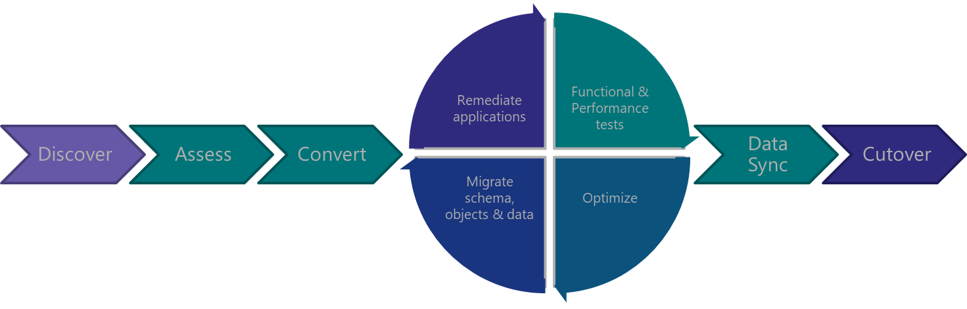
Discover

Slide 19
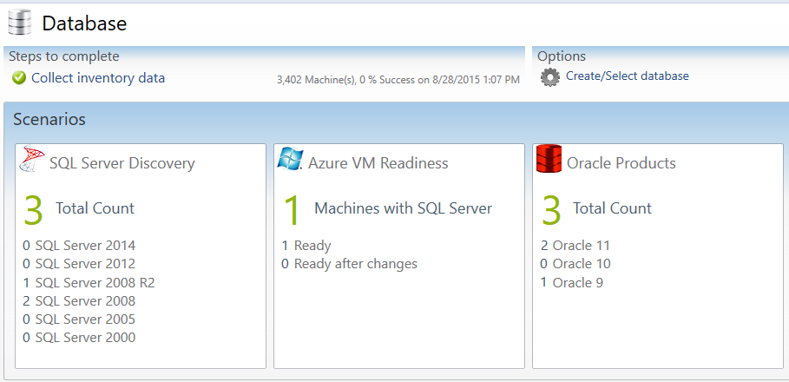
Discover with MAP Toolkit
Which SQL Server versions do I have?
Which Editions am I running?
Which SQL Server components are installed?
How many cores are on each server?
How many databases are in each instance?
What are the sizes of all my databases?
What are the settings for each instance and database?
Notes:
The Microsoft Assessment and Planning Toolkit (MAP) is an agentless, automated, multi-product planning and assessment tool for quicker and easier desktop, server and cloud migrations. MAP can be used to provide an inventory of all your database servers, including installed components, database details, settings and capacity planning information. This Solution Accelerator provides a powerful inventory, assessment, and reporting tool to simplify the migration planning process.
There are 8 areas that the Microsoft Assessment and Planning Toolkit (MAP) toolkit assesses:
Cloud
Desktop
Server
Desktop Virtualization
Server Virtualization
Database
Usage Tracking
Environment

Slide 20
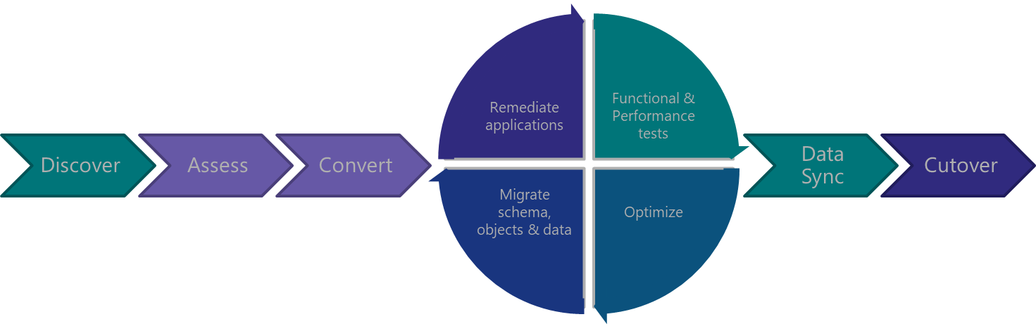
Assess & Convert

Slide 21

Assess & Convert with DMA
Breaking changes
Performance
Behavior changes
Deprecated features
Storage
Assess Compatibility Issues
Discover new features
Security
Perform Migration
Connect to source and target servers
Review final report
Choose databases
Monitor migration
“Upgrade readiness assessment was delivered with the help of Database Migration Assistant which helped us analyze our template databases to identify potential pitfalls and suggested automated remediation for our development teams to act on.”
Salesforce – PASS Summit 2017
Data Migration Assistant
Notes:
Data Migration Assistant (DMA) detects compatibility issues that can impact database functionality on your new version of SQL Server. It recommends performance and reliability improvements for your target environment. It allows you to not only move your schema and data, but also uncontained objects from your source server to your target server. Once the assessment is complete and issues have been mitigated, the DMA will automate the process of migrating your schema and data to the target instance.
Source for quote?

Slide 22
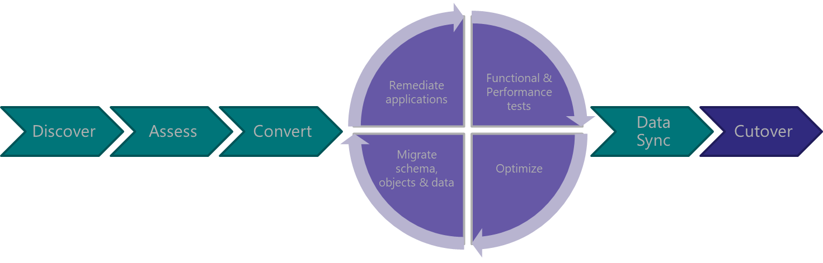
Test &
Optimize

Slide 23

Test & Optimize with DEA
Database Experimentation Assistant
A/B testing
Compatibility execution errors
Degraded queries
Workload comparison
Hardware comparison
Configuration setting comparison
“Database Experimentation Assistant helped us perform comparison tests between our current environment and a test SQL Server 2016 environment to identify regressions, breaking changes and performance characteristics.
Because of the automation, we were able to repeat such an exercise with multiple iterations using different configuration settings.”
Salesforce – PASS Summit 2017
Notes:
Database Experimentation Assistant (DEA) is an A/B testing solution for SQL Server upgrades. It will assist in evaluating a targeted version of SQL for a given workload. Customers who are upgrading from previous SQL Server versions (SQL Server 2005 and above) to any new version of the SQL Server will be able to use these analysis metrics.
DEA allows:
Automated script to set up workload capture and replay of production database (using existing SQL server functionality Distributed Replay & SQL tracing).
Perform statistical analysis on traces collected using both old and new instances.
Visualize data through detailed reports.
Source for quote?

Slide 24
Database Migration Assistant
Now with ad-hoc workload assessments!

Slide 25
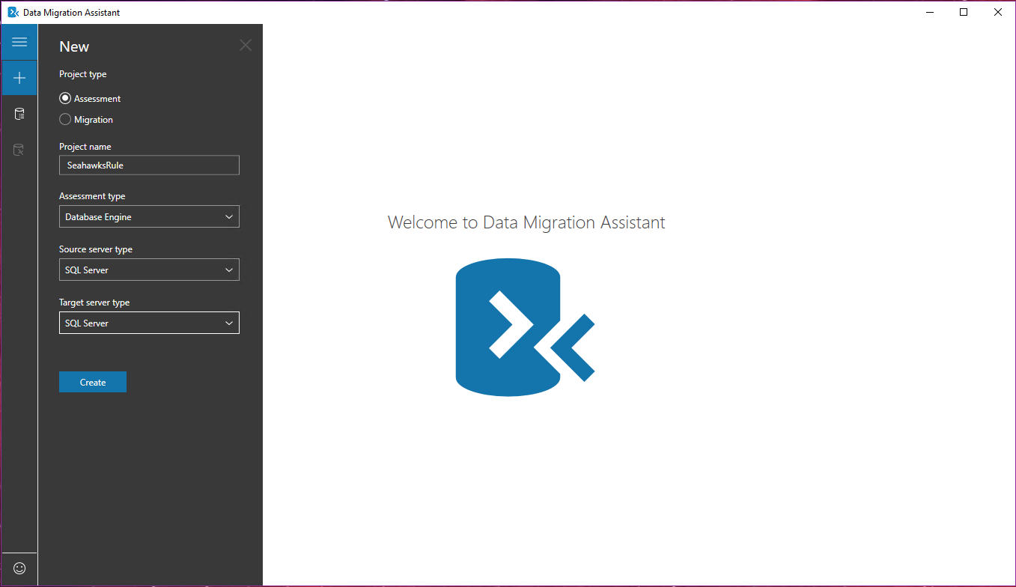

Slide 26
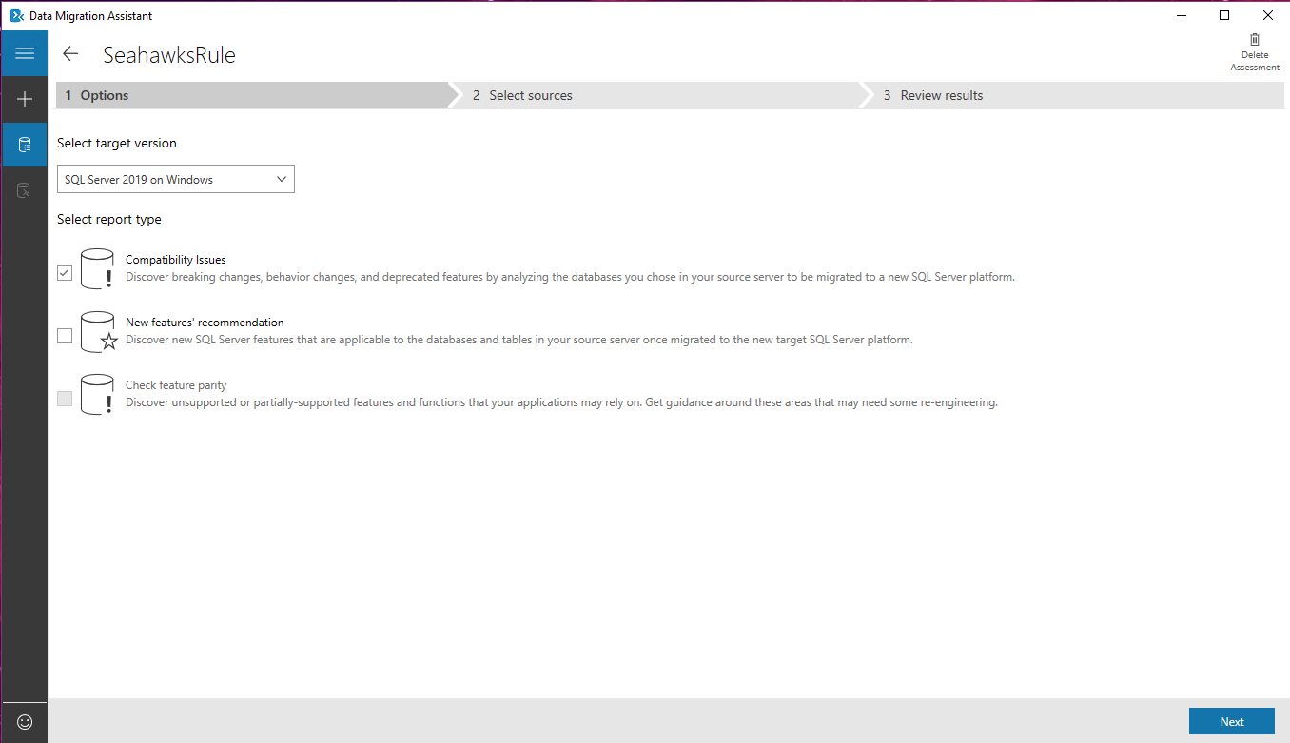
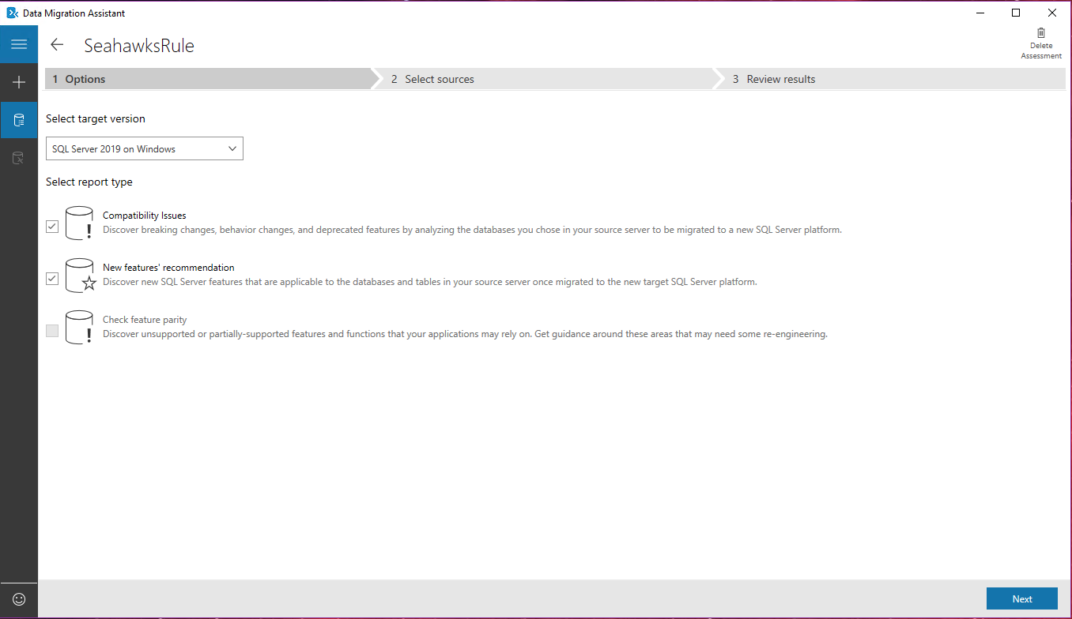
Notes:
DMA Assessment: Options

Slide 27
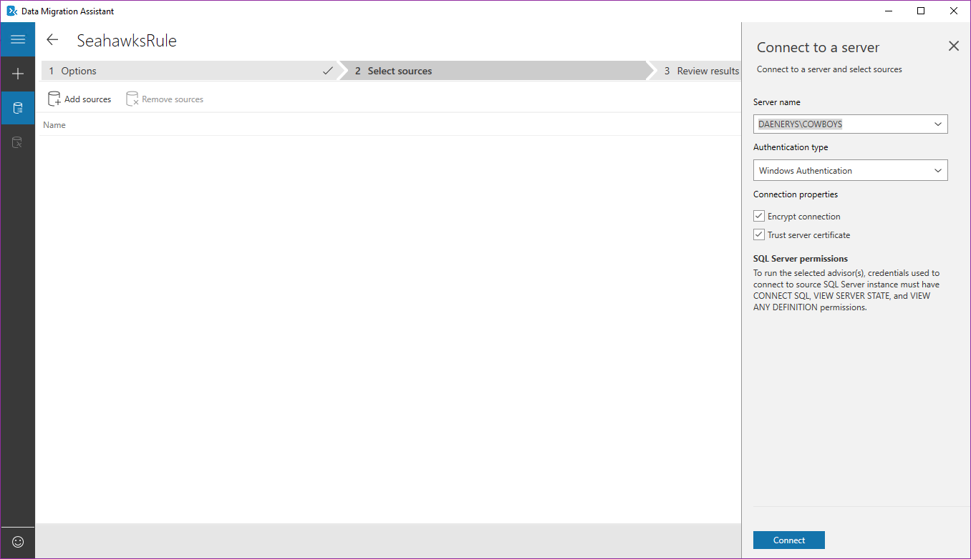
Notes:
DMA Assessment: Select Sources

Slide 28
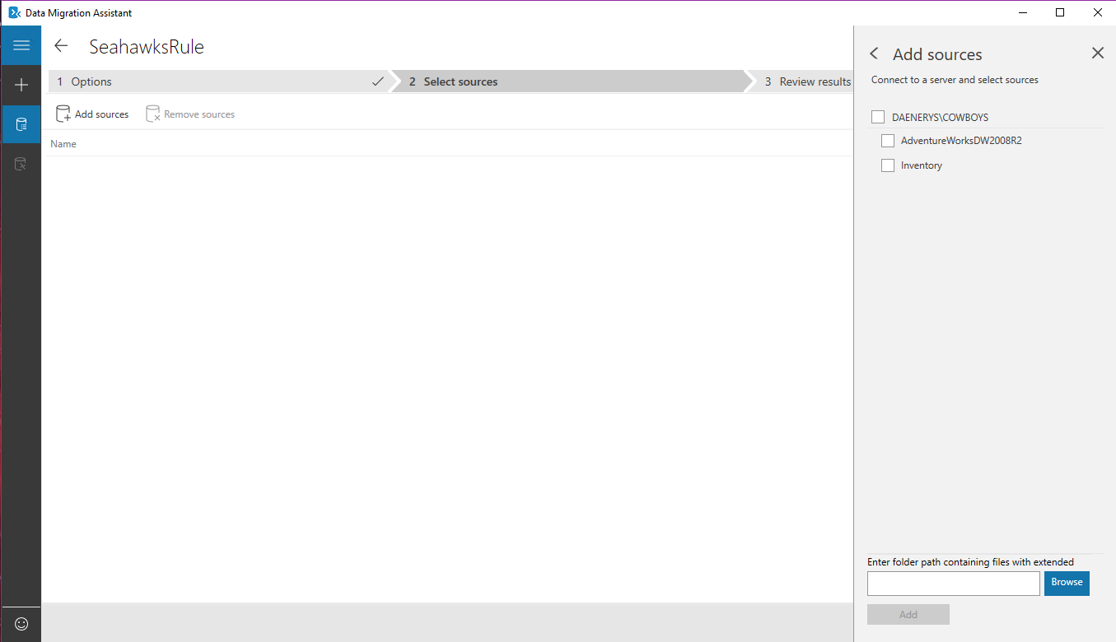
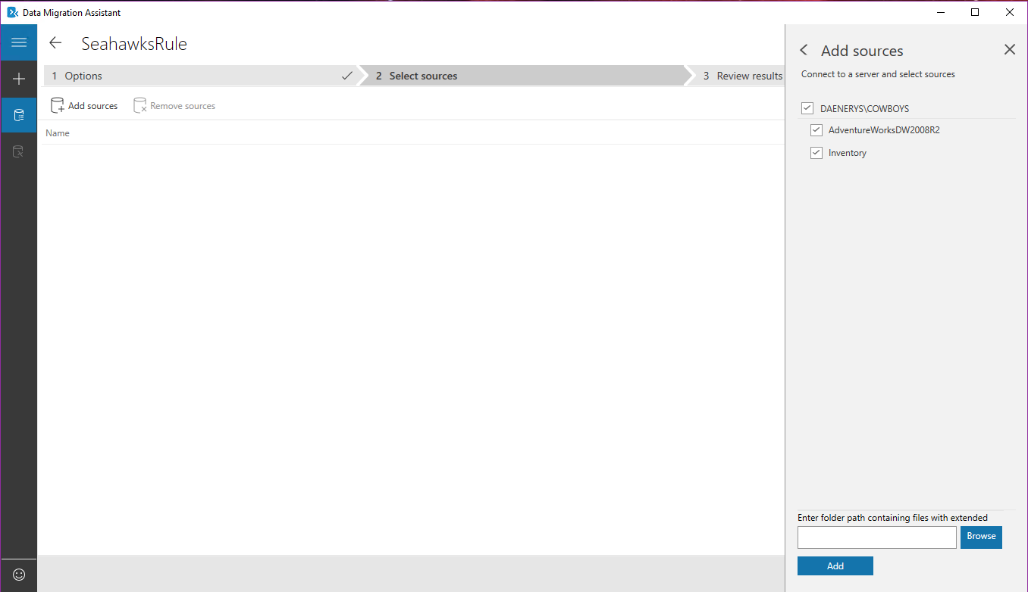

Slide 29
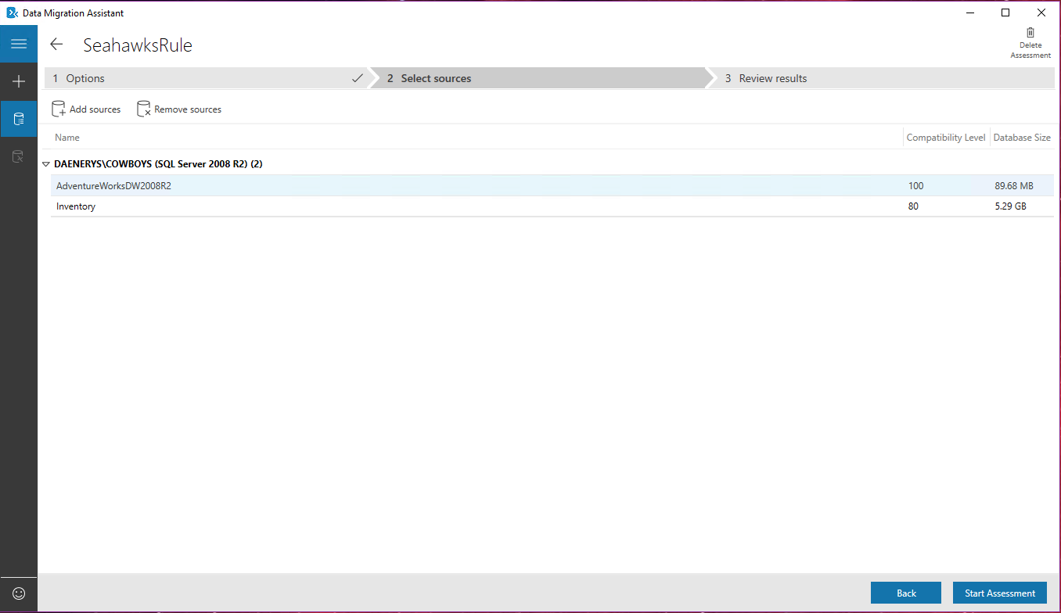

Slide 30
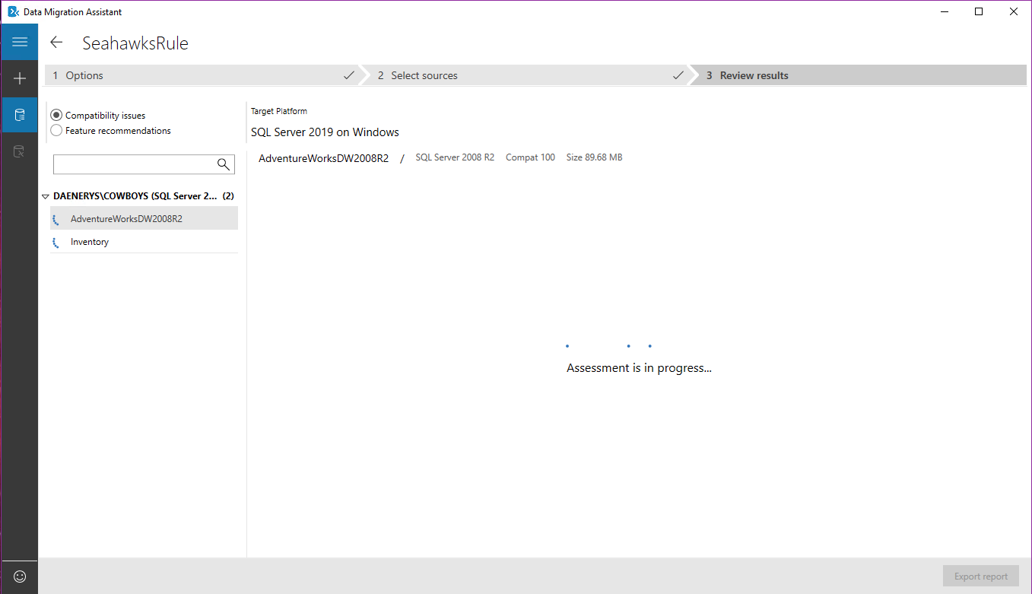

Slide 31
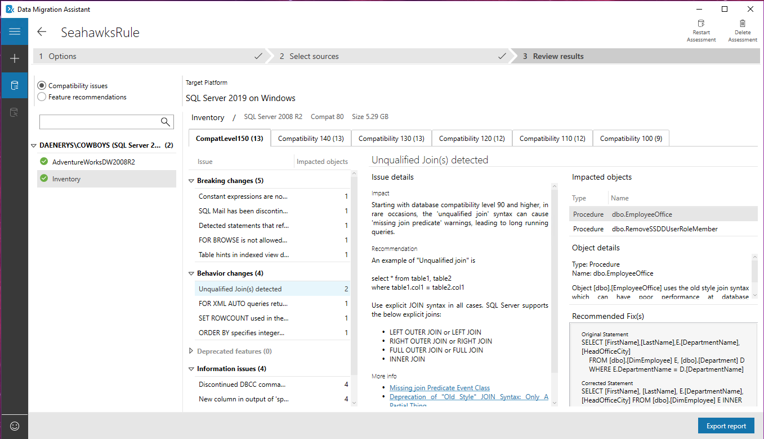
Notes:
DMA Assessment: Completed

Slide 32
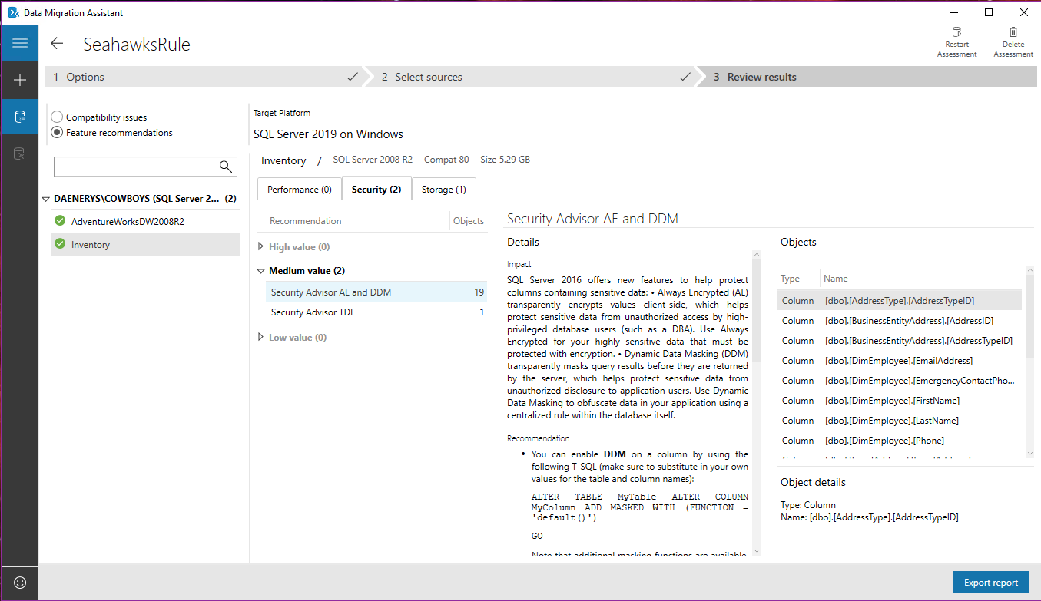
Notes:
DMA Assessment: Completed

Slide 33
Database Experimentation Assistant

Slide 34
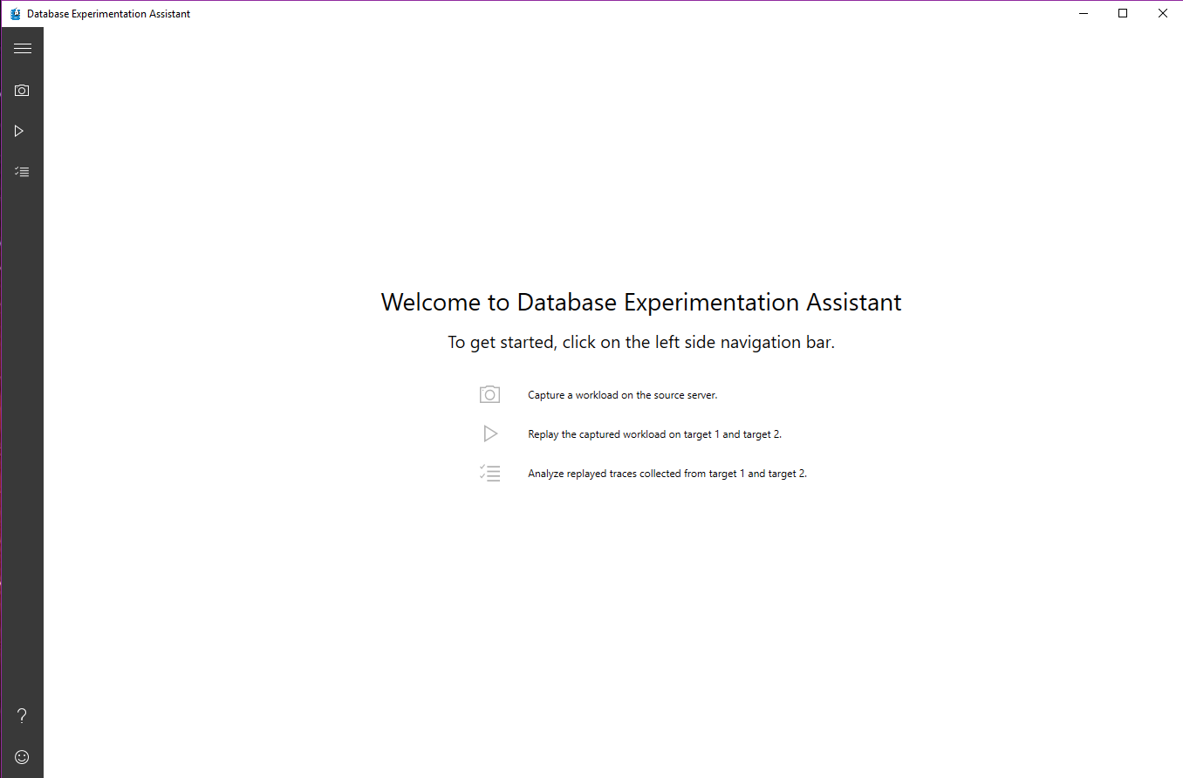

Slide 35
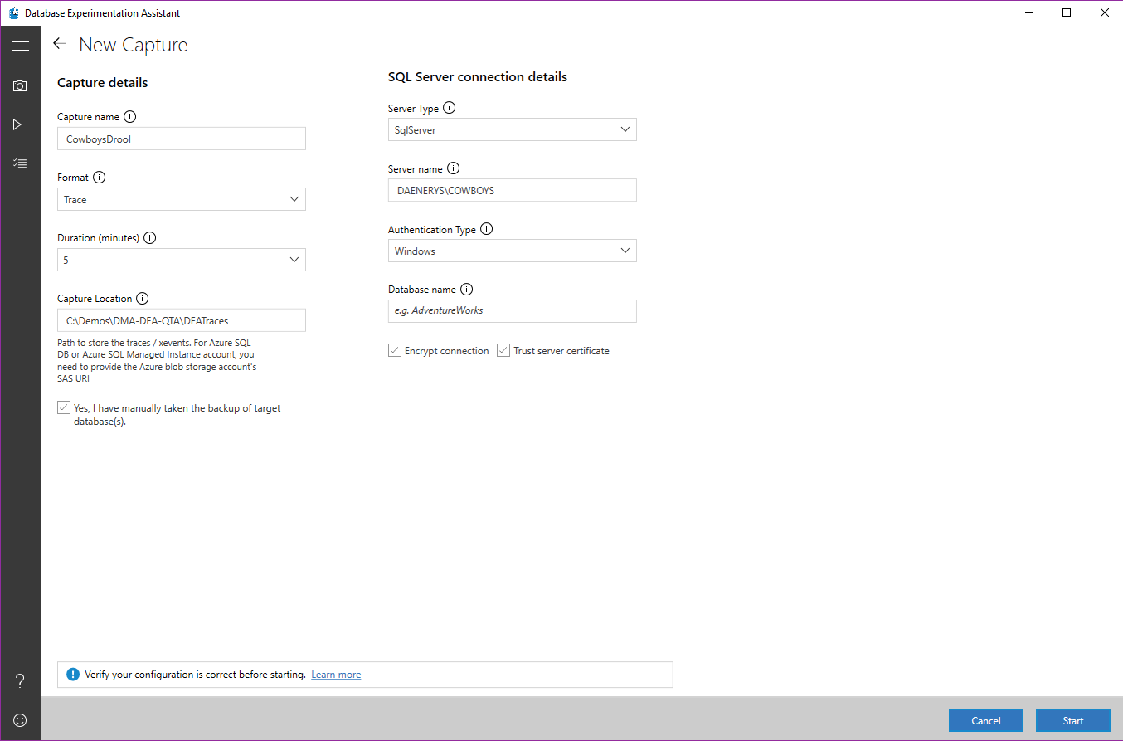
Must use Trace for SQL Server 2008, use xEvents for later versions

Slide 36
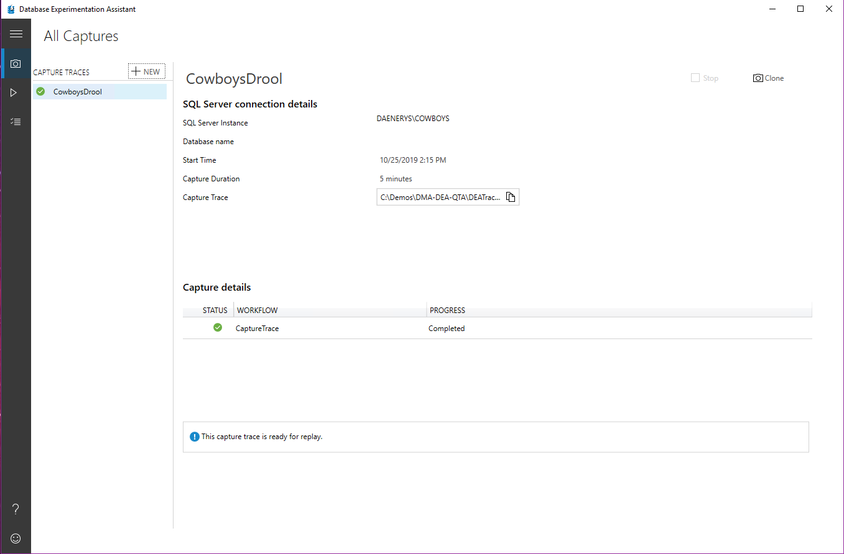

Slide 37
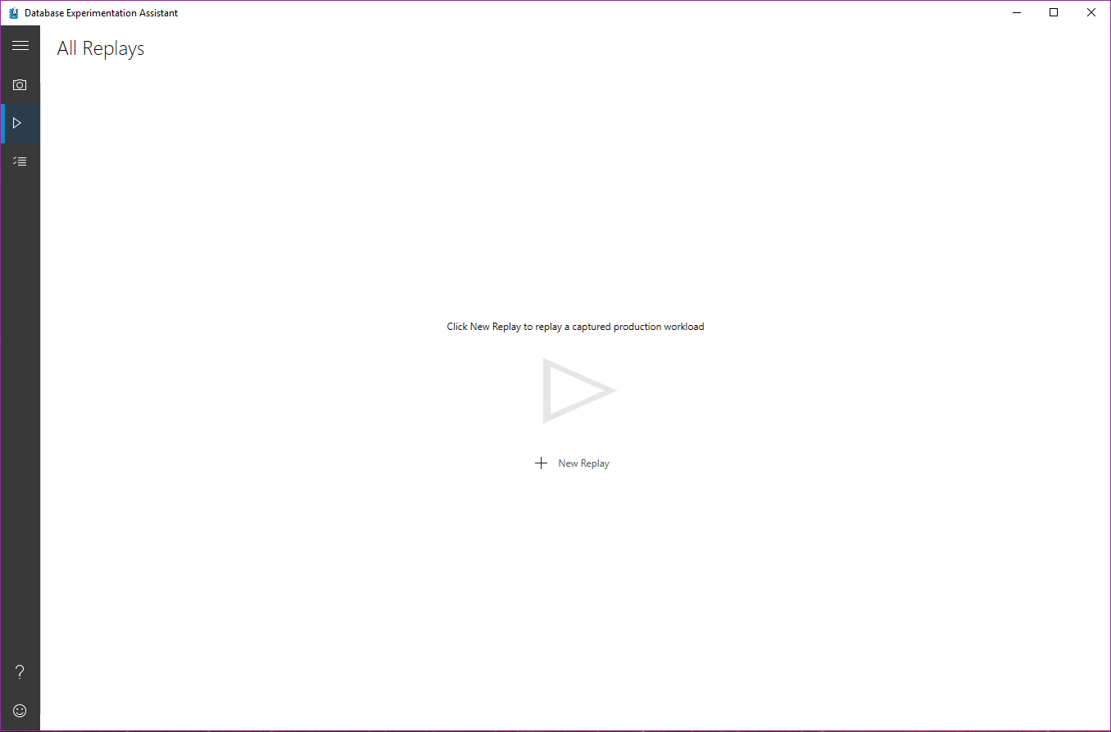

Slide 38
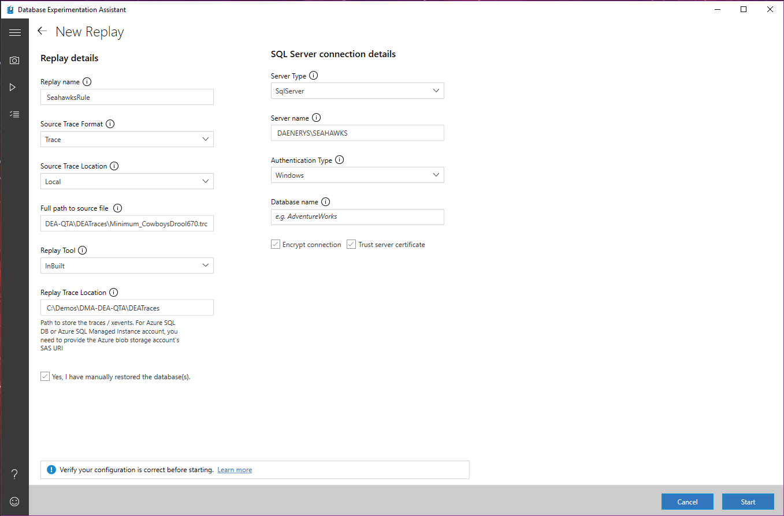

Slide 39
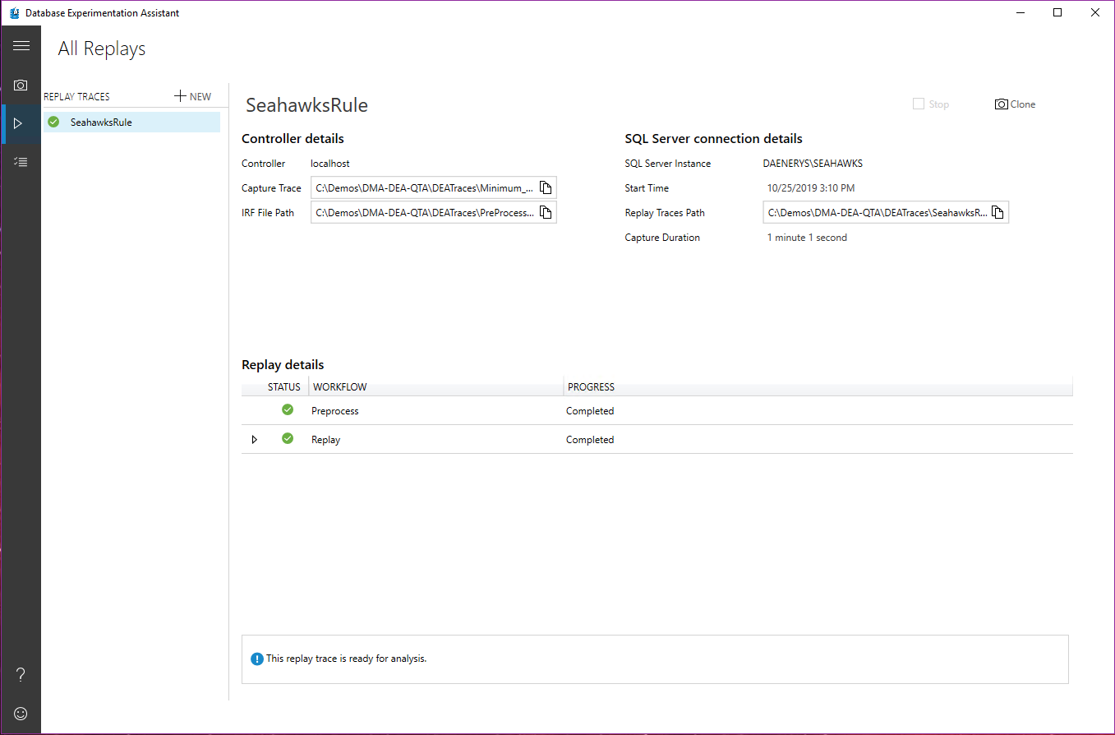

Slide 40
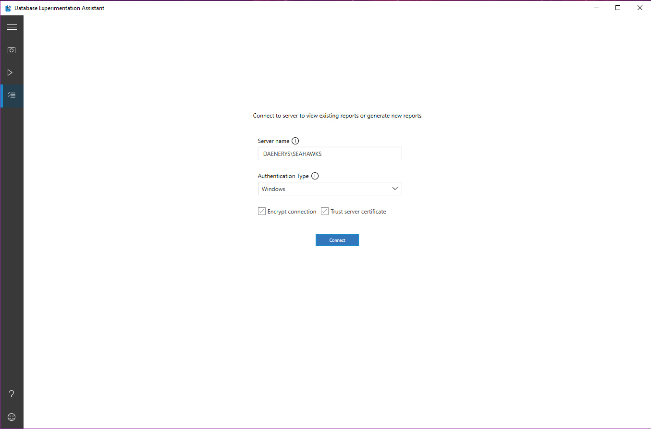

Slide 41
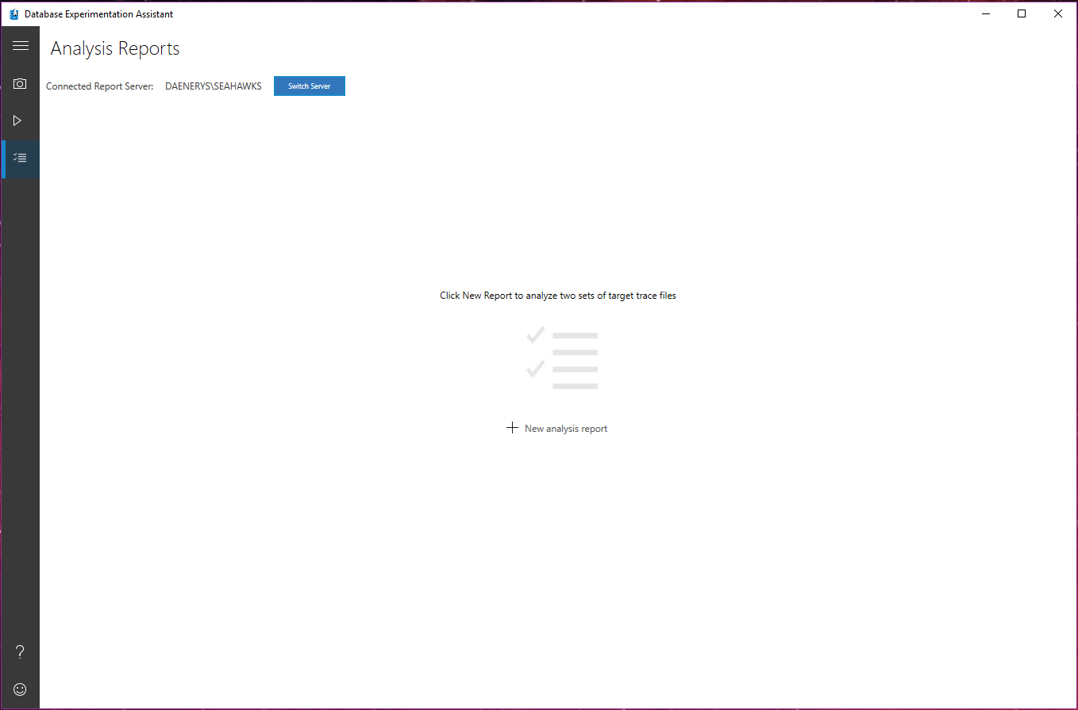

Slide 42
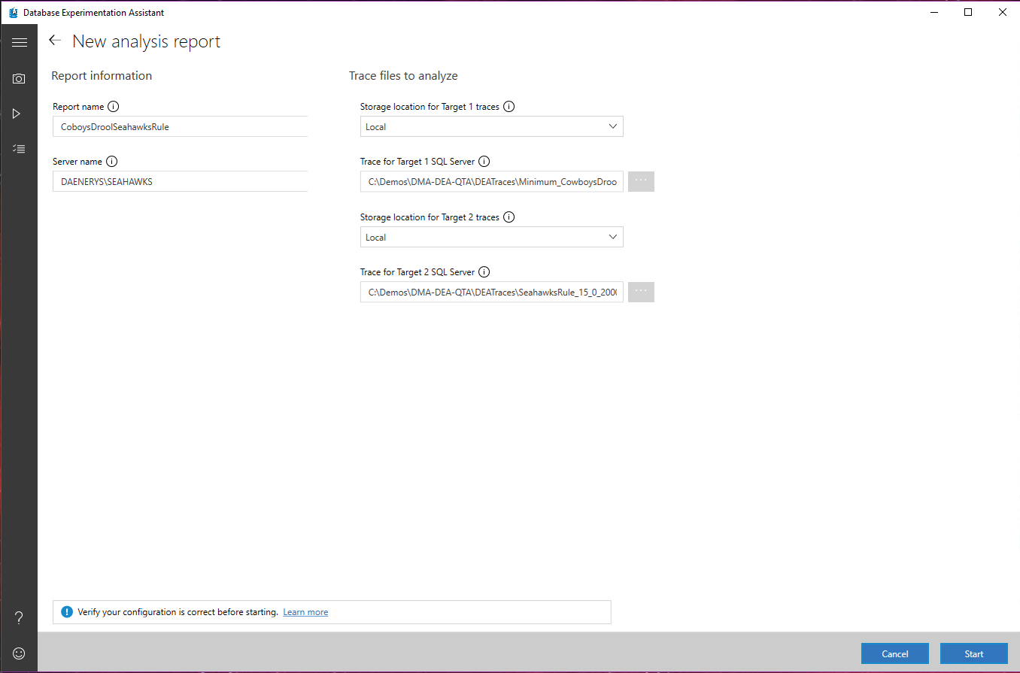

Slide 43
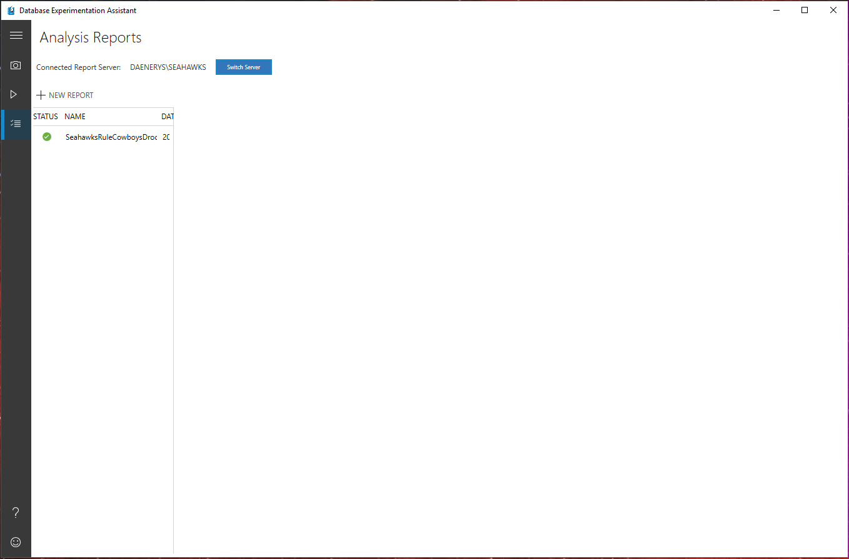

Slide 44
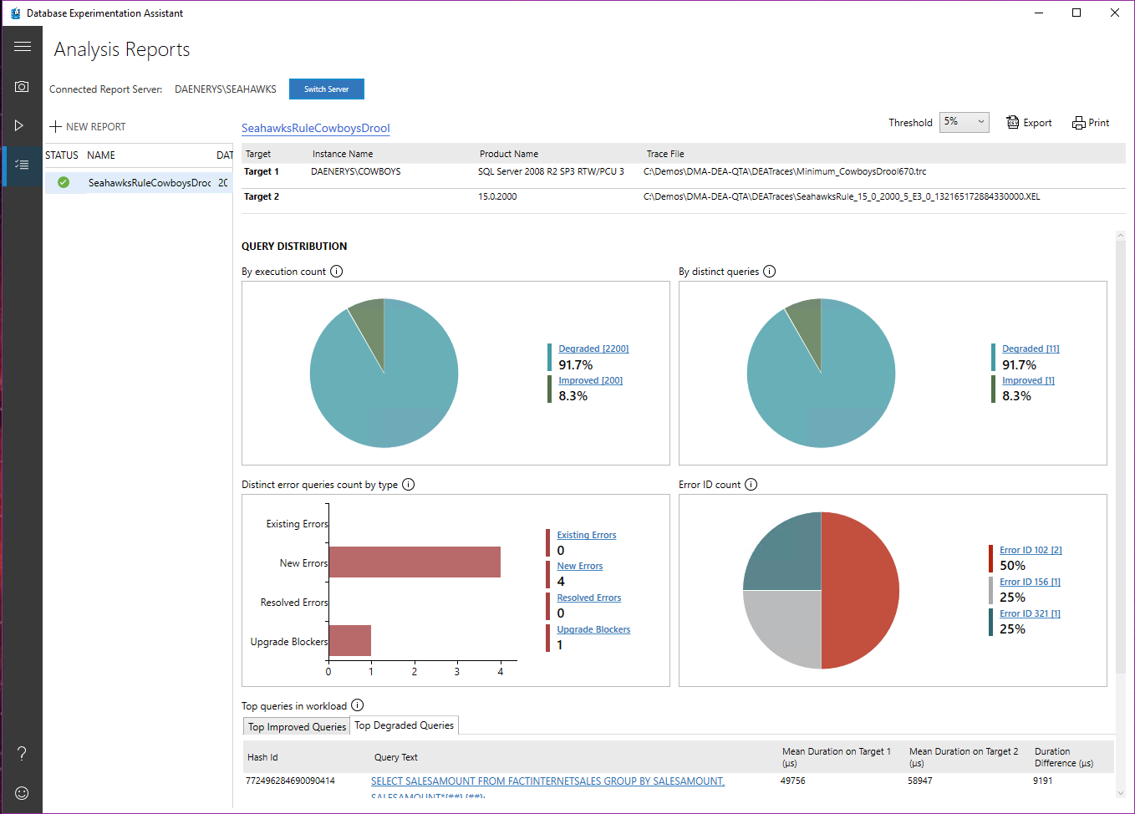
Notes:
Once we select one of the previous replays we’ve done, the report shows up.

Slide 45
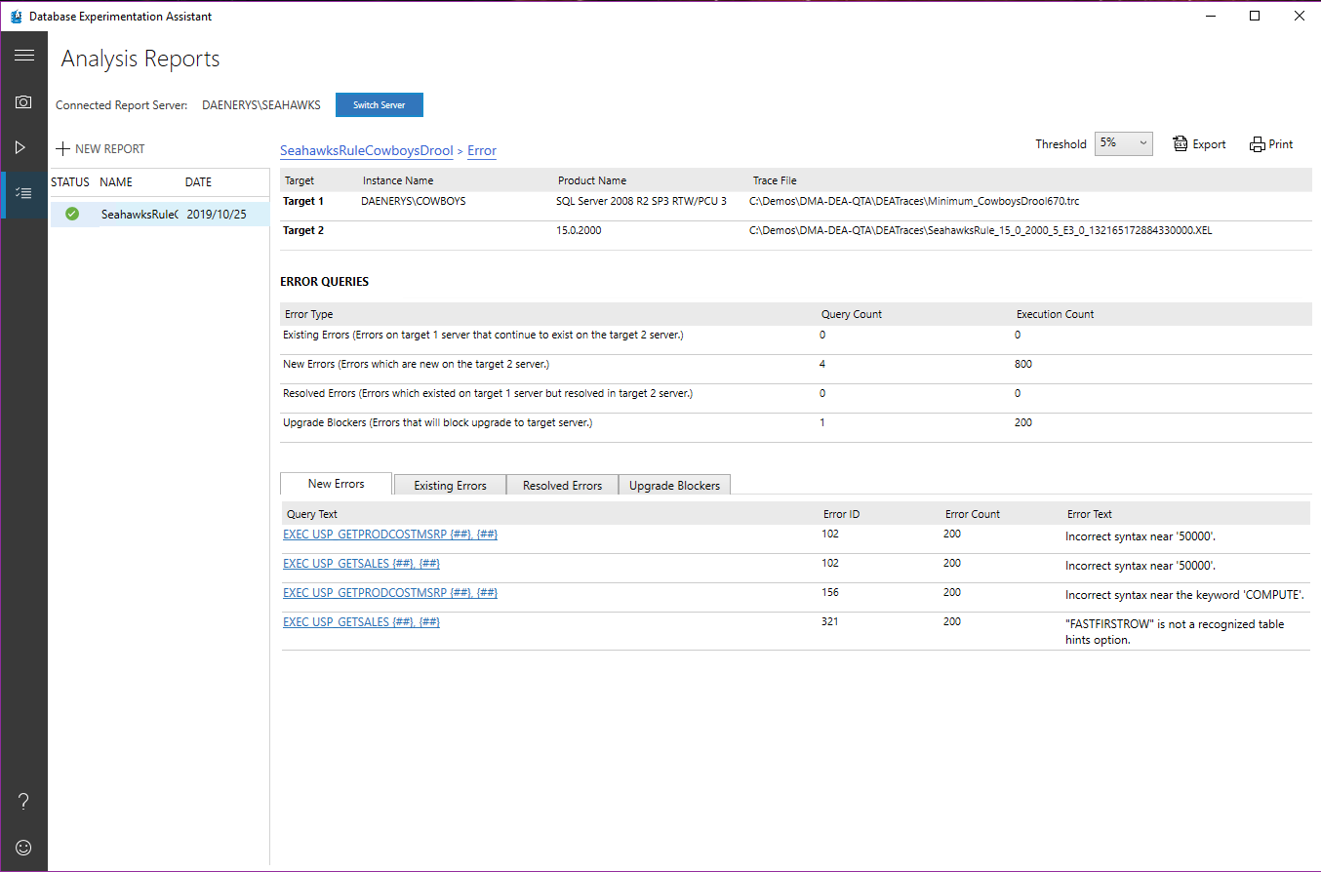
Notes:
We see we have a number of potential upgrade blockers. Click on the bar to see details.

Slide 46
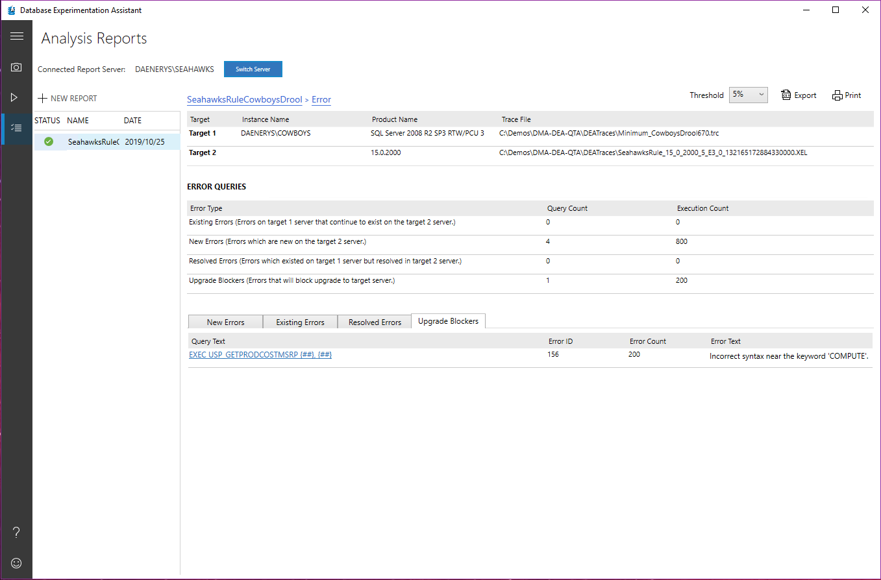
Notes:
The Upgrade Blockers tab shows any syntax execution errors that existed in the replay (B) that didn’t exist in the source (A). Syntax errors mapping to discontinued T-SQL are listed, in the context of the statement that produced the error. In this case, the “COMPUTE” clause was discontinued (back in SQL 2012), so this issue needs addressing.

Slide 47
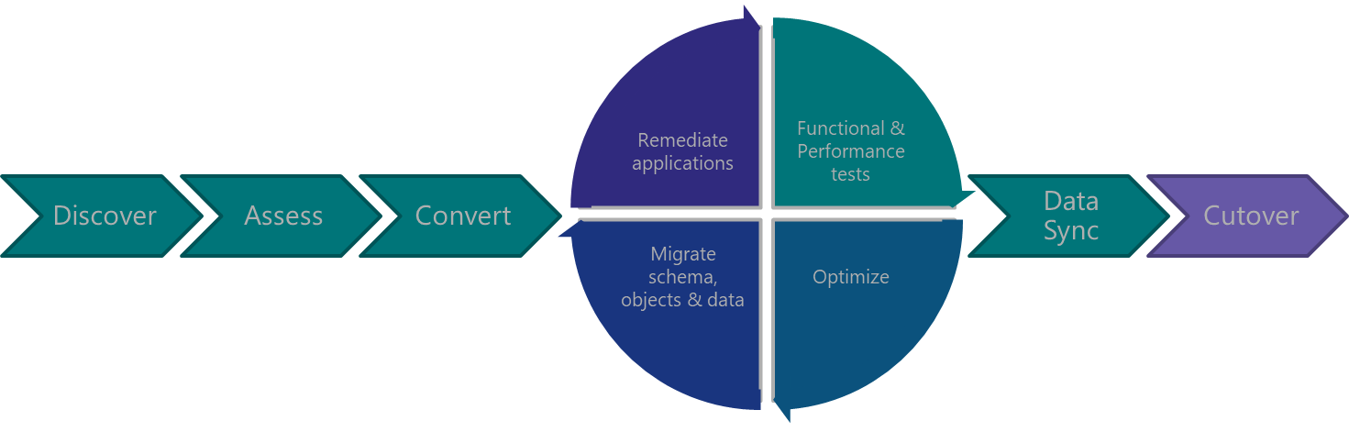
Post-
Migration

Slide 48
Am I done yet?
SQL Server Migration: The Last Mile
Be sure to check out Pedro Lopes’ session this afternoon at 4:45 PM to learn more about Compatibility Certification and the Query Tuning Assistant tool.

Slide 49
Modernization Tools Breakdown
QTA
Upgrade Database Compatibility Model to desired state
Provides tangible recommendations for tuning queries
Overall keeps use of CE version mapped to the DB Compatibility Level
DEA
A/B Testing
Capture and Replay workload for performance testing and reporting
Also reports on migration blockers because of failed T-SQL syntax
DMA
Readiness assessment: blocking issues breaking changes, behavior changes
Moves schema, data and uncontained objects (like logins) To Azure SQL Database
Backup / Restore to another SQL Server
Keeps source DB Compatibility Level
New feature recommendation
Detects workload regressions, and tests CE model variations (subsets)
Does not move to last known good state
Tweak most common CE model assumptions
Notes:
DMA
https://docs.microsoft.com/en-us/sql/dma/dma-assesssqlonprem
https://docs.microsoft.com/en-us/sql/dma/dma-overview
New feature recommendations include In-Memory OLTP and Columnstore, Stretch Database, Always Encrypted, Dynamic Data Masking, and Transparent Data Encryption.
DEA
Database Experimentation Assistant (DEA) is an A/B testing solution for changes in SQL Server environments (e.g. upgrade, new indexes, etc.). It assists in evaluating how the workload on your source server (current environment) will perform against your new environment. It guides you through performing an A/B test through three steps: capture, replay, and analysis.
QTA
Query Tuning Assistant (QTA) helps address some of the most common causes of CE-related performance regression, namely the following model assumption changes, starting with SQL Server 2014:
Independence vs Correlation
Simple Containment vs Base Containment
TVF fixed estimation of 100 rows vs 1 row
Note: as a last resort, full-fledge use of CE 70 is also considered, when all else doesn’t yield desired results. This is done by attempting to use targeted USE HINT query hints that change these assumptions, for regressed SELECT-based queries.
© Microsoft Corporation. All rights reserved. MICROSOFT MAKES NO WARRANTIES, EXPRESS, IMPLIED OR STATUTORY, AS TO THE INFORMATION IN THIS PRESENTATION.

Slide 51

Pam Lahoud
@SQLGoddess

