Slide 1
Turbocharge Your SQL Server with In-Memory Database
Pam Lahoud, Sr. Program Manager, Microsoft

Slide 4

Pam Lahoud
Program Manager in SQL Server engineering, focus on Storage Engine
Sr. Program Manager, Microsoft
Microsoft Certified Master
/pam_lahoud
@SQLGoddess

Slide 5
What is In-Memory Database?

Slide 6
Your data has always been in memory
Physical
Read
Logical
Read
Memory
Buffer Pool
Disks
Notes:
In the traditional database engine, the assumption is that data is on the disk. We use memory to make data access faster, but the primary data residence is on disk. The storage engine is designed with this premise in mind. Data is divided into pages which provide an efficient method to transfer data from disk into memory. The buffer pool mimics this page structure, again to make it easier to transfer data from disk into memory. Whenever we access data, however, it is from memory. We cannot read a page of data without first putting it into the buffer pool. And we keep things in the buffer pool as long as we can so that subsequent access is faster.

Slide 7




Your data has always been in memory
Data modification statement sent by application
2
Modification recorded in the log cache
Log cache record is flushed to the transaction log
1
4
Buffer cache
Transaction log
Data file
5
Dirty pages are written to disk
Affected data pages are located in or read into the buffer cache and modified
3
Notes:
The same is true for writes. We never modify a page directly on disk, we always bring it into the buffer pool first. Even if we’re only modifying a single row, the entire page must be read from disk into memory, and the page must be latched in memory in order to protect it from concurrent access while the row itself is being written. This has a significant impact on things like concurrency.
Once the modification is complete, we need to be sure that information is persisted somewhere so that we can guarantee durability. We write out a sequential transaction log that persists the logical change because it’s faster than writing the data page itself out synchronously. We still must persist the page on disk, albeit asynchronously, but we’re effectively writing the change out twice for performance purposes.
What if we didn’t have to do any of this data movement? What if once we wrote the change to memory we could guarantee that it would be persisted? Creating an in-memory database is so much more than just storing data in memory – it’s always been in memory. Creating an in-memory database is about rethinking how the database engine works in a world where two-tier slow/fast, persistent/non-persistent storage is no longer a necessity.

Slide 8
An in-memory database is a RDBMS that primarily relies on main memory for data storage. It is contrasted with RDBMSs that employ a disk mechanism as primary storage.
Notes:
Since the beginning of SQL Server the world of data storage has been divided into two tiers – fast volatile memory and slow stable storage. In today’s world, that story is changing rapidly. Disks are getting faster, memory is becoming non-volatile – in short, the lines are becoming blurred. What the future will look like is still up in the air, but the reality is that we can no longer look at storage in the same way as we have in the past. Whether we call it disk or memory is irrelevant, it’s all storage that has different properties such as speed, capacity, latency etc. that can be used to store data either temporarily or permanently, and the database engine needs to evolve to take advantage of everything this new world offers.

Slide 9
Hardware innovation breeds software innovation
Rethinking the database engine for the modern era
What does data storage look like?
How does resiliency change?
Can we rethink query processing?
Notes:
So in a world where memory and disk are converging, what does our database engine look like? What can we do differently and more efficiently? How can we harness the power of modern hardware to make the engine more efficient while retaining its reliability and ease of use?

Slide 10
In-Memory Database – The Journey

Slide 11
Flipping the script
What changes if we assume data is in memory?
No need for pages
Completely new concurrency model
Disk I/O for durability purposes only
Database engine no longer focused on minimizing memory usage
Index structures can change
New query processing modes
Notes:
What changes when you flip the assumption to the data resides in memory vs. on disk? What can you do differently? How can you modernize the database engine while continuing to maintain compatibility and interoperability with existing workloads and applications?

Slide 12
In-Memory Columnstore
Base table
Columnstore index
Compressed
column segments
A
B
C
D
Blobs
Encode
compress
Rowgroup
Rowgroup 1
Segment directory
~1M rows/group
Encode
compress
Rowgroup
Rowgroup 2
Encode
compress
Rowgroup
Rowgroup 3
sys.column_store_segments
Includes segment metadata: size, min, max, …
Notes:
SQL Server 2012 introduced something called In-Memory Columnstore that quite literally turned data storage on end. I always wondered why they called them “In-memory Columnstore Indexes” when they were in fact stored on disk, but columnstore is only possible if you think outside the box of traditional database storage.
Columnstore indexes are named as such because they store columns together rather than rows, but the innovation behind columnstore goes way beyond how the index is structured. With columnstore indexes, we are no longer bound to the page as a unit of transfer between disk and memory. Columnstore indexes are broken down into segments which consist of several pages stored as a large object. They are read and written as a whole, but even more, they are processed by the query engine differently than rowstore indexes. With the advent of batch mode processing we are able to process more data faster than ever by leveraging large amounts of memory and CPU. The power of columnstore lies in the reimagining of how data can be stored, accessed and processed – all within the constructs of the existing database engine. With SQL Server 2019, this innovation is now being brought to the rest of the database engine through batch mode on rowstore and other IQP innovations.

Slide 13
In-Memory OLTP
Row Header | Payload
Begin Ts | End Ts | StmtID | IdxLinkCount | Index1 ptr | Index2 ptr
8 bytes
8 bytes
4 bytes
2 bytes
8 bytes * Number of Indexes
Optimistic concurrency (latch-free, lock-free)
Indexes are logical pointers rather than physical structures
Notes:
In SQL Server 2014, In-Memory OLTP was introduced. While columnstore was targeted specifically to large DW OLAP workloads, In-Memory OLTP is specifically for high-speed transactional workloads. In fact, internally you may notice that the In-Memory OLTP DMVs and performance counters all have XTP in the name – eXtreme Transaction Processing. Hekaton is of course a cool code name, but XTP is what In-Memory OLTP is all about.
With In-Memory OLTP, it’s pretty clear why it’s named “In-Memory.” This is what many people consider a true in-memory database – the data structures are designed to reside in memory only and are guaranteed to always be memory-resident. There is still disk I/O to ensure durability across failures and restarts, but it’s streaming I/O simply for durability purposes. Given the in-memory assumption, we can rethink data storage yet again. There’s no need for pages, OLTP operations are generally atomic. Data storage is in tuples (rows) with pointers providing logical table and index structures. Concurrency now can be managed at the row level using versioning, which allows for optimistic concurrency and what the marketing folks like to call “frictionless scale.” Again, the power of In-Memory OLTP is not necessarily that the data resides in memory – it’s always been there. The true power of In-Memory OLTP lies in what that assumption allows us to do. It lies in optimized data structures, streaming I/O, and massively scalable concurrency. All of this on top of cross-compatibility with existing database engine workloads.
Combine columnstore indexes with in-memory OLTP and you can have the best of both worlds with what we call operational analytics or HTAP.

Slide 14
Today’s Innovations

Slide 15
Types of TempDB Contention
Object Allocation Contention
Contention for metadata pages used to manage space allocation in a data file
Metadata Contention
Contention for pages that belong to system objects used to track table metadata
Look for PAGELATCH waits on pages that belong to system objects
Temp Table Cache Contention
Contention for memory objects associated with the Temp Table Cache
Look for either CMEMTHREAD waits or SOS_CACHESTORE spinlock waits (both can be due to other causes)
Look for PAGELATCH waits on PFS and GAM pages
Notes:
Object Allocation Contention This type of contention happens when SQL Server is searching for space to store a new object in a database, or when it needs to deallocate space that has been allocated to an object. The metadata pages used to track these allocations are called PFS and GAM pages. When there are a large number of concurrent threads allocating space in the same database file, you will see PAGELATCH waits on these pages in memory.
Metadata Contention This type of contention occurs when multiple concurrent threads are attempting to modify the metadata associated with tempdb objects at the same time. This happens whenever we need to modify the definition of an object (such as adding an index, dropping or otherwise altering a table). This type of contention manifests as PAGELATCH contention on database pages associated with system object such as sysobjvalues.
Temp Table Cache Contention Temp table caching was introduced in SQL Server 2005 in order to help avoid metadata contention. As the amount of RAM and the number of CPUs in a system grows, the size of the cache and the number of concurrent threads accessing the cache grows, which can introduce slowness in cache access as well as contention for the memory object associated with the cache. This can manifest in two different ways: CMEMTHREAD waits and SOS_CACHESTORE spinlock waits.

Slide 16
Memory-Optimized TempDB Metadata
Node 1
Node 2
Node 3
DROP #T1
DROP #T2
DROP #T3
DROP #T4
DROP #T5
DROP #T6
DROP #T7
DROP #T8
DROP #T9
DROP #T10
DROP #T11
DROP #T12
NOP
NOP
NOP
NOP
NOP
NOP
NOP
NOP
NOP
NOP
NOP
NOP
Memory pressure triggers cache clock hand sweep to move items to deleted list.
Background process cleans up items from deleted list and removes the corresponding metatdata.
1
2
DELETE
If the background thread falls behind in keeping the list at a reasonable number, only one thread per NUMA node becomes a helper thread.
FETCH 1
If the background thread falls behind in keeping the list at a reasonable number, all CREATE threads potentially become helper threads.
FETCH 64
3
3
FETCH 1
deleted list
sysobjvalues
FETCH 64
DELETE
DELETE
DELETE
DELETE
DELETE
DELETE
DELETE
DELETE
DELETE
DELETE
DELETE
DELETE
Node 1
Node 2
Node 3
CREATE #TA
CREATE #TB
CREATE #TC
CREATE #TD
CREATE #TE
CREATE #TF
CREATE #TG
CREATE #TH
CREATE #TI
CREATE #TJ
CREATE #TK
CREATE #TL
Notes:
As workloads scale up and systems get larger and faster, contention on TempDB has increased exponentially and it has become a major bottleneck to overall system performance for many customers. We have made several innovations over the years to address these issues as they arise such as temp table caching, best practices around object allocation and multiple files, setup changes etc. We have also changed the way temp table cache trimming works. These changes have solved TempDB contention for some customers, but many others are still facing issues. So, given that TempDB is by its nature non-durable, why not leverage past innovation by making these system tables non-durable memory-optimized tables? In addition to cutting down I/O, this converts the metadata into latch-free lock-free structures that unlock concurrency in the same manner as In-Memory OLTP has done for our customers’ high-speed transactional workloads. In-Memory OLTP virtually removes all TempDB contention and unlocks scalability for even the heaviest TempDB workloads.

Slide 17
Memory-Optimized TempDB Metadata
Let’s Hekatonize!!!!

Slide 18
PMEM (non-volatile memory)
DRAM
hot tier
DRAM
Memory
Persistent Memory
Improving
memory capacity
SCM
NVMe
Improving
SSD performance
Faster SSD
Storage
Delivering
efficient storage
Higher Capacity SSD
HDD / TAPE
Notes:
Fast and volatile + slow and durable (two tiers)
Fast and volatile + new thing (a bit slower, a lot less volatile) + slow and durable (two tiers)
NAND – what SSDs are made of. 3D NAND = faster NAND as in a whole new universe
SCM = Storage-class memory -> kind of synonymous with PMEM. Two approaches – NVDIMM-N - memory make it persistent (capacitor battery) or Intel Optane - take really fast and consistent 3D NAND (no levelling issues, much more resilient) and put it on the memory bus
NVMe is the same tech as SSDs, exploiting it better by putting it on the PCIe bus
The classic memory/storage pyramid is:
Frequently used “hot” data stored in memory; primarily high-performance, but expensive and volatile DRAM. This provides low-latency access to data, but at relatively low capacity compared to today’s growth data volumes which constrains how much data application developers can utilize efficiently.
DRAM memory is supported by long term storage that is persistent, high capacity and lower cost. The challenge is that older technologies like hard drives or even magnetic tape are vastly slower than DRAM and so can quickly become a bottle neck to infrastructure performance. Hence these technologies are ideal suited for “cold” data; information that is rarely used or where users will tolerate delays in response
Over the past few years the reduction in the cost of non-volatile solid state drives has offered significant bandwidth gains vs hard drives while retaining the permanent data storage that DRAM lacks and much higher storage capacity than can realistically be deployed using traditional memory technologies. This creates a “warm” storage layer that strikes a balance between “hot” and “cold” storage approaches.
Note: Persistency vs volatile is the difference between needing electricity to retain information or not. DRAM is volatile since once the power is turned off no data is retained. Storage media like hard drives or SSDs are considered persistent since while power is required to read or write data, no electricity is required to store the data.

Slide 19
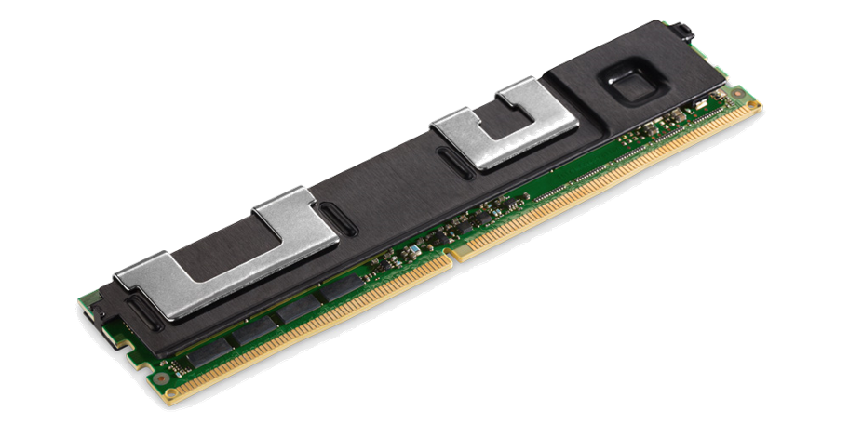
SQL Server and PMEM
mdf
Block device
SQL
Engine
Kernel I/O
ldf
Persisted Log Buffer (SQL 2016+)
Log cache
Enlightened I/O (SQL 2019)
ldf
Bpool
mdf
SQL
Engine
Kernel I/O
Hybrid Buffer Pool (SQL 2019)
mdf
ldf
Notes:
This is all foundational work we’re doing here, it’s about how the OS talks to the devices, SQL Server is just taking advantage of it.
Block device – any version of SQL Server, as long as the OS can talk to the PMEM device
Persisted Log Buffer (SQL 2016+) – NTFS formatted with DAX = true, in Linux, mount the device with DAX=true. Add a new 20MB log file to this device, SQL will pick it up automatically. If you make it bigger, it’ll resize it.
Enlightened I/O – We built the foundation in the PAL for now. Not really a feature, just kind of how Linux works.
Hybrid Buffer Pool – see later slides on this. Basically just storing your data files on PMEM with DAX=true

Slide 20
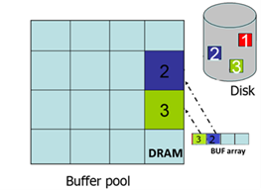
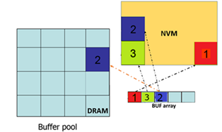
Hybrid Buffer Pool
Place data files directly on PMEM with DAX mode
Eliminates I/O
Increases cache capacity to meet peak workload I/O demands
Considerations
Applies to clean pages only
Not compatible with Buffer Pool Extensions (BPE)
Not compatible with pages using torn page detection
Not compatible with TDE (Optane encrypts data at the device level)
Cannot shrink DB files when the feature is enabled
No need to copy pages to DRAM (traditional buffer pool)
Buffer pool without Hybrid Buffer Pool
Buffer pool with Hybrid Buffer Pool

Slide 21
How do I get it?
Put your database file on a PMEM device with DAX = true
ALTER SERVER CONFIGURATION SET MEMORY_OPTIMIZED HYBRID_BUFFER_POOL = ON;
Restart the SQL Server instance
ALTER DATABASE <databaseName> SET MEMORY_OPTIMIZED = ON;

Slide 22
What does the future hold?

Slide 23
Our approach to persistent memory
PMEM enables both lower storage latency and increased memory capacity
Real world performance gains with minimal tradeoffs
Avoid unnecessary complexity
Balance performance gains with cost
Make it manageable – it should just work

Slide 24

Learn more
Check out these great data-related demos
https://aka.ms/DataDemos
https://aka.ms/IQPDemos
Continue learning with our new book
https://aka.ms/LearnTSQLQuerying
One shortcut to rule them all!
https://aka.ms/SQLShortcuts
Download and try SQL Server 2019
https://aka.ms/ss19
https://aka.ms/LearnTSQLQuerying_errata
https://aka.ms/SQL2019Notebooks
Use our free training
https://aka.ms/sqlworkshops
https://aka.ms/SQL2019WhatsNew

Slide 26

Pam Lahoud
@SQLGoddess

