Slide 1

THE JOB HUNT COCKPIT
Real openings.
Scored and explained.
Zero fake data.
21 verified employer boards · mail fraud screening · self organizing tracker · Chrome helper · free and open source
github.com/siddhant-pardeshi/JobForge · v1.4 · October 2026

Slide 2
THE PROBLEM IT SOLVES
Job hunting is broken. This fixes the workflow.
Boards bury engineering roles
Sales and BDA listings at software companies crowd out real engineering work. JobForge classifies the work described, not the company name, and keeps every exclusion auditable.
Fraud mails drain accounts
Fee demands, UPI traps and fake HR domains reach candidates daily. 23 indicators screen posts, full emails, and the open mail inside Gmail and Outlook.
Applications vanish
Clicks are not proof. A tracker with a real state machine counts a submission only when a receipt backs it, and blocks duplicates.
Relocation math is opaque
Fixed versus variable, deposits versus rent, bonuses versus monthly cash. Three scenarios answer: would the move actually pay?
JobForge · Why
2 / 15

Slide 3
ARCHITECTURE
One machine, one cockpit, one click that submits.
Your resume
21 live boards
Scoring engine
Scam shield
Packets
Chrome helper
Self moving board
→
→
→
→
→
→
parsed locally into a verified profile
polled every 20 min, closures detected
seven components, every reason shown
23 indicators on posts and open emails
cover letter, referral note, prep kit
capture, autofill, mail screening
rounds scheduled, reminders, receipts
Your submit click
The one step that always stays with you. Prefill yes, submit no: LinkedIn and Naukri ban automated activity and the ban lands on the user's account, so the helper stops one click short everywhere.
All of it runs on one machine: Express API, JSON store, React 19 client. No database, no cloud, no telemetry.
5,843
21
23
38
LIVE POSTINGS
VERIFIED BOARDS
FRAUD INDICATORS
TESTS PASSING
JobForge · Architecture
3 / 15

Slide 4
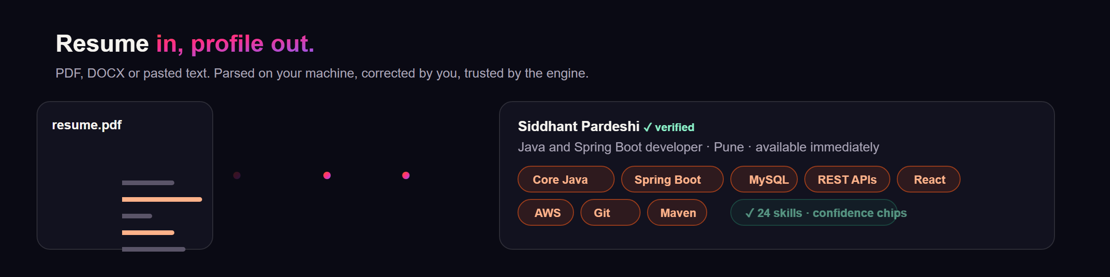
FEATURE 1 · RESUME ENGINE
Your resume becomes a verified profile.
Built for Indian resumes
Confidence, not blind trust
The highest leverage edit
Space eating PDF fonts are repaired by camel case reconstruction: SpringBoot maps to Spring Boot, RESTAPIs to REST APIs. A 70 skill synonym taxonomy means Java 17 counts as Core Java while JavaScript never counts as Java.
Every extracted fact carries a confidence chip. Skills, projects, education and certifications are all editable before anything counts, and the original file is never modified.
Skills drive 30 of the 100 score points. Saving the profile re-ranks every job instantly, so ten careful minutes here upgrade every score, packet and referral note the engine produces.
JobForge · Resume engine
4 / 15

Slide 5
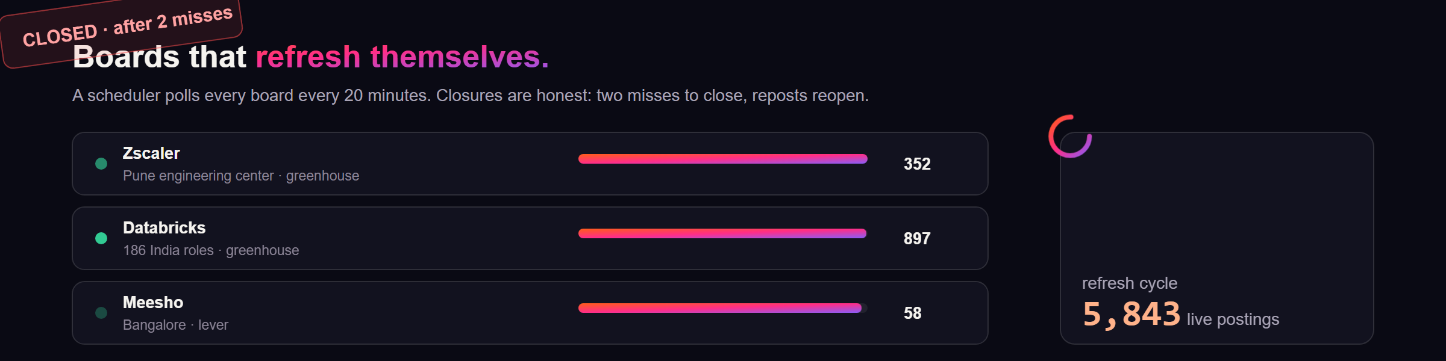
FEATURE 2 · LIVE BOARDS
Real postings, refreshing themselves.
Verified, then polled
The two miss rule
Grow your coverage
Every board in the registry was probed against its live endpoint before shipping. The scheduler polls all of them on your interval and logs every run.
A posting that vanishes gets one grace miss, because boards drop listings transiently. Two consecutive misses mark it closed with a timestamp; reposts reopen automatically.
Paste any Greenhouse, Lever or Ashby careers URL: the provider and handle are detected and the board probed before saving. Coverage honesty is a feature, not a bug.
JobForge · Live boards
5 / 15

Slide 6
FEATURE 3 · SCORING ENGINE
A score you can argue with.
0 to 100, fully explainable
Open any card and see which skills matched, which are missing, and why it landed in its lane. Unknowns stay neutral: an unlisted salary never buries a great Pune role and never fakes a relocation verdict.
Lanes
Best in Pune
Remote from Pune
Relocation
Needs verification
Filtered out · reason shown
Closed or redacted
Weights are sliders in Settings. Drag them and the board re-ranks live.
JobForge · Scoring engine
6 / 15

Slide 7
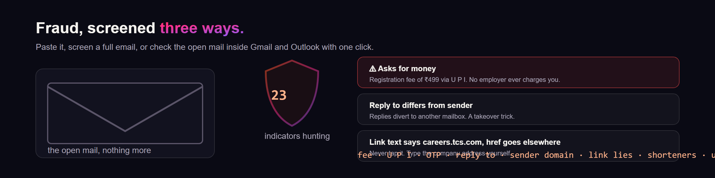
FEATURE 4 · DEFENSE
Fraud screening that earns its keep.
Three screens
Calibrated, not paranoid
Private by design
Paste any message, analyze a full email with sender, reply-to and link inspection, or pair the helper and check the open mail inside Gmail and Outlook with one click.
A WhatsApp contact alone is never declared fraudulent. A payment demand blocks automation regardless of the skill match. Every verdict shows the evidence behind it.
The screen reads exactly one email, the one you clicked on. Nothing is read in the background, and the log stays on your machine.
JobForge · Scam shield
7 / 15

Slide 8
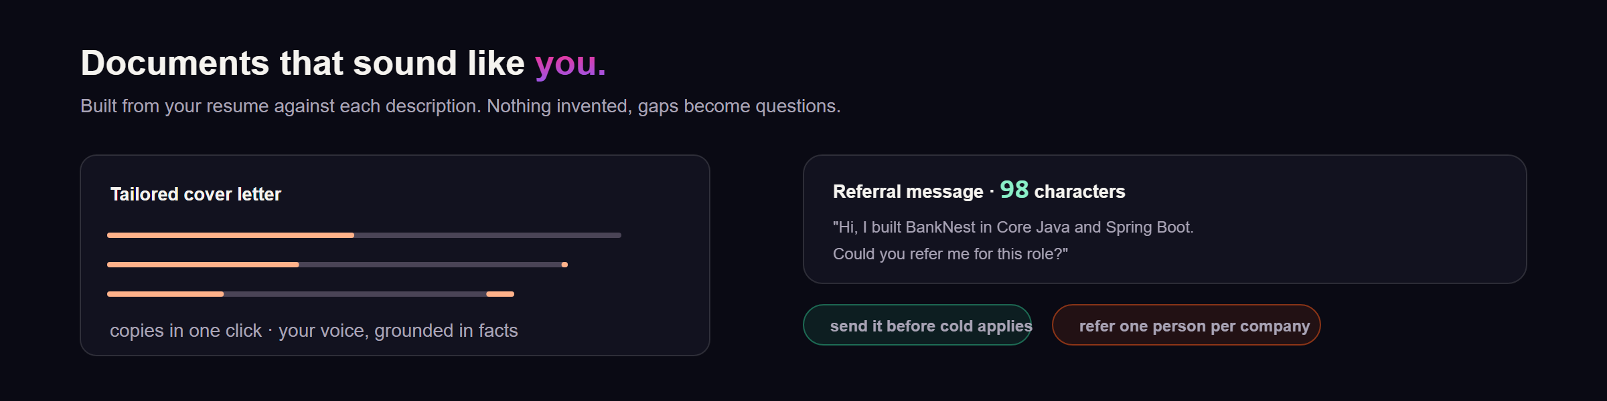
FEATURE 5 · DOCUMENTS
Packets that sound like you.
Grounded, always
The referral edge
Prep kit included
The cover letter connects your real projects to this description's requirements. Nothing is invented: if the resume does not support a claim, the packet asks you about it instead.
A ~100 character referral message per company, ready to send. Referred applications convert several times better than cold applies, and the message is already written.
Five to eight questions this interviewer would plausibly ask, grounded in required skills and real projects. Practice them aloud before the call.
JobForge · Packets
8 / 15

Slide 9
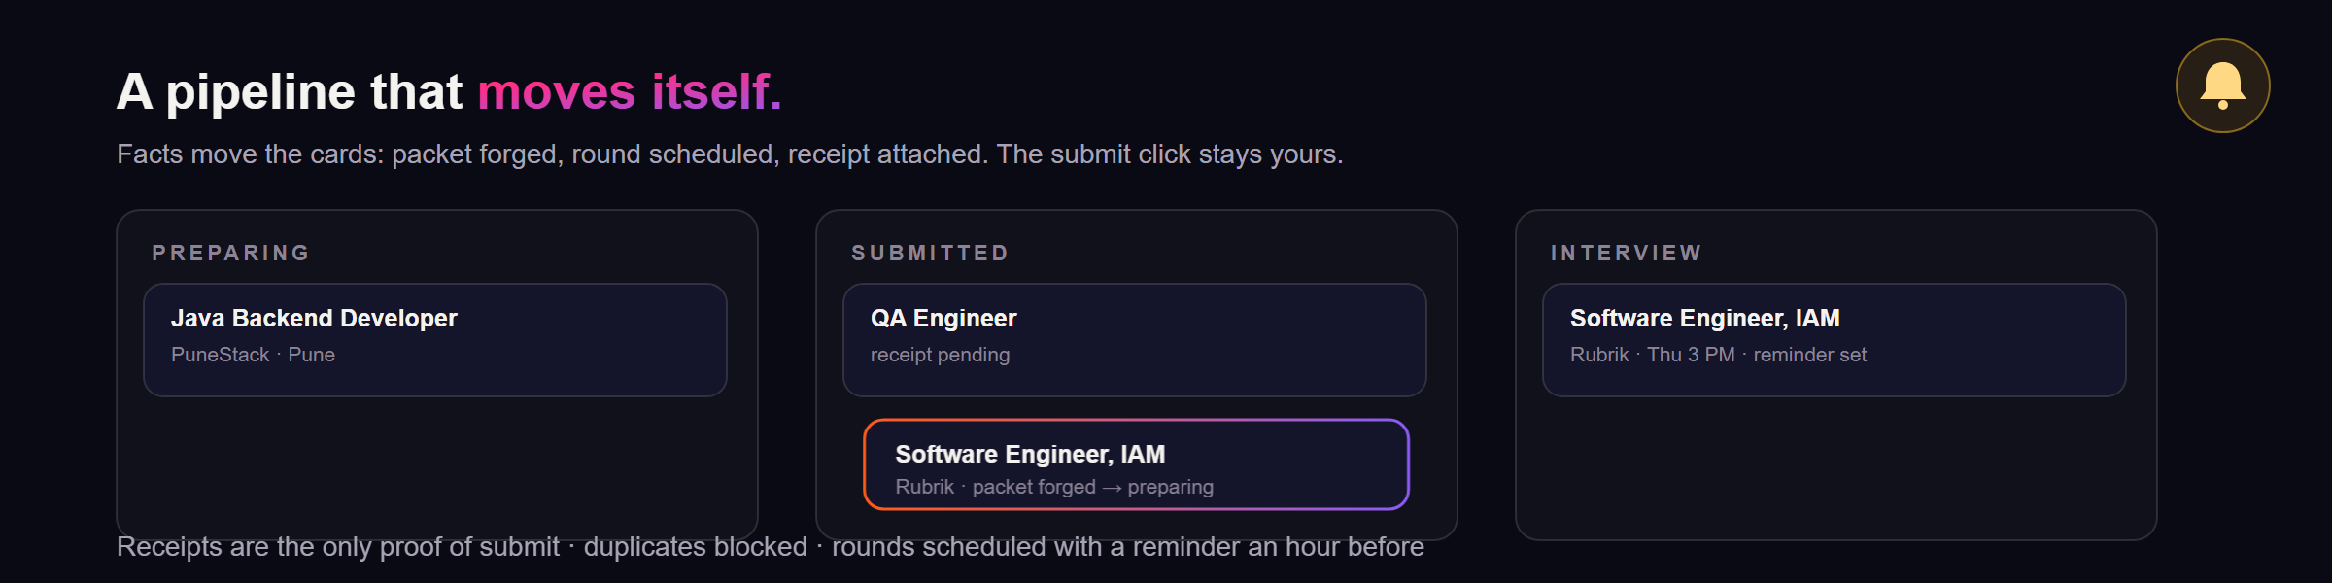
FEATURE 6 · PIPELINE
A tracker that organizes itself.
Moves on facts
Live by the second
Honest bookkeeping
Packet forged moves a role to preparing. Round scheduled moves it to interview with a reminder an hour before. Receipt attached makes the submission count.
The board re-renders every five seconds with spring animations. Leave it open on a second screen and watch the pipeline breathe.
Submissions count only with receipt evidence, duplicates are blocked, and the funnel shows what is actually working for you.
JobForge · Tracker
9 / 15

Slide 10
FEATURE 7 · DECISIONS
Would the move actually pay?
Cautious
Base
Favorable
Net
₹61,200
Net
₹68,000
Net
₹73,440
Costs
₹33,600
Costs
₹30,000
Costs
₹27,600
Surplus
₹27,600
Surplus
₹38,000
Surplus
₹45,840
vs Pune
+₹8,100
vs Pune
+₹9,000
vs Pune
+₹11,700
Separate the truth
Unknown stays unknown
Your budgets win
Fixed versus variable pay, deposits as liquidity never monthly cost, joining bonuses excluded from every recurring figure, and a Pune baseline for comparison.
Undisclosed pay returns affordability unknown plus the exact questions to ask the recruiter. The role stays visible; the guess never happens.
Six city default budgets across nine categories, all editable. Your numbers override every default the moment you save them.
JobForge · Relocation
10 / 15

Slide 11
FEATURE 8 · OPTIONAL BRAIN
Works free. Sharper with a key.
Everything runs with no key at all. A provider only polishes the cover letters and bullets. Keys live in a git ignored local file and travel only to the provider you chose.
Groq
console.groq.com/keys
Free tier
Fastest start, generous limits, the recommended first key
Anthropic Claude
console.anthropic.com/settings/keys
Pay per use
Best cover letter writing. Haiku is cheap, Sonnet is the finest
OpenAI
platform.openai.com/api-keys
Pay per use
Solid all rounder. gpt-4o-mini is inexpensive for this workload
Ollama
ollama.com/download
Free, local
Runs offline on your machine. The resume never leaves it
OpenRouter
openrouter.ai/keys
Free daily models
One key, hundreds of models to experiment with
Z.ai GLM
z.ai/manage-apikey/apikey-list
Pay per use
GLM models through an OpenAI compatible endpoint
Settings, AI provider, paste the key, press Test. The sidebar dot turns green with the model name.
JobForge · AI keys
11 / 15

Slide 12
FEATURE 9 · CHROME HELPER
LinkedIn and Naukri, on your team.
01
02
03
Send to JobForge
Autofill with JobForge
Check this email
One click on any posting you are viewing on LinkedIn, Naukri, Greenhouse, Lever, Ashby, SmartRecruiters or Workday. It lands in your cockpit scored and scam screened within a second.
Application forms fill from your saved data: name, contact, links, notice period, approved answers. Every value is remembered and editable, so a wrong fill never repeats.
Inside Gmail and Outlook, the open mail is screened in place with a color coded verdict panel. It reads exactly one email, the one you clicked on, and nothing else.
The one line that matters
The helper never presses submit. Not on any site. LinkedIn and Naukri ban automated activity and the ban lands on your account, so the helper stops one click short and leaves that click to you. Prefill yes, submit no.
1
Copy the token from Settings
2
Load unpacked the extension folder
3
Pair, Test, browse as always
JobForge · Chrome helper
12 / 15

Slide 13
FEATURE 10 · SHARING
Open to everyone. Private on demand.
Open access
Private with code
You are the admin
The default. Anyone with the link uses the full hunt free: live boards, scored matches, scam screening, pay insights, relocation math.
One flip in Settings and visitors need the six digit code. Flip back and the link is open again. Instant, both ways.
Flip it on the host machine with one click, or from any browser with the admin code. Guests can never flip it: they get a 403.
Guests stay read only
The server enforces it, not a promise: settings, profile, tracker changes, imports, exports and resets all require the owner. Secrets, the resume text and the host filesystem path never appear in a guest response. Verified by the test suite over the live tunnel.
Hosting in two lines
npm start · cloudflared tunnel --url http://localhost:8787 · share the URL. A permanent home is the same server on any VPS behind HTTPS.
JobForge · Sharing
13 / 15

Slide 14
ENGINEERING
Built like a product, not a script.
Stack
Quality gates
Honest limits
Express API over a JSON store, atomic writes
React 19, Vite 7, Tailwind 4, Framer Motion 12
Chrome MV3 extension, vanilla, no build step
No database, no cloud, no telemetry
38 tests covering the hard guarantees
Classification edges and fraud blocking
Closure detection and dedupe provenance
Salary parser across four formats
Listing access is read only
LinkedIn and Naukri stay capture only
Relocation math is a planning aid
Refresh runs while your machine runs
Exports include everything: profile, tracked jobs, packets, logs. Reset wipes it all locally. The repo carries a full build context document so any developer or AI tool can extend it without breaking the invariants.
38 tests · MIT · zero telemetry
JobForge · Engineering
14 / 15

Slide 15

Forge your applications.
Land the role.
Star the repo. Fork it. Break it. Improve it.
github.com/siddhant-pardeshi/JobForge
MIT · free forever · built in Pune by Siddhant Pardeshi

