Slide 1
Community
Connect
🧵
Your group chat is a crime scene.
🕵️
3 event links. 0 decisions. 1 friend who “saw the message late”.
CommunityConnect turns that chaos into one plan everyone actually attends.
Free while we grow · never event alone
Notes:
Open with the crime-scene line. Pause. Everyone has lived this. Then: 'We built the detective.'

Slide 2
THE USUAL SUSPECT
Exhibit A: the group chat
😤
bro which event??
wait they clash???
idk man, both look fun
i'll decide tomorrow
tomorrow (3 weeks ago)
*mutes group chat*
Everyone has been here. Nobody is proud.
Notes:
Let the bubbles land one by one. The last one gets a laugh every time.

Slide 3
THE HERO ENTERS
One loop. Zero chaos.
📌
🗳️
✅
🎉
→
→
→
Share
Vote
Confirm
Attend
post events or paste any link
can / maybe / cannot
2 people = real plan
bring a buddy
Every listing keeps its source link. The math behind every result is published. No black boxes.
Notes:
The whole product in four tiles. If they remember one slide, it's this one.

Slide 4
FEATURE · DECISION ROOMS
Voting, but for your Saturday
✅
can
🤔
maybe
❌
cannot
I'm so there
if I survive Friday
next time, promise
Pick a favorite. Change your mind until the deadline — the deadline is real (sorry).
For the nerds 🤓
score = 100 × (0.65·can + 0.15·maybe + 0.20·favorite) ÷ roster
Quorum 60%. Ties stay ties. The formula is public — no mystery AI picking your weekend.
Notes:
Emphasize: ballots are private, results follow a published formula. Trust is the feature.

Slide 5
FEATURE · CLASH DETECTION
Two events. One Saturday.
Zero of you.
🏃 Run + Chai Club
🤖 AI Demo Night
⚡ clash!
Sunday · 6:30 AM · Cubbon Park
Sunday · 8:00 AM · Koramangala
CommunityConnect flags the overlap the moment your circle shortlists both — before your heart does 💔
Travel time, buffers and partial attendance included. Your calendar finally makes sense.
Notes:
This is the 'aha' — clash detection is automatic the moment both options are shortlisted.

Slide 6
FEATURE · CIRCLES
A private room for your crew
🔑
Invite codes
What happens in the circle…
revoke old links any time
…stays in the circle. Votes, plans and attendance are never public. Private rooms, public good times.
🕵️
Circle-only events
never in public search
💬
Discussion
decide before, recap after
Notes:
Circles are the privacy story: private by default, revocable invites, no leaking.

Slide 7
FEATURE · BUDDY BOARD
Nobody walks in alone
(not even you, Dave)
🫂
🤝
🙈
Post a request
Mutual accept
Private cancel
“first time — would love company”
both sides say yes, always
no explanations owed, ever
Plus the Support Hub: job seekers, referral seekers and people between roles can opt in — and communities show up for them.
Notes:
The buddy board is why first-timers come back. Mention the support hub briefly — heartfelt beat.

Slide 8
FEATURE · PEER VOUCHES
Receipts for being a decent human
❤️
Hearts
14-day refresh 🔁
they were great to meet
Vouches fade after two weeks. Records renew, conduct improves, fake profiles leave the chat.
🎓
Verified claims
college · company · course — “I saw the proof”
🌟
Conduct
polite. professional. recorded.
Vouching needs a shared event — no drive-by ratings, no points for reputation.
Notes:
Key differentiator: peer verification with a rolling window. Nothing permanent to weaponize.

Slide 9
FEATURE · NETWORKING CARD
Business cards are dead. Carry a QR.
🖨️
Print it
COMMUNITYCONNECT
standard 85.6 × 54 mm — feels premium, costs pocket-change
Your Name
your role · your city
📷
Scan it
opens your live profile — links, interests, real you
🔒
▯▮▯
Trust it
respects your privacy settings — hide college, card obeys
scan → profile
Also a vCard QR, so phones can save you as a contact. Fancy.
Notes:
The card is the event icebreaker — one scan beats 20 paper scraps.

Slide 10
FEATURE · INVITE & EARN
Invite a friend. You both win.
🎁 Your side
🎀 Their side
+75 XP
14-day directory boost
Connector badge
+75 XP
7-day welcome boost
Connector badge
Joins through founder-team links become Founding Members: +100 XP, every profile theme, top directory placement — permanent.
It's not a pyramid. It's a friendship triangle. ▲
Notes:
Symmetric bonuses are the point — no recruiting pressure, both sides win equally.

Slide 11
FEATURE · SUPPORT HUB
Communities open doors when you ask honestly
💼 Open to work
🔗 Seeking referrals
🌱 Between roles
📣 Hiring
Opt in with intent chips. Others see them and help — intros, referrals, a friendly face at your next event. The buddy board means even your first event isn't solo.
Laid off without warning?
Turn on 'Between roles — open to support'. Ask for specific help. Attend anyway — the buddy board exists for exactly this. Communities are kinder than job markets.
Notes:
Slow down here — this is the heart of the platform. One sincere beat before the funny returns.

Slide 12
FEATURE · MOMENTUM
Streaks without the guilt trip
🔥
Gentle streaks
What we will never do 🚫
one check-in a day, weekly grace day built in
Countdown guilt
Public shame
Paid streak repair
Selling your data
🎯
Real XP
vote, post, connect, confirm — capped at 30/day, no grinding
🎨
Cosmetics only
themes and badges; XP never buys trust or reach
Hide the whole thing if you want. It's your Momentum.
Notes:
Contrast with attention-economy apps: the product succeeds when people leave and attend.

Slide 13
PRIVACY & PRICE
Your details, your rules. Your ₹0.
🔒 Privacy
💸 Price
Hide college, company, background, intents — anytime, everywhere, even on your printed card
Circles, votes and busy times are private by default
No GPS stalking, no contact uploads, no data sale — ever
₹0 today — the entire platform, free while we grow
Later: a minimal subscription for organizer tools only
Students & people between roles: subsidized or free, always
Safety and privacy are never paywalled
Open source (Apache-2.0) — audit us, fork us, star us ⭐
Notes:
Two objections killed here: 'what do they do with my data' and 'what will this cost me'.

Slide 14
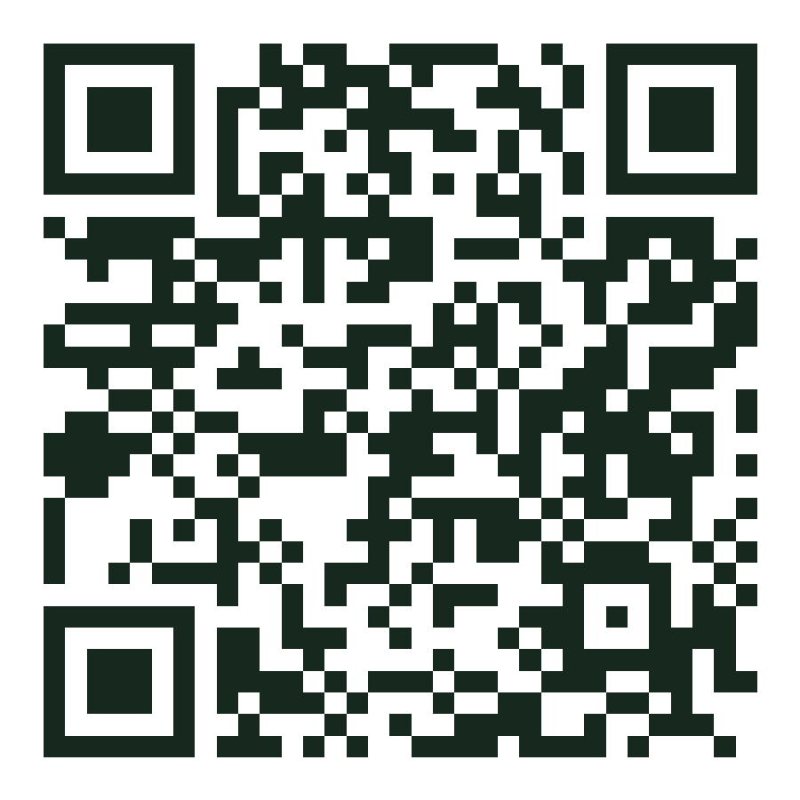
⭐ Star the repo — it helps other communities find us
Your circle has chosen.
Confirm whether you can attend. 😎
https://siddhant-pardeshi.github.io/communityconnect/
Scan → join free → invite your crew
Notes:
Close on the QR. Hold eye contact. 'See you at the event.'

