Slide 1
🌿 AI JOB SIMULATOR
Human-Centered Workplace Simulation &
On-Device Anti-Cheat Proctoring
Real-time conversational interviews, empathetic AI mentoring, and privacy-preserving computer vision.
Speakers: 4-Member Team • Time Limit: 8 Minutes • Stack: React 19, FastAPI, Google Gemini, MediaPipe

Slide 2
AI JOB SIMULATOR
The Assessment Dilemma: Robotic Tests vs. Real-World Readiness
❌ THE OLD WAY
• Cold, Robotic Interfaces: Static multiple-choice questionnaires that do not test how people speak or collaborate.
• Harsh & Rigid AI Grading: Pedantic keyword matching penalizes everyday human explanations that possess solid common sense.
• Remote Integrity Vulnerability: Exams are vulnerable to mobile phones, unauthorized second persons, and copy-pasting.
✓ OUR SOLUTION: AI JOB SIMULATOR
• Spoken Human Dialogue: Candidates listen to a natural human voice and speak their answers naturally aloud.
• Empathetic Practical Evaluation: Grades practical problem solving, empathy, and composure with generous, mentor-like coaching.
• 100% On-Device Anti-Cheat: Real-time MediaPipe Vision detects phones, absence, and blocks clipboard shortcuts with zero cloud video upload.

Slide 3
AI JOB SIMULATOR
Full-Stack System Architecture & Technology Foundation
FRONTEND LAYER
React 19 + Vite + Tailwind v4
Minimal pastel UI, client-side session routing, Recharts visual analytics, and reactive question runner.
AI & REASONING ENGINE
Google Gemini 3.5 Flash
Sub-second workplace scenario generation, multi-criteria answer evaluation, and json-repair fault tolerance.
VISION PROCTORING
MediaPipe Tasks Vision (WASM)
Client-side BlazeFace presence check and EfficientDet-Lite0 mobile phone detection running 100% in browser.
BACKEND API LAYER
FastAPI (Python) + Uvicorn
High-throughput asynchronous REST API, Pydantic v2 schemas, and zero-database stateless architecture.

Slide 4
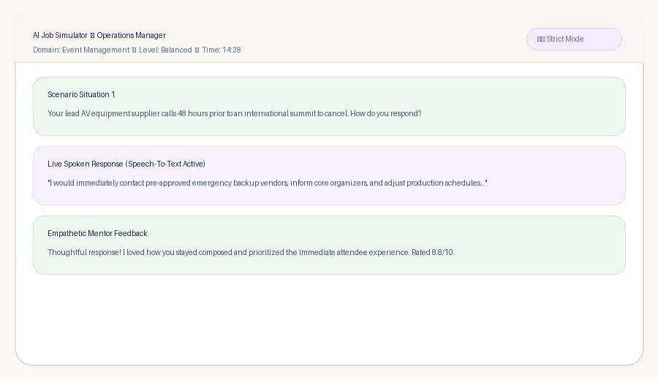
AI JOB SIMULATOR
Conversational Speech & Fair, Empathetic Human Evaluation
NATURAL SPEECH & FAIR MARKING
• Warm Spoken Tone (0.95x): Auto-selects top natural human voices in Chrome/Edge. Questions flow conversationally like a senior colleague over coffee.
• Respects Human Speech: Spoken answers are transcribed live. The evaluation ignores filler words and values common sense, empathy, and practical initiative.
• Generous Scoring Bands: Thoughtful practical answers score 7.5 to 9.5 / 10 instead of harsh penalties for missing textbook terminology.
• Supportive Mentoring: Every evaluation delivers genuine praise, an ideal framing from a senior peer, and gentle growth steps.

Slide 5
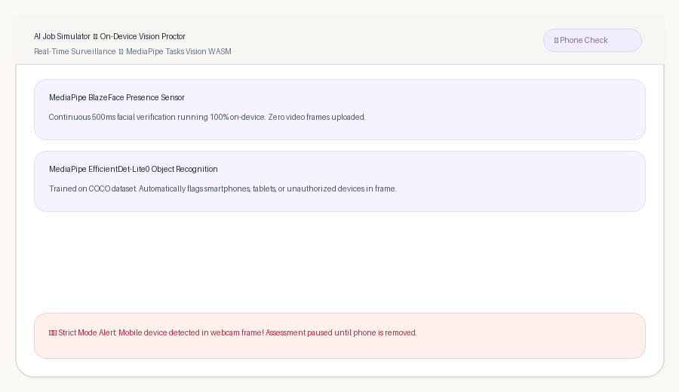
AI JOB SIMULATOR
Strict Anti-Cheat Proctoring: On-Device Vision & Clipboard Lock
MULTI-LAYER PROCTORING DEFENSE
• 📱 AI Mobile Phone Detection: MediaPipe EfficientDet-Lite0 scans every video frame for smartphones. Detecting a phone immediately blurs the screen and pauses the exam.
• 👤 Presence & Multi-Person Lock: MediaPipe BlazeFace verifies single-candidate presence every 500ms. Leaving the frame or a second face triggers an instant blur.
• 🚫 Clipboard & Text Lock: Text selection is disabled. Copy, cut, and paste events are intercepted and blocked with real-time warning toasts.
• 📑 Tab-Switch & Inactivity Tracking: Monitors document visibility. Navigating away to another browser tab immediately blurs the test and logs a violation.

Slide 6
AI JOB SIMULATOR
Comprehensive Debrief: Visual Analytics & Proctor Audit
Balanced Evaluation Rubric
Exact 40 / 30 / 30 Math
Evaluates Practical Solution (40%), Composure & Problem Solving (30%), and Communication (30%) computed with exact code arithmetic.
Interactive Visual Analytics
Recharts Competency Radar
Radar profile and performance bar charts provide candidate and recruiter with an instant graphical overview of core strengths.
Empowering Career Mentoring
Actionable Next Steps
Identifies 3 concrete strengths and 2 gentle growth areas, plus 3 tailored next steps to prepare candidates for real interviews.
Strict Proctor Integrity Audit
Full Transparent Audit Trail
Reports exact counts of Mobile Phone sightings, Clipboard paste attempts, Tab switches, and Face absences with verified clean badges.

Slide 7
AI JOB SIMULATOR
Engineering Excellence: Zero-Database Resilience & 1-Click Launch
Zero-Database Stateless Architecture
Client-Side LocalStorage Engine
No user database or login barriers. Candidate sessions, question states, audio transcripts, and integrity logs persist locally in browser localStorage.
Mid-Test Refresh Resume
Timestamp-Based Recovery
Accidental browser refreshes or disconnects show a 1-click 'Resume Session' screen, re-requesting media permissions and continuing without data loss.
Self-Installing 1-Click Launcher
Plug-and-Play start.bat
Intelligent launcher verifies Python and Node.js, auto-installs missing npm and pip dependencies, configures .env, and boots both servers simultaneously.
Future Scalability Roadmap
Enterprise & Global Recruiting
Next milestones: Custom company knowledge base simulation, ATS integrations (Greenhouse/Workday), and real-time multilingual roleplays.

