Slide 1

INVENTORY MANAGEMENT
-Aditi Patel, Nishant Patel,
Siddhant Pillai, Vinu Ratnayake

Slide 2

ABOUT US!
Pharmlabs is pharmaceutical company that sells medicine to customers over the counter and online. This is a pharmacy inventory system for Pharmlabs which will help automate the pharmacy workflow.
It will give the pharmacy a competitive edge by providing better customer experience and help improve pharmacists' efficiency.
The system contains information about the clients, employees, orders placed by the clients, order details in terms of products as well as the products/medicines the company sells.
Source of Data : Synthetic Data created by us. Due to privacy reasons in the Medical Industry, we could not obtain a dataset of clients to go with the drugs ordered.

Slide 3
MISSION STATEMENT
Create and maintain a database that contains detailed information about each customer, including purchases and other pertinent customer information, calculates the final receipt for each order.
Keep track of order information to keep track of business transactions for the company.
Keep records of employee information, sales made by an employee, salary information such as pay slips and additional benefits. Additionally, provide incentives to employees like pay raises to improve business.
Find the Net Pay received by each employee.

Slide 4
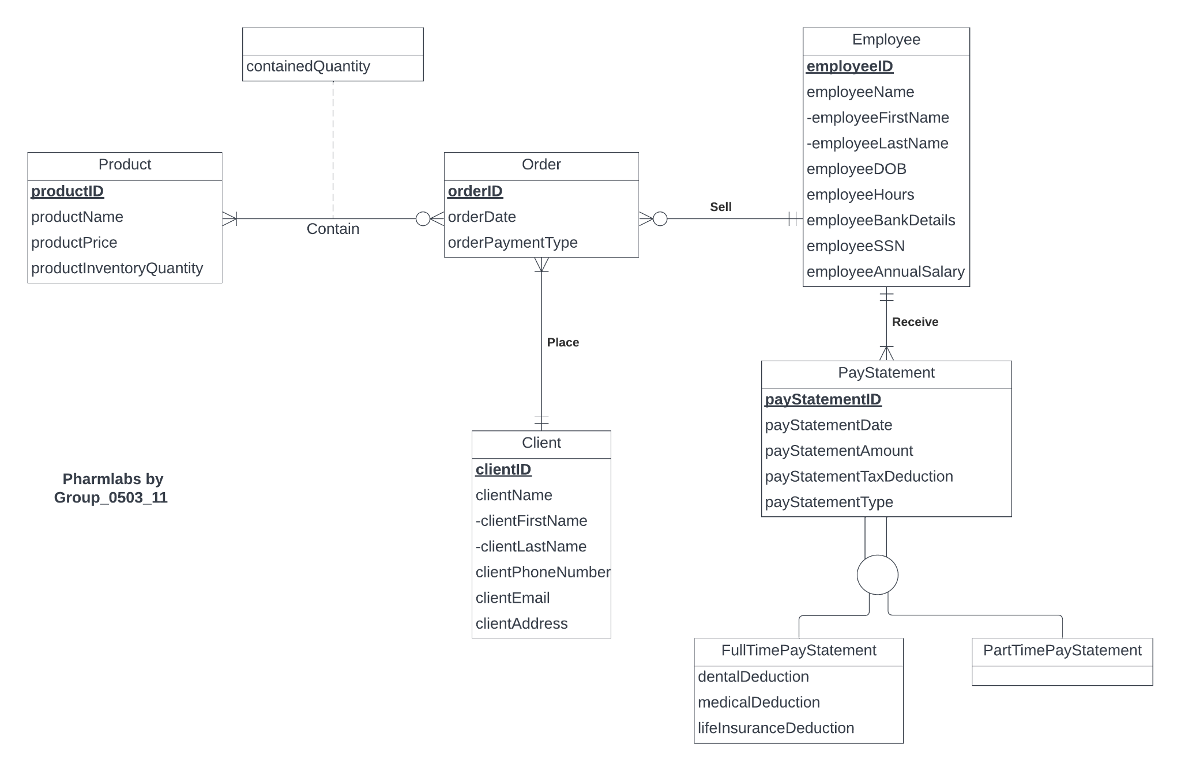
ER DIAGRAM

Slide 5
RELATIONAL SCHEMA
Employee (employeeID, employeeFirstName, employeeLastName,employeeDOB,
employeeHours, employeeBankDetails, employeSSN, employeeAnnualSalary)
Product (productID, productName, productPrice, productInventoryQuantity)
Client (clientID, clientFirstName, clientLastName, clientPhoneNumber, clientEmail,
clientAddress)
Order (orderID, clientID, employeeID, orderDate, orderPaymentType, orderAmount)
Contain (orderID, productID, containedQuantity)
PayStatement (payStatementID, employeeID, payStatementDate, payStatementAmount,
payStatementTaxDeduction, payStatementType)
FullTimePayStatement (payStatementID, dentalDeduction, medicalDeduction, lifeInsuranceDeduction)
PartTimePayStatement (payStatementID)

Slide 6
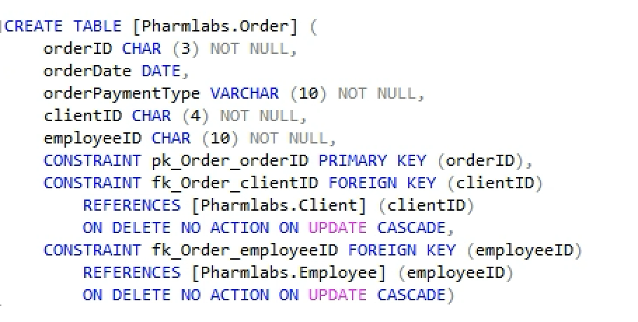
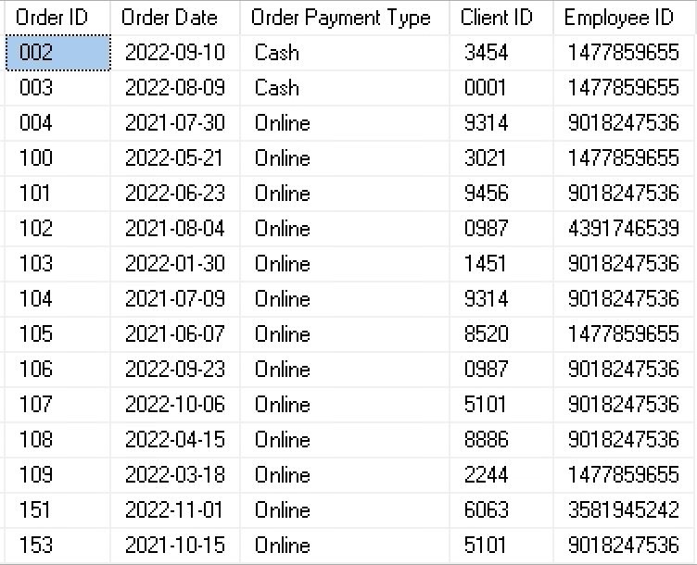
DATABASE DESIGN

Slide 7
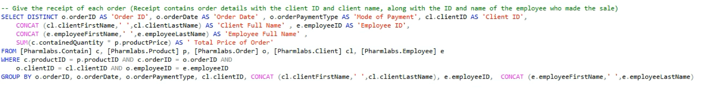
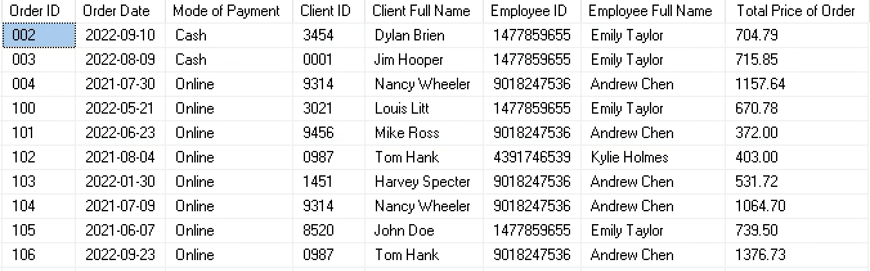
BUSINESS TRANSACTION 1

Slide 8
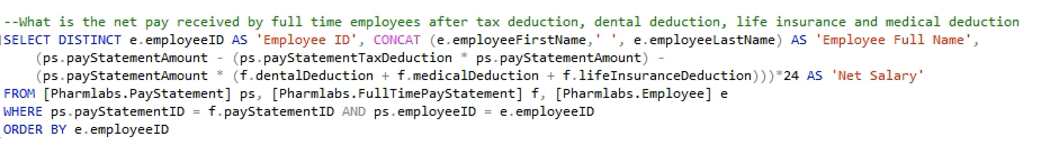
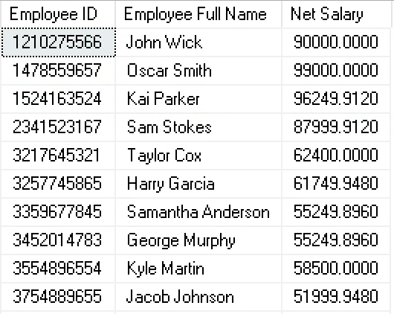
BUSINESS TRANSACTION 2

Slide 9
THANK YOU

