Slide 1
Applied Machine Learning Final Project: Home Credit Default Risk
Indiana University
December 2022
Group 11
Anuj Mahajan
Shubham Jambhale
Shashwati Diware
Siddhant Patil

Slide 2

Team Members:

Slide 3
Contents
Four P’s
Project Description
Overview of modelling Pipelines
Modelling Pipeline Flow
Results and discussion (Accuracy, AUC, Kaggle)
Conclusion

Slide 4
Four P’s
Past:
The HCDR Project, which uses a variety of financial and nonfinancial variables to determine whether borrowers will fail or not.
We performed EDA and feature engineering to develop baseline models (Logistic, Decision, Random Forest, etc) to enhance results.
AUC and the Confusion Matrix were used to assess the accuracy.
We tunned the hyperparameters of the models and found the best parameters using Grid Search.
Present:
We built the Multi Linear Perceptron using PyTorch.
In this project, to visualize the results of training in real-time we used Tensor board.

Slide 5
Four P’s
Planned:
In near Future we plan to perform and use different Activation Functions with various different combinations to attain more reliable and accurate results.
Try to reduce and minimize the loss and error rate as low as possible.
Problems:
There was a time constrain to run more experiments and different combination to achieve our optimal solution.
Some computational barriers restricted us to perform some experiments and run at a larger expense.

Slide 6
Project Description:
The object of the Home Credit Default Risk (HCDR) project is to predict the repayment abilities of the financially under-served population.
The well-established prediction is necessary for both Home Credit and borrowers.
Lend money to whom can pay back and give them a chance to build credit.
We trained and assessed a number of potential models before selecting the best one.
Our potential models include Random Forest, Decision Making Trees, Logistic Regression, Lasso Regression and Ridge Regression.
In this Phase we tried different MLP combinations to achieve the current results considering the accuracy and the AUC score.
Accuracy, AUC score, confusion Matrix and BCE loss are just a few measures we employ to evaluate the model precisely.

Slide 7
Modelling Pipeline:
The goal is to predict whether the borrower is a defaulter or not. Phase 4 involves working on the Multilayer Perceptron Model with its combinations to achieve desirable results.
Preprocess the entire dataset.
Prepare the MLP model with all its parameters to achieve some output.
Process this Multilayer Perceptron model with different Activation Functions.
Using Activation Functions such as Relu and Sigmoid for the prediction.
At the end, analyze these models' using measures such as Accuracy, AUC, and loss functions.
Perform the above steps through multiple iterations.

Slide 8
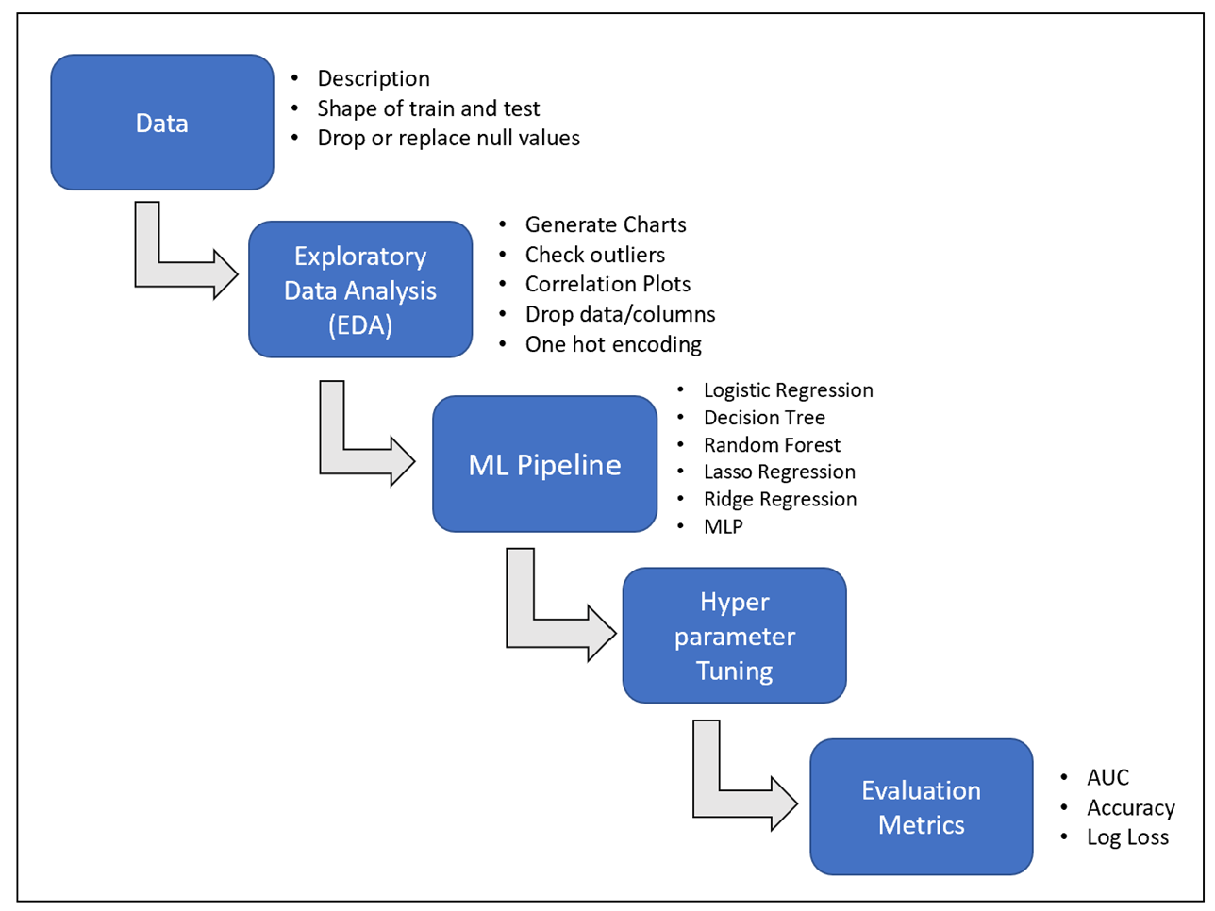
Modelling Pipeline Flow:

Slide 9
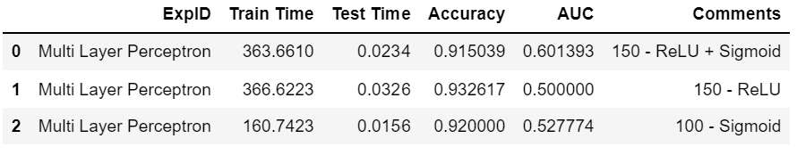
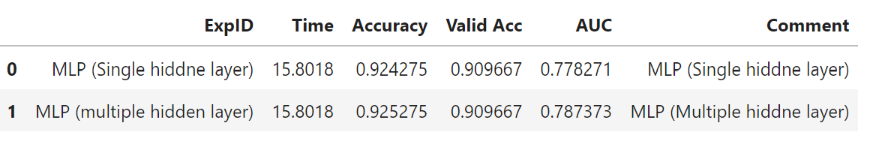
Result and Discussion:
The overall accuracy of the decision tree grew significantly and reached 92%. Hyper tuned Decision Tree is the best-fit algorithm since it surpasses other models in Phase 3.
In this Phase 4, we implemented deep learning, and our model was a multi-layer perceptron.
We then generated a visualization of the loss function and accuracy using Tensor Board to visualize our training model.
Our accuracy for the multi-Layer perceptron was out to be 92.4% which is quite efficient and overall good for the given data.
We received Test AUC of 60 % for the Pytorch MLP

Slide 10
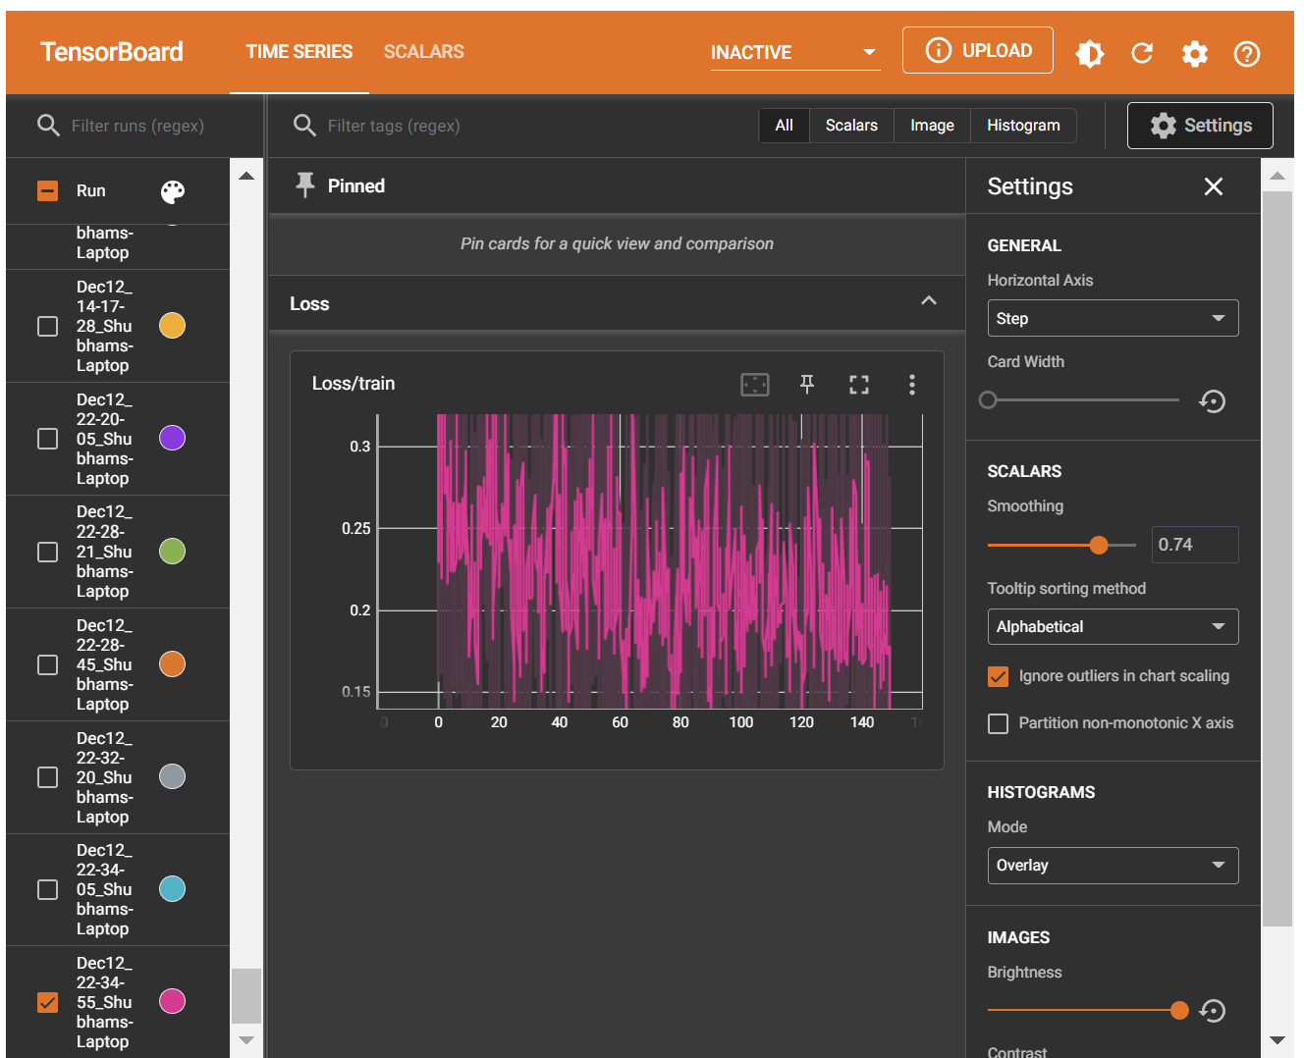
Tensor Board:

Slide 11
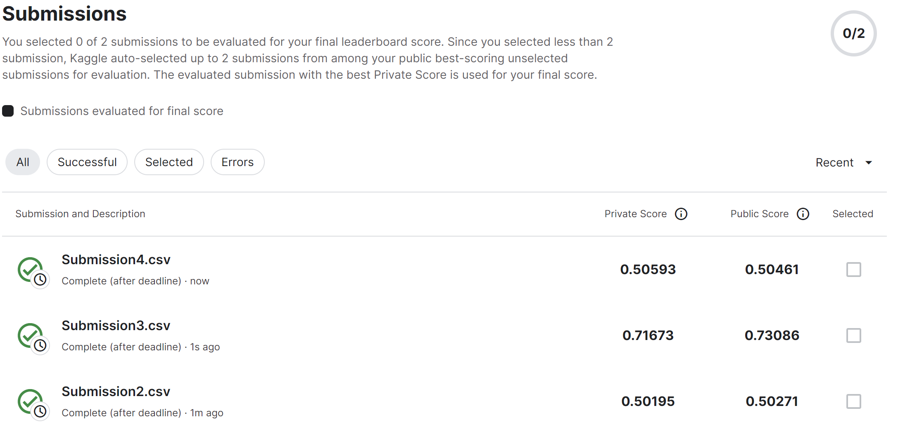
Result and Discussion:
Below are our best submission from each phase 2 ,3, 4

Slide 12
Conclusion :
During Phase 2 we concluded that the best model for this dataset will be logistic regression having the highest accuracy of 91.9 %.
In Phase 3 we conclude that the decision tree model performs the best out of all the other hyper tuned models.
As part of phase 4, we implemented Multi-Layer Perceptron with activation function ReLu and Sigmoid along with multiple hidden layer settings, we got the result that ReLu and Sigmoid together can give us the effective result.
We have determined that the Multi-Layer Perceptron's accuracy for the provided dataset using PyTorch was 92.4%, which is extremely effective and generally good.
With all the experiments taken into consideration Decision Tree and Lasso Regression turned out to be the best performing models. Additional experimentation on MLP model could have yielded better results.

