Slide 1
Population Regression

Slide 2
Table of content
01
02
03
04
05
06
Problem Solving
Experimental setup
Introduction
Statistics
Results Analysis
Reflections &
Conclusions

Slide 3
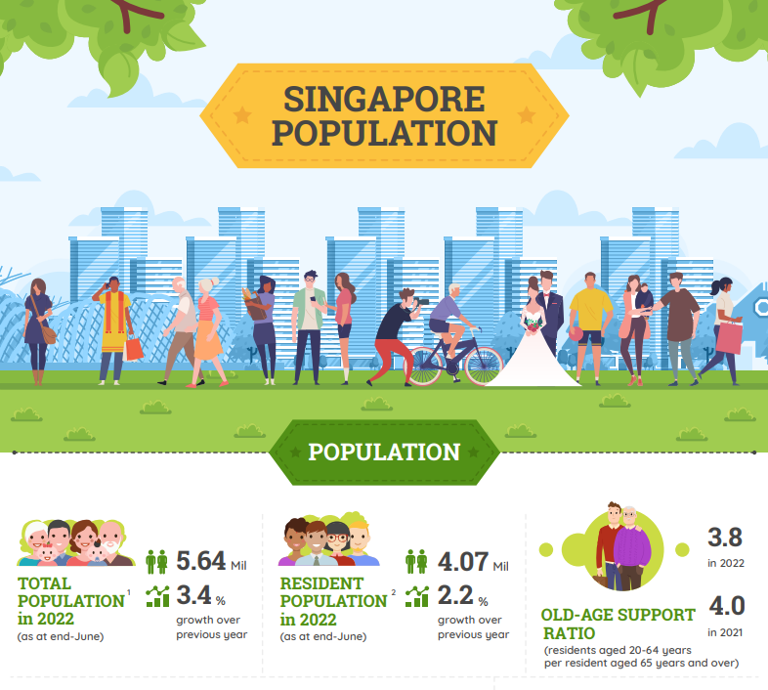


Slide 4
Problem solving
Making population predictions with provided data.
Making inferences about entire population and predict values of the dependent variable for new observations.

Slide 5
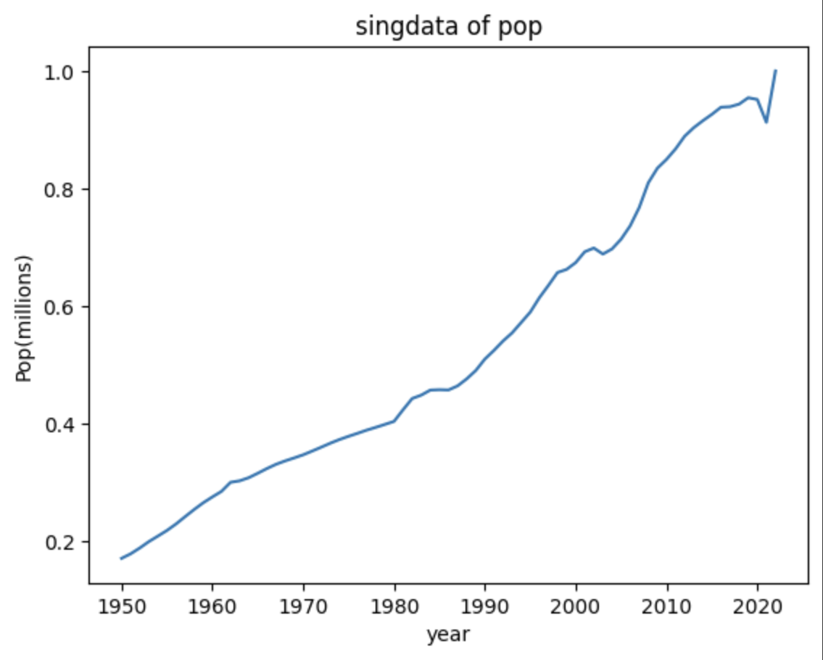

Slide 6
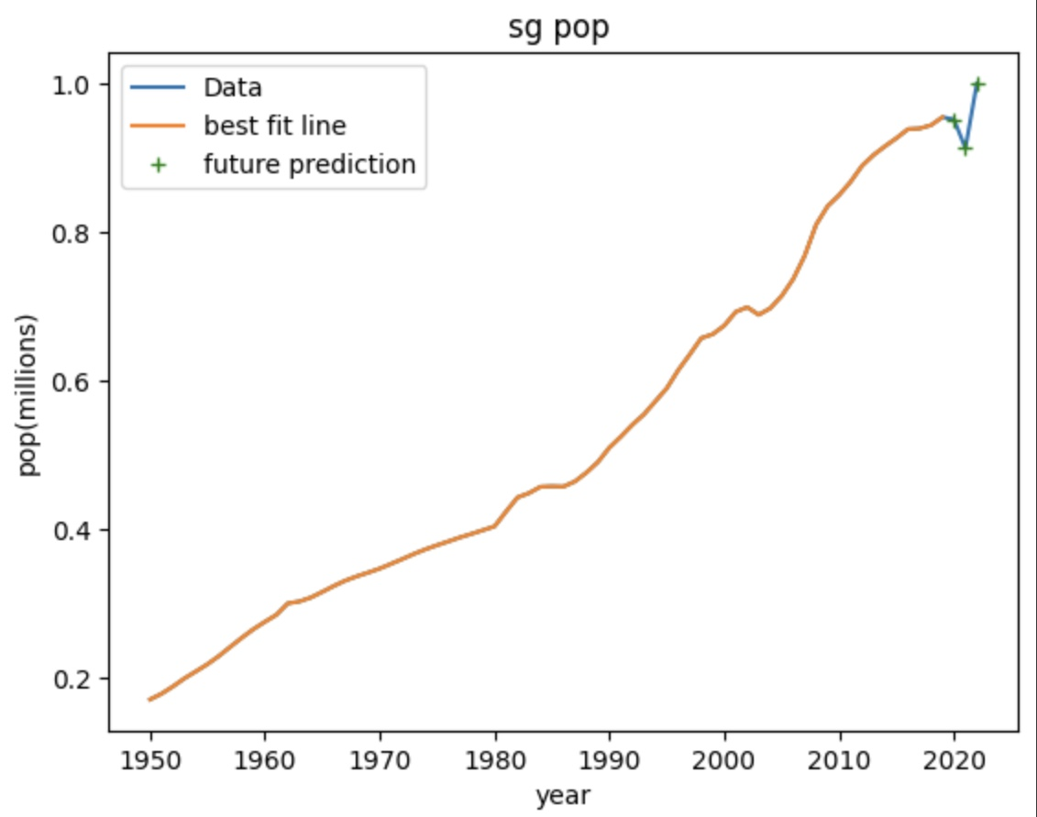

Slide 7
POPULATION GROWTH ISSUES
WATER SCARCITY
POLITICAL INSTABILITY
CLIMATE CHANGE

Slide 8
WE MUST KNOW
HOW MANY OF US ARE THERE
WHERE DO WE ALL LIVE
HOW OLD WE ALL ARE
HOW MANY WILL BE BORN

Slide 9
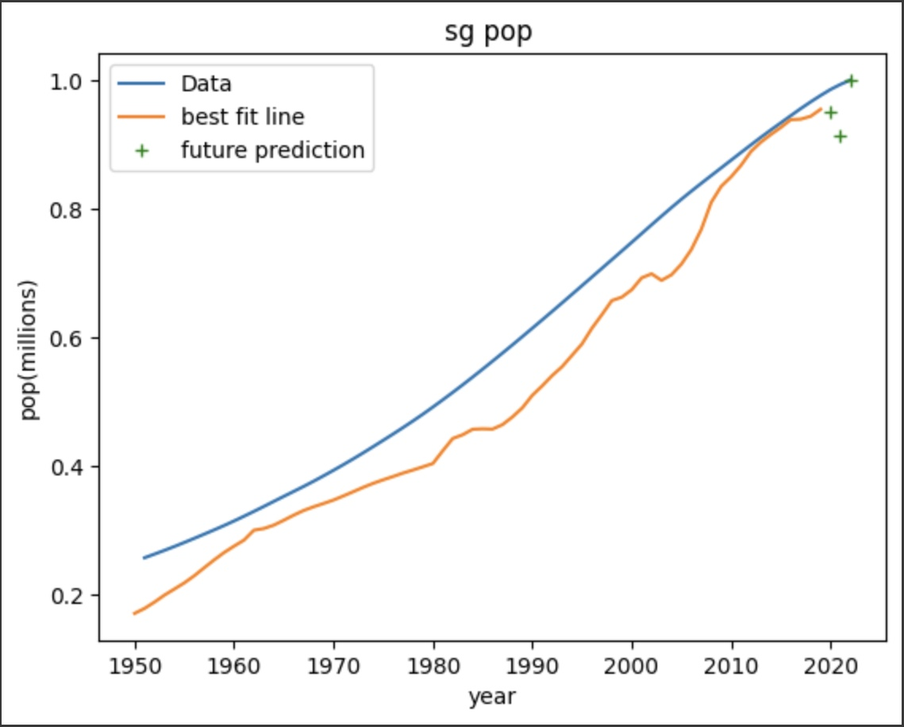

Slide 10
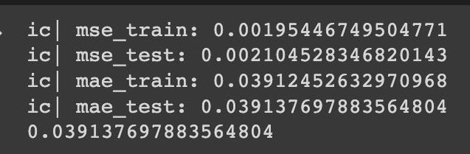

Slide 11
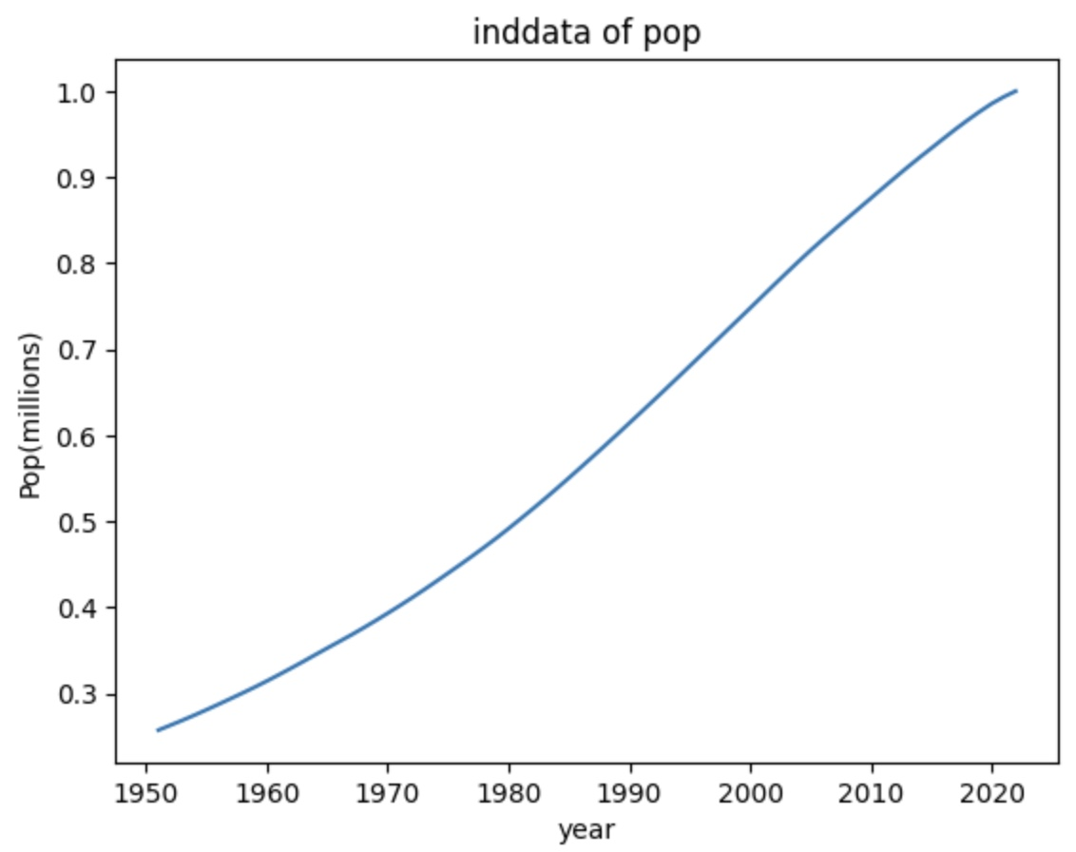

Slide 12
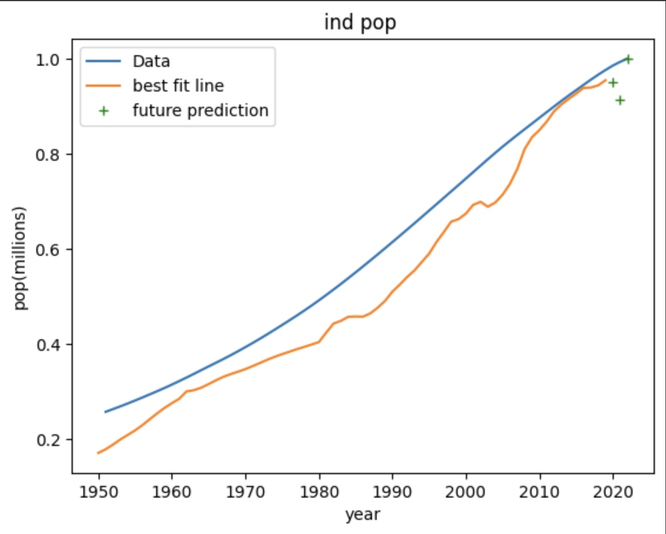

Slide 13
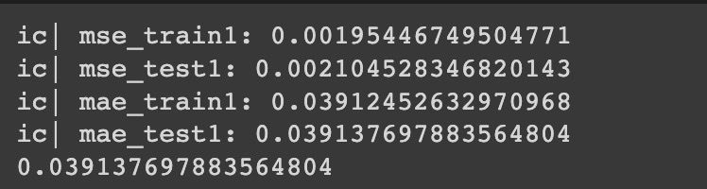

Slide 14
—Garrett Hardin
“A finite world can support only a finite population; therefore, population growth must eventually equal zero

Slide 15
OUR TEAM
Kunwarveer Singh
Dhriti Kochhar (speaker)
Siddhant Agnani
Rohaan Goklaney (speaker)

Slide 16
Bibliography
colab.research.google.com
www.slidesgo.com
www.singstat.gov.sg

Slide 17
THANK YOU

