Slide 1

EE-694 : Seminar Improving the Performance and Energy Efficiency of Asymmetric Multicore System
Presenter: Siddhant Singh Tomar
Roll No.: 213079010
Supervisor: Prof. Virendra Singh
Computer Architecture & Dependable Systems Laboratory,
Department of Electrical Engineering, Indian Institute of Technology Bombay

Slide 2
Outline
Introduction
Motivation
Literature Survey:
- Improving Single Thread Performance
- Reducing Switching Overhead
- Increasing Dynamic Adaptability of a Asymmetric multicore system.
Conclusion

Slide 3
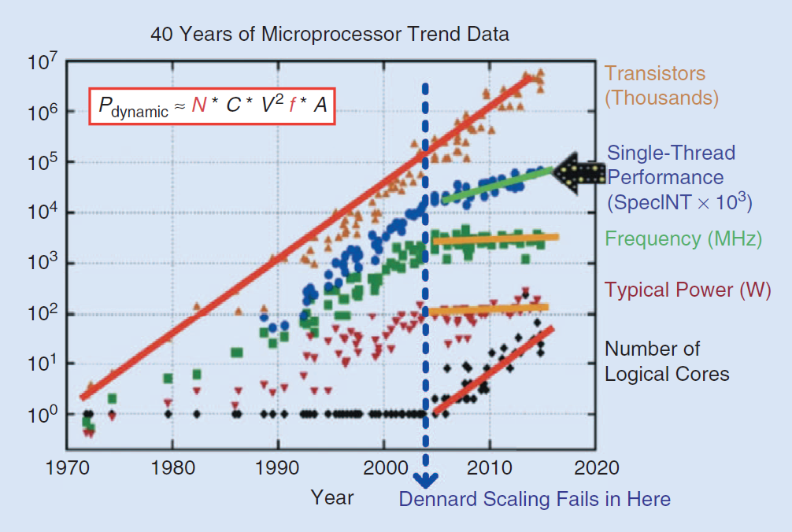
Introduction
Notes:
Increase freq while proportionally scaling down voltages

Slide 4
Symmetric CMPs vs Asymmetric CMPs
Symmetric CMPs (All Big OoO cores) | Symmetric CMPs (All Small InO cores) | Asymmetric CMPs (Few big and multiple small cores)
Low throughput | High throughput | Avg. throughput
Best single thread performance | Poor Single thread performance | Good single thread performance
Power hungry cores | Power efficient cores | Best of both

Slide 5
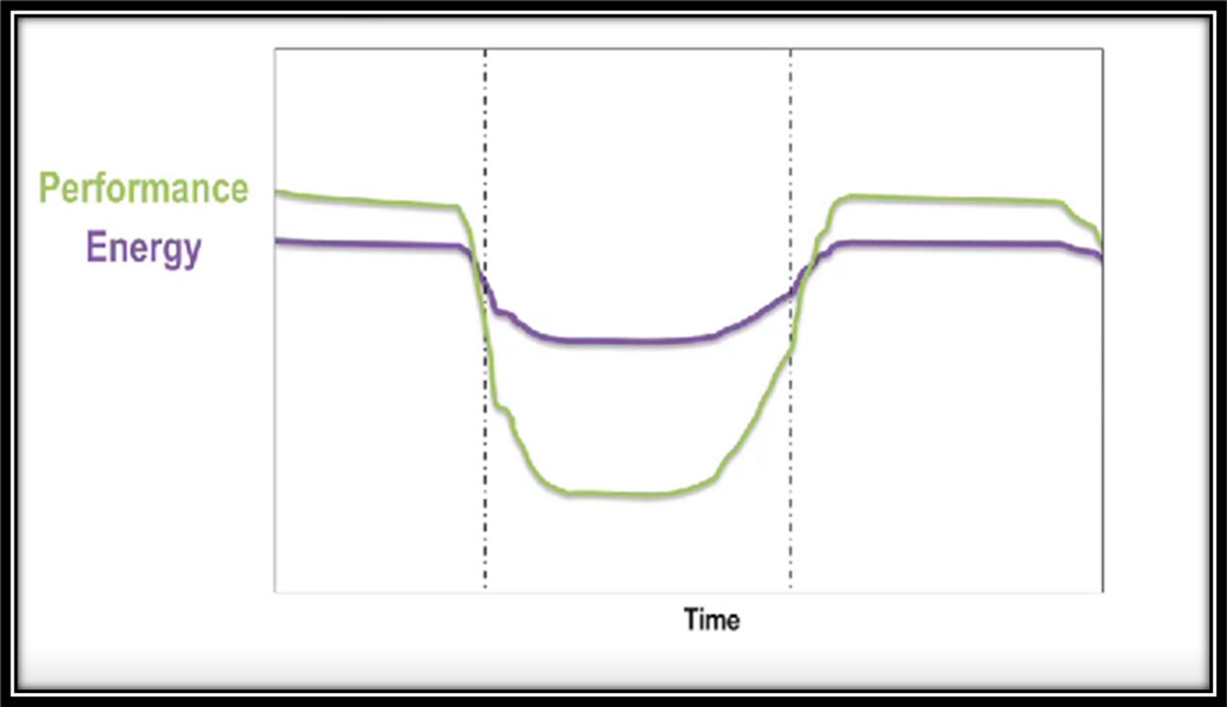
ARM’s big.LITTLE
Cortex-A15 is a 3-way out-of-order (OoO) core (15-25 stages).
Cortex-A7 is a narrow 2-way in-order (InO) core (8-10 stages).

Slide 6
Opportunities for Improvement
Single Thread
Performance
Switching
Overhead
Dynamic Adaptability

Slide 7
Single Thread Performance

Slide 8
Run-Ahead Execution
Small instruction Window: Full window stalls
(8-instruction ROB)
LLC Miss! Takes 80-100 of cycles
Remove the Blocking instruction from the head of ROB.
If instruction is a long latency cache miss: =>Checkpoint ARF and enter Run-ahead mode
Head:
LOAD R1 ← mem[R5]
ADD R7, R1, R2
Run-Ahead mode:
Pre-execute instructions for prefetching purposes.
Cache-miss dependent instructions are marked invalid and dropped.
When Original miss returns=>restore checkpoint=>flush pipeline=>resume normal execution
ADD R2 ← R2, 8
LOAD R3 ← mem[R2]
MUL R4 ← R4, R3
ADD R4 ← R4, R5
LOAD R2← mem[R5]
Younger instructions cannot be executed.
ADD R2 ← R2, 64
LOAD R3 ← mem[R7]
Notes:
When the ROB becomes full instruction dispatching needs to be stalled, ROB can become full if oldest instr. is a long latency cache miss

Slide 9
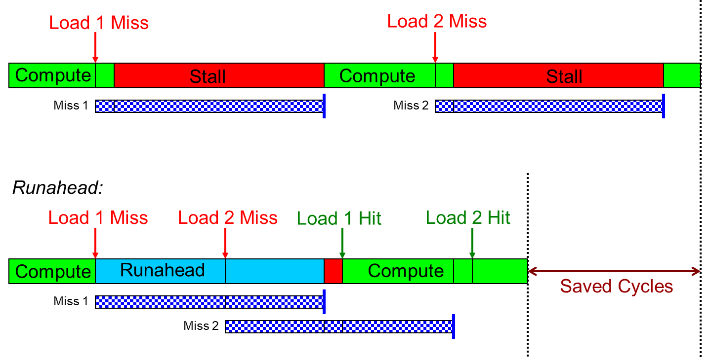
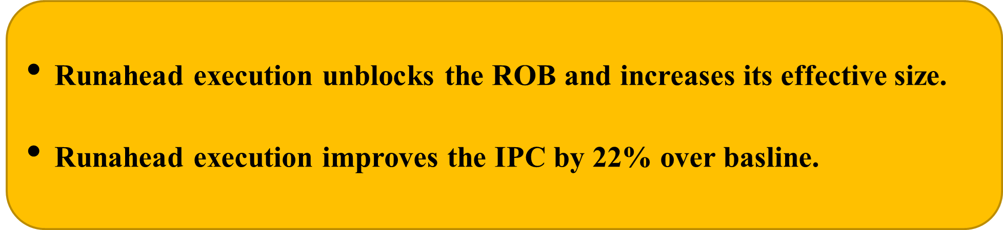
Run-Ahead Execution (contd..)
Without Runahead:

Slide 10
Limitations of Run-Ahead Execution
Reorder Buffer (ROB), Reservations station (issue queue) and physical register file is freed.
All the instructions executed in Run-Ahead mode needs to be re-executed in normal mode.
Poor performance in pointer chasing application.(Load dependent load instructions)
Notes:
State of ROB,RS and PRF rendered useless

Slide 11
Precise Run-Ahead (PRE)
PRE does not release processor state when entering runahead mode.
PRE leverages the available issue queue and physical register file entries to speculatively execute instructions in Run-ahead mode.
Key observations:
-37% of the issue queue entries
-51% of the integer registers
-59% of the floating-point registers are free.

Slide 12
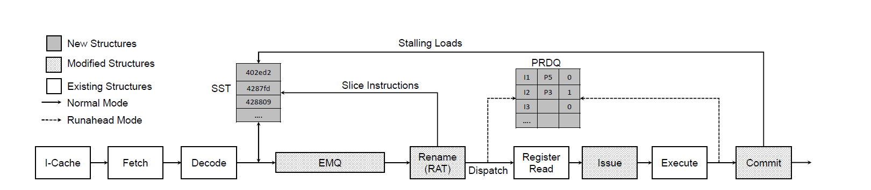
Processor Pipeline For PRE
Precise Run-ahead execution improves the IPC by 38.2% over the baseline.

Slide 13
Limitations of Precise Runahead
Poor performance in pointer chasing application and for complex indirection patterns.(Load dependent load instructions)

Slide 14

Vector Runahead
MOV eax, dword ptr[rax]
Striding load instruction
One loop iteration
(scalar instructions)
ADD rax,0x04
XOR eax,0x12345678
MOV ebx, dword ptr[eax]
MOV ecx, dword ptr[ebx]
ADD edx, edx, ecx
(Vectorizing load slice)
Eight Loop iterations
(x86-AVX-512 SIMD
instructions)
VMOVUPD zmm0,zmmword ptr [rax*4]
VXORUPD zmm0,0x12345678
VGATHERDPD zmm1, zmm0
VGATHERDPD zmm2, zmm1
VADDPD zmm3,zmm3,zmm2
Notes:
VA prefetch entire load chains across multiple iterations, using vector or SIMD instructions………………….explain slide…….issue batch of mem. Access to A

Slide 15
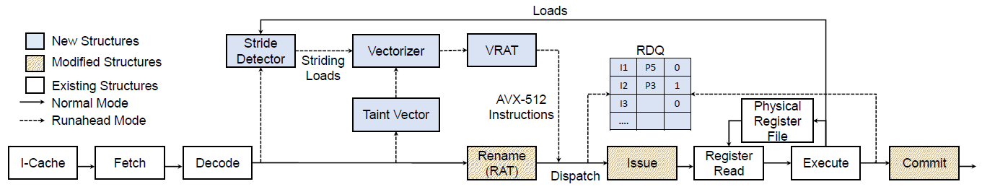
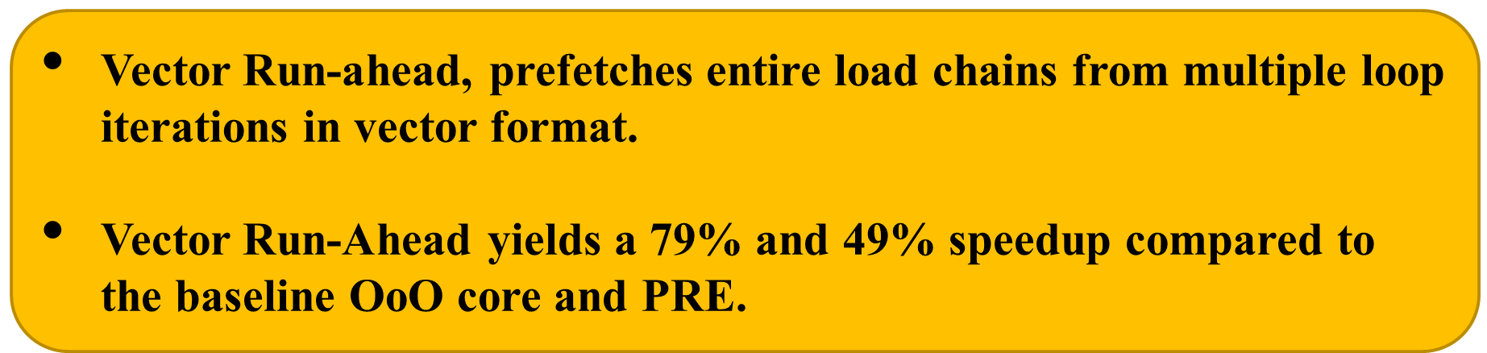
Processor Pipeline for Vector Runahead
Stride detector => Produce vector load instruction for striding load
Taint vector => Track instructions dependent on vector load
Address generating scalar instructions → vector unit operations
Dependent Loads → vector gathers

Slide 16
Limitations of Vector Runahead
Complex control flow limits the ability of Vector Runahead to cover enough of the application’s memory accesses
Vector Run-ahead stays in “Run-ahead” mode for longer duration, can prefetch data from wrong path due to branch divergence, incurring more penalty.

Slide 17
Reducing Switching Overhead

Slide 18
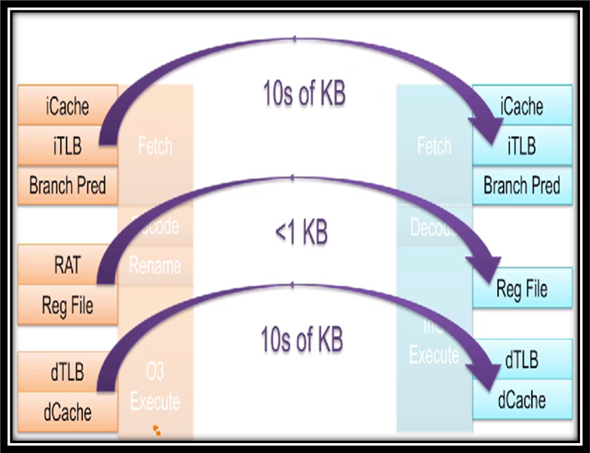
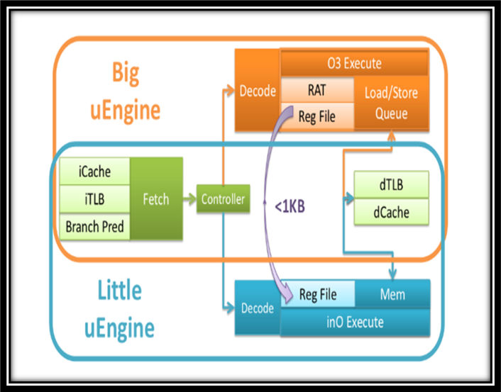
Composite core
Composite core achieves 18% energy efficiency over execution on only big core, while limiting performance to 5% loss.

Slide 19
Limitations of Composite Core
On an average of only 25% of the dynamic execution is mapped to the little uEngine
little uEngine adds an additional 20 % area overhead

Slide 20
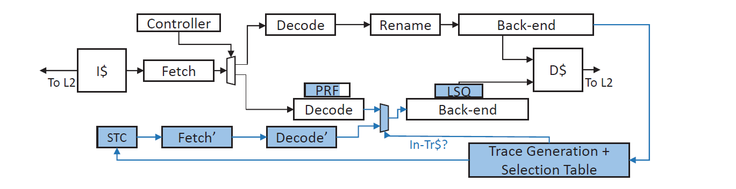
Dynamic schedule Migration for heterogenous cores (DynaMOS)
Out-of-Order (OoO) cores creates optimized issue schedules of instructions
Offload recurring issue schedule from big to little core
DynaMOS is able to run 37% of its instructions on little.
DynaMOS achieves energy savings of 32% over execution on only big core, with an allowable 5% performance loss

Slide 21
Limitations of DynaMOS
Renaming of architectural register is limited to at most 4 physical registers =>discard schedules, limiting achievable energy savings.
Size of physical register file is 4 times as compared to simple in order core.

Slide 22
Dynamic Asymmetric multicore system

Slide 23
MorphCore
“MorphCore” micro-architecture can handle single threaded code at high performance, and multi-threaded code at high throughput.
It provides two modes of execution: => 2-way SMT out-of-order core mode. => 8-way SMT in-order core.
Notes:
MorphCore exposes 8 logical cores to OS.

Slide 24
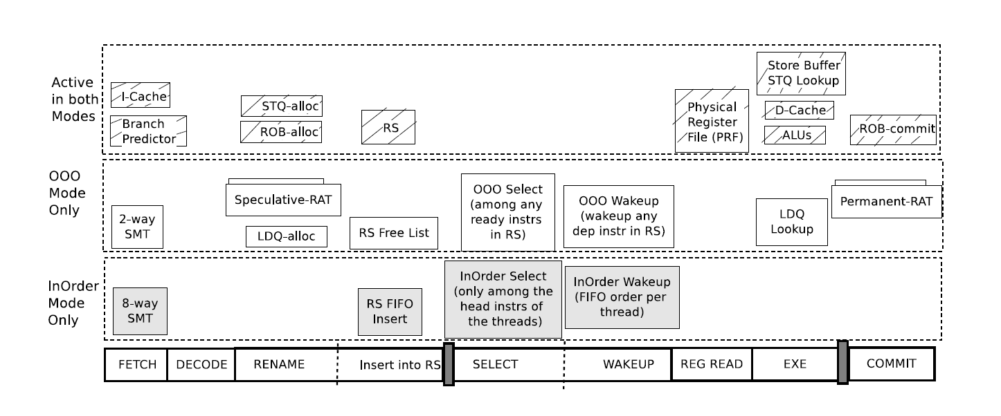
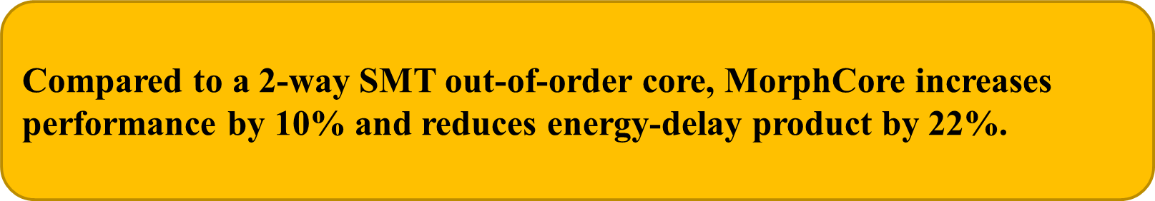
The MorphCore Microarchitecture

Slide 25
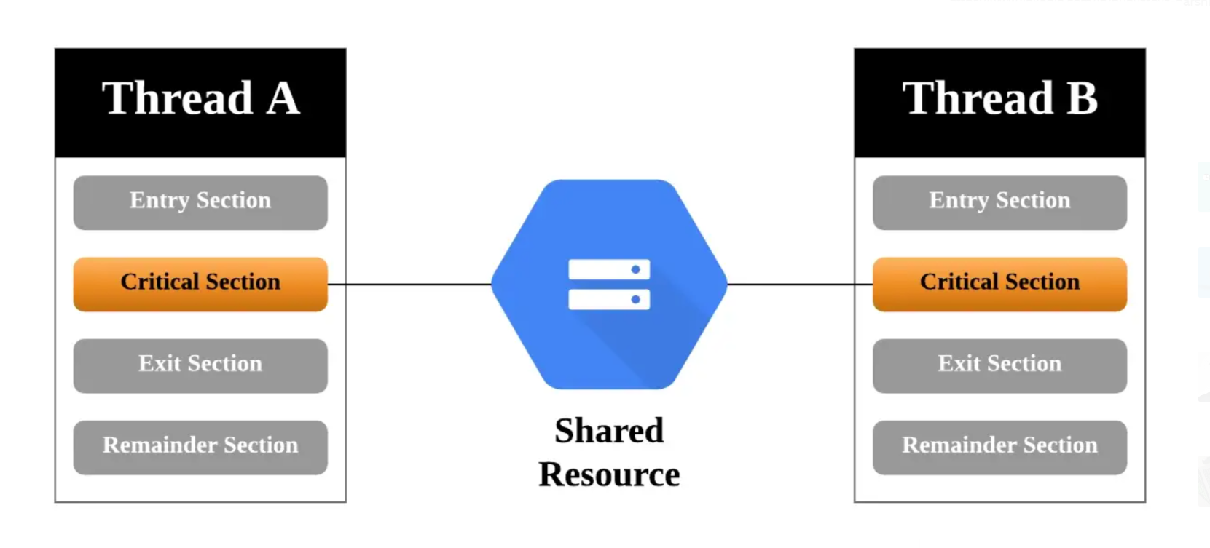
Limitation of MorphCore
.
Poor performance for multithreaded applications which have more no. of critical sections.

Slide 26
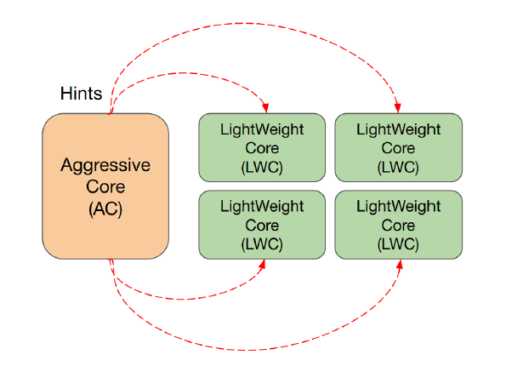
Illusionist
A large number of lightweight cores by get execution hints from an aggressive core.
A just-in-time compiler analysis for program distillation
A predictor for identifying the phases of program execution that benefit most from execution hints.

Slide 27
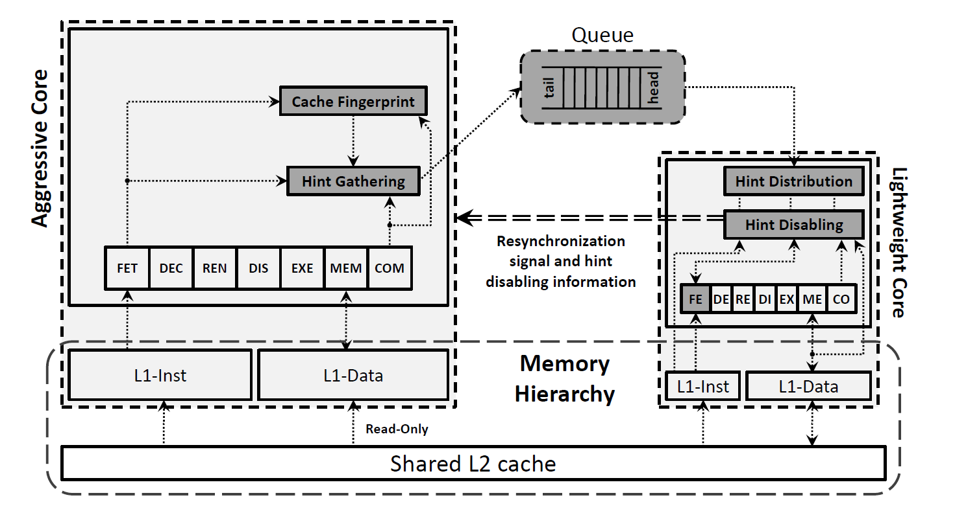
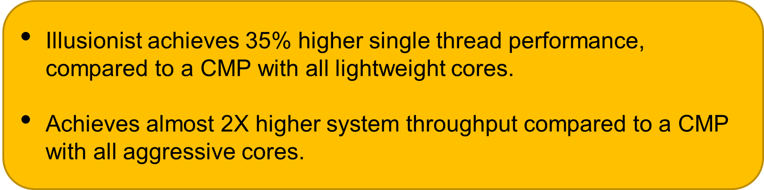
Aggressive and lightweight core working together

Slide 28
Limitations of Illusionist
PC, age tag and release window metric are sent along with the branch outcome to LWC
=> Increasing Branch Outcome Queue (BOQ) sizes.
=> Not enough to guarantee perfect timing for hints utilization.

Slide 29
R3-DLA : Decoupled Look Ahead Execution
On top of this basic design, we propose to add a number of supporting elements to accelerate main thread (MT) as well as reduce the size of lookahead thread (LT):
Reduce : T1, A prefetching FSM to offload prefetching of loop based strided accesses
Reuse : logic to pass register values from LT through FQ and used as predictions in the front-end of MT
Recycle: cycles through a number of skeleton mask bits to pick the best performing configuration

Slide 30
Illusionist vs R3-DLA
Idea | Size of look ahead thread | Utilization of Branch hints | Utilization of Other hints | Branch Alignment
Illusionist | 25% of the main thread. | PC, Age tag, release window. | Age tag, release window. | Preserving PC in LT
R3-DLA | 20% of the main thread. | Only branch outcome. | Dequeue with branch outcome. | No branches removed in LT

Slide 31
Conclusion
Single Thread Performance:
Run-Ahead execution generates highly accurate prefetches, which increases the IPC at the expense of executing more no. instructions.
Reducing The Switching Overhead:
Composite Core minimizes switching overhead to enable fine grained switching,But the little uEngine incurs an additional overhead of 20%.
DynaMOS builds on the work of composite core to increase utilization of little core, but little core requires additional hardware to run in OinO mode.

Slide 32
Conclusion (contd..)
Dynamic Adaptability:
MorphCore is more energy-efficient than a traditional out order core when executing multi-threaded programs
Illusionist, dynamically adapts to workloads ,providing the performance of a symmetric multicore system with all big cores while consuming energy equivalent to that of little cores
R3-DLA improves the single thread performance. But compiler support is needed to generate skeleton mask bits and identifying strided instructions

Slide 33
References
O. Mutlu, J. Stark, C. Wilkerson and Y. N. Patt, "Runahead execution: an alternative to very large instruction windows for out-of-order processors," The Ninth International Symposium on High-Performance Computer Architecture, 2003. HPCA-9 2003. Proceedings., 2003, pp. 129-140, doi: 10.1109/HPCA.2003.1183532.
A. Naithani, J. Feliu, A. Adileh and L. Eeckhout, "Precise Runahead Execution," 2020 IEEE International Symposium on High Performance Computer Architecture (HPCA), 2020, pp. 397-410, doi: 10.1109/HPCA47549.2020.00040.
Naithani, S. Ainsworth, T. M. Jones and L. Eeckhout, "Vector Runahead," 2021 ACM/IEEE 48th Annual International Symposium on Computer Architecture (ISCA), 2021, pp. 195-208, doi: 10.1109/ISCA52012.2021.00024.
A. Ansari, S. Feng, S. Gupta, J. Torrellas and S. Mahlke, "Illusionist: Transforming lightweight cores into aggressive cores on demand," 2013 IEEE 19th International Symposium on High Performance Computer Architecture (HPCA), 2013, pp. 436-447, doi: 10.1109/HPCA.2013.6522339.

Slide 34
References continued..
A. Lukefahr et al., "Composite Cores: Pushing Heterogeneity Into a Core," 2012 45th Annual IEEE/ACM International Symposium on Microarchitecture, 2012, pp. 317-328, doi: 10.1109/MICRO.2012.37.
S. Padmanabha, A. Lukefahr, R. Das and S. Mahlke, "DynaMOS: Dynamic schedule migration for heterogeneous cores," 2015 48th Annual IEEE/ACM International Symposium on Microarchitecture (MICRO), 2015, pp. 322-333, doi: 10.1145/2830772.2830791.
Khubaib, M. A. Suleman, M. Hashemi, C. Wilkerson and Y. N. Patt, "MorphCore: An Energy-Efficient Microarchitecture for High Performance ILP and High Throughput TLP," 2012 45th Annual IEEE/ACM International Symposium on Microarchitecture, 2012, pp. 305-316, doi: 10.1109/MICRO.2012.36.
S. Kondguli and M. Huang, "R3-DLA (Reduce, Reuse, Recycle): A More Efficient Approach to Decoupled Look-Ahead Architectures," 2019 IEEE International Symposium on High Performance Computer Architecture (HPCA), 2019, pp. 533-544, doi: 10.1109/HPCA.2019.00064.

Slide 35
Thank You!

