Slide 1
Minimax with alpha-beta pruning to play Othello
Siddhant Attri
Computer Science and Engineering
B18CSE052

Slide 2
Introduction
Othello is a classical game in which two players take turns placing pieces-one player white and the other black-on an 8 × 8 grid board
The goal is to capture the other opponent’s pieces on the board and finish the game with as many pieces on the board as possible
In order to capture, player1 should place a piece adjacent to one of player2’s pieces, so that there is a straight line (horizontal, vertical, or diagonal) ending with player1’s pieces and connected continuously by player2’s pieces. Then the player2’ pieces on the line will change to player1’s

Slide 3
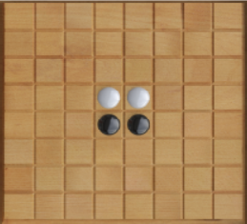
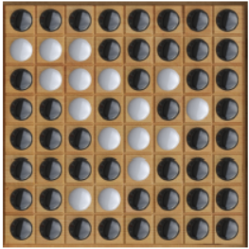
Initial state of othello Final state of Othello where black wins

Slide 4
Problem Definition
. . . . . . . .
. . . . . . . .
. . . . . . . .
. . . 1 2 . . .
. . . 2 1 . . .
. . . . . . . .
. . . . . . . .
. . . . . . . .
A representation of the initial state of Othello
‘1’ and ‘2’ are black and white respectively and ‘.’ represents empty spaces
Adversary will try to find a move that will minimise the reward for its opponent

Slide 5
Other Algorithms used to create an AI opponent
Random
Selects a random move from the available moves for the opponent
Fast and consider only the current state
Local Maximisation
More sophisticated strategy, evaluates every available move according to a reward
Very short sighted

Slide 6
Minimax search
Searches several turns ahead
Player1 tries all the available moves and chooses the one with the most reward
Player2 chooses a move that will minimise player1’s reward
Alternate maximisation and minimisation of child nodes of the game tree
Naive and time consuming

Slide 7
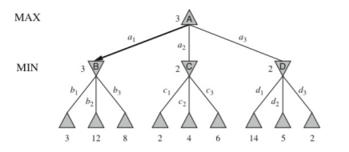

Slide 8
Algorithm used
Minimax along with α-β pruning used
An optimisation over the traditional minimax algorithm
Seeks to decrease the number of nodes evaluated in its search tree
Stops evaluating a move when it has been proved to be worse than a previously examined move
Returns the same moves as minimax would, but prunes the branches that cannot affect the final decision

Slide 9
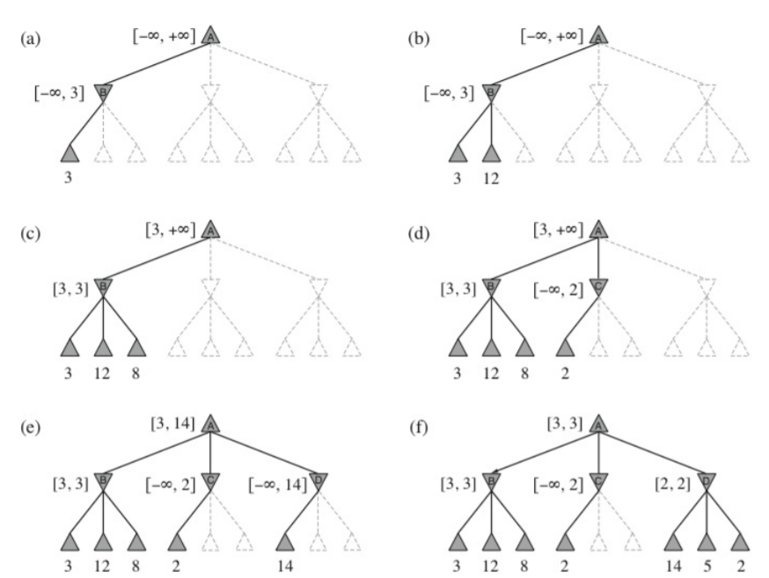
A depiction of α-β pruning of the game tree

Slide 10
The triangle is player1 who wants to maximize his reward, and the downward-point triangle is player2 who wants to minimize player1’s reward
α is the best already explored reward for player1, and β is the best reward play1 can get under player2’s suppression
From node A, player1 chooses a move to node B, then it’s player2’s turn
Player2 chooses a move and makes player1 get a reward 3. Then player2 chooses another move that makes player1 get a reward 12 ,etc.
Player2 always wants to make player1 get the smallest reward, so the maximum reward play can get will be no more than 3 if player1 moves from node A to B
So the value of α can be updated to 3 since the current best reward player1 can get is 3
Similarly, player1 tries the next available move to node C. The first child node of C rewards 2
Since player2 will choose the move that minimizes player1’s reward, the reward player1 can get from node C will be never more than 2. Thus, node C will never be better than node B
According to α-β pruning, we will completely stop searching any other child nodes of node C. Then, we go on trying other moves
Again, when searching for the third child node of D, we can confidently prune node D

Slide 11
Evaluation Function
The evaluation function used was the summation of the following parameters:
The piece difference i.e the difference of the white pieces and the black pieces when the move will be made. This component of the utility function captures the difference in coins between the max player and the min player
Corner Captures i.e the number of corners that will be available with the player if they make that particular move. Corners hold special importance because once captured, they cannot be flanked by the opponent. They also allow a player to build coins around them and provide stability to the player’s coins.
Close to Corner Pieces i.e the number of pieces on the boundary of the board owned by each player

Slide 12
4 . Stability
The stability measure of a coin is a quantitative representation of how vulnerable it is to being flanked
Stable coins are coins which cannot be flanked at any point of time in the game from the given state
Unstable coins are those that could be flanked in the very next move
Semi-stable coins are those that could potentially be flanked at some point in the future, but they do not face the danger of being flanked immediately in the next move
Corners are always stable in nature, and by building upon corners, more coins become stable in the region
Weights are associated to each of the three categories, and summed to give rise to a final stability value for the player. Typical weights could be 1 for stable coins, -1 for unstable coins and 0 for semi-stable coins.

Slide 13
5. Mobility: It attempts to capture the relative difference between the number of possible moves for the max and the min players, with the intent of restricting the opponent’s mobility and increasing one’s own mobility

Slide 14
Constraints
For a large search tree such as that of chess, even α-β pruning won’t be sufficient enough to reduce the size of the search tree. And it is not practically possible to search such a large tree.
Use Expectimax search for such situations
A variation of the minimax algorithm
Outcome depends on a combination of the player's skill and chance elements such as dice rolls
In addition to "min" and "max" nodes of the traditional minimax tree, this variant has "chance" nodes, which take the expected value of a random event occurring
In game theory terms, an expectimax tree is the game tree of an extensive-form game of perfect, but incomplete information

Slide 15
Algorithm Complexity
Time complexity of minimax is O(b^{d} ), where b is the branching factor and d is searching depth
For α-β pruning, the time complexity will drop to O(b ^{d/2} )
Space complexity of α-β pruning is O(b^{d}) and for minimax search this complexity remains the same

Slide 16
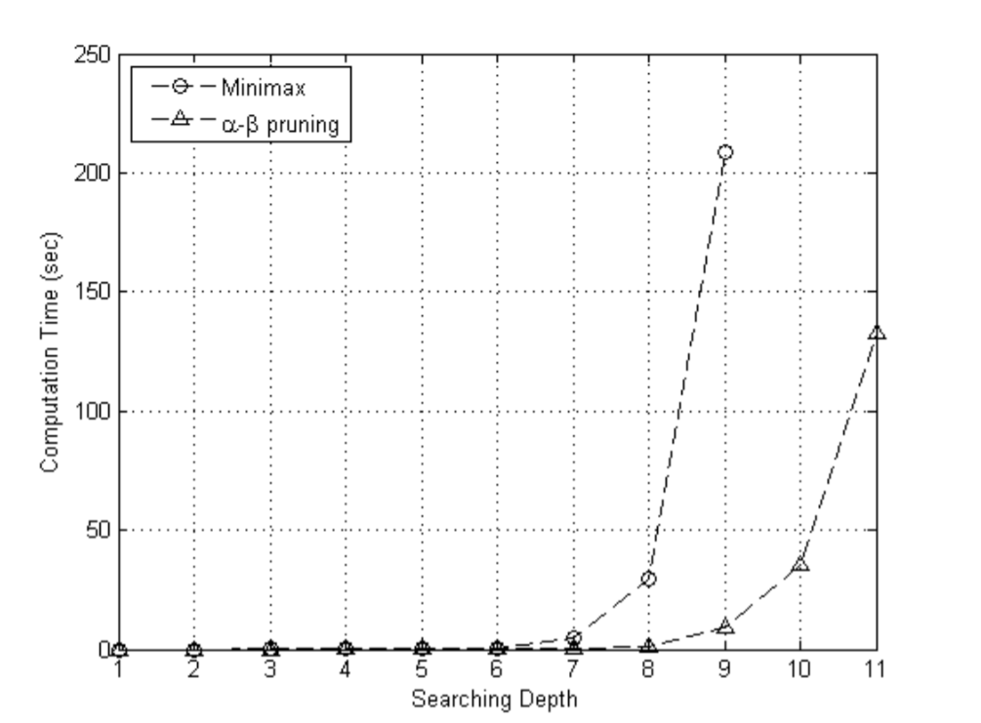
Time Complexity comparison

Slide 17
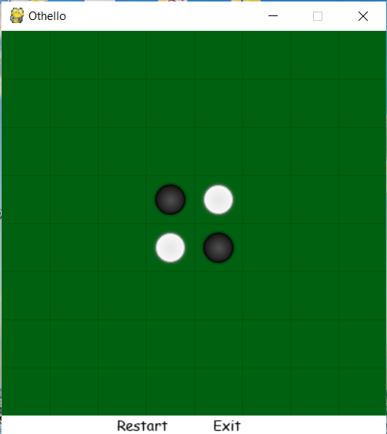
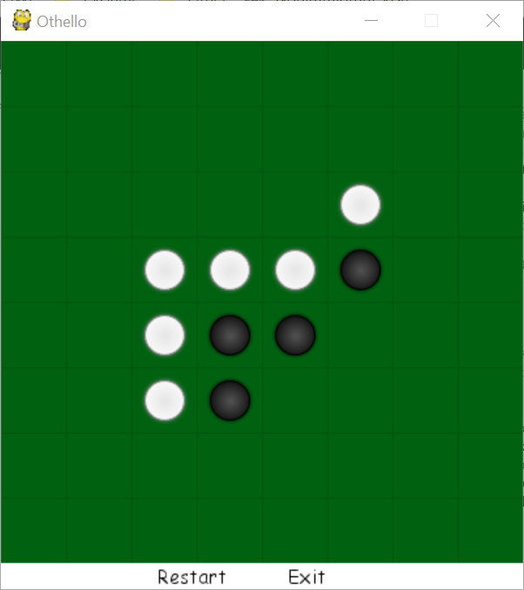
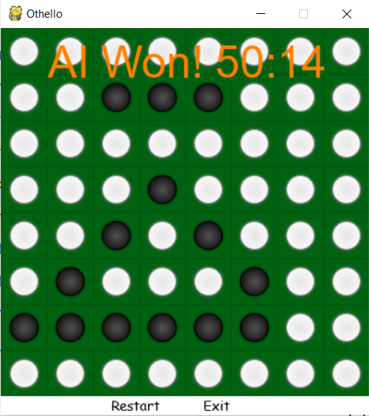
Implementation
A basic GUI created using PyGame

Slide 18
Conclusions
The most intelligent Othello algorithm can win the best human Othello players
It may be a good choice to use Othello knowledge to handcraft a more intelligent search policy than α-β pruning such as expectimax search which could use a complex evaluation function to estimate the rewards for each move
Could help in saving a lot of time by not actually searching a deep tree but by providing estimates of the values of the deeper nodes to the higher tree level
Given a hard time constraint such as a few minutes my implementation would not be able to solve the problem because the AI opponent needs some time to search the game tree and make the best possible move

