Slide 2
Lab 8

Slide 3
Agenda
Objectives
Architecture

Slide 4
Objectives
Learn about the EcoSystem.
What is Db4oUtil
Learn Enterprise, Organizations and Networks

Slide 5
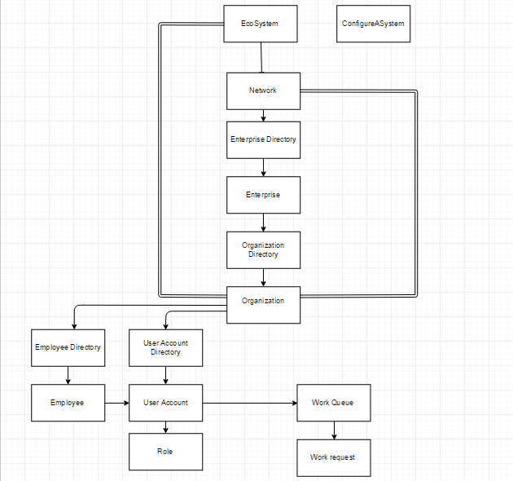
Eco System Architecture

Slide 6
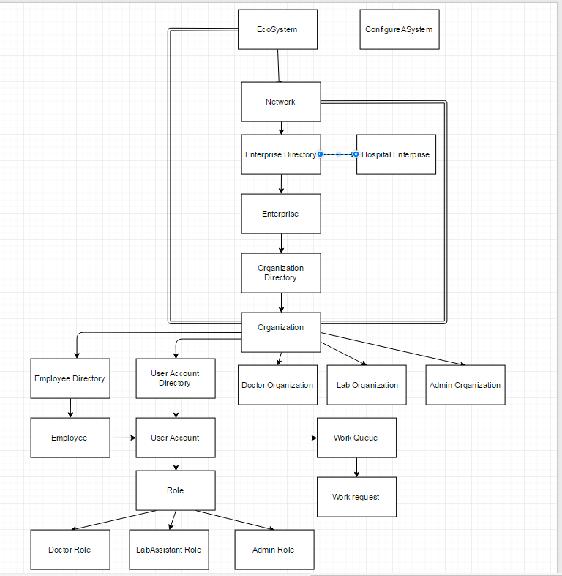
Lab8 Architecture

Slide 7
Steps
Admin Role
1. Admin creates a Lab and Doctor Organization
2. Admin Role adds users of Doctor and Lab.
3. Admin creates doctor and lab employee's
4. Admin Provides username and password for doctor and lab employee's
Doctor Role
1. Doctor login
2. Doctor request for the test(Initiate work request)
3. Doctor submits the request
Lab Role
1. Lab Assistant Login
2. Lab Assistant processes the request which was submitted by the Doctor
3. Lab Assistant assigns the work request to itself
4. Lab Assistant process the request and submit back the request.

