Slide 1
HackerRank-JAVA (Basics)
DAY - 10
-Siddhant Dixit

Slide 2
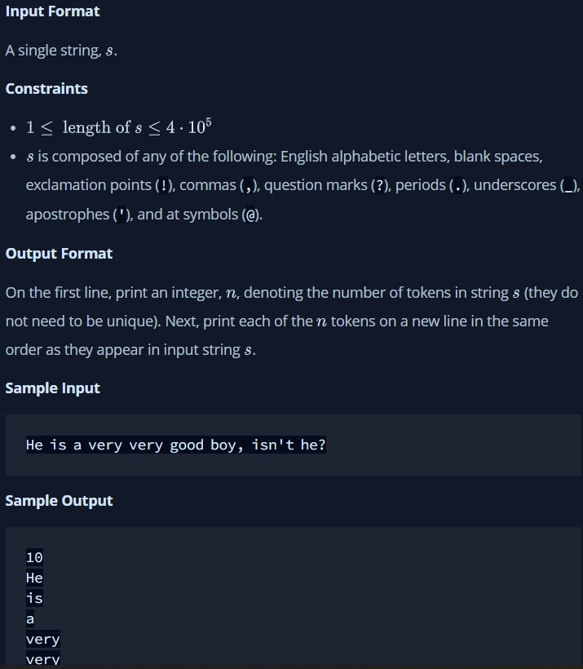
Q-1)

Slide 3
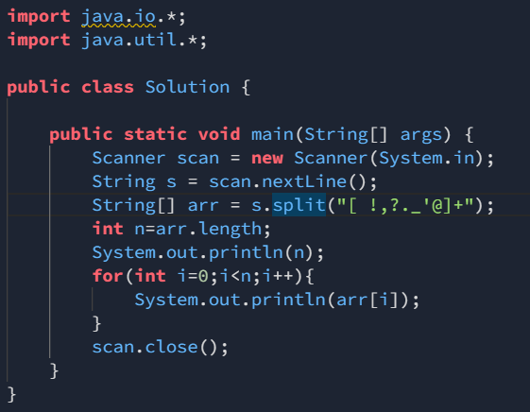
Sol-

Slide 4
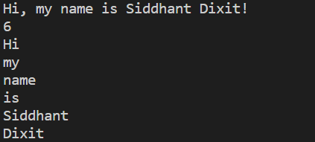
Output-
Input-
Output-

Slide 5
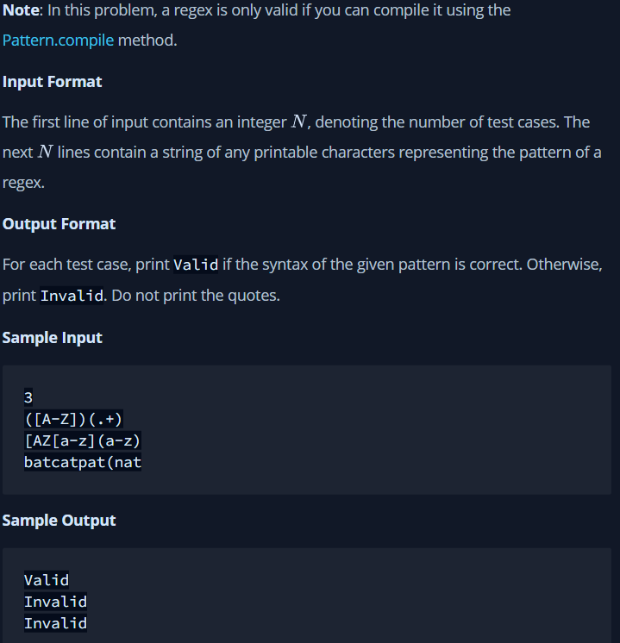
Q-2)

Slide 6
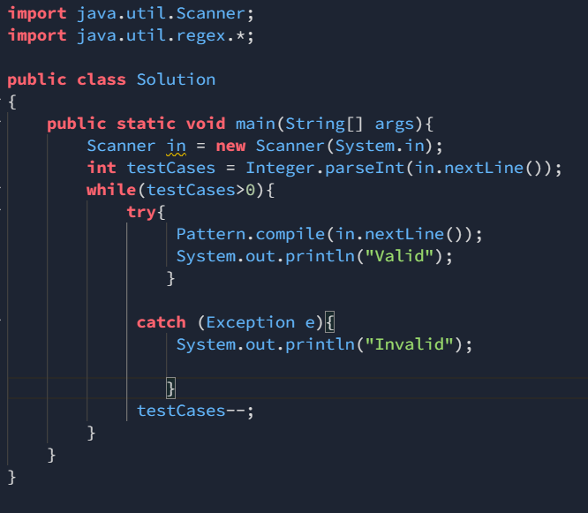
Sol-

Slide 7
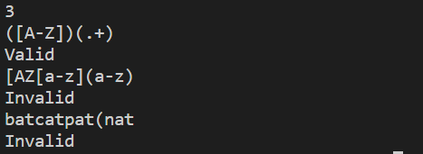
Output-
Input 1->
Output->
Input 1->
Output->
Input 1->
Output->

