Slide 1
HackerRank-JAVA (Basics)
DAY - 8
-Siddhant Dixit

Slide 2
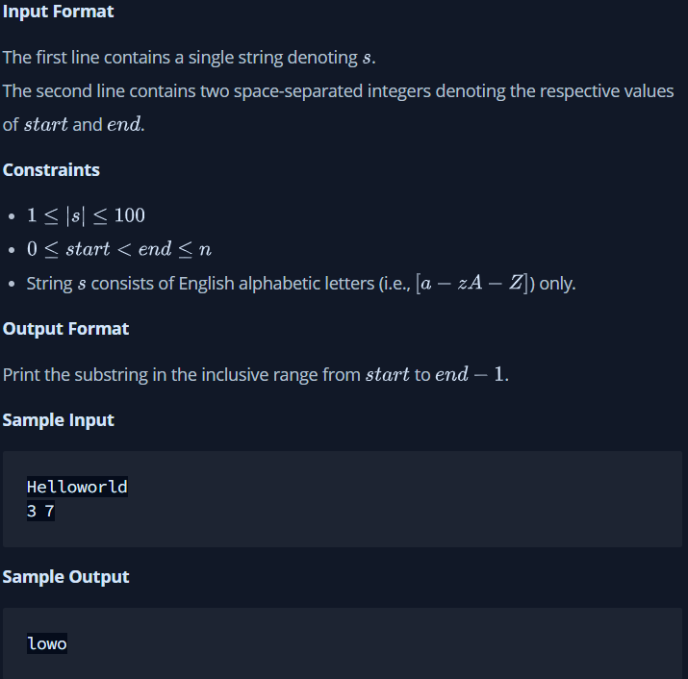
Q-1)

Slide 3
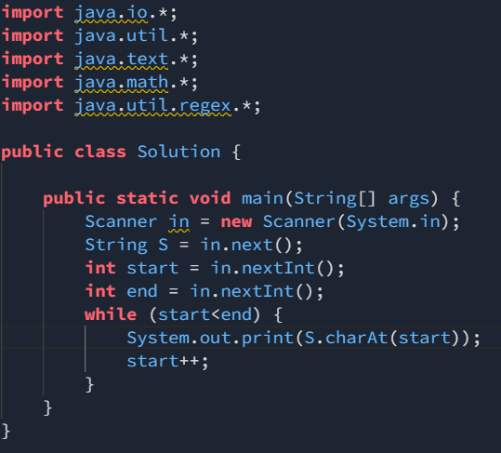
Sol-

