Slide 1
CLIENT SHOWCASE · EQUITAS BANK DISCUSSION
Aadhaar document
masking
A local AI pipeline that finds Aadhaar documents, verifies number lines and masks the first eight digits before PDF delivery.
PROJECT STACK
YOLO26 · OpenCV · PaddleOCR · Verhoeff validation
Working prototype · Synthetic training data · Local processing
01 / 05
Notes:
Introduce this as the current local Aadhaar masking prototype. It detects the full document, verifies the number through OCR and checks, masks the first eight digits, then returns a flattened PDF. The model weights were trained on generated examples, not real Aadhaar records; production readiness is not claimed.

Slide 2
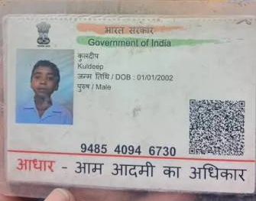
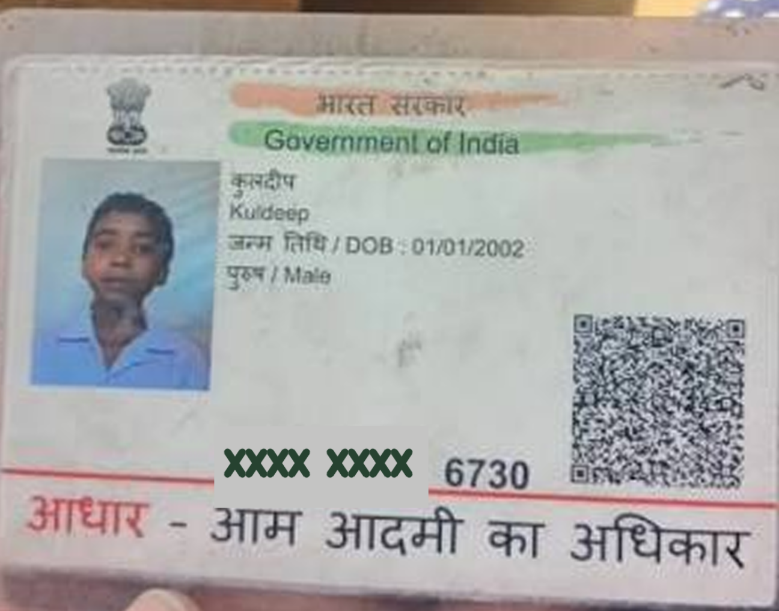
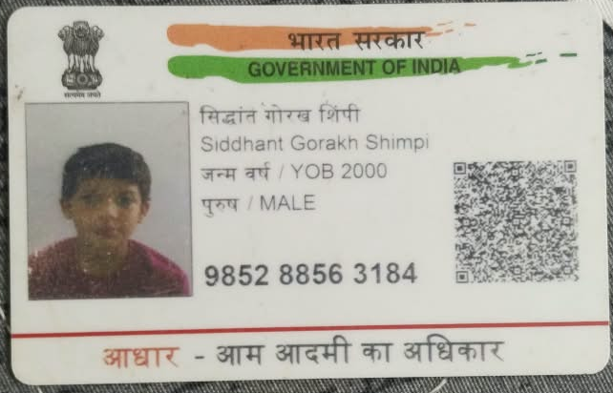
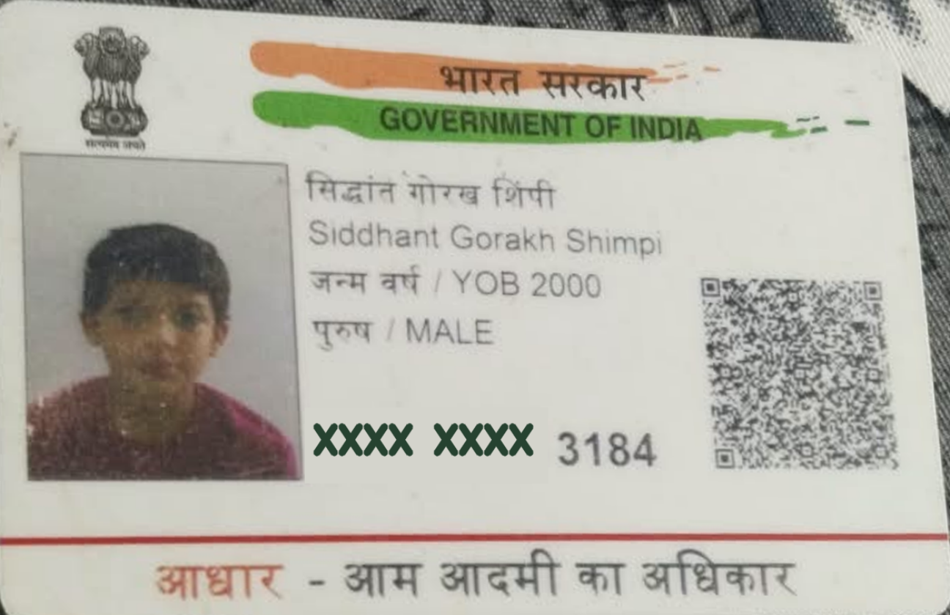
Before and masked output
Two sample captures processed by the current local pipeline.
01 SINGLE CARD PHOTO
02 MIXED CARD SCENE
BEFORE · ORIGINAL
AFTER · MASKED COPY
BEFORE · ORIGINAL
AFTER · MASKED COPY
Pipeline score 76 / 100
Pipeline score 64 / 100
One Aadhaar document · one number line redacted
Aadhaar isolated · one number line redacted
The mixed-scene result contains the Aadhaar page only; the unrelated debit card is not included in the output.
AADHAAR MASKING WORKBENCH · CLIENT SHOWCASE
02 / 05
Notes:
The two input photographs were supplied by the user. The output pages were generated locally from those photographs by the current application pipeline; each run produced one Aadhaar document and redacted one number line. The displayed 76/100 and 64/100 values are the actual conservative pipeline scores for these two runs. The mixed-scene output contains the Aadhaar only, not the debit card. Personal document imagery is included at the user's request for this client showcase.

Slide 3
System processing flow
Document detection, independent number checks and a fail-closed masking audit.
01 FIND AND RECTIFY
01
02
03
04
05
Upload + decode
Aadhaar boundary
Rectify + quality
Read number
Verhoeff + identity gate
Image, PDF or document
YOLO segmentation + OpenCV quadrilaterals
Perspective, size and orientation checks
OCR positions + YOLO boxes
12 digits, first-digit rule and Aadhaar context
02 MASK, THEN VERIFY THE OUTPUT
09
08
07
06
Flattened PDF
Post-mask OCR audit
Mask digits 1–8
Locate digit boxes
Preview and download
A full number must no longer be readable
Leave only the final four visible
Use OCR word-level coordinates
Uncertain verification or a readable full number after masking → reject; no PDF is returned.
AADHAAR MASKING WORKBENCH · CLIENT SHOWCASE
03 / 05
Notes:
Source: SYSTEM_DIAGRAM.md and the current backend pipeline. YOLO segmentation proposes Aadhaar document boundaries; OpenCV proposes geometric quadrilaterals and helps rectify perspective. PaddleOCR supplies text and word-level coordinates, while the separate YOLO number detector supplies an additional number-region proposal. The verification stage checks the twelve-digit shape, the first-digit rule, Verhoeff checksum and Aadhaar-specific context. The checksum alone does not prove identity. The app masks digits 1–8, runs OCR on the masked result, and returns a flattened PDF only when the audit passes; uncertain inputs fail closed.

Slide 4
YOLO26 fine-tuning and model size
COCO-pretrained nano starters were updated on task-specific synthetic labels; the network architecture stayed YOLO26.
DOCUMENT SEGMENTATION
COCO STARTER
FINE-TUNED CHECKPOINT
Learns full-card or letter polygons for front, back and letter documents.
Classes: aadhaar_front
aadhaar_back · aadhaar_letter
yolo26n-seg.pt
aadhaar-document-seg.pt
6.41 MiB
6.20 MiB
NUMBER DETECTION
COCO STARTER
FINE-TUNED CHECKPOINT
Locates each printed Aadhaar number line; this final run continued from an earlier custom checkpoint.
Class: aadhaar_number
yolo26n.pt
aadhaar-number-det.pt
5.29 MiB
5.10 MiB
11.31 MiB
TRAINING DATA
RECORDED FINAL RUNS
Combined size of the two custom .pt checkpoints.
Checkpoint size only; runtime dependencies add storage.
Each task: 180 train · 36 validation · 36 test images.
47.0 MiB of generated images in total.
No real Aadhaar records used for training.
Segmentation: 20 epochs · 384 px · batch 8 · first 5 layers frozen · ~25 min.
Number detector: 15 more epochs from prior custom weights · 512 px · batch 4 · all layers trainable · ~27 min.
Fine-tuning updates learned weights; it does not append another model.
The .pt extension marks a PyTorch checkpoint. These are synthetic bootstrap weights, not production-certified models.
AADHAAR MASKING WORKBENCH · CLIENT SHOWCASE
04 / 05
Notes:
Exact checkpoint sizes come from backend/models and CTO_APPLICATION_GUIDE.md. The base files are the official Ultralytics YOLO26 nano segmentation and detection weights. Ultralytics model.train() fine-tuned the task-specific weights and heads. The document model used 20 epochs, 384 px, batch 8, freezing the first five layers. The final number model continued from the earlier custom number checkpoint for 15 more epochs at 512 px and batch 4 with all layers trainable. Per task, the generated set had 180 train, 36 validation and 36 test images; no real Aadhaar records were used. The .pt extension marks a PyTorch checkpoint, not pytest. The reported disk size covers only the checkpoint files, not PyTorch, PaddleOCR and other runtime components. Check Ultralytics commercial licensing before external deployment. Official documentation: https://docs.ultralytics.com/models/yolo26 ; https://docs.ultralytics.com/tasks/segment ; https://docs.ultralytics.com/tasks/detect .

Slide 5
AI metrics and Equitas pilot
Prototype evidence today; a measured, human-reviewed document-intelligence pilot next.
HELD-OUT SYNTHETIC MODEL METRICS
CURRENT UI CONFIDENCE SCORE
TASK PRECISION / RECALL mAP50 / mAP50–95
100 × min(document confidence,
verification confidence)
Document masks .981 / .946 .982 / .959
Number boxes .998 / 1.000 .995 / .667
Rejected / no safe output = 0 · missing score data = unavailable
A conservative pipeline signal, not a calibrated probability or end-to-end accuracy claim.
36 synthetic test images per task; not real-world accuracy.
PROPOSED AI / ML EXTENSIONS FOR EQUITAS
Mapped to Equitas’s public digital onboarding, lending and API context; these are proposals, not existing Equitas features.
KYC / loan-pack intake
Privacy masking
Guided human review
Classify documents, extract fields with OCR and flag missing or unreadable pages.
Extend redaction to PAN and account values in review copies and case attachments.
Surface cross-document mismatches and duplicates for staff review; do not auto-decide credit.
First pilot: KYC pack completeness + PII masking. Measure field accuracy, unsafe outputs, false accepts/rejects and review minutes.
AADHAAR MASKING WORKBENCH · CLIENT SHOWCASE
05 / 05
Notes:
Prototype metrics are from CTO_APPLICATION_GUIDE.md and ARCHITECTURE.md. The final synthetic test evaluation reported document mask precision/recall 0.981/0.946, mask mAP50 0.982 and mask mAP50–95 0.959; number-box precision/recall 0.998/1.000, mAP50 0.995 and mAP50–95 0.667. These are synthetic-set results, not estimates of real camera or production performance. The UI score is round(100 × min(document detector confidence, verification confidence)); no safe output maps to zero, while unavailable inputs remain unscored. It is not calibrated. Equitas context is based on its FY2024–25 Integrated Annual Report and public Developer Portal API catalogue. The suggested KYC/loan-pack pilot is a proposal subject to Equitas security, legal and architecture review, and should keep human operators responsible for decisions. Sources: https://ir.equitas.bank.in/wp-content/uploads/2025/08/Equitas-AR-2024-25-1.pdf ; https://developer.equitas.bank.in/ .

