Slide 1
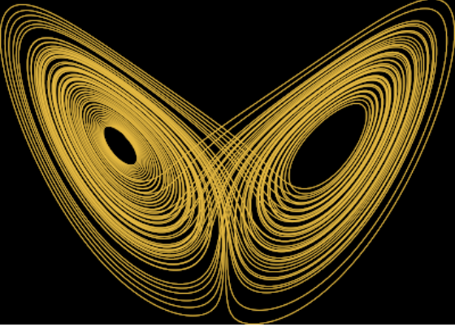
CHAOS AS AN INTERMITTENTLY FORCED LINEAR SYSTEM
Presented by: Siddhanth Janadri

Slide 2
Abstract
The state of a dynamical system often evolves with time over state space. Sometimes, these dynamics of a system give rise to complex behaviours that makes it difficult to predict its nature which is commonly known as Chaos. We make use of Lorenz system to present a data-driven approach to decompose chaotic dynamics as an intermittently forced linear system. Takens’ delay embedding along with Koopman operator theory and spare regression are considered to represent non-linear dynamics. The process of decomposing chaotic dynamics into a linear model with forcing by low energy delay co-ordinates is known as Hankel Alternative View Of Koopman (HAVOK) analysis.

Slide 3
Abstract
The state of a dynamical system often evolves with time over state space. Sometimes, these dynamics of a system give rise to complex behaviours that makes it difficult to predict its nature which is commonly known as Chaos. We make use of Lorenz system to present a data-driven approach to decompose chaotic dynamics as an intermittently forced linear system. Takens’ delay embedding along with Koopman operator theory and spare regression are considered to represent non-linear dynamics. The process of decomposing chaotic dynamics into a linear model with forcing by low energy delay co-ordinates is known as Hankel Alternative View Of Koopman (HAVOK) analysis.

Slide 4

Dynamical Systems
Systems that change over time that are represented over state space.
Each state of a system corresponds to a unique point in a state space.
Deterministic or Stochastic
Geometric and statistical perspectives
It is of the form:
Discretized version:

Slide 5
Abstract
The state of a dynamical system often evolves with time over state space. Sometimes, these dynamics of a system give rise to complex behaviours that makes it difficult to predict its nature which is commonly known as Chaos. We make use of Lorenz system to present a data-driven approach to decompose chaotic dynamics as an intermittently forced linear system. Takens’ delay embedding along with Koopman operator theory and spare regression are considered to represent non-linear dynamics. The process of decomposing chaotic dynamics into a linear model with forcing by low energy delay co-ordinates is known as Hankel Alternative View Of Koopman (HAVOK) analysis.

Slide 6
Chaotic systems
Ubiquitous in the physical, biological, and engineering sciences
Sensitive dependence on initial conditions
Dense collection of points with periodic orbits
Not random – balance of order and structure
Butterfly effect – a small change in one state of a deterministic nonlinear system results in large differences in a later state.

Slide 7
Abstract
The state of a dynamical system often evolves with time over state space. Sometimes, these dynamics of a system give rise to complex behaviours that makes it difficult to predict its nature which is commonly known as Chaos. We make use of Lorenz system to present a data-driven approach to decompose chaotic dynamics as an intermittently forced linear system. Takens’ delay embedding along with Koopman operator theory and spare regression are considered to represent non-linear dynamics. The process of decomposing chaotic dynamics into a linear model with forcing by low energy delay co-ordinates is known as Hankel Alternative View Of Koopman (HAVOK) analysis.

Slide 8
Lorenz System
Simple deterministic dynamical system that exhibit chaos
System of three ordinary differential equations:
Lorenz attractor:
attractor in 3D space that relates three parameters in fluid dynamics
Classical system to study chaos
Simulation of Lorenz attractor

Slide 9
Abstract
The state of a dynamical system often evolves with time over state space. Sometimes, these dynamics of a system give rise to complex behaviours that makes it difficult to predict its nature which is commonly known as Chaos. We make use of Lorenz system to present a data-driven approach to decompose chaotic dynamics as an intermittently forced linear system. Takens’ delay embedding along with Koopman operator theory and spare regression are considered to represent non-linear dynamics. The process of decomposing chaotic dynamics into a linear model with forcing by low energy delay co-ordinates is known as Hankel Alternative View Of Koopman (HAVOK) analysis.

Slide 10

Koopman Operator Theory
Infinite dimensional linear operator acts on the Hilbert space of functions
Linear representation of nonlinear dynamics
Advances measurement functions of the state forward in time
Trades finite dimensional nonlinear dynamics for infinite dimensional linear dynamics
Goal is to find the finite-dimensional approximation in data-driven analysis

Slide 11

Koopman Operator Theory
Koopman Invariant Measurement Subspaces
For any measurement g in the measurement subspace spanned by measurement functions {g₁,g₂,….g_{p}} :
It remains in the subspace after being acted on by Koopman Operator

Slide 12
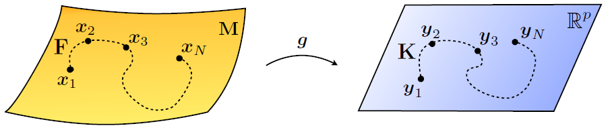
Koopman Operator Theory
Koopman Invariant Measurement Subspaces
p × p matrix representation of K is obtained
Identifying good measurement coordinates is the central challenge
Figure 1: Schematic illustration of Koopman Operator

Slide 13
Abstract
The state of a dynamical system often evolves with time over state space. Sometimes, these dynamics of a system give rise to complex behaviours that makes it difficult to predict its nature which is commonly known as Chaos. We make use of Lorenz system to present a data-driven approach to decompose chaotic dynamics as an intermittently forced linear system. Takens’ delay embedding along with Koopman operator theory and spare regression are considered to represent non-linear dynamics. The process of decomposing chaotic dynamics into a linear model with forcing by low energy delay co-ordinates is known as Hankel Alternative View Of Koopman (HAVOK) analysis.

Slide 14
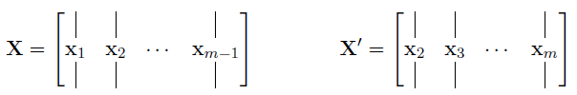

Data-driven dynamic regression
Dynamic Mode Decomposition
Provides best-fit linear operator from high-dimensional data
These matrices are related by an operator A given by:
We seek eigen decomposition of A by taking SVD of X:

Slide 15
Data-driven dynamic regression
Dynamic Mode Decomposition
Full dimensional vectors of A are given by the columns of Φ:
Its based on linear measurements of the state x of the system
Extended to an augmented measurement vector
Measurement functions are determined either
Using information from the dynamical system
By a brute force search in a particular basis of Hilbert space

Slide 16
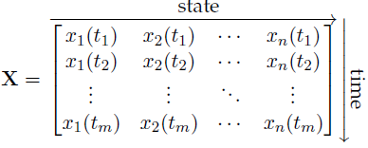
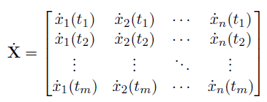
Data-driven dynamic regression
Sparse Identification of Nonlinear Dynamics (SINDy)
Another technique to identify nonlinear dynamics from measurement data
Uses sparse regression to determine active terms
To determine the function f from data
Time history of the state x(t)
Its derivative are captured

Slide 17



Data-driven dynamic regression
Sparse Identification of Nonlinear Dynamics (SINDy)
Construct augmented library of consisting nonlinear candidate functions
Sparse regression is used to determine sparse vectors of coefficients
A model of each row of the governing equations are constructed as

Slide 18
Abstract
The state of a dynamical system often evolves with time over state space. Sometimes, these dynamics of a system give rise to complex behaviours that makes it difficult to predict its nature which is commonly known as Chaos. We make use of Lorenz system to present a data-driven approach to decompose chaotic dynamics as an intermittently forced linear system. Takens’ delay embedding along with Koopman operator theory and spare regression are considered to represent non-linear dynamics. The process of decomposing chaotic dynamics into a linear model with forcing by low energy delay co-ordinates is known as Hankel Alternative View Of Koopman (HAVOK) analysis.

Slide 19
Takens’ Embedding Theorem
Choosing good measurements has been critical to modelling, predicting and controlling dynamical systems
Dynamics of a system maybe revealed from a time series of a single point measurement
Makes use of measurement, x(t) with time shifted copies of itself – Delay Coordinates
Entire attractor of a dynamical system that is diffeomorphic to the original can be constructed
Based on SVD of a Hankel matrix

Slide 20
Abstract
The state of a dynamical system often evolves with time over state space. Sometimes, these dynamics of a system give rise to complex behaviours that makes it difficult to predict its nature which is commonly known as Chaos. We make use of Lorenz system to present a data-driven approach to decompose chaotic dynamics as an intermittently forced linear system. Takens’ delay embedding along with Koopman operator theory and spare regression are considered to represent non-linear dynamics. The process of decomposing chaotic dynamics into a linear model with forcing by low energy delay co-ordinates is known as Hankel Alternative View Of Koopman (HAVOK) analysis.

Slide 21
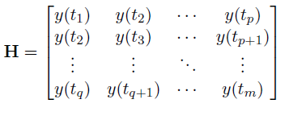
Hankel Matrix
Formed from a time series of a measurement y(t)
Singular Value Decomposition of the Hankel Matrix:
Decomposition of the matrix into eigen time series by the columns of U and V
Ordered by the ability to express the variance

Slide 22
Abstract
The state of a dynamical system often evolves with time over state space. Sometimes, these dynamics of a system give rise to complex behaviours that makes it difficult to predict its nature which is commonly known as Chaos. We make use of Lorenz system to present a data-driven approach to decompose chaotic dynamics as an intermittently forced linear system. Takens’ delay embedding along with Koopman operator theory and spare regression are considered to represent non-linear dynamics. The process of decomposing chaotic dynamics into a linear model with forcing by low energy delay co-ordinates is known as Hankel Alternative View Of Koopman (HAVOK) analysis.
HAVOK

Slide 23
Hankel Alternative View of Koopman
Alternative perspective of how to get koopman invariant measurement subspaces
Based on time delay coordinates, embedding theory and system identification of Hankel operator
Good intrinsic measurement coordinates are uncovered
DMD gives best fit linear model but based on linear measurements
Instead of propagating states, propagate measurements based on time history of the state
More data provides more information

Slide 24
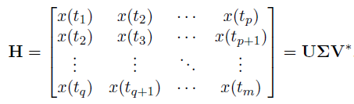
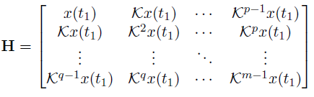
Hankel Alternative View of Koopman
Eigen time delay coordinates are obtained from a time series of a single measurement x(t) by taking a SVD of the Hankel matrix:
Rewriting it with the koopman operator K:

Slide 25

Hankel Alternative View of Koopman
A linear model cannot characterize multiple fixed points describing chaos
Build a linear model on first r-1 variables, treat last variable v_{r} as a forcing term
v_{r} is an input forcing that approximate non-linear dynamics
Forcing term signifies lobe switching or bursting phenomena
Judge the behavior based on forcing signal being small or large

Slide 26
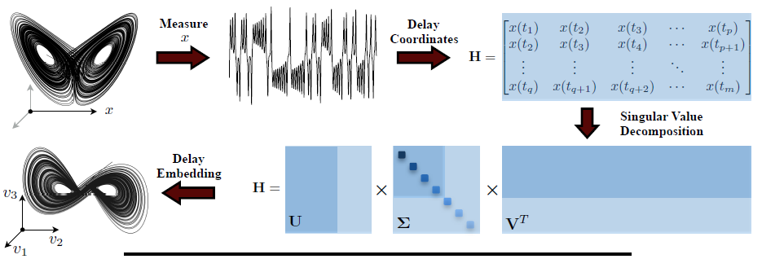
HAVOK on Lorenz System
Decomposition of Chaos into a linear dynamical system with intermittent forcing

Slide 27
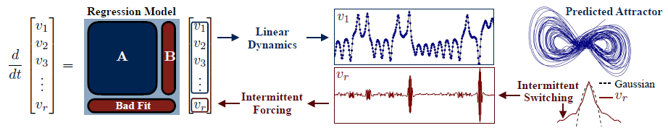
HAVOK on Lorenz System
A best fit linear model from time-delay coordinates and lobe switching in chaotic dynamics

Slide 28
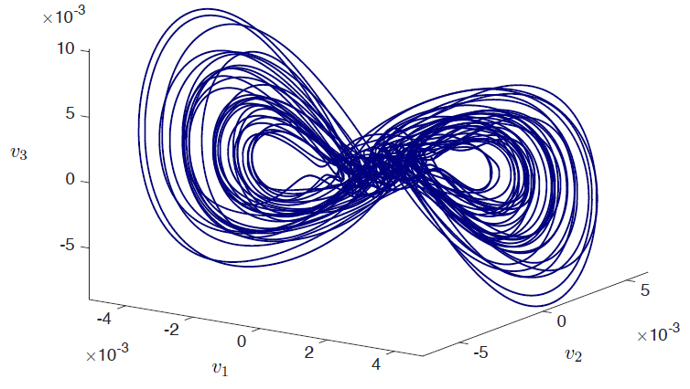
HAVOK on Lorenz System
Reconstructed embedded attractor using linear HAVOK model with forcing term

Slide 29
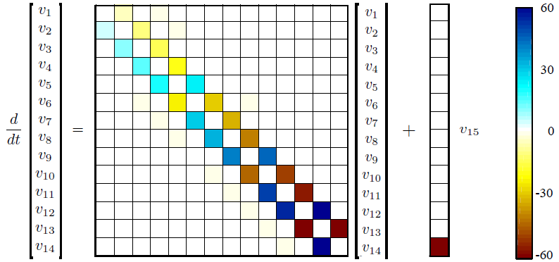
HAVOK on Lorenz System
HAVOK model obtained from time-delay coordinates of the Lorenz system

Slide 30
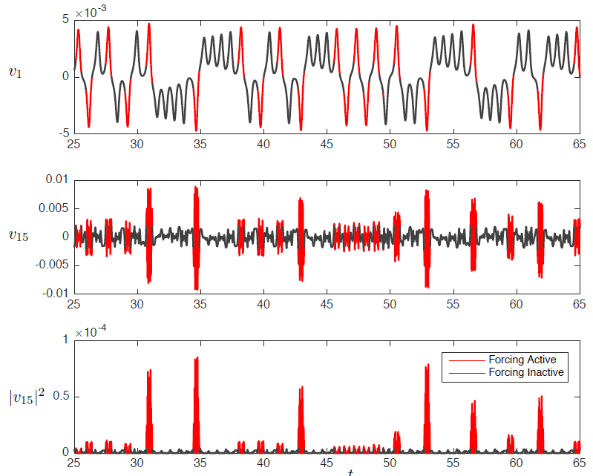
Are HAVOK models predictive??
Isolate regions where the forcing
term is active by selecting values
when v₁₅² are larger than a
threshold value and coloring these
sections of the trajectory in red.
We can say that bursting precedes
the lobe switching which makes it
predictive

Slide 31
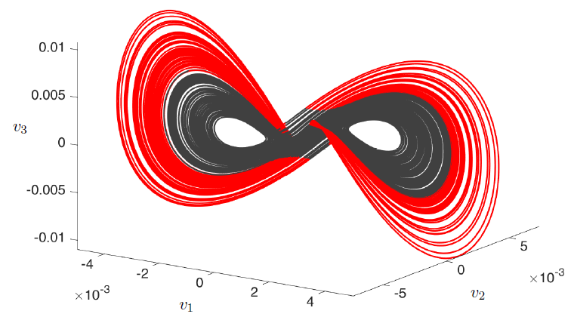
Are HAVOK models predictive??
Color coded time delayed embedded attractor of the Lorenz system by the activity of v₁₅

Slide 32
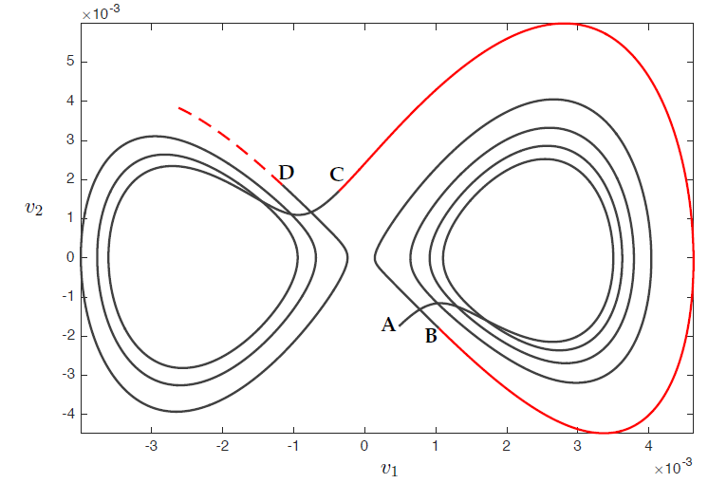
Still not clear?
Illustration of one intermittent lobe switching activity

Slide 33
Abstract revisited
The state of a dynamical system often evolves with time over state space. Sometimes, these dynamics of a system give rise to complex behaviours that makes it difficult to predict its nature which is commonly known as Chaos. We make use of Lorenz system to present a data-driven approach to decompose chaotic dynamics as an intermittently forced linear system. Takens’ delay embedding along with Koopman operator theory and spare regression are considered to represent non-linear dynamics. The process of decomposing chaotic dynamics into a linear model with forcing by low energy delay co-ordinates is known as Hankel Alternative View Of Koopman (HAVOK) analysis.

Slide 34
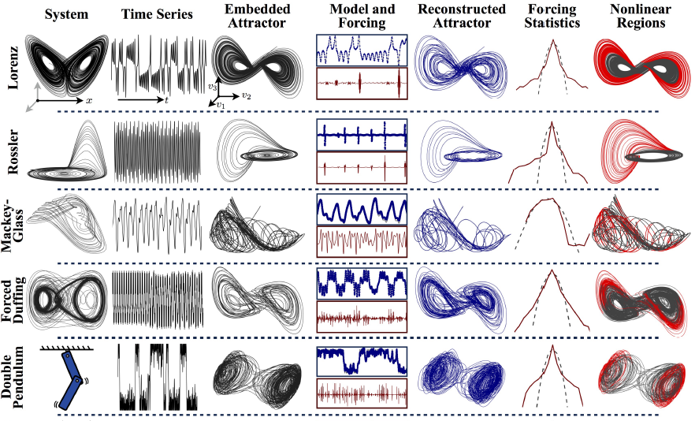
HAVOK on other chaotic systems

Slide 35
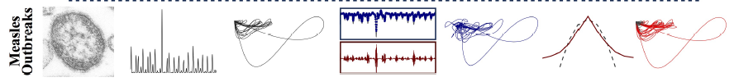
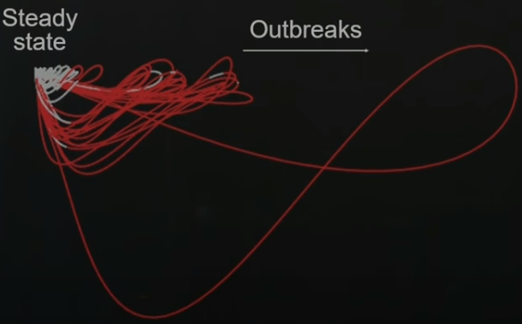
HAVOK on other chaotic systems
Measles outbreak

Slide 36
Conclusion
Primary goal is to go from data to dynamics
Data driven procedure to identify intermittently forced linear system
The activity of the forcing signal predict intermittent transient events
Finding measurement coordinates is of central importance to represent complex system
Hopefully motivate novel strategies to measure, understand and control chaotic systems in a variety of scientific and engineering applications

Slide 37
Thank you

