Slide 1
why this seminar?
Engineer – anyone who can identify problems and use his/ her expertise to solve that problem
An E and E Engineer’s expertise is their knowledge and application capability of Electrical and Electronic fundamentals.
Aim of this project : To show that I can identify real world problems and build electrical/electronics solutions to solve them.

Slide 2
introduction to project
The problem - People in homes are unable to remove laundry from clotheslines during unpredicted rains.
The solution – A smart home system which can automatically sense rain and protect the laundry put on the clothesline.
Current solutions – Involve sensing of rain using chemical reactions or electronics.
The clothesline is then moved inside or a shed is projected out to protect the laundry.

Slide 3
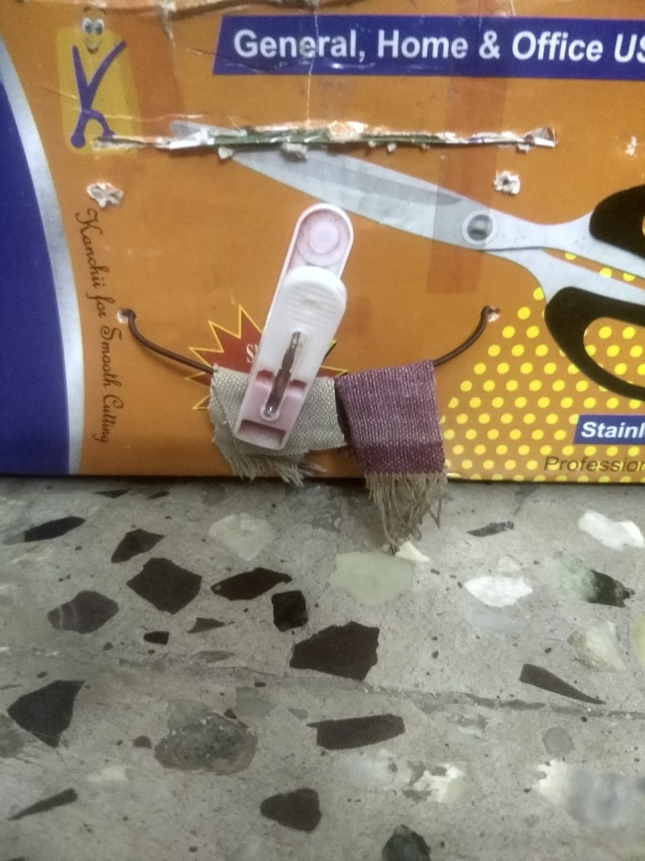
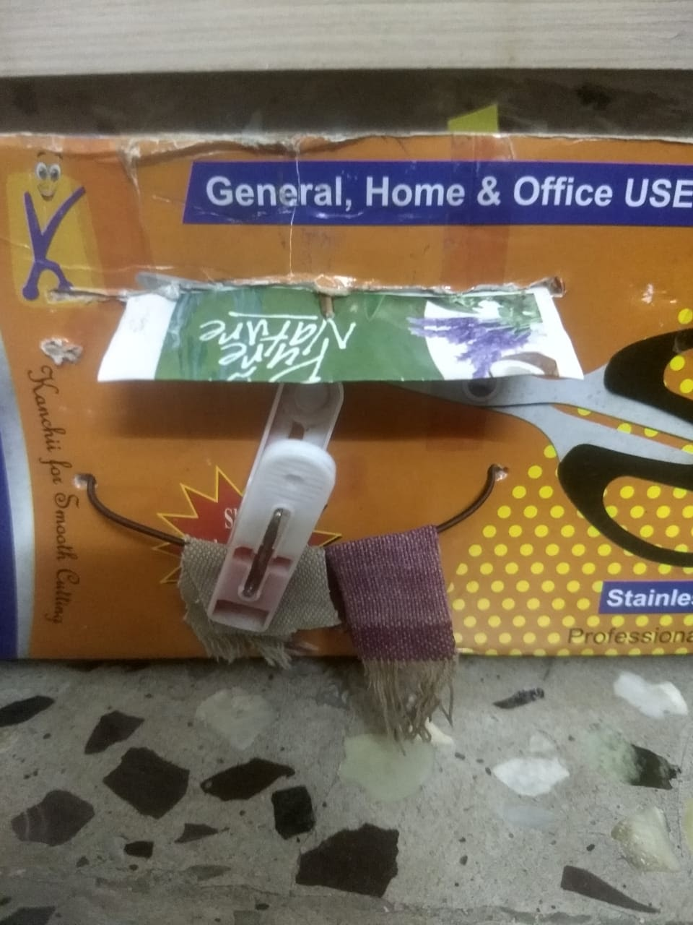
introduction to my solution
This solution uses a LDR to detect light and uses this to open a shed to protect the laundry
during rainy (dark) weather.
During rains
Closed Shed (during no rain)
Shed opens (during rains)

Slide 4
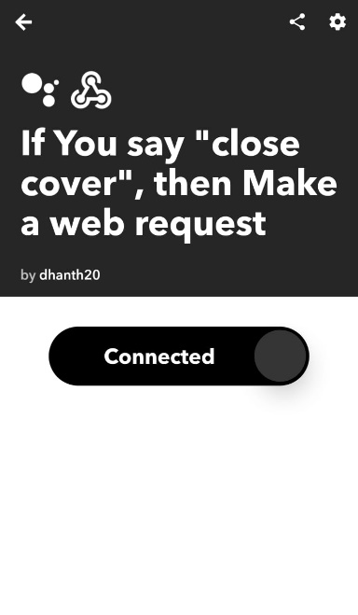
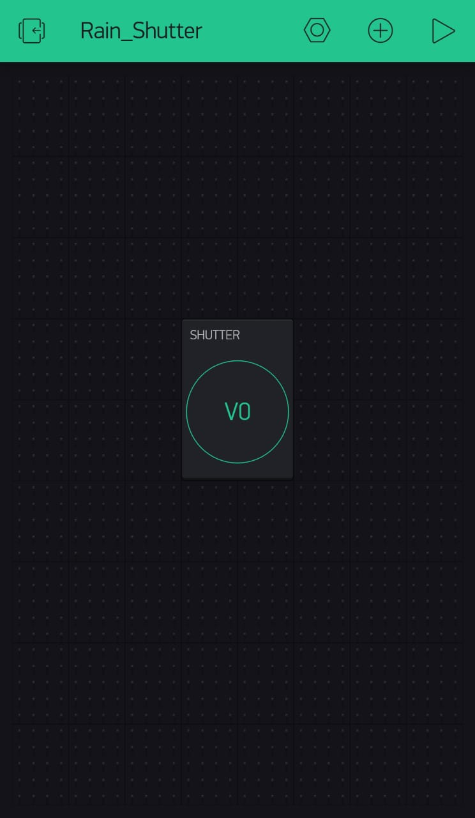
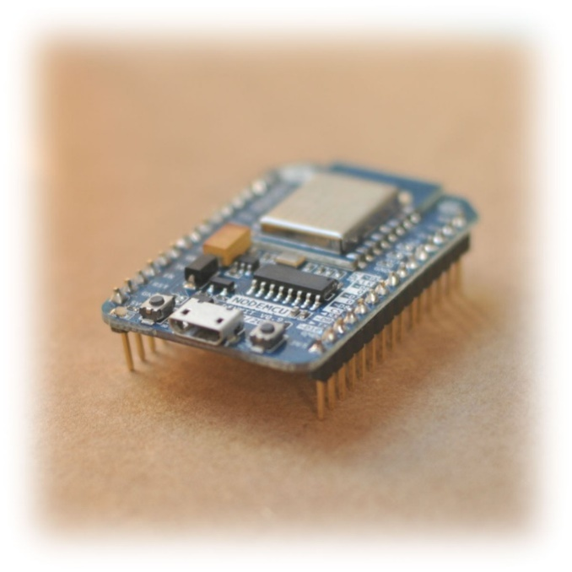
why is my solution better?
Augments existing solutions by providing a choice for the user to override the automation
using voice commands
User issues
voice command
using Google Assistant

Slide 5
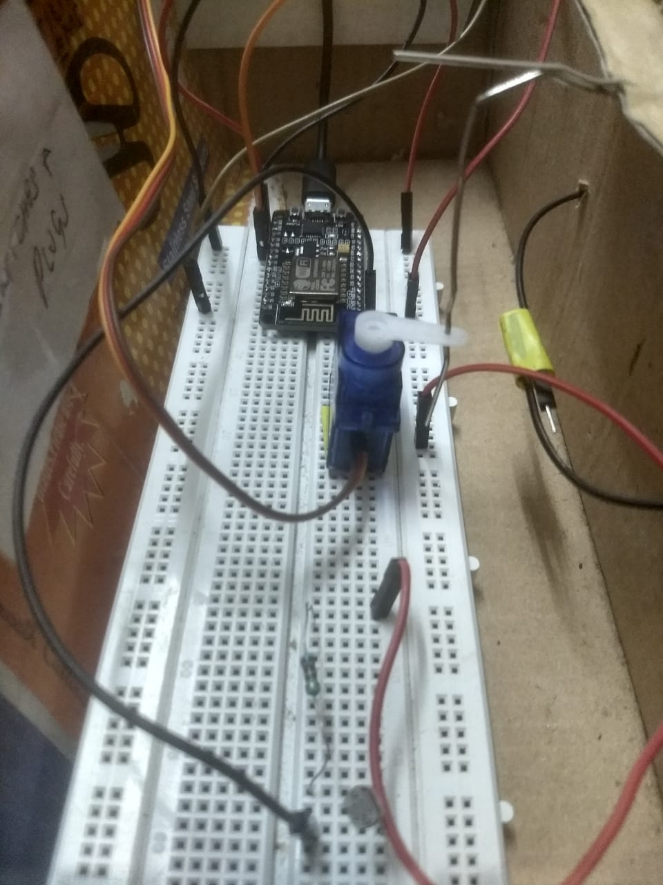
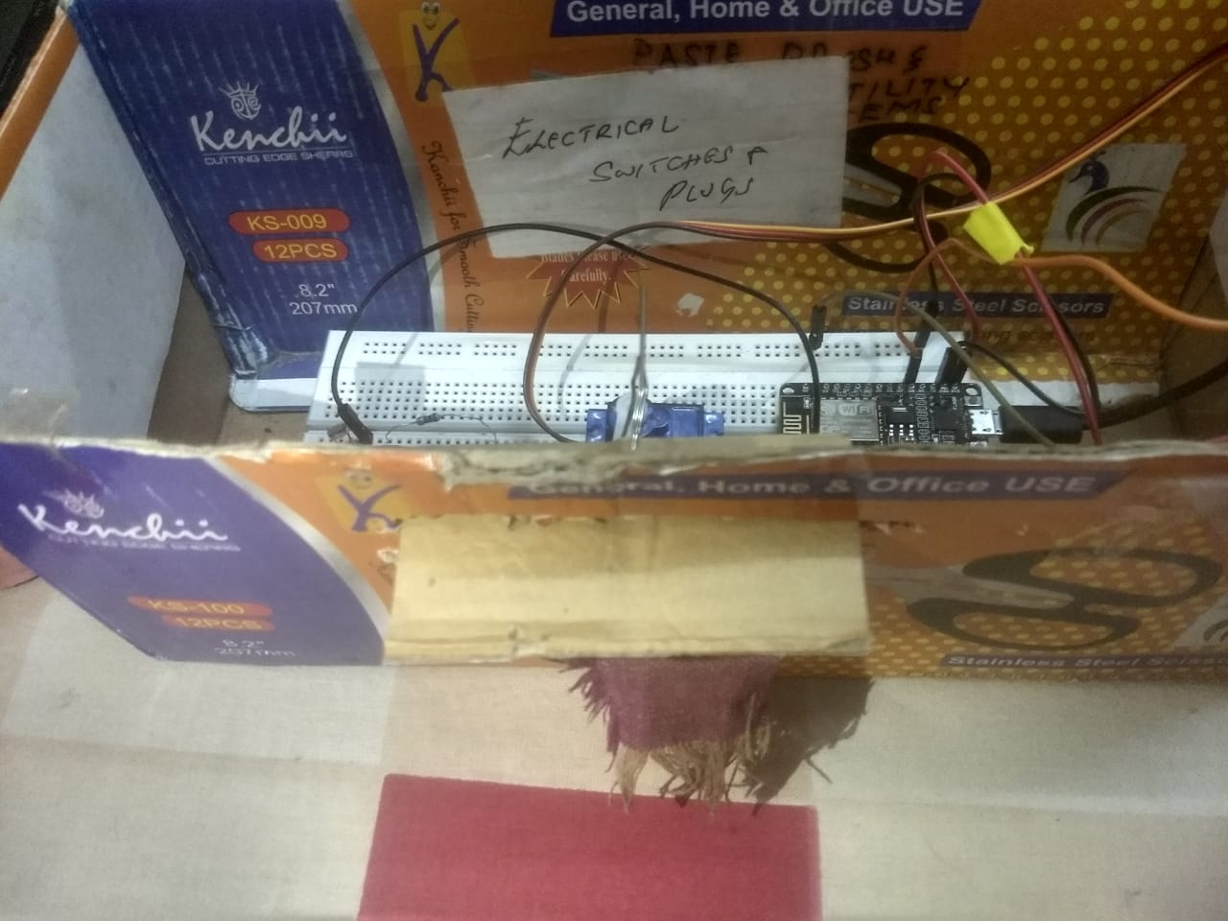
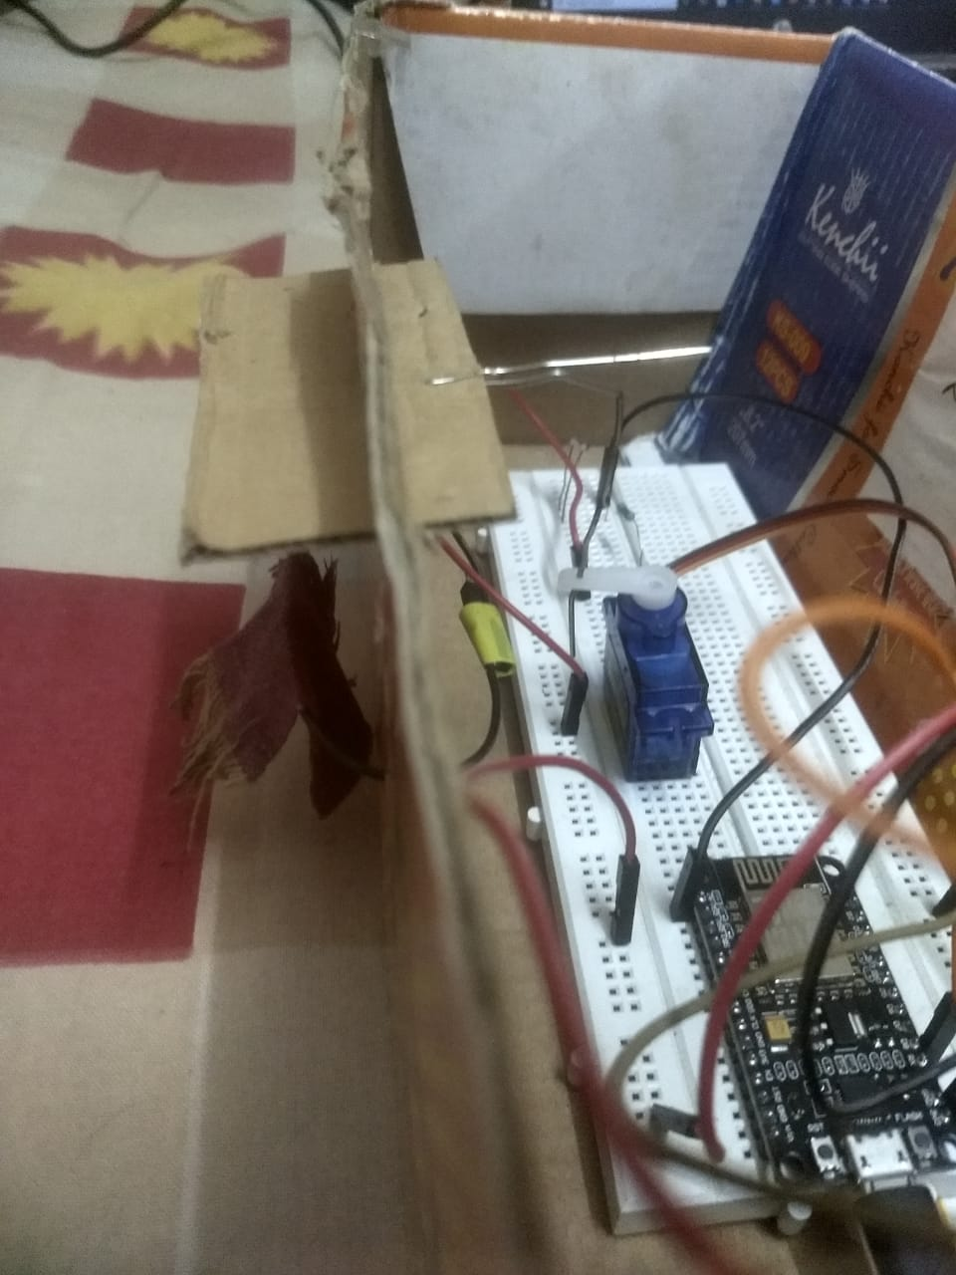
the prototype

Slide 6
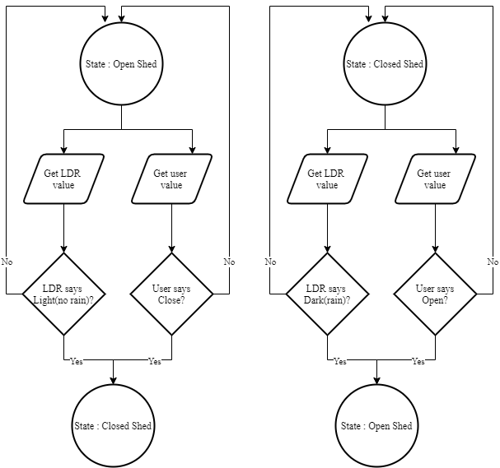
results
The system was able to sense both LDR and voice inputs as expected
Computation of output based on different scenarios worked according to the designed State flowchart
Actuation worked as expected but was unable to move the shed properly due to the lack of a linear actuator

Slide 7
practical implementation
The IOT system solves a real problem of laundry getting wet during rains.
The prototype working as expected ensures that this solution is feasible.
While the prototype proves that the project might be feasible, we still have to test it’s viability as the project could become expensive.
Today : we can target the top 2% - 16% of the Indian population based on annual income
The future : with a booming Indian economy and the growth of inexpensive MEMS, this project holds
a great promise – it can make your home smart and your life easy

Slide 8
acknowledgment
“Knowledge can be gained only when knowledge is shared”
- Unknown
I would like to thank the following people who shared their valuable knowledge to help me complete this project.
Professor Vipin Valsan
Professor Bharathi R.B.
Professor Gururaj Rao H.V.
Mr. Javad Baig
Mr. Bharath R
I would also like to thank https://app.diagrams.net/ for providing a convenient and free tool for drawing flowcharts.

