Slide 1
Exploration of parallel implementation of Machine Learning algorithms for shared memory architecture
By, Team #1
Siddhant Kulkarni
Ritesh Sangurmath

Slide 2
Content
INTRODUCTION AND RECAP
KMEANS
INPUT DATA
SERIAL IMPLEMENTATION
PARALLEL IMPLEMENTATION
CHALLENGES FACED
EXECUTION TIME
WORK TO BE DONE

Slide 3
Content
NAIVE BAYESIAN
RECAP AND SERIAL IMPLEMENTATION
PARALLEL IMPLEMENTATION METHODS
CHALLENGES AND IMPROVEMENTS
CONSIDERATIONS AND SOLUTIONS
WORK
DONE
SPEEDUP OBSERVED
TO BE DONE
CONCLUSION

Slide 4
What is machine learning?
Get Data
Learn
Apply Knowledge

Slide 5
Machine learning
Supervised
Unsupervised
Categories of Machine Learning

Slide 6
Supervised Machine learning
Available data is labelled
Example: WEATHER HISTORY
Popular techniques
Classification
Regression

Slide 7
UNSUPERVISED LEARNING
Unsupervised learning is where we have the input data(x), we don’t have the corresponding output variables.
All the data in the unsupervised is unlabeled or with the same label.
The goal for unsupervised learning is to model the underlying structure or distribution in the data in order to learn more about the data.

Slide 8
K-MEANS

Slide 9
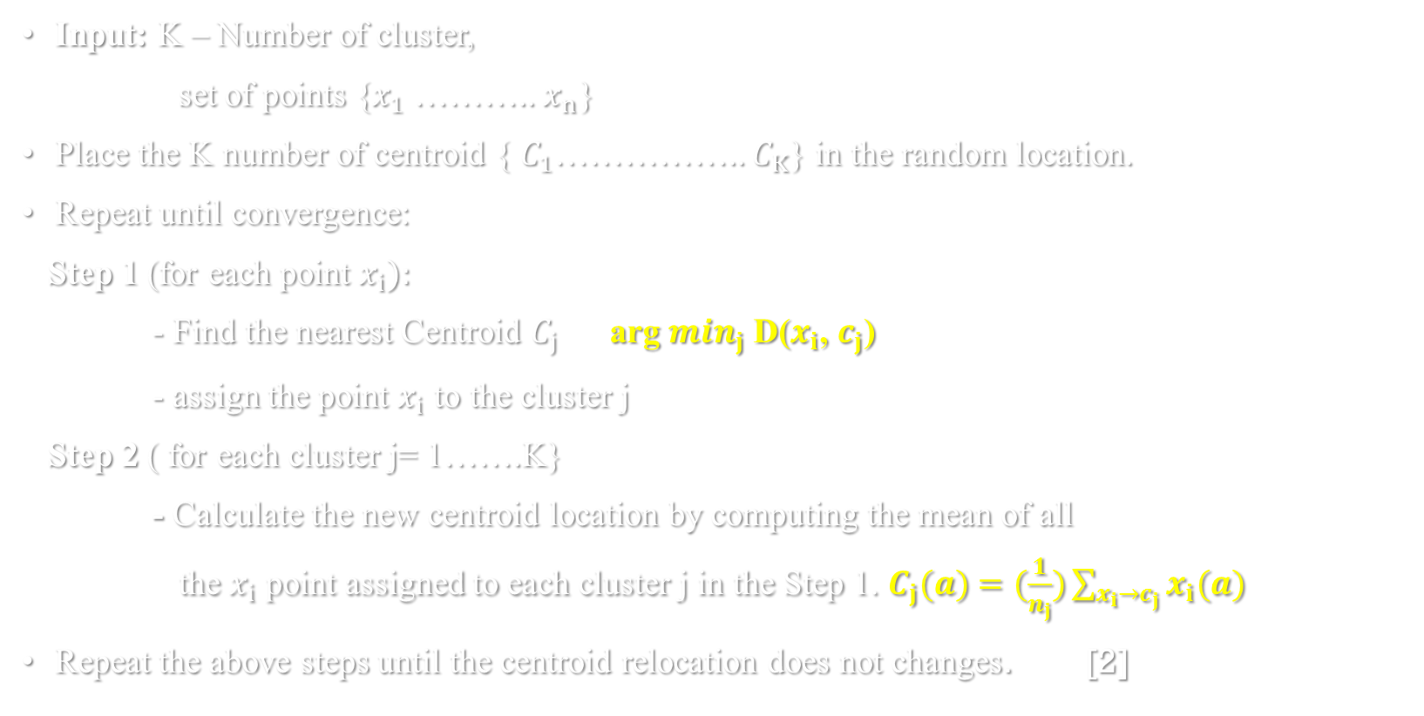
K-MEANS CLUSTERING ALGORITHM
Input: K – Number of cluster,
set of points {$x_{1}$ ……….. $x_{n}$}
Place the K number of centroid { $C_{1}$…………….. $C_{K}$} in the random location.
Repeat until convergence:
Step 1 (for each point $x_{i}):$
- Find the nearest Centroid $C_{j}$ arg $\min_{j}$ D($x_{i}$, $c_{j}$)
- assign the point $x_{i}$ to the cluster j
Step 2 ( for each cluster j= 1…….K}
- Calculate the new centroid location by computing the mean of all
the $x_{i}$ point assigned to each cluster j in the Step 1. $C_{j}(a)$ $=(\frac{1}{n_{j}})\sum_{{x_{i}→c}_{j}}{x_{i}(a)}$
Repeat the above steps until the centroid relocation does not changes. [2]

Slide 10
K-MEANS CLUSTERING EXAMPLE

Slide 11
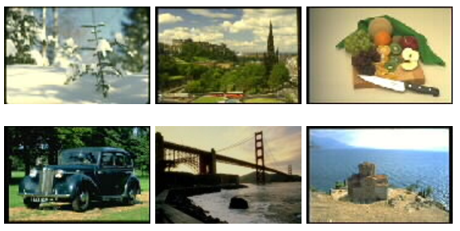
INPUT DATA
There are 68,040 photo images from various categories. [1]

Slide 12
INPUT DATA
In this file, a line corresponds to a single image. The first value in a line is the image ID and the subsequent values are the feature vector of the image.
Color Histogram: 32 dimensions (8 x 4 = H x S)
The value in each dimension in a ColorHistogram of an image is the density of each color in the entire image.
Histogram intersection (overlap area between ColorHistograms of two images) can be used to measure the similarity between two images.

Slide 13
SERIAL IMPLEMENTATION
USER INPUT :
TEXT FILE
NUMBER OF CLUSTER

Slide 14
SERIAL IMPLEMENTATION
images [IMAGE_ID][FEATURES]
numFea: number of features in single image data point
numImg : Number of images in the input text file
numCluster : Number of cluster (user request)
Threshold: The end point were the program has to stop
cluster_id[image_id]: Specifies the cluster_id in which the image belongs
Loopiteration: Number of iteration taken.

Slide 15
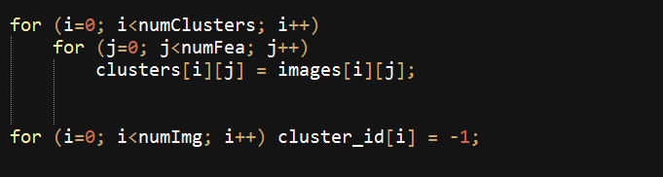
SERIAL IMPLEMENTATION
Selection of Cluster’s centroid points

Slide 16
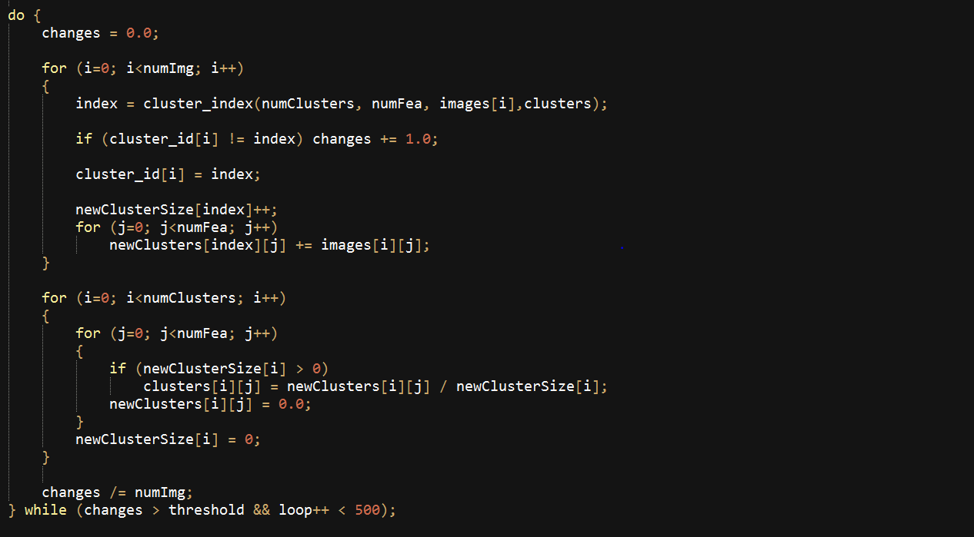
SERIAL IMPLEMENTATION
A

Slide 17
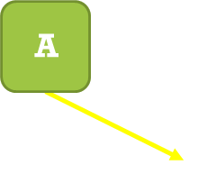
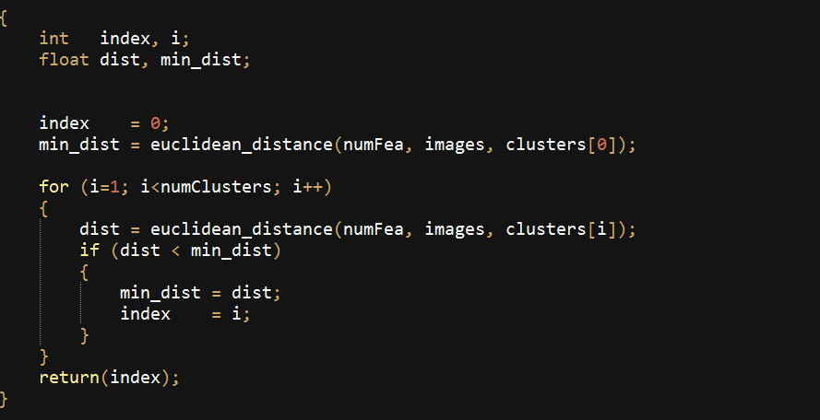
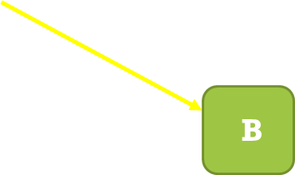
SERIAL IMPLEMENTATION

Slide 18
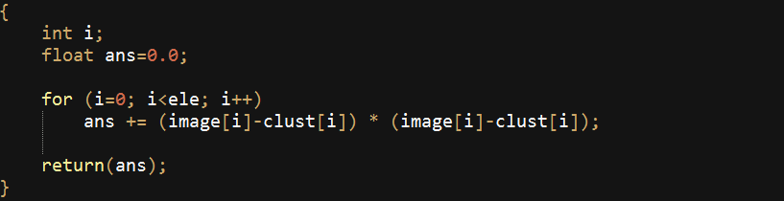
SERIAL IMPLEMENTATION
B

Slide 19
SERIAL IMPLEMENTATION

Slide 20
SERIAL IMPLEMENTATION

Slide 21
Execution times SERIAL IMPLEMENTATION
 | TIME IN sec
K=2 | 5.2031
K=4 | 7.6318
K=6 | 9.8725
K=8 | 19.6792

Slide 22
SERIAL IMPLEMENTATION
OUTPUT
Final location of the cluster’s centroid
The membership (cluster_id) of each image (image_id)

Slide 23
Parallel implementation
Accessing the data points parallelly
Computing the Euclidean distance between two array parallelly

Slide 24
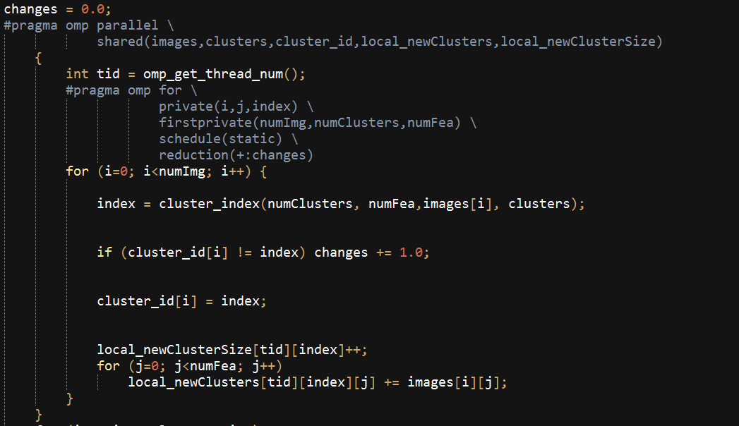
Accessing the data points parallelly

Slide 25
Accessing the data points parallelly
Challenges:
1. Unable to get the correct data points in the correct cluster_id
2. The time keeps on varying

Slide 26

Computing the Euclidean distance between two array parallelly
Computing the euclidean distance between two array parallelly

Slide 27
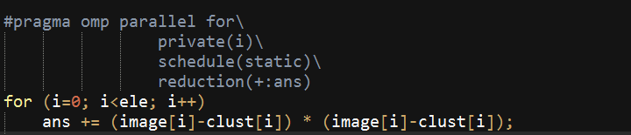
Computing the Euclidean distance between two array parallelly
[3]

Slide 29
NUTSHELL
WORK TO BE DONE:
Improvise the parallel implementation for the data points
Improvise the parallel implementation for finding the Euclidean distance between the two array.
Modify the parallel implementation for the distributed memory.

Slide 30
Naïve Bayesian Recap + Serial implementation

Slide 31
Reading Data – Static For both phases (for now)

Slide 32
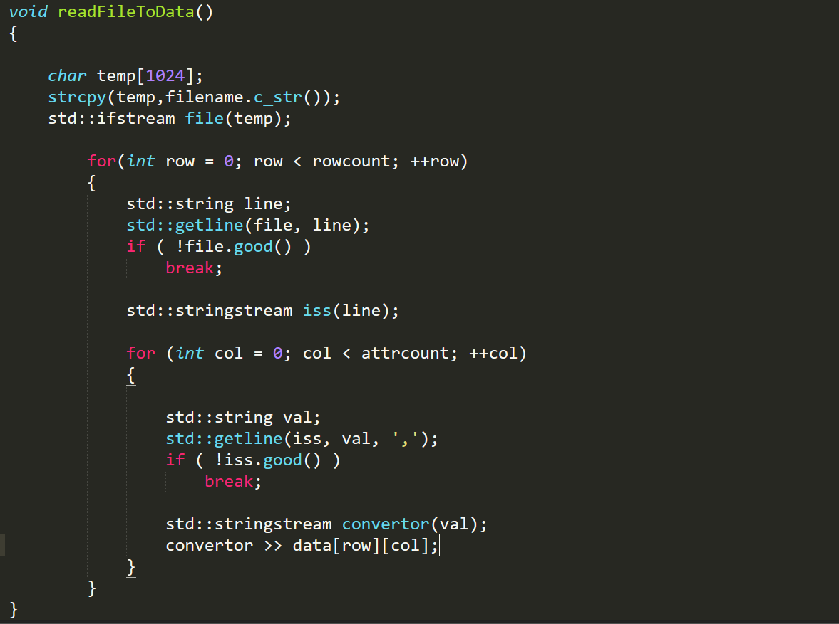
Stores data as a matrix

Slide 33
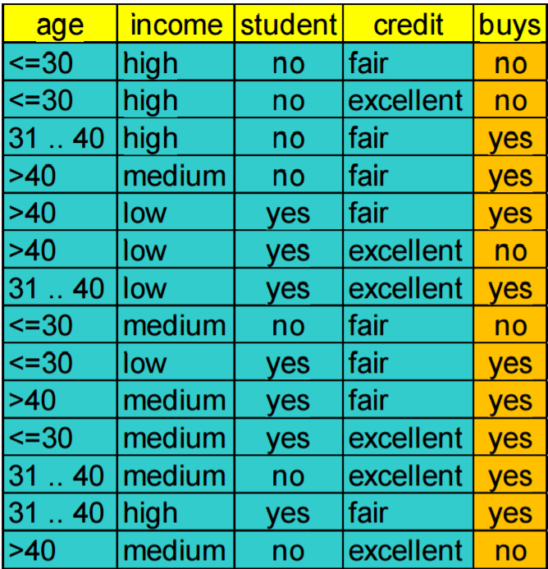

Slide 34
Training the classifier

Slide 35
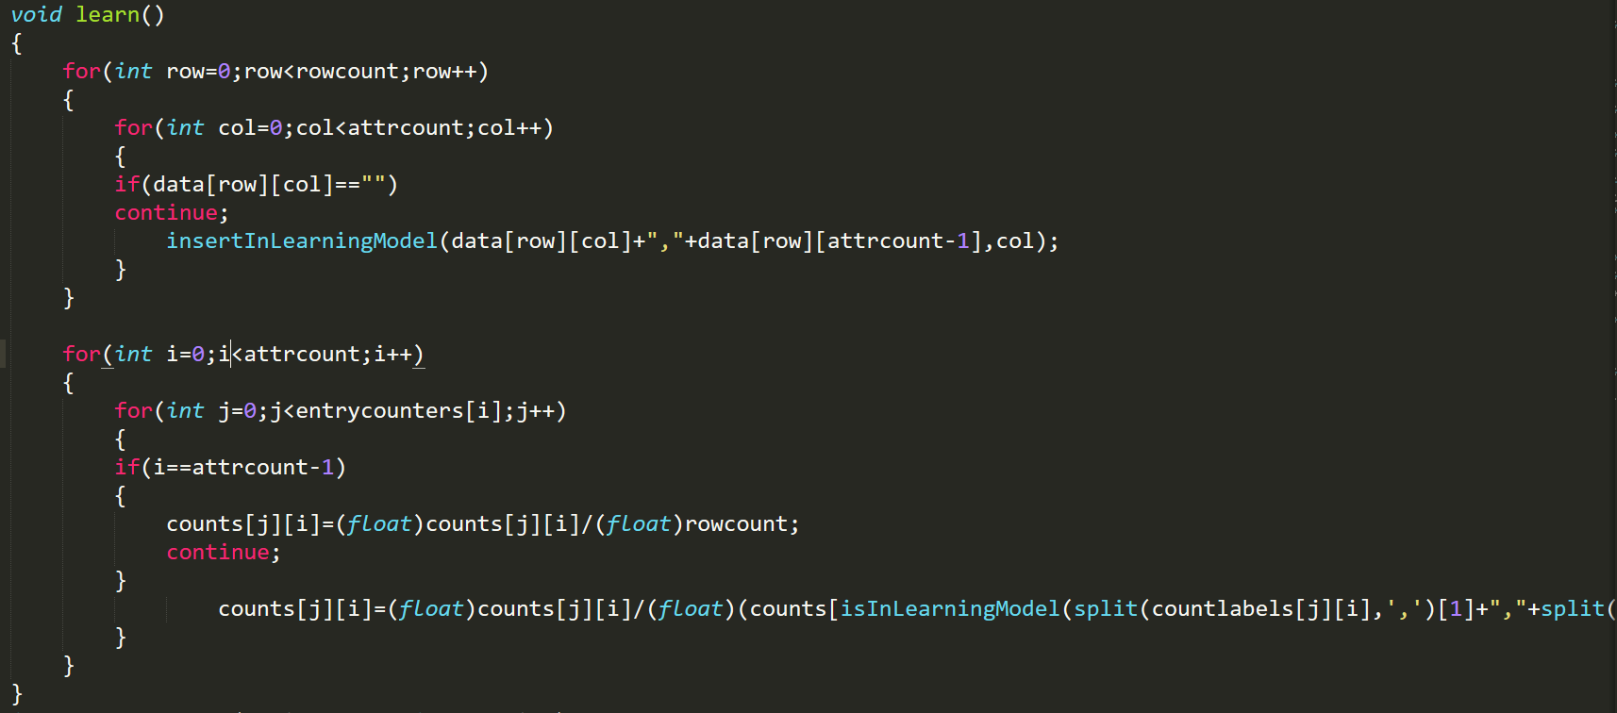

Slide 36
Age | Buys | Count
<=30 | No | 3
31-40 | No | 0
>40 | No | 2
<=30 | Yes | 2
31-40 | Yes | 4
>40 | Yes | 3
Stud | Buys | Count
No | No | 4
Yes | No | 1
No | Yes | 3
Yes | Yes | 6
Income | Buys | Count
High | No | 2
Medium | No | 2
Low | No | 1
High | Yes | 2
Medium | Yes | 4
Low | Yes | 3
Credit | Buys | Count
Fair | No | 2
Excellent | No | 3
Fair | Yes | 6
Excellent | Yes | 3
Buys | Buys | Count
No | No | 5
Yes | Yes | 9

Slide 38
Age | Buys | P(B|A)
<=30 | No | 0.6
31-40 | No | 0
>40 | No | 0.4
<=30 | Yes | 0.22
31-40 | Yes | 0.44
>40 | Yes | 0.33
Stud | Buys | P(B|A)
No | No | 0.8
Yes | No | 0.2
No | Yes | 0.33
Yes | Yes | 0.67
Income | Buys | P(B|A)
High | No | 0.4
Medium | No | 0.4
Low | No | 0.2
High | Yes | 0.22
Medium | Yes | 0.44
Low | Yes | 0.33
Credit | Buys | P(B|A)
Fair | No | 0.4
Excellent | No | 0.6
Fair | Yes | 0.67
Excellent | Yes | 0.33
Buys | Buys | P(B)
No | No | 0.36
Yes | Yes | 0.64

Slide 39
Explained in next slide
counts[j][i]=(float)counts[j][i]/
(float)(counts[isInLearningModel(split(countlabels[j][i],',')[1]+","+
split(countlabels[j][i],',')[1],attrcount-1)][attrcount-1]);

Slide 40
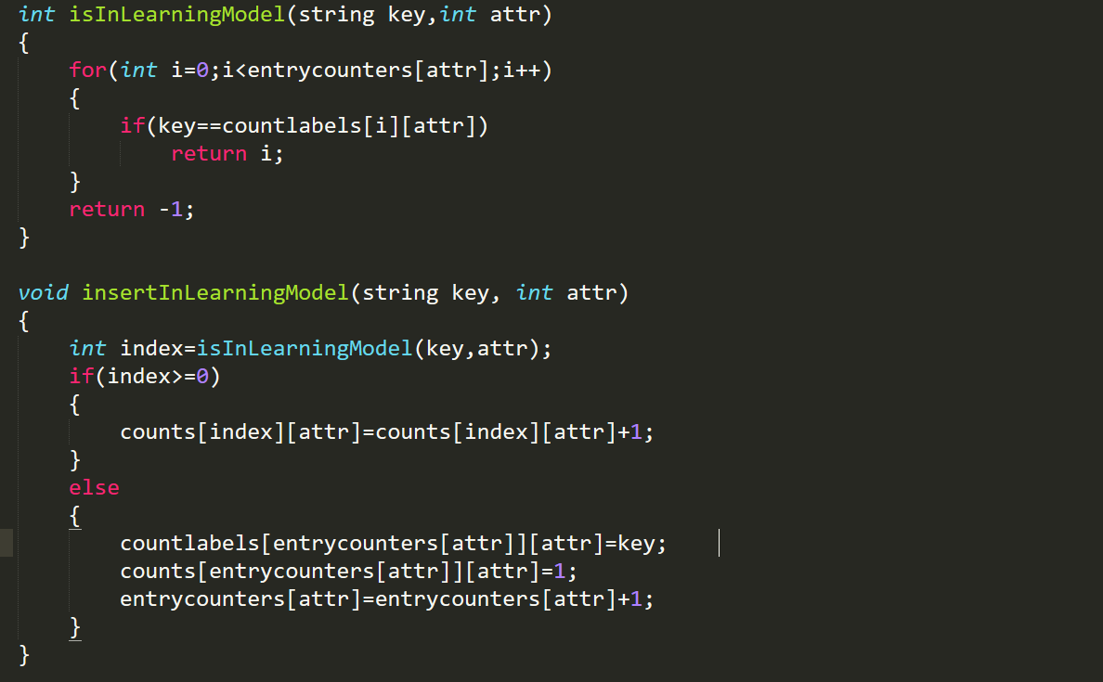
Update count
Add and update count

Slide 41
Testing

Slide 42
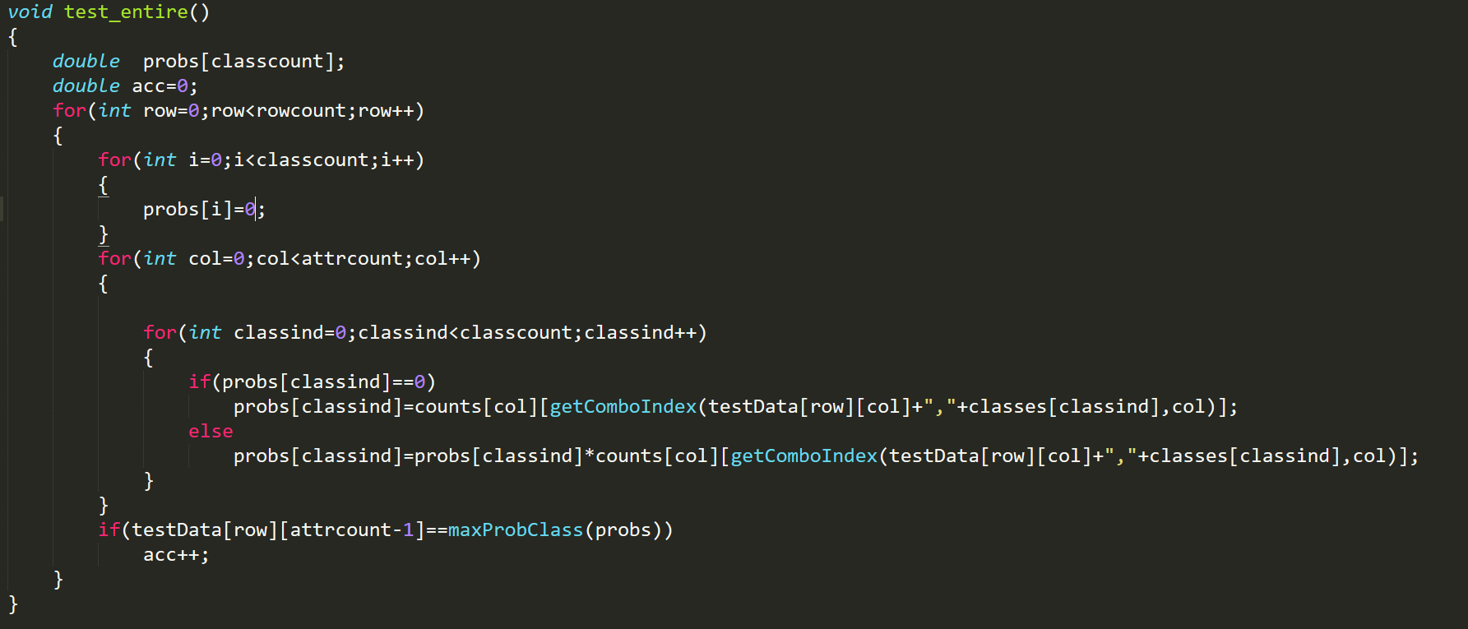
Explained in next slide

Slide 43
Testing
Assume we get the following customer in store:
P(X | ” yes ”) = 0.22*0.44*0.67*0.67*0.64 = 0.028
P(X | ” no ”) = 0.6*0.4*0.2*0.4*0.36 = 0.007
So, P(X | ” yes ”) > P(X | ” no ”)
We predict that this customer WILL buy
X =

Slide 44
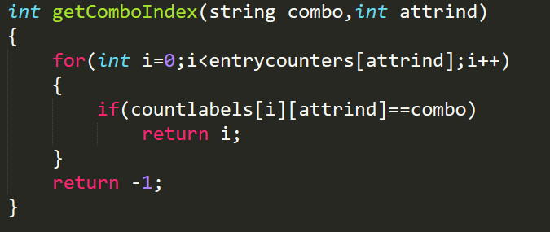
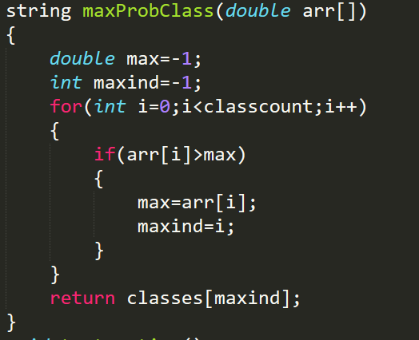
Used for testing

Slide 45
How do we know if the implementation is correct?

Slide 46

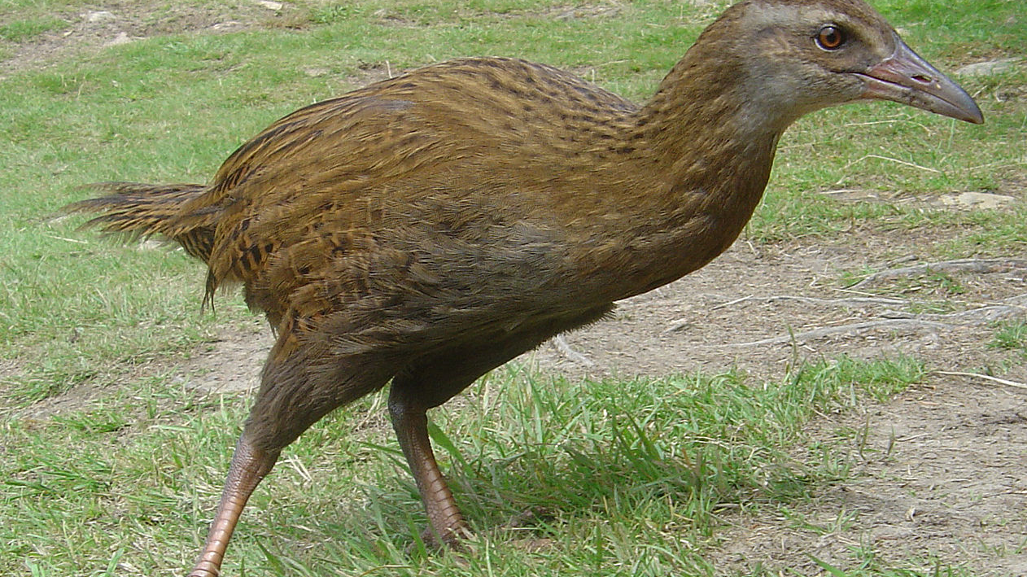

Slide 47

Allow me to explain…
There is this tool called Weka
We evaluated their Naïve Bayesian implementation to validate accuracy

Slide 48

Remembering the embarrassingly parallel possibilities

Slide 49
Training

Slide 50
Why naïve Bayesian?

Slide 51

Testing We can use the same approaches

Slide 52
…well there is.
We can only use these approaches as is if the following two conditions are satisfied:
We have all the training and testing data captured and stored
We are not making use of an incremental training model

Slide 53
So… Why is this challenging?

Slide 54
1. Incremental Learning
What is incremental learning?
We can never know if the labelled training data we had is enough
Keep training as you test!!

Slide 55
Conventional Classification Process
Training Data
Testing Data
Train
Test
Learning Model
Result of Classification

Slide 56
Classification Process with incremental learning
Training Data
Testing Data
Train
Test
Learning Model
Result of Classification
Feedback

Slide 57
For example, in case of the example on next slide, we can use it to improve the knowledge of the classifier.

Slide 58
Example – Incremental Learning
Assume we get the following customer in store:
P(X | ” yes ”) = 0.22*0.44*0.67*0.67*0.64 = 0.028
P(X | ” no ”) = 0.6*0.4*0.2*0.4*0.36 = 0.007
So, P(X | ” yes ”) > P(X | ” no ”)
We predict that this customer WILL buy
X =

Slide 59

Now let’s use the result – Old model
Age | Buys | Count
<=30 | No | 3
31-40 | No | 0
>40 | No | 2
<=30 | Yes | 2
31-40 | Yes | 4
>40 | Yes | 3
Stud | Buys | Count
No | No | 4
Yes | No | 1
No | Yes | 3
Yes | Yes | 6
Income | Buys | Count
High | No | 2
Medium | No | 2
Low | No | 1
High | Yes | 2
Medium | Yes | 4
Low | Yes | 3
Credit | Buys | Count
Fair | No | 2
Excellent | No | 3
Fair | Yes | 6
Excellent | Yes | 3
Buys | Buys | Count
No | No | 5
Yes | Yes | 9

Slide 60
Now let’s use the result – New model
Age | Buys | Count
<=30 | No | 3
31-40 | No | 0
>40 | No | 2
<=30 | Yes | 3
31-40 | Yes | 4
>40 | Yes | 3
Stud | Buys | Count
No | No | 4
Yes | No | 1
No | Yes | 3
Yes | Yes | 7
Income | Buys | Count
High | No | 2
Medium | No | 2
Low | No | 1
High | Yes | 2
Medium | Yes | 5
Low | Yes | 3
Credit | Buys | Count
Fair | No | 2
Excellent | No | 3
Fair | Yes | 7
Excellent | Yes | 3
Buys | Buys | Count
No | No | 5
Yes | Yes | 10

Slide 61
Recalculate probabilities

Slide 62
Now let’s use the result New Probabilities
Age | Buys | P(B|A)
<=30 | No | 0.6
31-40 | No | 0
>40 | No | 0.4
<=30 | Yes | 0.3
31-40 | Yes | 0.4
>40 | Yes | 0.3
Stud | Buys | P(B|A)
No | No | 0.8
Yes | No | 0.2
No | Yes | 0.3
Yes | Yes | 0.7
Income | Buys | P(B|A)
High | No | 0.4
Medium | No | 0.4
Low | No | 0.2
High | Yes | 0.2
Medium | Yes | 0.5
Low | Yes | 0.3
Credit | Buys | P(B|A)
Fair | No | 0.4
Excellent | No | 0.6
Fair | Yes | 0.7
Excellent | Yes | 0.3
Buys | Buys | P(B)
No | No | 0.33
Yes | Yes | 0.67

Slide 63
Now use this model for classification

Slide 64
Challenges
Incremental Learning
We cannot really use every tested record to improve the model!
Updating learning model needs to be an atomic operation
Cannot be halfway done and classify new records
Updating the learning model with every valid record will have impact on performance of testing process

Slide 65
What can we do?
Incremental Learning
There are two ways in which we can handle this
Set a threshold for validity of the record so that learning model does not need to be updated too often
Buffer the valid records to a certain point and then update the learning model
This will allow for reducing the number of times other threads need to wait while the learning model gets updated

Slide 66
2. Testing Stream Data
Going back to our target data,
We intend to use this classifier for identifying if incoming connections in a network are attacks or not
There is no way that this data will be static and readily available at once!
Data will be flowing in:
With different latency
From different sources

Slide 67
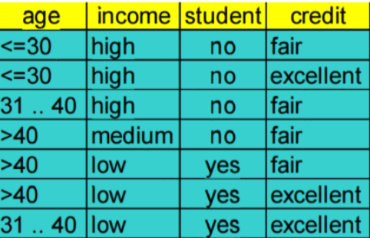
Conventional Classification Process
Train
Test
Learning Model

Slide 68
Stream Classification Process
Train
Test
Learning Model

Slide 69
Challenges Return
Stream Processing
There needs to be a way to buffer incoming records for two reasons
We might not be classifying incoming records in real time
We need to be able to manage work distribution under different circumstances

Slide 70
What can we do?
We can make use of
Buffering and
Dynamic scheduling
Similar concept to thread pooling

Slide 71
Work Done
Serial Implementation of Naïve Bayesian
Along with the data structures and miscellaneous methods required
Embarrassingly Parallel Version with parallel training over columns and testing over rows
In progress – incremental learning
Collected data from two sources –
Network log data[4] –> 42 attributes ~28000 records
Google Ads data [5] -> 3279 attributes ~15600 records
Why these?

Slide 73
Work to be done
Implement incremental learning model with required data structure and constraints
Implement buffer structure for handling streams while testing
Simulate records flowing into the system to evaluate this

Slide 74
Future challenges?
Making stream processing work hand in hand with the incremental learning model

Slide 75
Conclusion
We looked at
Unsupervised Learning
Serial Implementation of k-Means
Parallel Implementation of k-Means
Challenges
Supervised Learning
Serial Implementation of Naïve Bayesian
Parallel Implementation of Naïve Bayesian
Challenges and improvements over conventional learning

Slide 76
References
[1] Kdd.ics.uci.edu. (1999). Corel Image Features. [online] Available at: https://kdd.ics.uci.edu/databases/CorelFeatures/CorelFeatures.data.html [Accessed 26 Nov. 2016].
[2] Tapas Kanungo, David M. Mount, Nathan S. Netanyahu, Christine D. Piatko, Ruth Silverman, and Angela Y. Wu. 2002. An Efficient k-Means Clustering Algorithm: Analysis and Implementation. IEEE Trans. Pattern Anal. Mach. Intell. 24, 7 (July 2002), 881-892.
[3] http://www.plutospin.com/files/OpenMP_reference.pdf
[4] Kdd.ics.uci.edu. (1999). KDD Cup 1999 Data. [online] Available at: https://kdd.ics.uci.edu/databases/kddcup99/kddcup99.html [Accessed 15 Nov. 2016].
[5] GitHub. (2012). verus/Internet-Advertisements-Data-Set-as-Weka-Format. [online] Available at: https://github.com/verus/Internet-Advertisements-Data-Set-as-Weka-Format [Accessed 19 Nov. 2016].

Slide 77
What are the Questions?

Slide 78
Thank you!

