Slide 1
DSB Assignment | Group 8 | July 2026
Global Events, Commodities
and Currency Markets
What a century of oil, gold and silver prices and four SWIFT currency reports say about risk and market direction.
+52%
x2.7
51.1%
Brent oil in a single month, February to March 2026
gold annual average, 2022 to 2026
US dollar share of global payments, April 2026 report

Slide 2
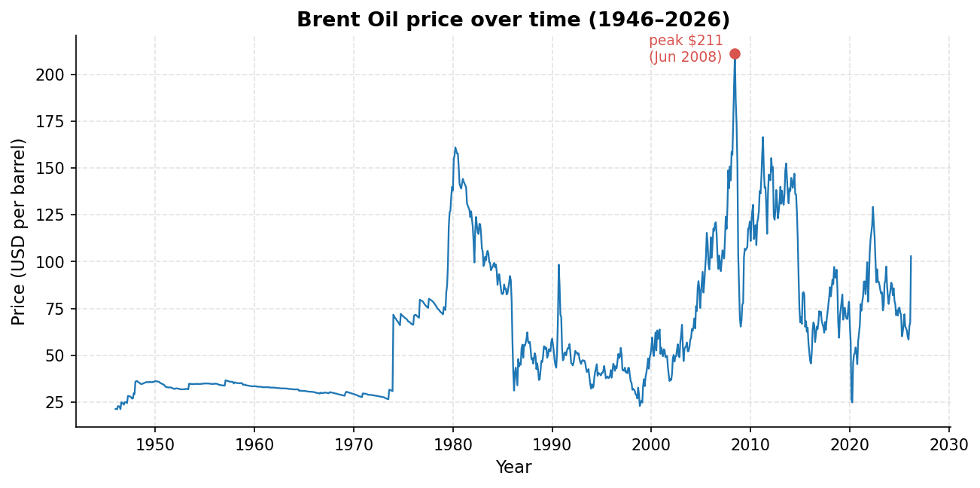
Oil reprices in weeks, not years
+52%
Feb to Mar 2026, during the Hormuz shipping disruption
+28.2%
2022 annual average, Russia-Ukraine war and sanctions
-33.6%
2020 annual average, Covid demand collapse
Every major move in the series maps to a supply or demand shock. Planning assumption: 30 percent annual swings in either direction.
2

Slide 3
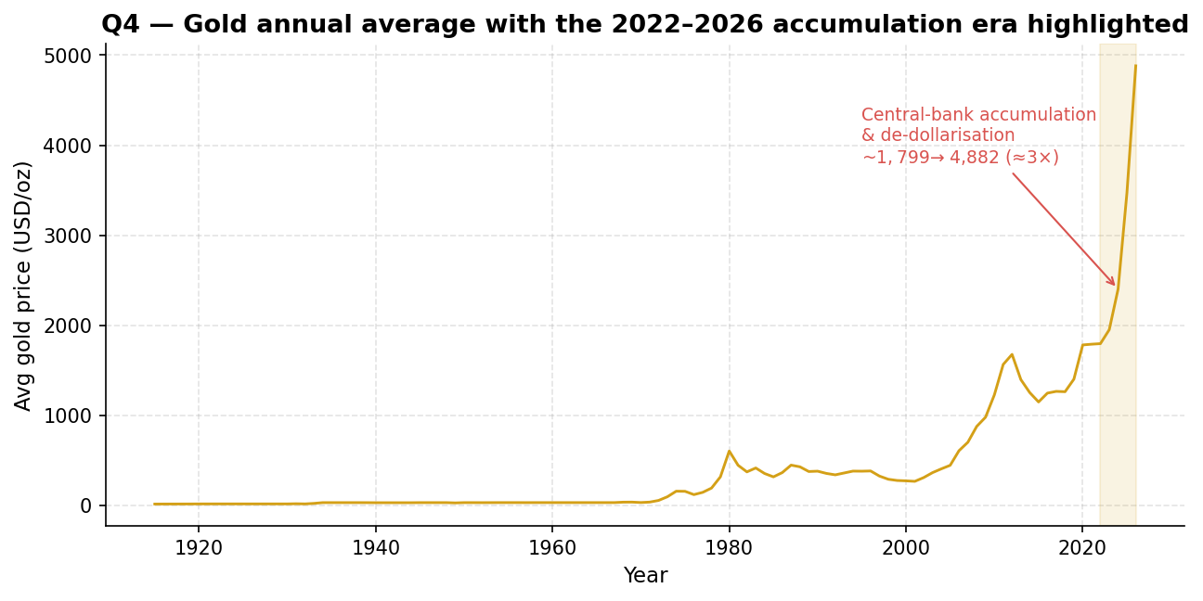
Gold: a four-year structural climb
4,882
gold annual average 2026, up from 1,799 in 2022 (USD)
+131.5%
silver in 2026 alone; it tracks gold with larger swings
0.954
gold-silver correlation on annual averages; oil sits near 0.5
Rising every year since 2022, consistent with central-bank accumulation and de-dollarisation, unlike the one-year fear spike of 2020.
3

Slide 4
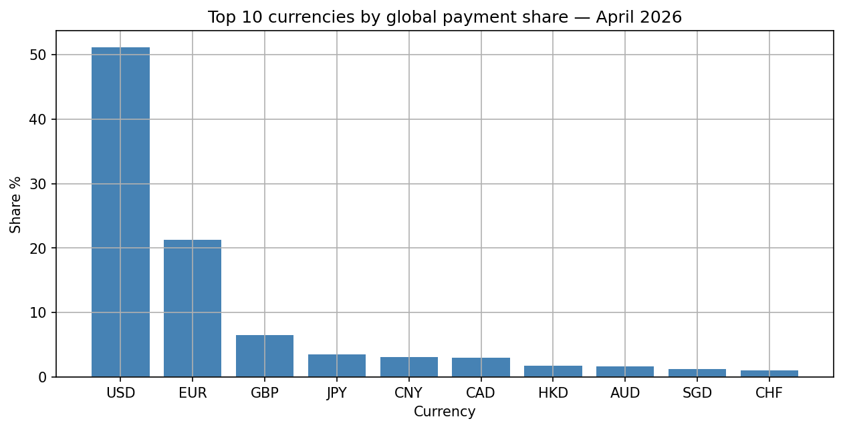
The dollar still settles the world
80.7%
US dollar share of trade finance; 51.1% of global payments
8.0%
renminbi in trade finance, rank 2, against 3.1% of payments
75.2%
of offshore renminbi activity runs through Hong Kong
Payment shares barely move across the four reports. The growth is on the renminbi trade-finance rail, pushed along by sanctions and settlement alternatives.
4

Slide 5
Recommendations
1
Hedge oil exposure and budget for large swings
Treat a 30 percent annual move as the planning case and a one-month 50 percent spike as the stress case. Buy protection during the calm stretch; 2025 was that stretch, March 2026 was the bill.
2
Treat gold as a strategic allocation, not a trade
The climb tracks reserve diversification by central banks, so hold a deliberate share built up gradually. Entering after a near-tripling means accepting correction risk.
3
Keep settling in dollars, build renminbi capability now
The dollar remains the operational backbone. For trade with Asia, tested renminbi channels and a view on Hong Kong concentration are cheap insurance today.
Crisis type decides direction: 2020 (demand shock) sent oil down 33.6% while metals rose 27%; 2022 (supply shock) did the reverse. Full analysis: report, workbook and four notebooks.
5

