Slide 1
DSB Assignment | Group 8 | July 2026
Global Events, Commodities
and Currency Markets
Brent oil, gold and silver since 1915, the global events that moved them, and the currencies the world settles in.
Ivan Logutov | Siddhant Mathapati | Sudheer Chowdary | Muthoju Sandeep
University of Europe for Applied Sciences · Department of Business
Notes:
Four raw datasets: Brent oil 1946-2026, gold and silver 1915-2026, and four monthly SWIFT currency tracker reports. Everything in this deck is generated from those files by notebooks — no numbers typed by hand.

Slide 2
Team
Who did which dataset and which part
SM
Siddhant Mathapati
IL
Ivan Logutov
TEAM LEAD
CO-LEAD
Brent oil EDA · Brent oil dataset cleaning · coordination and deadlines
Gold EDA · gold dataset cleaning · Part I descriptive statistics and trends · Part II market research and event analysis
SC
Sudheer Chowdary
MS
Muthoju Sandeep
CONTRIBUTOR
CONTRIBUTOR
SWIFT currency tracker EDA · SWIFT dataset cleaning
Silver EDA · silver dataset cleaning
2
Notes:
Be honest and specific here: EDA and cleaning were shared one dataset each, the two analysis parts were single-authored, the write-up was collective.

Slide 3
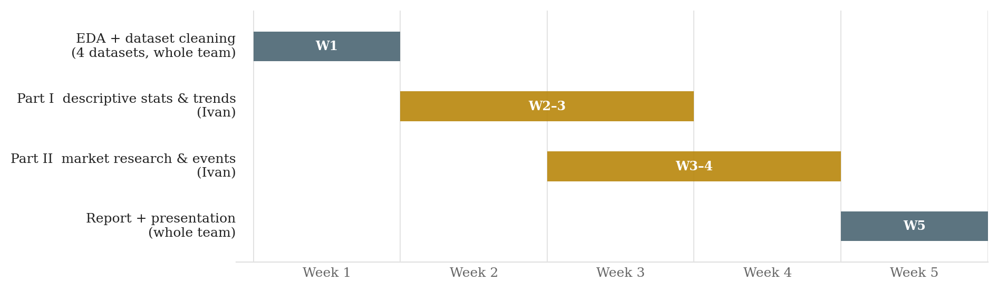
Timeline
Five weeks, four people
Week 1
Weeks 2–4
Week 5
EDA and cleaning of all four datasets, in parallel
Part I and Part II analysis, notebooks and figures
Report, workbook and presentation, whole team
3
Notes:
Weeks 2-4 overlap because Part I feeds Part II: the cleaned annual series from Part I are the input to the event analysis.

Slide 4
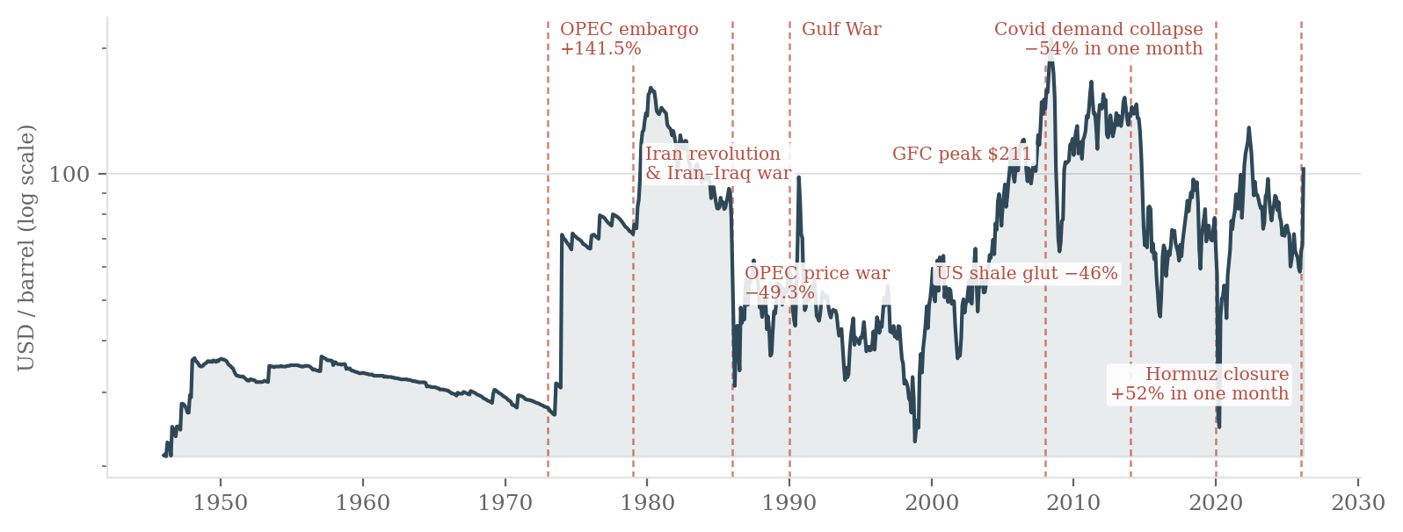
Oil
Monthly Brent, Jan 1946 – Mar 2026, log scale. Dashed lines are global events.
$211.21
$21.11
+52.0%
38%
highest monthly reading (Jun 2008), inflation-adjusted
lowest monthly reading (Mar 1946)
largest one-month rise (Mar 2026)
annualised volatility since 2000
4
Notes:
Two things to have ready. The flat 1946-1973 stretch is the era of administered posted prices, before OPEC, so volatility before and after 1973 is not comparable. And this series is inflation-adjusted: $211 in June 2008 is about $133 of 2008 money, which is why our peak looks higher than the number people remember. Every extreme here is also the highest MONTHLY reading, because the data has one observation per month.

Slide 5
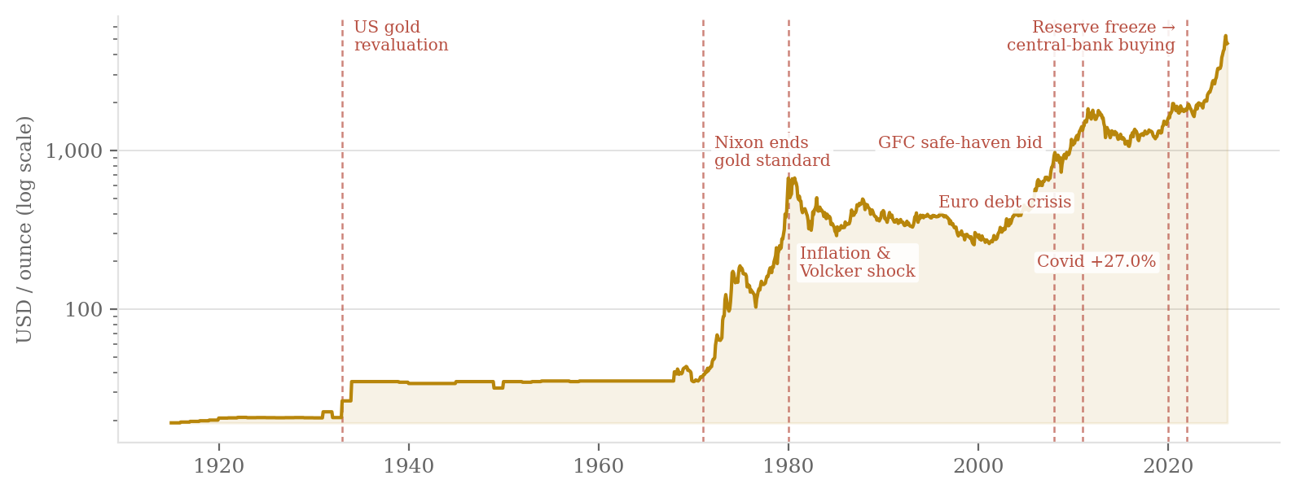
Gold
Monthly gold, Jan 1915 – Apr 2026, log scale. The flat shelves are fixed-price regimes.
$5,277.89
$19.25
16%
+44% / +41%
highest monthly reading (Feb 2026), nominal
lowest monthly reading (Jan 1915)
annualised volatility — half of oil
annual average, 2025 and 2026 YTD
5
Notes:
The two flat shelves are fixed-price regimes: about $20.67 until 1933, then $35 under Bretton Woods until 1971. Gold only becomes a market price after Nixon closes the gold window in August 1971. On the record question: this series is nominal, so the 1980 peak of $668 is roughly $2,700 in 2026 money. Gold in 2026 is therefore a real record, but about twice the 1980 peak, not eight times it.

Slide 6
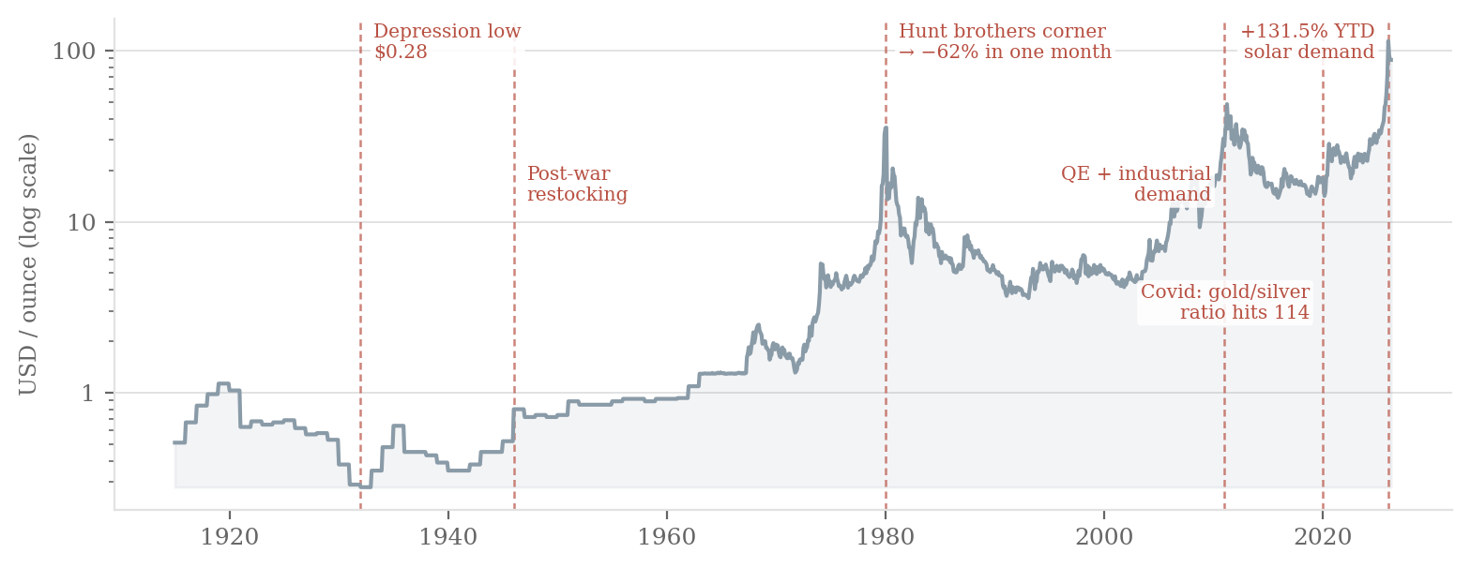
Silver
Monthly silver, Jan 1915 – Apr 2026, log scale. Part monetary metal, part industrial input.
$113.95
$0.28
+131.5%
−62%
highest monthly reading (Jan 2026)
lowest monthly reading (Jan 1932)
2026 YTD annual average, the largest of the three
largest one-month fall (Mar 1980)
6
Notes:
Silver's dual nature is the whole story: it rises with gold when the driver is monetary, and falls with oil when the driver is industrial demand. That is why it is the most volatile of the three.

Slide 7
Record prices
Our monthly series against the actual daily records, nominal USD unless stated
 | Our series (monthly, 1st of month) | Actual daily high | Actual daily low
Brent oil | $211.21 Jun 2008 $21.11 Mar 1946 inflation-adjusted USD | $146.08 3 July 2008 Dated Brent set its own record at $144.42 on 7 Apr 2026 | $9.12 21 April 2020 Covid demand collapse
Gold | $5,277.89 Feb 2026 $19.25 Jan 1915 | $5,595 28 January 2026 intraday | $19.25 5 January 1905, gold standard
Silver | $113.95 Jan 2026 $0.28 Jan 1932 | $121.64 29 January 2026 intraday | $0.25 late 1932 Great Depression
Why our numbers differ. Our files carry one observation per month, dated the 1st, so a daily spike between those dates is invisible to us. The oil series is also inflation-adjusted, which is why $211 in June 2008 is really $132 of 2008 money. And Brent as a benchmark only starts in May 1987 — before that our oil series is US crude.
Sources: EIA Europe Brent spot · Platts Dated Brent · LBMA and spot gold and silver fixings. Silver's 1980 high of $49.45 is worth about $203 in today's money, so silver's 2026 record is nominal, not real.
7
Notes:
This slide exists because the extremes question is fair. Say it plainly: our dataset is monthly, so our maximum is the highest monthly observation, not the true peak. Here are the real daily records for all three, from the primary sources. Three numbers to have ready: Brent's daily high is $146.08 on 3 July 2008 and its daily low is $9.12 on 21 April 2020; gold peaked intraday at $5,589.38 on 28 January 2026; silver peaked at $121.67 on 29 January 2026. If pressed on why our oil peak reads $211, the series is inflation-adjusted to current dollars, and Brent as a published benchmark only begins in May 1987.

Slide 8
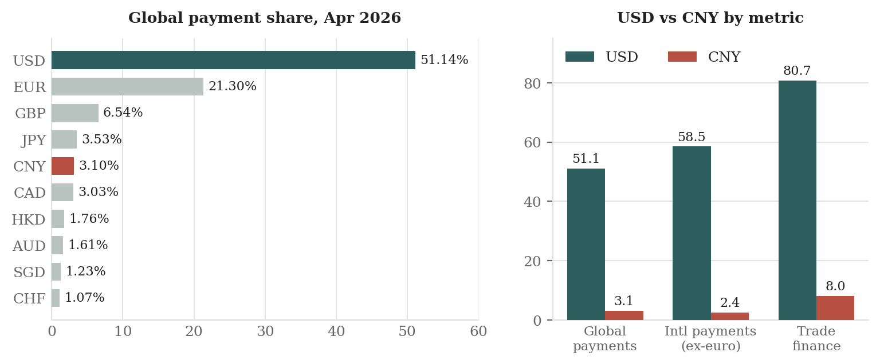
Currencies
SWIFT currency tracker, four monthly reports, January – April 2026
51.14%
80.73%
8.04%
75.23%
US dollar share of global payments
US dollar share of trade finance
renminbi in trade finance — rank 2
of offshore renminbi clears in Hong Kong
8
Notes:
The key contrast: the renminbi is small in payments (3.10%, rank 5) but already second in trade finance (8.04%). Payments are a stock of installed infrastructure and move slowly; trade finance is renegotiated deal by deal, so it moves first. That is where de-dollarisation shows up first.

Slide 9
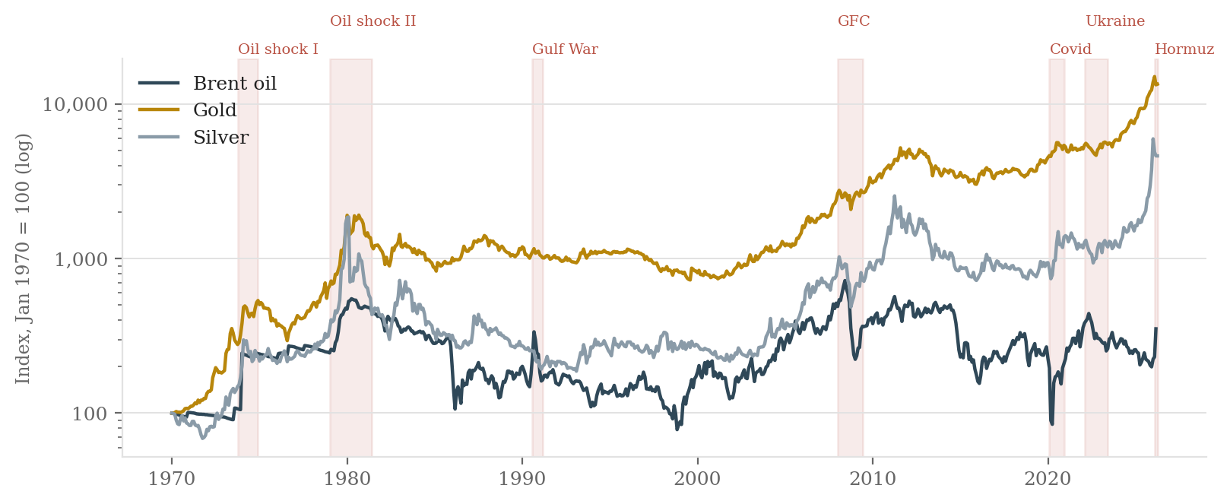
Events
All three indexed to Jan 1970 = 100, log scale.
1973 & 1979
2008 & 2020
2022
2026
supply shocks: oil leads, metals follow with a lag
financial and demand shocks: metals lead, oil breaks
sanctions: oil and gold diverge for the first time
Hormuz: all three rise together, which is rare
9
Notes:
The point of indexing is that it removes the scale problem: gold at $4,700 and silver at $88 cannot be plotted together in levels. Over 1970-2026 gold compounds fastest, but oil does the sharpest single moves.

Slide 10
Event impact
Change in annual average unless stated
Event | Mechanism | Oil | Gold | Silver | Currency
1973–74 OPEC embargo | Physical supply cut | +141.5% | Surge begins | Follows gold | USD weakens
1979–81 Iran revolution | Supply cut + inflation | Peak of the era | +89.3% (1979) | Hunt squeeze, then −62% | Volcker shock
1986 OPEC price war | Deliberate oversupply | −49.3% | Flat | Flat | Limited
1990–91 Gulf War | Supply fear, short-lived | Spike, then reversal | Slight rise | Slight rise | USD inflows
2008–09 Financial crisis | Credit + demand collapse | +26.7% then −35% | +24.9% | +10.8% | USD safe haven
2014–16 US shale | Structural oversupply | −46% | Flat | −40% | USD strengthens
2020 Covid-19 | Demand collapse | −33.6% | +27.0% | +27.1% | Global rate cuts
2022 Ukraine + sanctions | Supply shock + reserve freeze | +28.2% | +0.3% | −13.2% | CNY share rises
2026 Hormuz closure | Chokepoint closure | +52% in one month | +40.6% YTD | +131.5% YTD | CNY rank 5
Every large oil move is a supply event except 2008 and 2020, which are demand events. Those two are also the only years where oil and the metals move in opposite directions.
10
Notes:
If asked 'why does gold not rise in 2022 when there is a war?': because gold had already been bid up through 2020-21 on rate cuts, and 2022 brought aggressive rate rises, which raise the opportunity cost of holding a non-yielding asset. The reserve-freeze effect on gold shows up later, in 2023-2026 central bank buying.

Slide 11
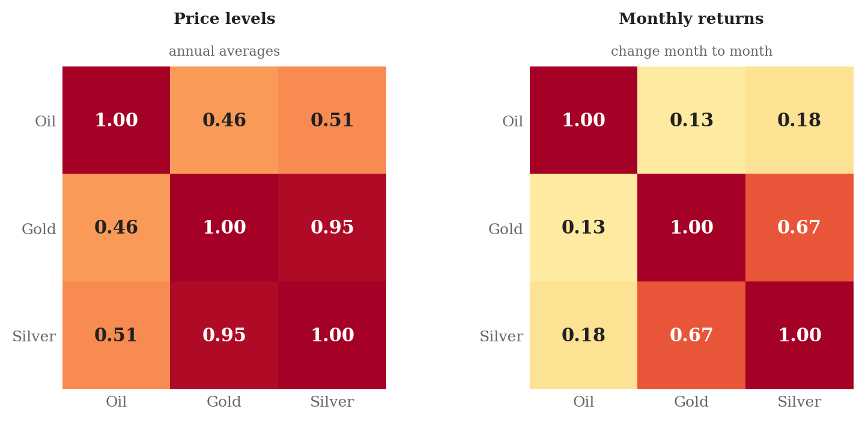
Correlation
Same three series, two ways of measuring it
11
Notes:
This is the strongest methodological point in the deck. Correlation of two trending price levels is a spurious-regression problem — Yule 1926, Granger and Newbold 1974. The standard fix is to difference the series, i.e. correlate returns. We report both and say which one supports which claim.

Slide 12
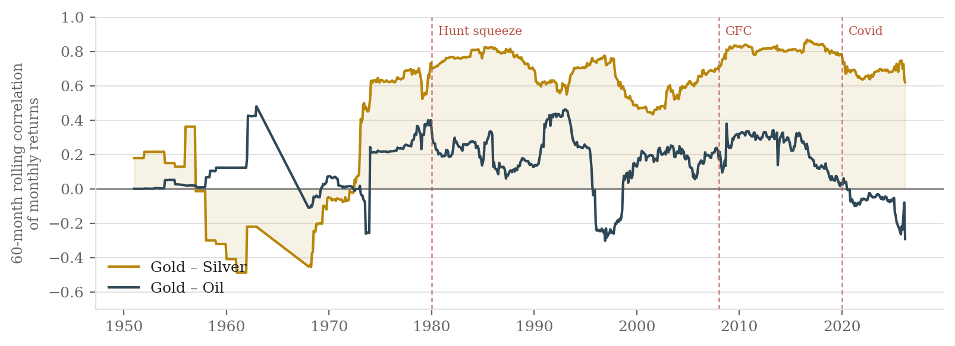
Rolling correlation
60-month rolling correlation of monthly returns
0.62
−0.29
0.87
Diversify
gold–silver today: strong, and it has been positive since 1972
gold–oil today: they now move in opposite directions
the gold–silver peak, reached in 2016
an oil hedge is not a gold hedge, they are different risks
12
Notes:
Why gold-oil has turned negative since about 2015: oil is now driven mostly by supply (shale, OPEC+), while gold is driven by real interest rates and reserve policy. A supply-driven oil spike is inflationary, which historically lifted gold, but since 2015 central banks respond by raising rates, which pushes gold down. The two effects cancel and then reverse.

Slide 13
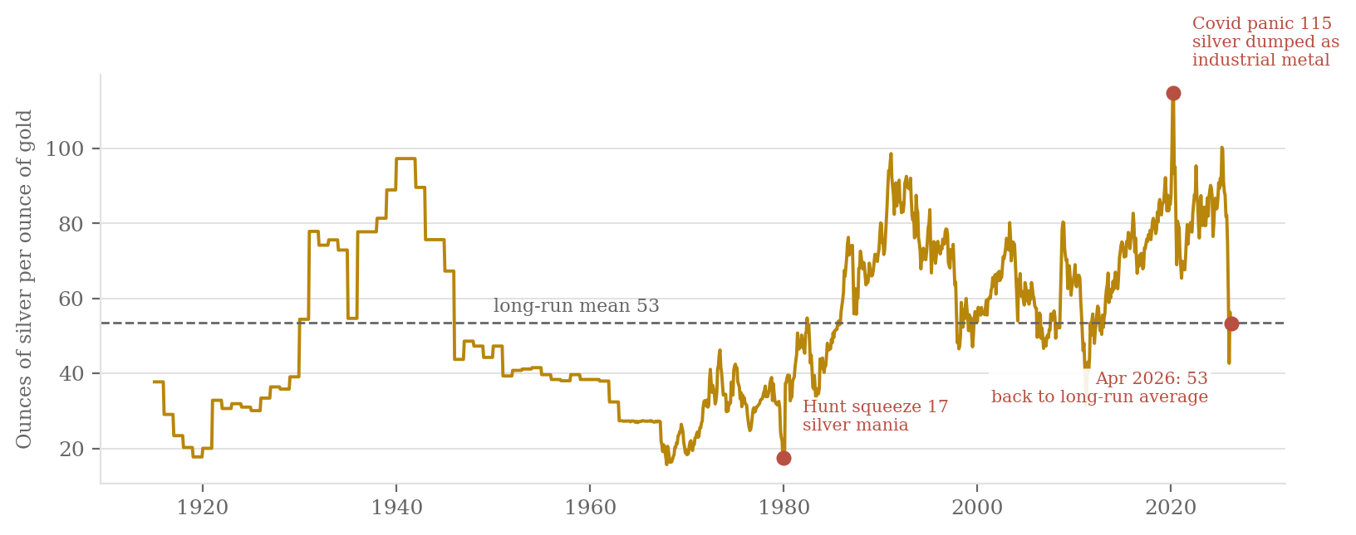
Gold vs silver
How many ounces of silver one ounce of gold buys
115
17
53
Rising = fear
April 2020, the highest ever: industry shut, gold bid
January 1980, the Hunt brothers' silver corner
April 2026, the long-run average
falling = industrial demand returning
13
Notes:
Use this if asked to justify the claim that 2026 is not a panic. In a pure fear episode the ratio spikes, because investors buy gold and dump silver as an industrial metal. In 2026 the ratio is at its long-run average while both metals are at record highs — so the driver is monetary demand for both, not a flight to safety.

Slide 14
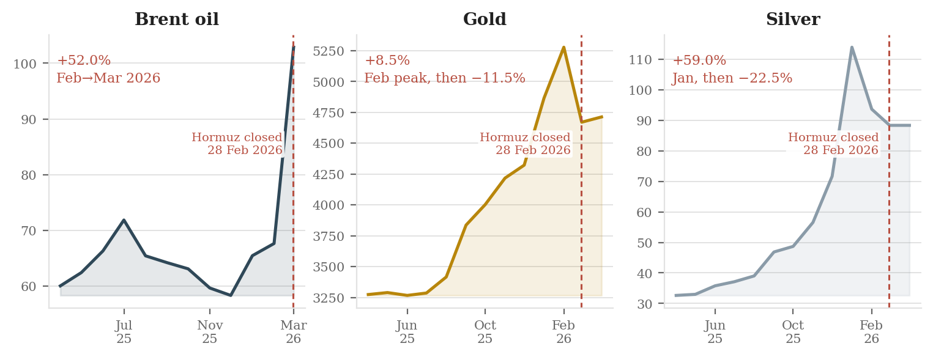
Hormuz
One chokepoint, four markets, twelve months of data
1
Chokepoint closes
2
Oil reprices in weeks
3
Metals price the policy response
4
Settlement barely moves
About a fifth of seaborne crude cannot sail. Physical supply, not sentiment.
+52.0% in a single month, the largest monthly rise in the eighty-year series.
Gold peaks in February on the expectation of easing; silver overshoots, then gives back 22.5%.
The dollar's payment share changes by less than two percentage points across the whole episode.
14
Notes:
Real-world anchor: shipping through Hormuz was largely blocked from 28 February 2026; the IRGC declared closure to allied vessels on 27 March. Brent's reported intraday peak in early March was near $118 — higher than our $102.86 monthly reading, which is exactly the sampling point from slide 4. Conversely, a truce hypothesis: oil falls fastest, silver next, gold last and least, because gold has priced a change in monetary regime rather than a change in shipping.

Slide 15
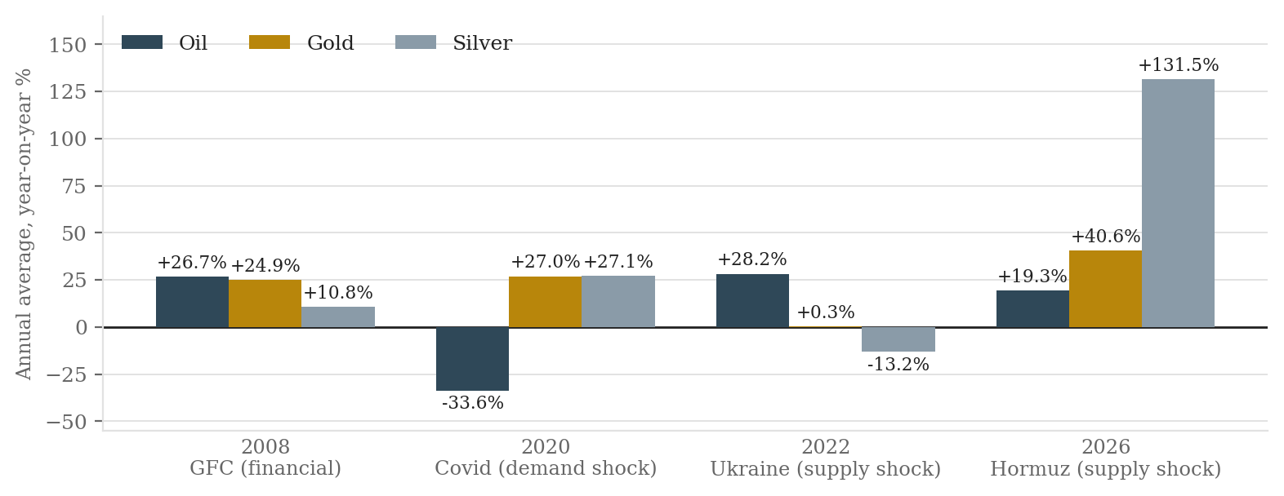
Crisis types
Year-on-year change in annual average. 2026 is year-to-date, four months.
Demand shock
Supply shock
Financial shock
Monetary shift
2020: oil collapses, both metals rise. Opposite signs.
2022: oil rises, silver falls. Opposite signs again.
2008: everything rises, then everything falls together.
2024–26: metals rise on their own, without a crisis.
15
Notes:
The practical use: knowing an event is bad tells you nothing about direction. You have to classify the mechanism first. Ask which of the four boxes an event falls into, then read the historical analogue.

Slide 16
Recommendations
1
Hedge oil and budget for large swings
Plan for a ±30% year and stress-test a one-month +52%. Buy protection during the calm stretch: 2025 was calm, March 2026 was the bill.
2
Hold gold as a strategic allocation
The 2022–2026 climb tracks central-bank reserve buying, which is a policy trend rather than a panic. Build the position gradually. Entering after a near-tripling carries correction risk.
3
Keep settling in dollars, add renminbi capability
The dollar handles 51% of payments and 81% of trade finance, so it stays the default. The renminbi is already second in trade finance, so tested channels there are cheap insurance.
Three markets, three speeds. Oil reprices in weeks on supply, metals over years on monetary policy, settlement currencies barely at all. Full analysis in the report, the workbook and four notebooks.
16
Notes:
Close on the three-speeds line. If there is time for one question, invite the correlation question — slide 11 is the answer.

