Slide 1
City’s Safety Predictor
Siddhant Mahalle

Slide 2
Introduction
Imagine visiting a new city for the first time. You want to visit all the top sites and the best restaurants there. But you have no one to show you around or to suggest these places.
You want to visit these places, but you want to be cautious of crime-riddled neighborhoods and avoid such routes.
The idea is to combine the venue and location data from Foursquare along with open source crime data to provide the traveler with a list of attractions and restaurants along with a graphical representation of crime statistics in those areas

Slide 3
Approach
The traveler decides on a city location [in this case, Chicago].
The Foursquare website is scrapped for the top venues in the city.
From this, a list of top venues is augmented with additional geographical data
Using this data, the top nearby restaurants are selected.
The historical crime statistics within a predetermined distance of all venues is obtained.
A map is presented to the traveler showing the selected venues and crime statistics of the area.
The future probability of a crime happening near or around the selected top sites is also presented to the user

Slide 4
Data acquisition
The data acquisition section is divided in two parts:
Venues and Location data obtained from FourSquare
Query the Foursquare website for the top sites in Chicago
Use the Foursquare API to get supplemental geographical data about the top sites
Use the Foursquare API to get top restaurant recommendations closest to each of the top site
Chicago Crime Data
This dataset can be obtained from the Chicago Data Portal and reflects reported incidents of crime (except for murders where data exists for each victim) that occurred in the City of Chicago.

Slide 5
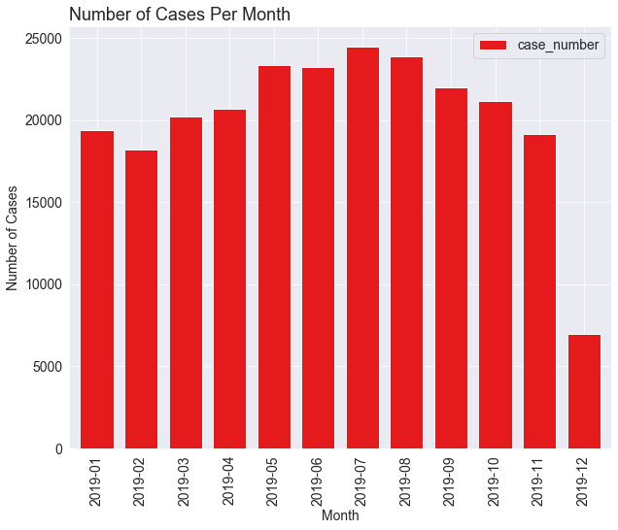
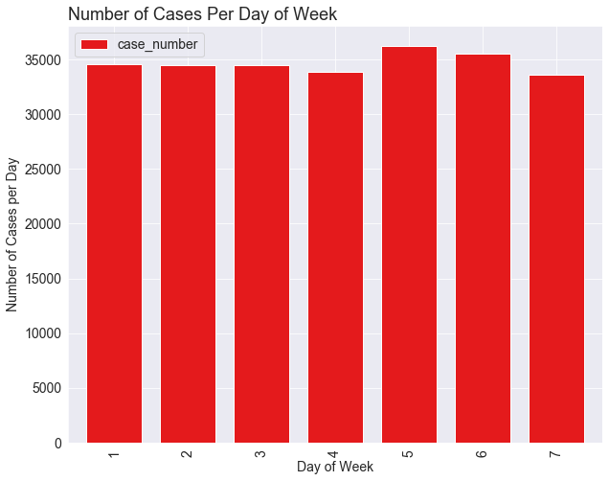
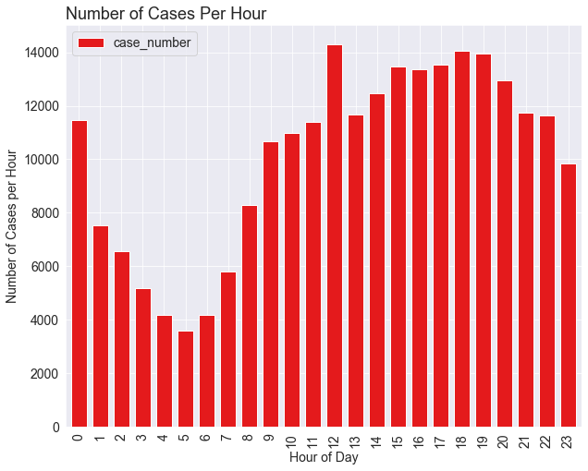
Data Visualization
Visualizing the Chicago crime data

Slide 6
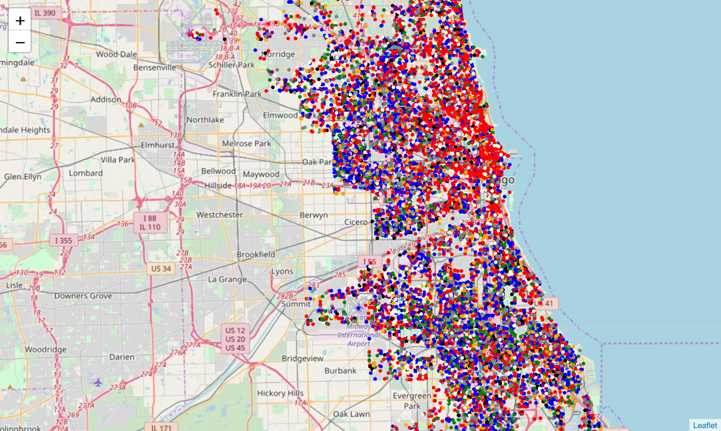
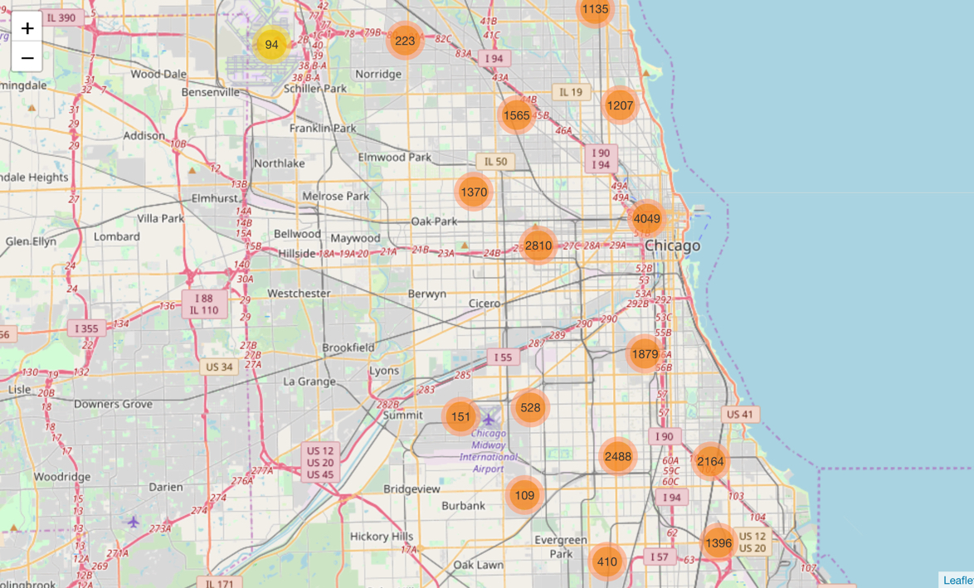
Data Visualization (Cont.)

Slide 7
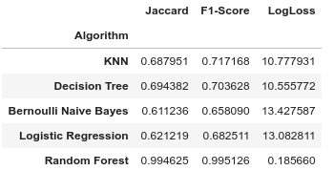
Data Analysis
Five model type were then chosen to be evaluated:
K Nearest Neighbors
Decision Trees
Logistic Regression
Naive Bayes
Decision Forest using a Random Forest

Slide 8
Results and Prediction
Of the top 20 venues 17 were identified as potentially dangerous to visit and 3 was deems safe. As there is no data to compare the predictions against the best way, we will visualize the data again.

