Slide 1



OHDSI India Symposium 2025
2 Dec 2025
Bengaluru, India
Leveraging LLMs and a Common Data Model to Unlock Real World Evidence from Unstructured Electronic Health Record Data in India
Siddhant Poudyal, Machine Learning Engineer
Augmented Health Systems Laboratory
Koita Centre for Digital Health at Ashoka (KCDH-A)
Ashoka University

Slide 2
Aim
To analyse current antibiotic prescription patterns in India among outpatients with febrile respiratory illness
To leverage open source Large Language Models and NLP algorithms to extract, transform and load clinical features from unstructured clinical notes into the Observational Medical Outcomes Partnership (OMOP) Common Data Model (CDM)

Slide 3
Gap
Intended analysis is difficult as current open-source Large Language Models perform poorly on tasks involving medication terms specific to Indian settings.
A comprehensive, standardised knowledge base of Indian medication terms is required that can be leveraged by Language Models (through pre-training or fine-tuning or in-context learning) for better performance on clinical notes in Indian settings.

Slide 4
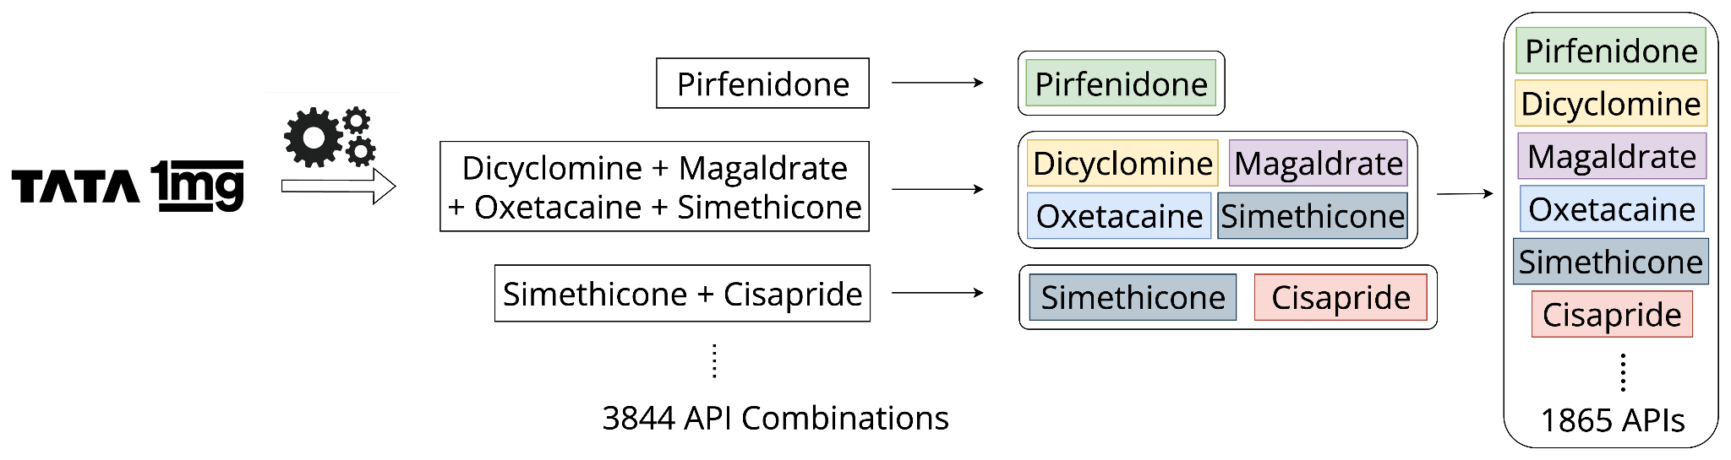
Knowledge base development
To develop a comprehensive, interoperable knowledge base, we first need a list of all medication terms specific to India.
Amongst the many ecommerce platforms in India selling both prescription-based and over-the-counter medication, we extracted medication terms from 1mg.com.
The extraction process resulted in lists of 3,63,525 Brand Drug names and 1865 unique Active Pharmaceutical Ingredients.

Slide 5
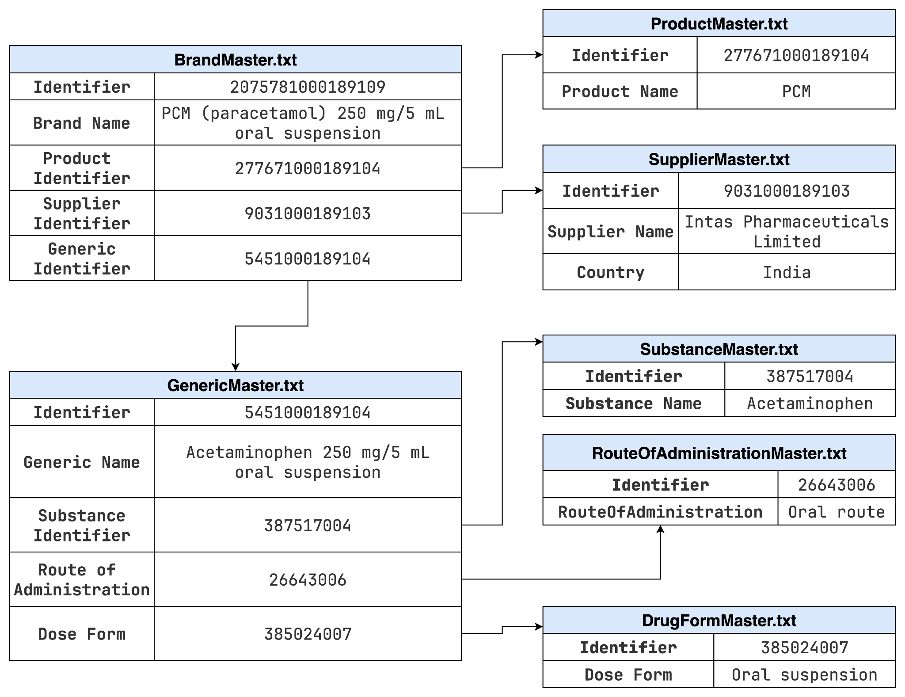
NRCeS Common Drug Codes for India tables

Slide 6
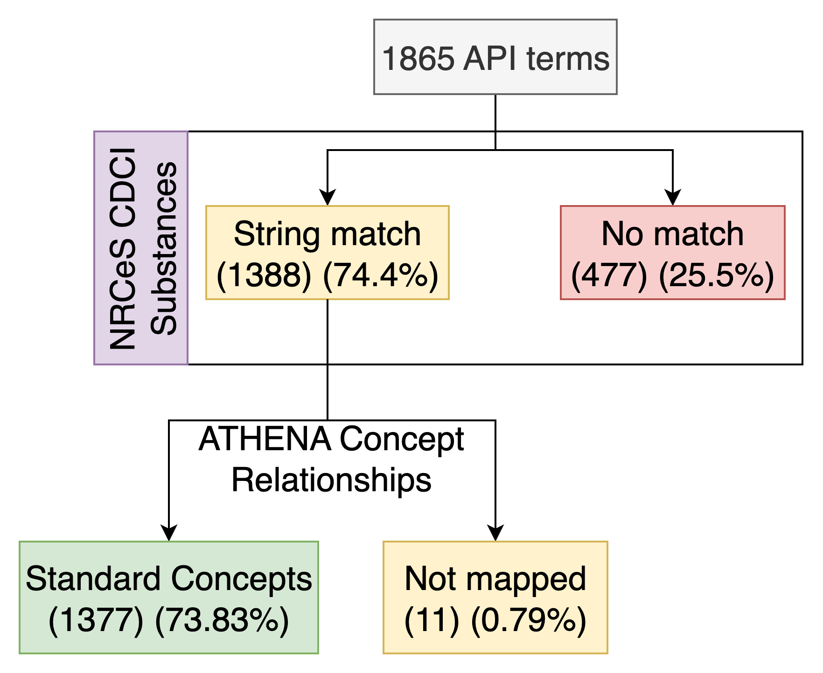
Knowledge base development
We map the API terms to the NRCeS CDCI Substances table by string matching.
Next, we see how many of these terms (mapped to NRCeS CDCI) were mapped to standard.

Slide 7
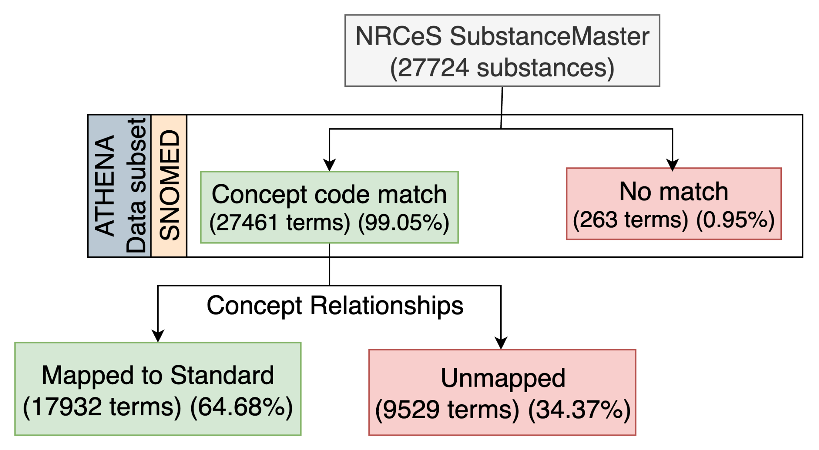
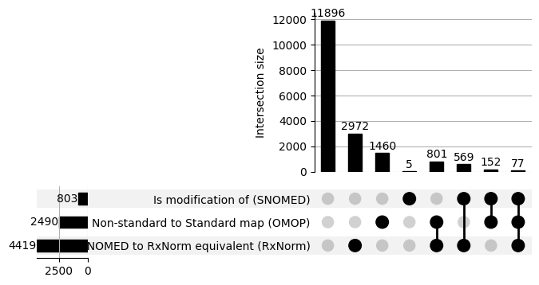
Knowledge base development
We assess how many Substances in the NRCeS Substance table map to Standard using OHDSI Standardised Vocabularies and ATHENA Concept Relationships table

Slide 8
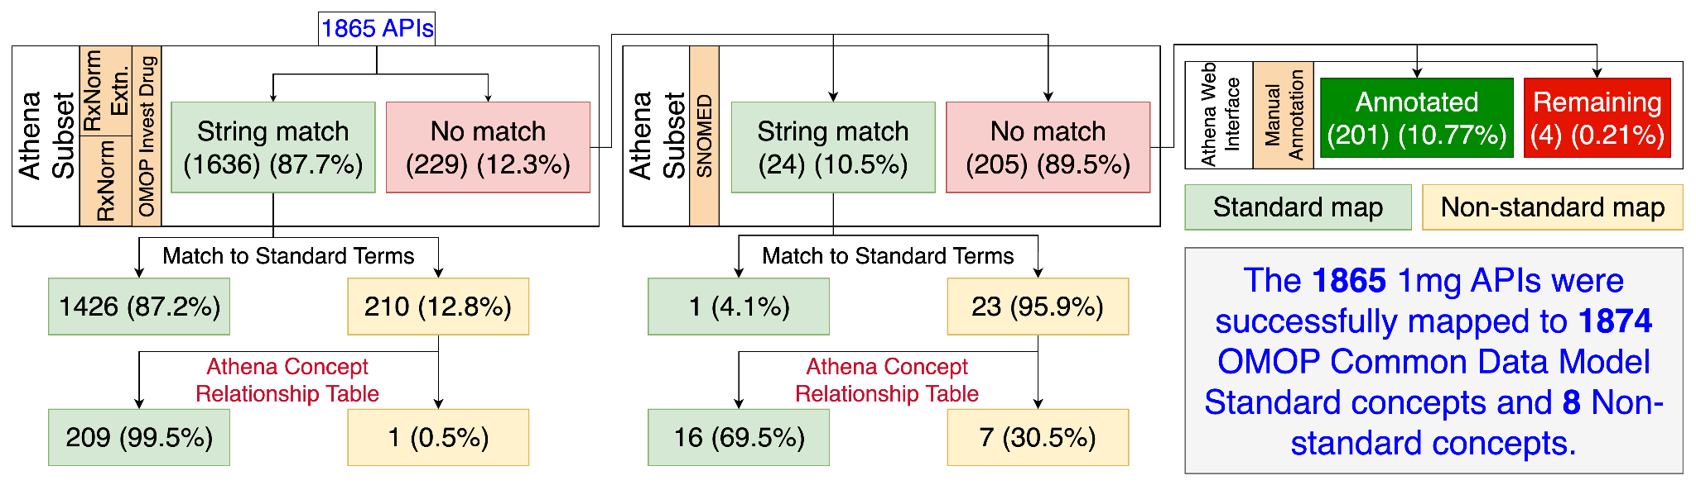
Knowledge base development
Extracted API terms were mapped to OMOP Concepts using the OHDSI ATHENA data dump (August 2024) and the ATHENA web interface for manual annotation.

Slide 9
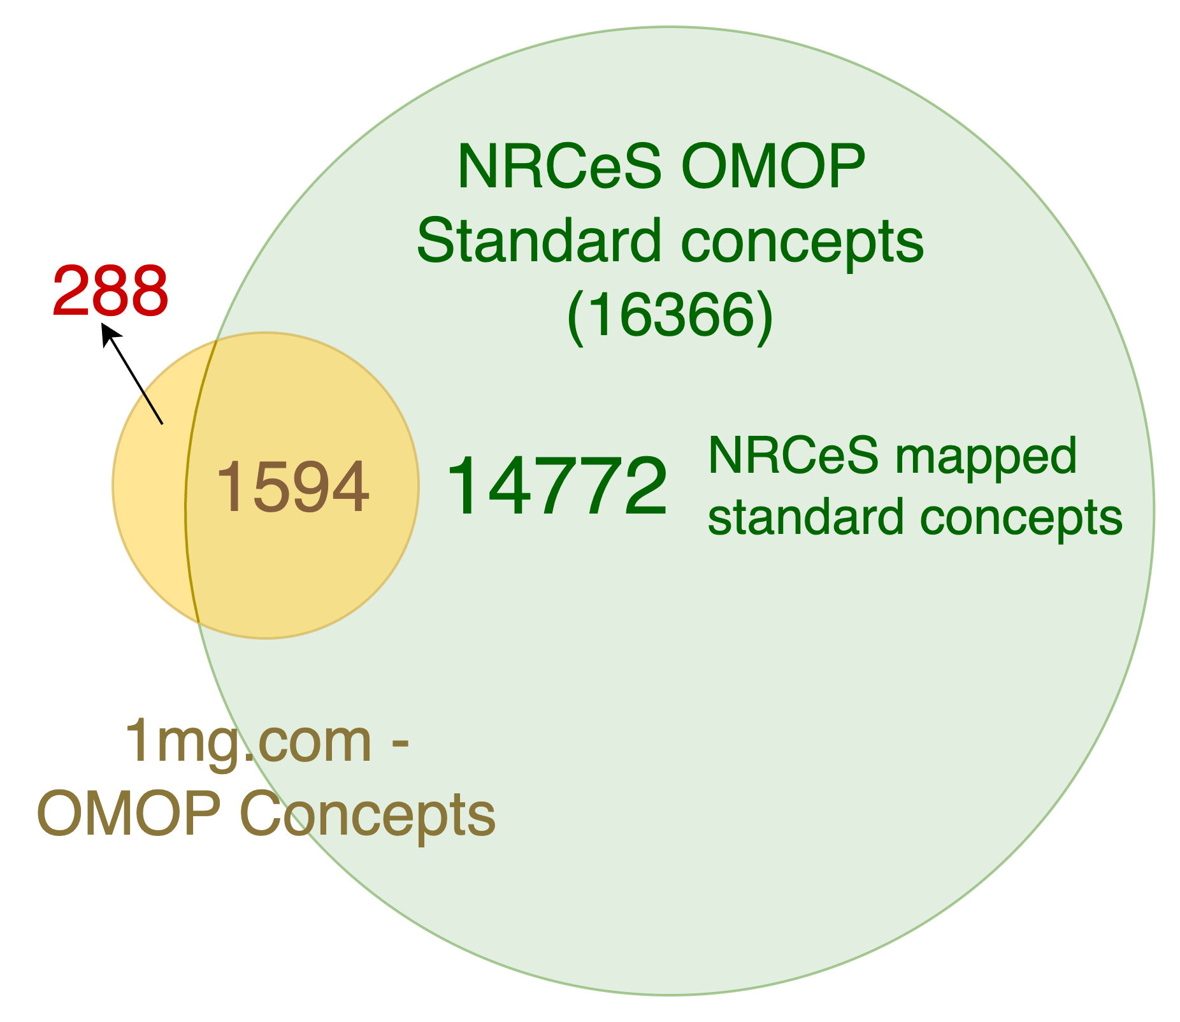
Intersection of NRCeS OMOP and 1mg.com OMOP concepts
This venn diagram showcases intersection between mapped OMOP Concepts from NRCeS CDCI Substances and extracted API terms.

Slide 10
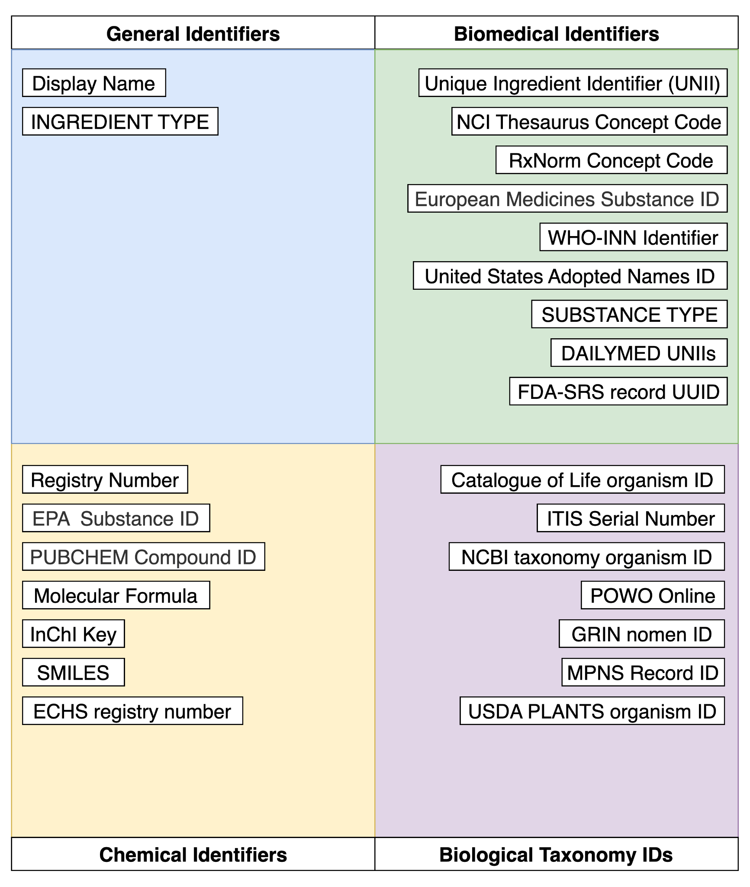
Linking to Global Databases
FDA's Global Substance Registration System (GSRS) enables accurate exchange of information on substances through their Unique Ingredient Identifiers (UNIIs)
The UNII GSRS Records file consists of unique identifiers from different Chemical, Biomedical and Taxonomic databases.
The following figure showcases the different Identifiers collated in the UNII GSRS Records file.

Slide 11
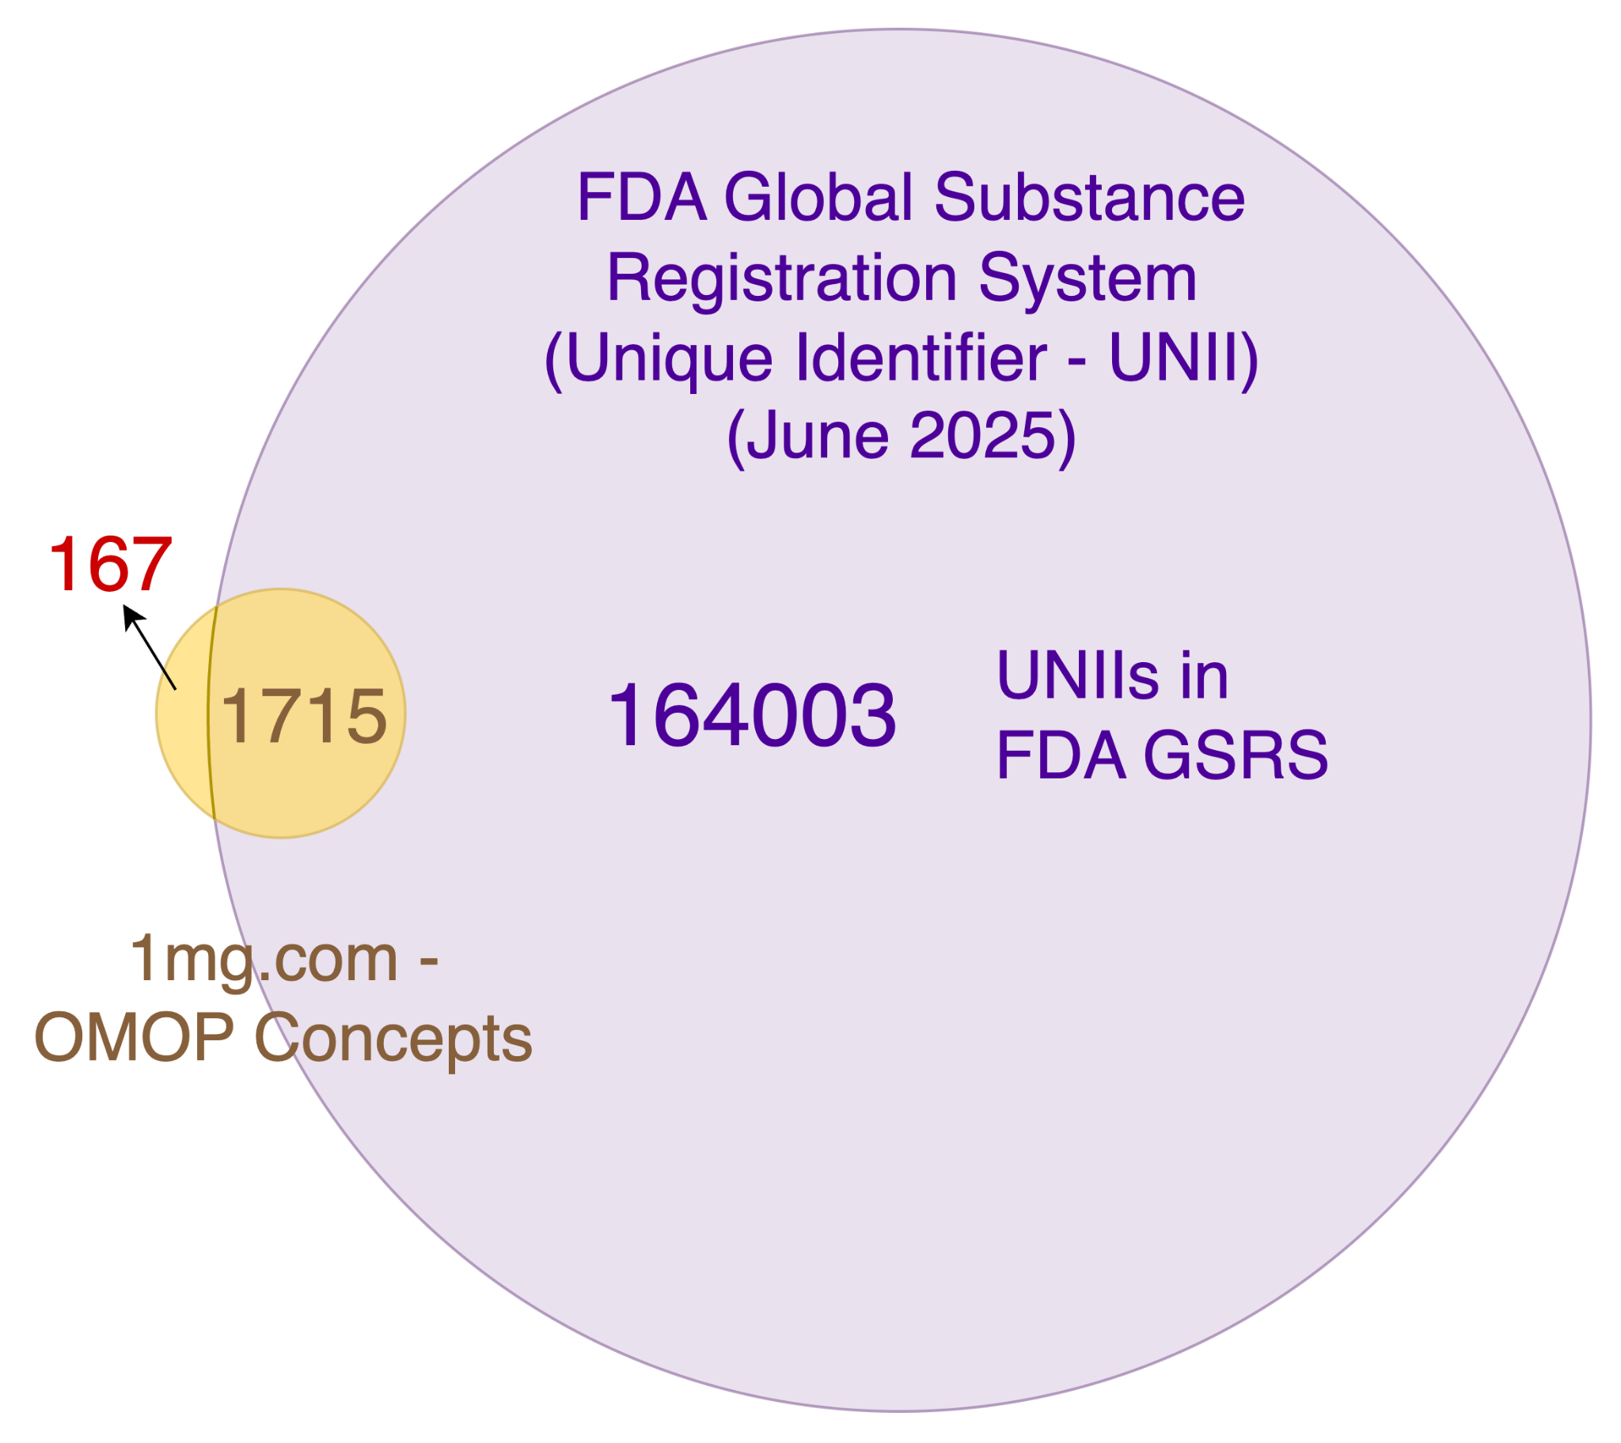
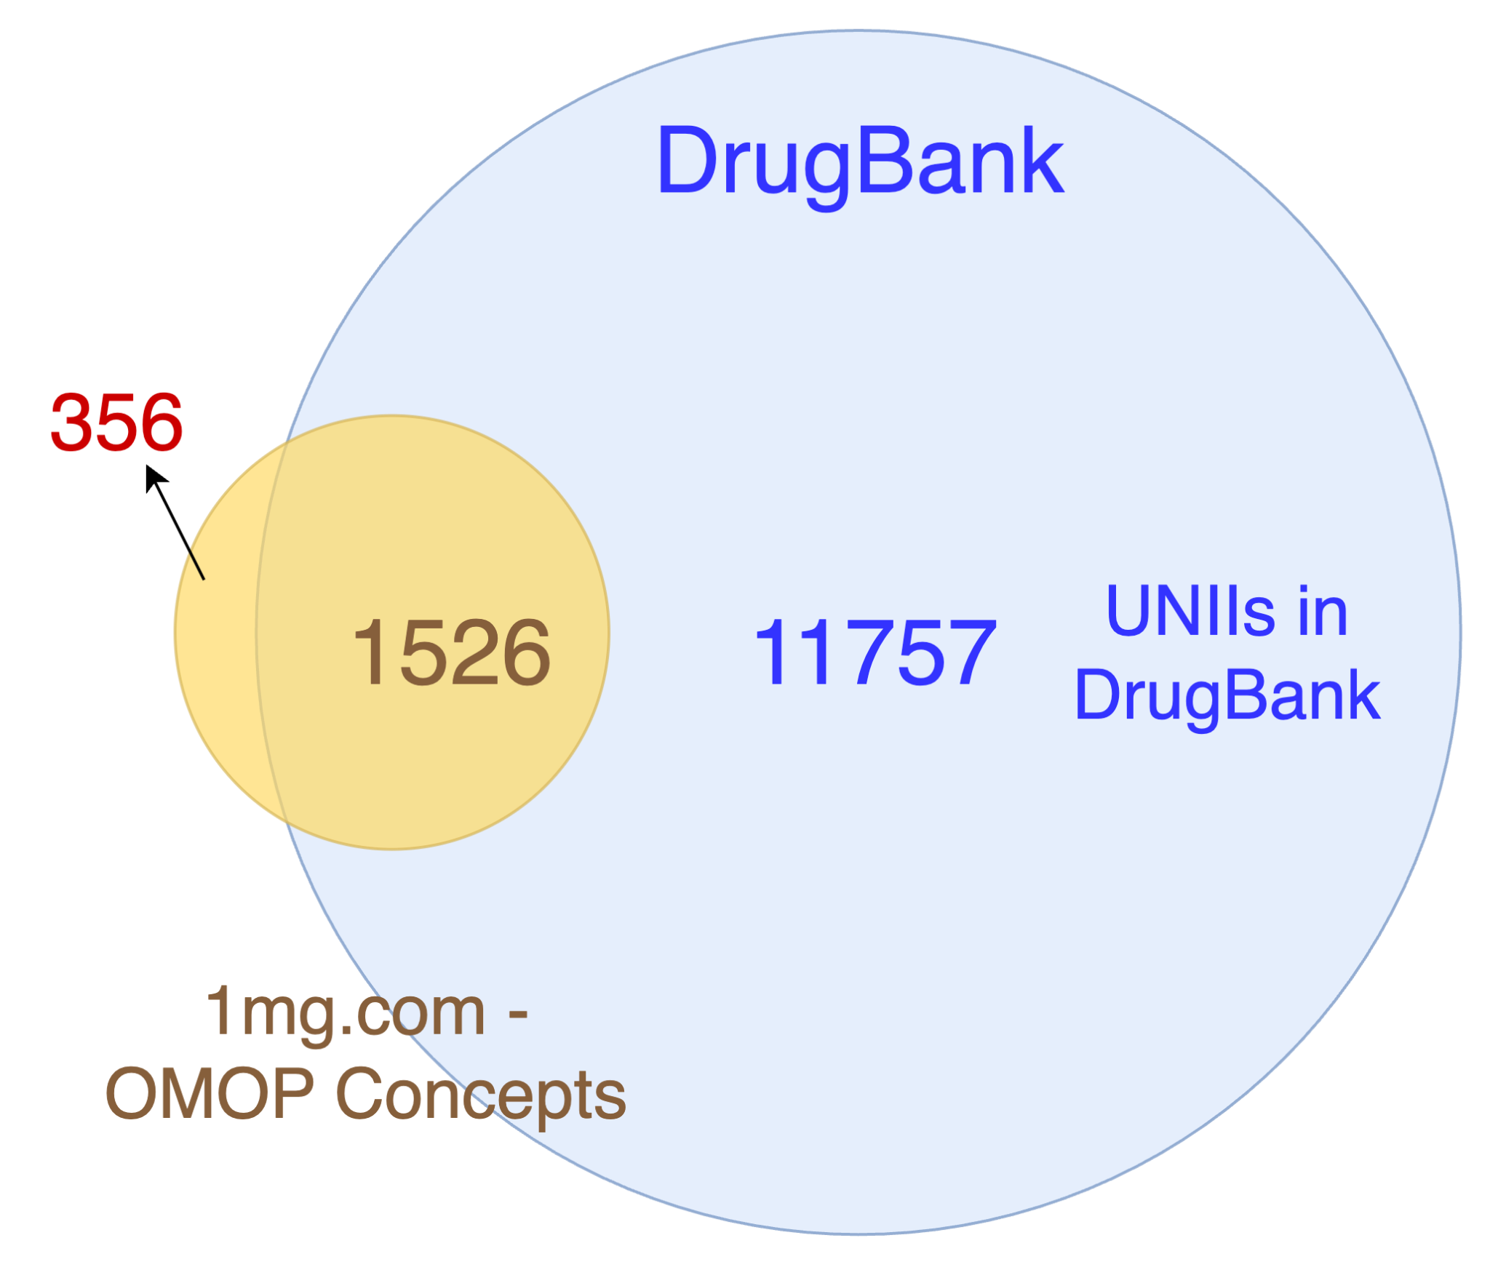
Linking to Global Databases

Slide 12
WHO AWaRe classification of antibiotics
The AWaRe (Access, Watch, Reserve) classification of antibiotics was developed in 2017 by the WHO Expert Committee on Selection and Use of Essential Medicines as a tool to support antibiotic stewardship efforts
The classification of antibiotics is based on their susceptibility to inducing antimicrobial resistance, with Access antibiotics being the least susceptible and Reserve antibiotics being the most susceptible.
The 2025 AWaRe antibiotics list was mapped to OMOP Standard Concepts, and then these were mapped directly to the 1mg.com extracted brand drugs.
Access | Watch | Reserve
92 | 146 | 30
Table: No. of antibiotics for each AWaRe category

Slide 13
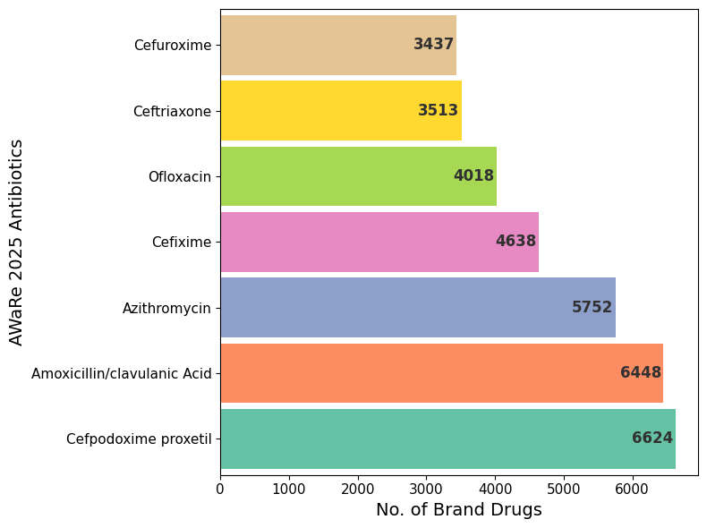
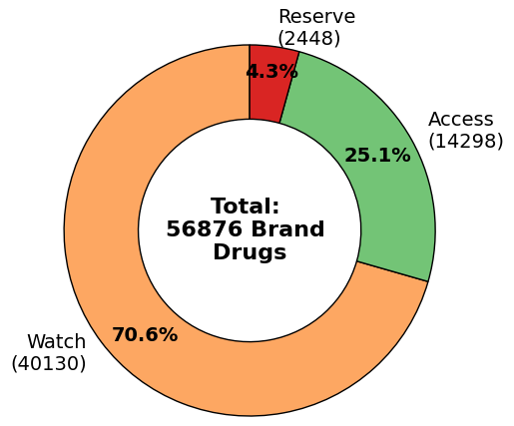
WHO AWaRe classification of antibiotics
(i) Top 7 Antibiotics based on number of brand drugs
(ii) AWaRe antibiotics brand drugs segregated by AWaRe category

Slide 14
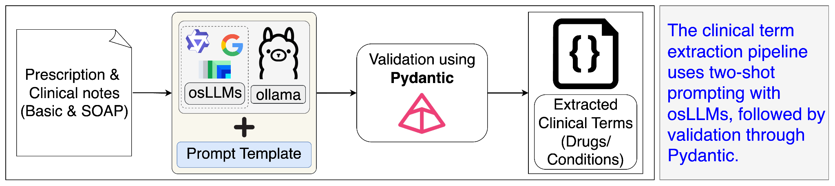
Clinical term extraction from unstructured clinical notes
The dataset consisted of a total of 263774 unique records.
Prescription notes |  | Diagnosis notes
Basic | SOAP | Basic | SOAP assessment | SOAP assessment notes
45723 | 26941 | 60972 | 16388 | 13002

Slide 15
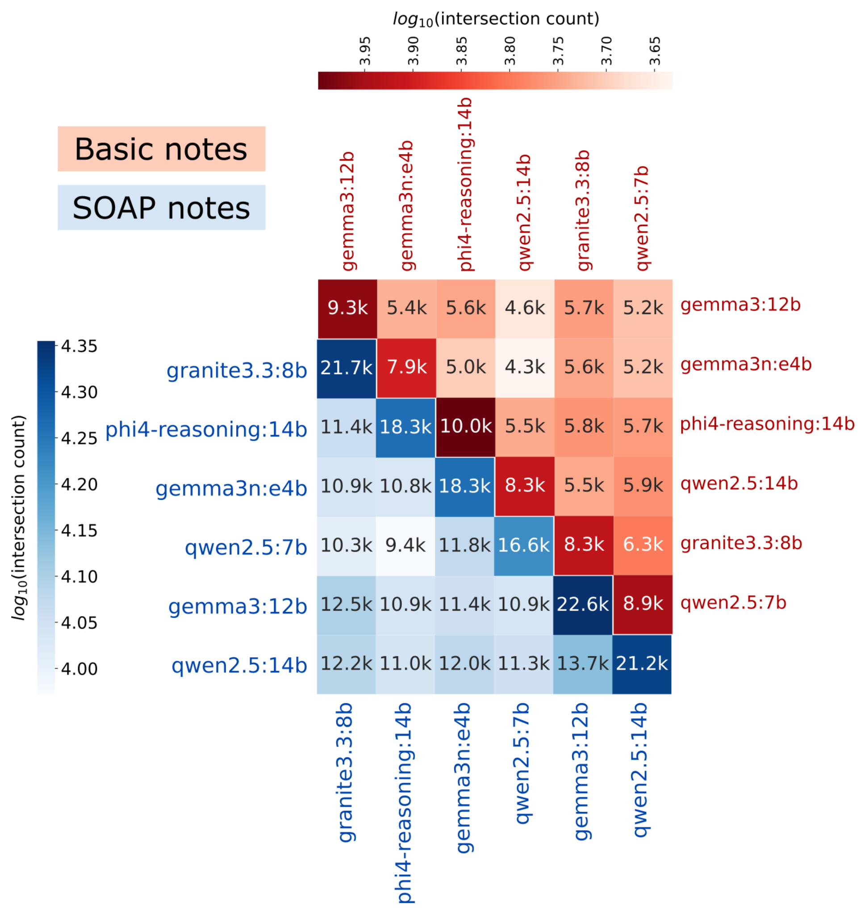
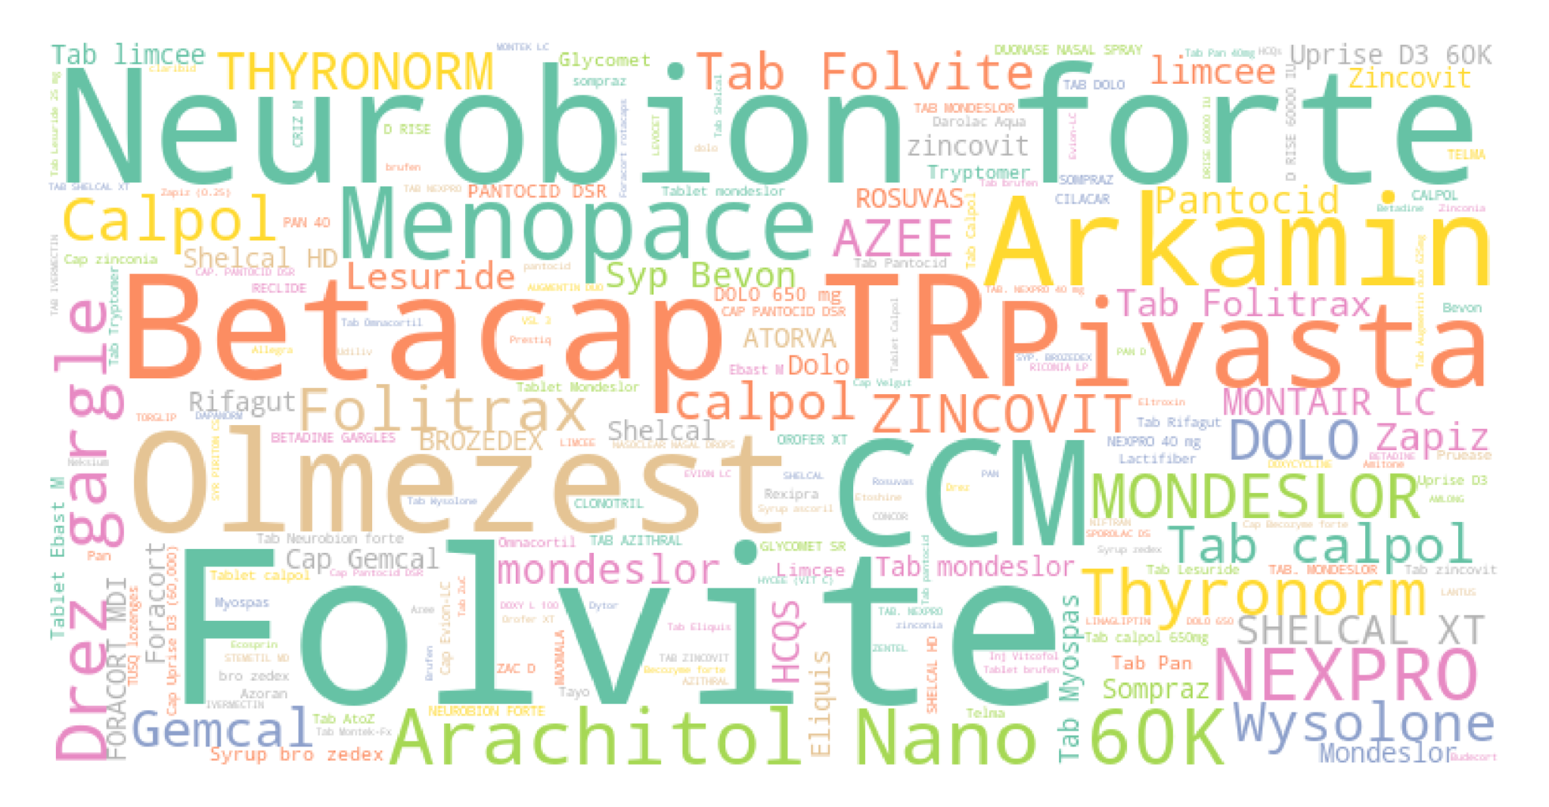
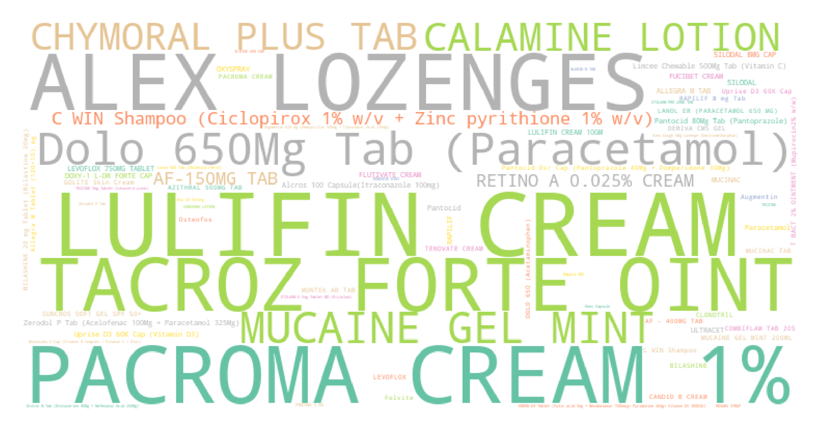
Clinical term extraction from unstructured prescription notes
Basic notes extracted terms
SOAP notes extracted terms

Slide 16
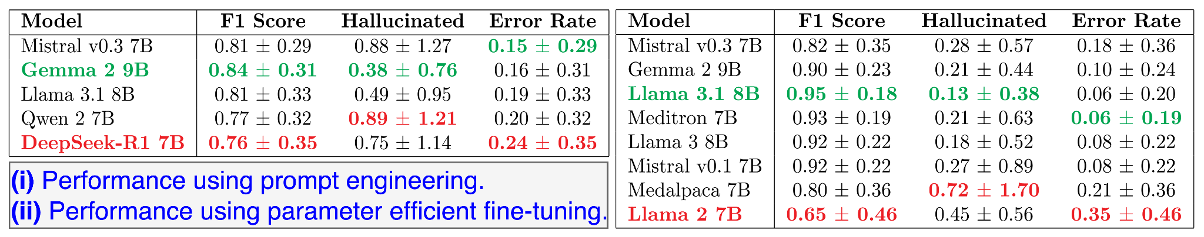
Benchmarking Open source Language models for medication extraction task

Slide 17
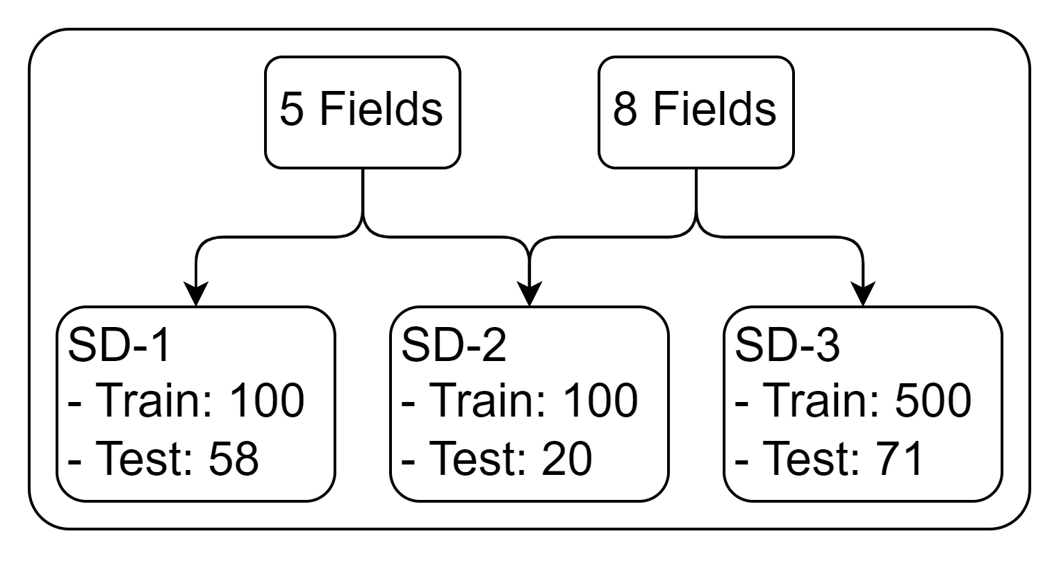
PEFT DATA
We have developed a high-quality annotated dataset of 800+ clinical prescription notes, categorized based on different annotation schemes and timelines. The annotations contains following fields:
5 Fields:
  name, dosage_form, duration, frequency, strength
8 Fields:
  drug_name, dose, dose_amount, dose_change, frequency,
  intake_time, route, duration
The dataset is structured into three sub-datasets (SD):
SD-1: 158 notes (5 Fields)
SD-2: 120 notes (5 Fields + 8 Fields)
SD-3: 571 notes (8 Fields)
Total Notes: 158 + (120 + 571) = 849
Key Distinction:
The primary difference between SD-1 and the combined SD-2/SD-3 datasets lies in the time and type of prescription notes. SD-1 was annotated earlier with a focus on the 5 fields and contains , whereas SD-2 and SD-3 were annotated later with 8 Fields.

Slide 18
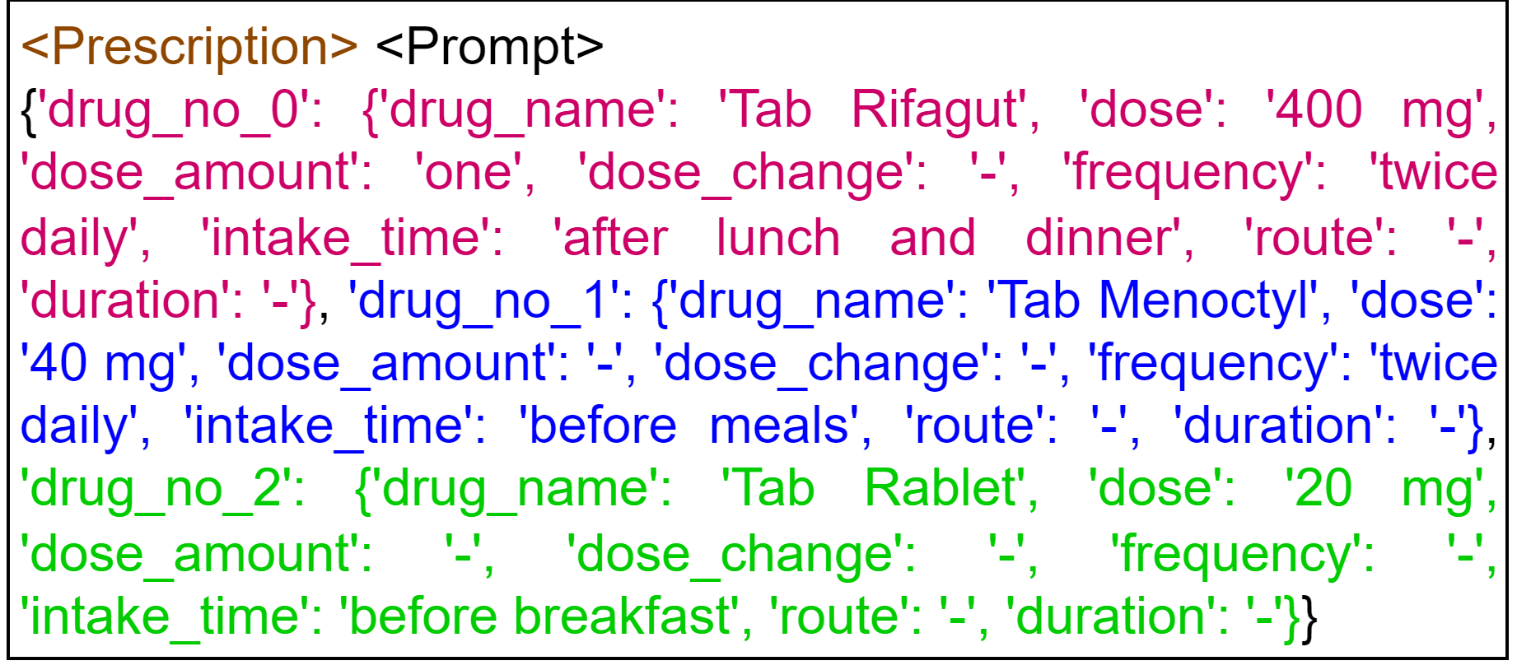
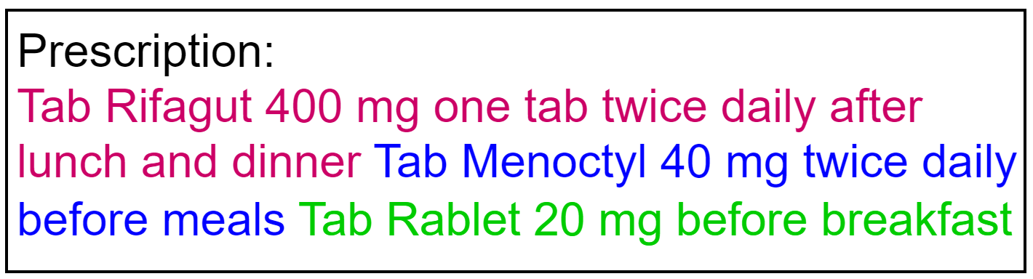

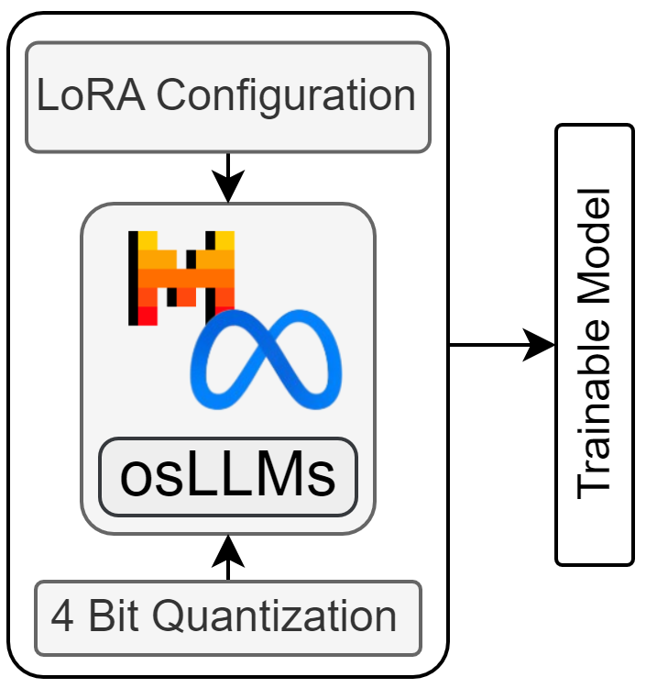
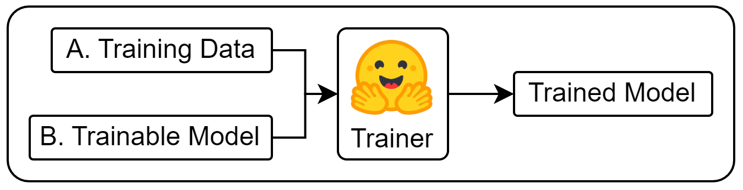
PEFT
A. Training Data Preparation (500 training data and 71 test data)
Prescription Notes
Training Data
Tokenized
Training Data
Token Length
B. Model Preparation
C. Training

Slide 19
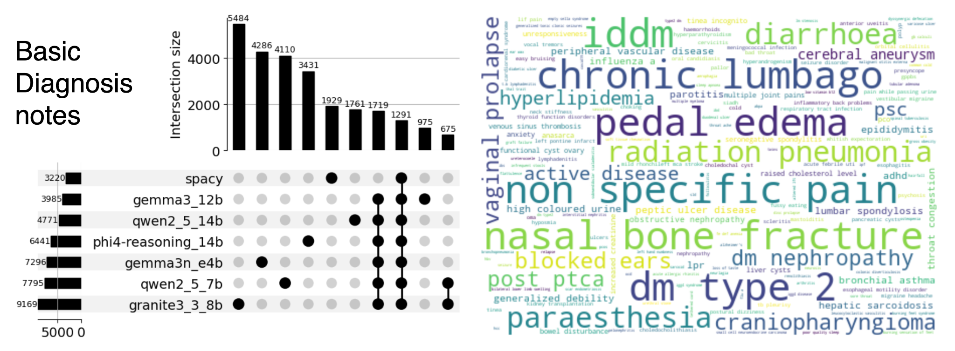
Clinical term extraction from unstructured diagnosis notes
60972

Slide 20
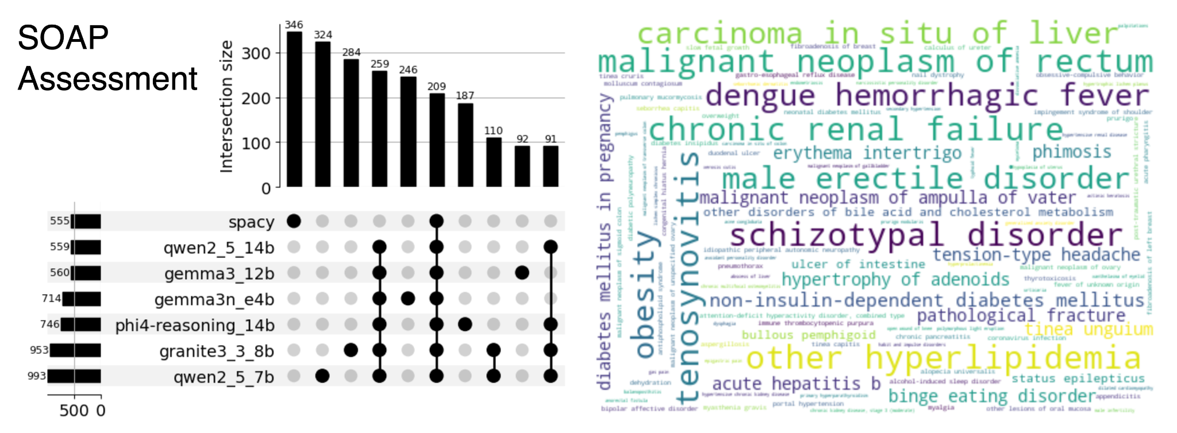
Clinical term extraction from unstructured diagnosis notes
16388

Slide 21
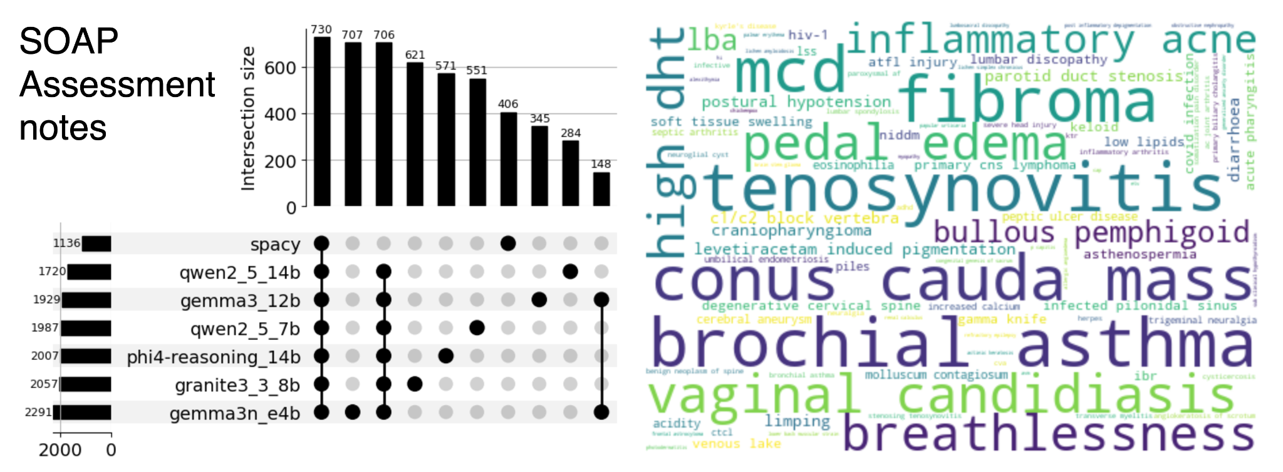
Clinical term extraction from unstructured diagnosis notes

Slide 22
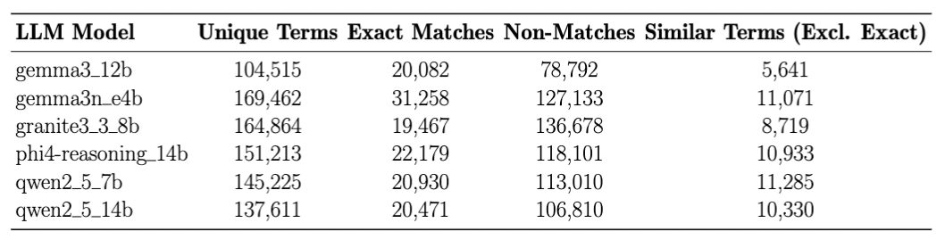
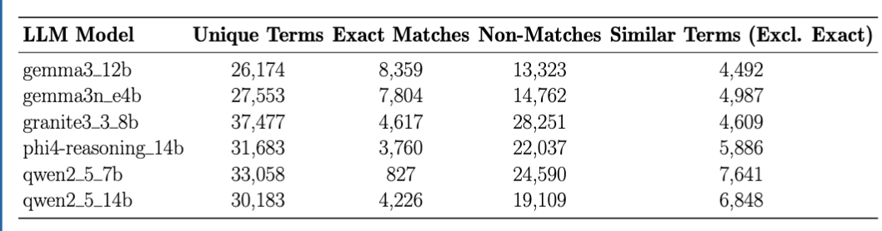
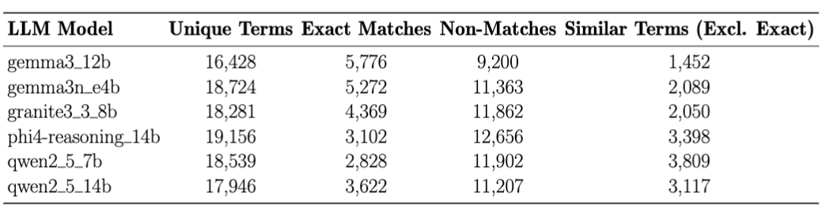
Table 2: Comparison between LLM and spaCy NER Models — Basic Notes
Table 3: Comparison between LLM and spaCy NER Models — SOAP Assessment
Table 4: Comparison between LLM and spaCy NER Models — SOAP Assessment Notes

Slide 23
Conclusion and future directions
Development of comprehensive medication knowledge base from active pharmaceutical ingredients to products to brand drug names interlinked with national standards to global community standards and databases through OMOP CDM
Development of computational workflows for automatic extraction of clinical terms (medication, symptom/signs, and diseases) from unstructured EHR notes using open source small language models and rule-based NLP algorithms
Benchmarking of language models highlights fine-tuning models outperformed prompt-based methods
Integration of Human-In-The-Loop (HITL) Intelligent Systems would be promising solutions to accelerate the automatic standardization and harmonization of large scale unstructured clinical notes

Slide 24
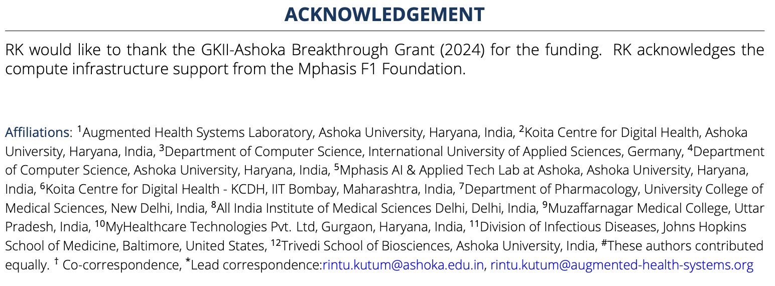

Contributors & Acknowledgements

