Slide 1

WECARE
An Online site for helping poor and needy people
Submitted
by:
Shubham Srivastava 11404283
Siddhant Pandey 11406701

Slide 2
ABSTRACT
The Purpose of this project is to create a platform where one can donate goods/money to poor and needy people.

Slide 3
INTRODUCTION
Project titled WeCare website is an online portal where we can track & locate people in need in order to provide help to them.
The project tends to aim on a particular problem which is faced by those who want to do monetary donations. With the help of this website, they can easily find concern group or people to whom they want to donate.

Slide 4

PROVIDES HELP TO
BEGGARS: It's estimated that there are around 500,000 beggars in India -- half a million people!

Slide 5
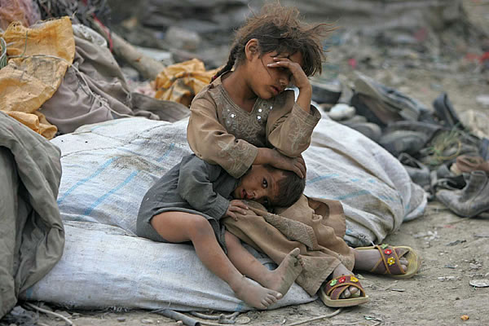
PROVIDES HELP TO
HOMELESS: Homelessness is a major issue in India. There are 1.77 million homeless people in India, or 0.15% of the country's total population.

Slide 6
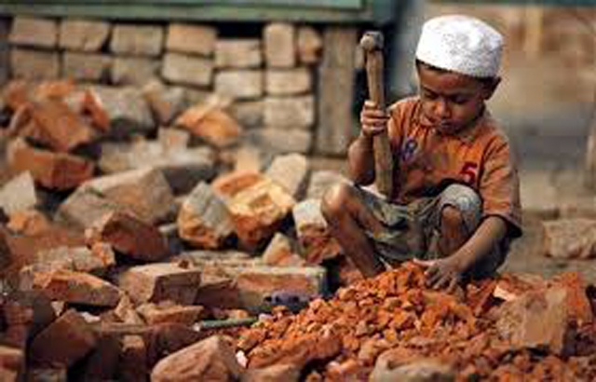
PROVIDES HELP TO
CHILD LABOUR: Child labour is the practice of having children engage in economic activity. According to a Campaign Against Child Labour (CAC) study, India has 1,26,66,377 child labourers.

Slide 7
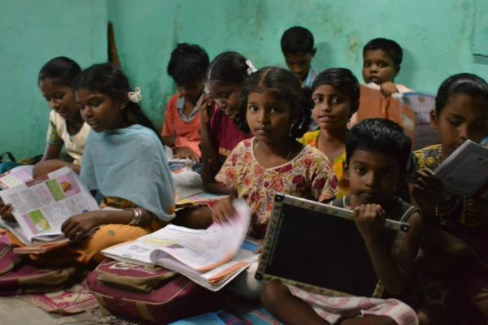
PROVIDES HELP TO
GOVERNMENT SCHOOLS: Major problem with the govt. schools is that they don’t have qualified teachers, poor infrastructure.

Slide 8


DONATION OPTIONS
We provide two options for donation.
Money
Used Goods/ New Goods

Slide 9

KEY FACILITIES PROVIDED
Those who need to donate used goods can set up an appointment where we will schedule a pick up from their residences.

Slide 10

KEY FACILITIES PROVIDED
Anyone can give the information regarding the needy people by filling the form in the website.

Slide 11
DEVELOPMENT TOOL USED
PHP(Hypertext Preprocessor):
It is a programming language that allows web developers to create dynamic content that interacts with databases. PHP is basically used for developing web based software applications.

Slide 12
DEVELOPMENT TOOL USED
MySql:
MySQL, the most popular Open Source SQL database management system, is developed, distributed and supported by Oracle Corporation. MySQL database are relational that stores data in separate tables rather than putting all the data in one big storeroom.

Slide 13
OTHER TOOLS
Apache
XAMPP
Brackets

Slide 14

COMPETITORS
Smile Foundation is an NGO in India benefitting children’s through welfare projects on education, healthcare and livelihood.

Slide 15

Demonstration of the website

Slide 16


