Slide 1
TIC–TAC–TOE using AI
Group 5

Slide 2
MINIMAX ALGO
Minimax is a kind of backtracking algorithm that is used in decision making and game theory to find the optimal move for a player, assuming that your opponent also plays optimally. It is widely used in two player turn-based games such as Tic-Tac-Toe, Backgammon, Mancala, Chess, etc.

Slide 3
In minimax, the two players are called maximizer and minimizer. The maximizer tries to get the highest score possible while the minimizer tries to do the opposite and get the lowest score possible.
Every board state has a value associated with it. In a given state if the maximizer has upper hand then, the score of the board will tend to be some positive value. If the minimizer has the upper hand in that board state then it will tend to be some negative value. The values of the board are calculated by some heuristics which are unique for every type of game.

Slide 4
EVALUATION FUNCTION
We need to implement a function that calculates the value of the board depending on the placement of pieces on the board. This function is often known as Evaluation Function. It is sometimes also called Heuristic Function.
The idea behind the evaluation function is to give a high value for a board if maximizer‘s turn or a low value for the board if minimizer‘s turn.

Slide 5
BUILDING THE evAL FUNCTION
If X wins on the board we give it a positive value of +10.
If O wins on the board we give it a negative value of -10.
If no one has won or the game results in a draw then we give a value of +0.

Slide 6
MINIMAX FUNCTION
The maximizer's move:
If the cell is empty, the ai makes the move and then calls the minimax function (of the minimizer) and then picks the maximum value.
The minimizer’s move:
It does the same, but now calls the minimax function (of the maximizer) and picks the minimum value.

Slide 7
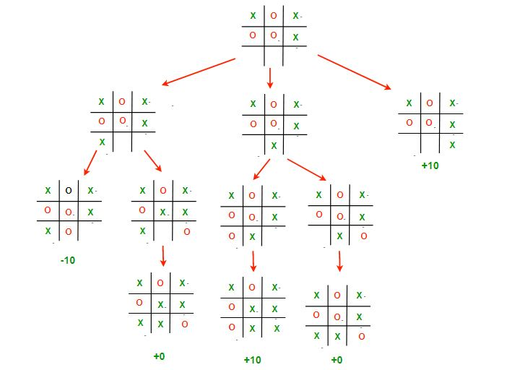

Slide 8
findBestMove FUNCTION
Finds an empty cell
Makes the move
Calls minimax function on this state and finds and returns the best possible move which is a structure containing the indices of the move to be made

