Slide 1
FINAL YEAR PROJECT PRESENTATION
Group Members -
Rushabh Patel (131070005)
Siddhant Shah (131070010)
Abhijit Gupta (131070014)
Mehul Jain (1310700xx)

Slide 2
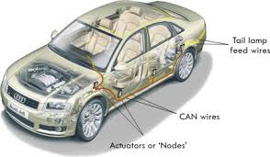
EXPLOITING THE CAN BUS

Slide 3
What is CAN Bus ?
A vehicle bus standard designed to allow microcontrollers and devices to communicate with each other in applications without a host computer.
message-based protocol, designed originally for multiplex electrical wiring within automobiles, but is also used in many other contexts.
CAN is a network used in many every-day products consisting of multiple microcontrollers that need to communicate with each other.
Also referred to as CANbus or CAN bus.
It replaces the traditional architecture of wiring with a anew architecture consisting of only one bus, the CAN bus.

Slide 4












Applications of CAN Bus
Railways, Ships & Marine
Automotive
Construction Equipments
CAN
Building Automation
Medical Equipments
Industrial Automation

Slide 5
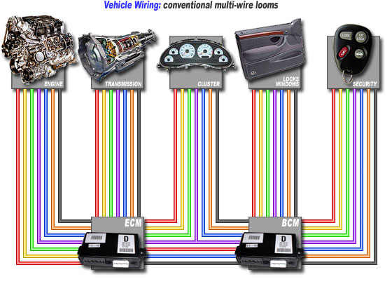
How it worked before
CAN Bus

Slide 6
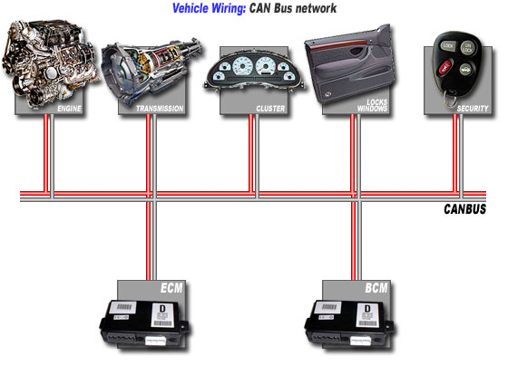
How it works after CAN Bus
Notes:
after

Slide 7
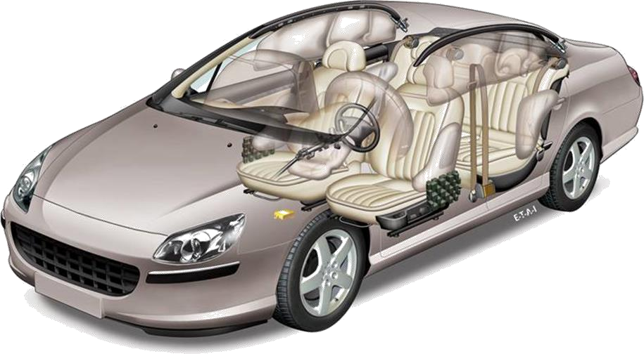
Examples for CAN in Automotive
High Speed
500-1000 [Kbit/s]
-Engine
-Brakes
-Gearbox
Low Speed
25-125 [Kbit/s]
-Central locking system
-Air conditioning
-Lights

Slide 8
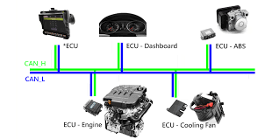
Notes:
architecture

Slide 9
Bus stations (Nodes)
Typically 3 to 40 nodes per bus
No limit for node number defined in CAN specification.
Number of nodes depends on capabilities of CAN transceivers.
Bus load usually gets higher with more nodes.
Hot plug-in / plug-out
Connect / disconnect nodes while the bus is up and running.

Slide 10

Advantages of CAN Bus
Advantages of
CAN Bus
conventional
cabling
over
Less wires
Less connections
Less weight
Less EMI problems
Less space requirements Easier addition of new nodes Lower assembly costs
Increased transmission reliability

Slide 11
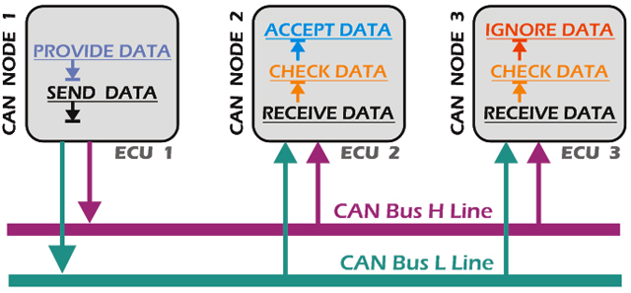
A Brief Overview of Working of CAN
Notes:
Broadcasting technique is the main aspect of CAN Bus.

Slide 12
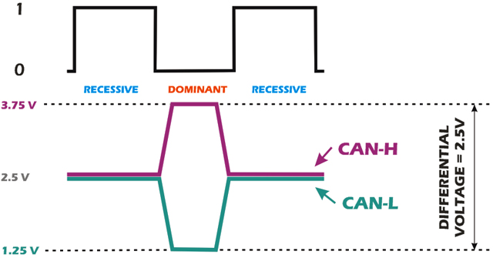
CANH and CANL
Notes:
How does CANH and CANL work?

Slide 13
Frames
Data Frame
Remote
Frame
Overload
Frame
Error Frame

Slide 14




Data Frames : Format
Standard Format ( CAN 2.0A ): 11-bit identifier
Bus Idle Arbitration Field
Control Data Field CRC Field
Field
Ack End of Inter-
Bus Idle
Field Frame
frame Space
Field
recessive
S
R I r
D A D
Bus Idle
^{O} 11-bit Identifier ^{T D 0} DLC
0..64 Bit Data
15-bit CRC
^{E C E} 7-bit EOF IFS
Bus Idle
dominant
F
R E
L K L
Extended Format ( CAN 2.0B ): 29-bit identifier
Bus Idle
Arbitration field
Control Field
Data Field
CRC Field
Ack End of
Inter- Bus Idle
Field Frame
frame Space
Field
recessive
S
S I
R r r
D A D
Bus Idle
^{O} 11-bit Base Id
^{R D} 18-bit Ext. Id ^{T 1 0} DLC 0..64 Bit Data 15-bit CRC ^{E C E} 7-bit EOF IFS Bus Idle
dominant
F
R E
R
L K L
Notes:
Data frame structure
CAN standard implements four types of frames:
Data frame: a frame containing node data for transmission
Remote frame: a frame requesting the transmission of a specific identifier
Error frame: a frame transmitted by any node detecting an error
Overload frame: a frame to inject a delay between data and/or remote framee

Slide 15
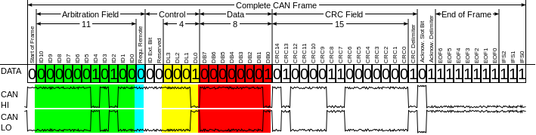
Encoding of bits on CANH and CANL
Notes:
https://en.wikipedia.org/wiki/CAN_bus#Frames

Slide 16
Why is Security needed in CAN Bus ?
A CAN frame has no authentication field, enabling malicious nodes to send spurious commands to the motor controller and the like.
The data field in a CAN frame is only 8 bytes long, making it difficult to add large-key security measures.
ECUs do not always have the computational power necessary to perform cryptographic functions
There is no authentication performed on the sender and receiver of a particular frame.
These flaws do not necessarily mean that CAN is poorly designed; again, it was intended to be a simple protocol that would work in isolation.
They do mean, however, that it will be difficult to add authentication while still keeping within the parameters of the protocol.

Slide 17
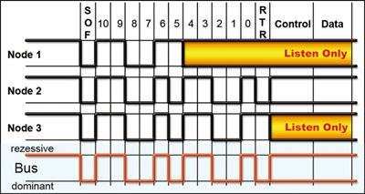
Working of Arbitration in CAN
Notes:
Working starts here -
Arbitration in canbus

