Slide 1
ATTRITION RATE
ANALYSIS
Problem Statement :
Reduction in number of employees in the organization. Identification of possible churners.

Slide 2
Frameworks Used
Python Frameworks
Pandas
NumPy
SciPy
Machine Learning Frameworks
Scikit Learn

Slide 3
Approach
Load the data
Profile the features (Feature dropping, selection, extraction and modification)
Data Preprocessing (One Hot Encoding, Nominal Encoding and Standard Scaker)
Modelling
Logistic Regression with an Accuracy of 87.4% as a benchmark
Random Forest with Grid Search Cross Validation with 9 folds having
88% Accuracy
100 % Recall which is more important as we are more concerned with not classifying churners as non churners or not correctly classifying churners.
NOTE: For details regarding each steps, please open the HTML file sent alongside this presentation

Slide 4
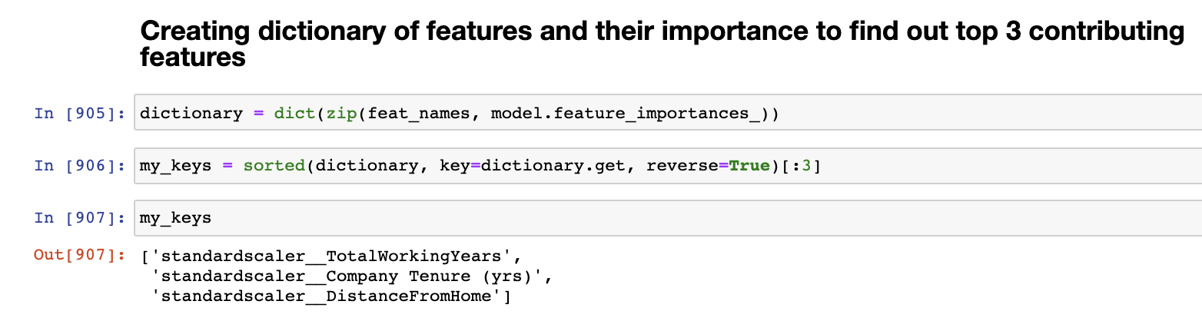
Summary About Data Analysis
Top 3 Features that contribute most to Attrition of Employees are:
TotalWorkingYears – 6%
Company Tenure (yrs.) – 5%
DistanceFromHome – 5%

Slide 5
Summary About Data Analysis
People with Total Working Years between 0-10 tend to leave more than people between 10-40.
People with Company Tenure, Years in current role, Years since last promotion, Years with current manager, all between 0 and 2 tend to leave more. This trend decreases with time.
People with Distance from home between 22-25 tend to leave more than others.
More than half of the employees who are in their 20’s tend to leave the company. People in their 30’s also leave quite a bit. This tread decreases as the age increases.
People who Don’t Travel at all tend to leave the company the least.
People in the Sales Department tend to leave the company more.
People with Education Bucket of Bachelors or College tend to leave way more than PhD.
Single people tend to leave more than Married or Divorced.
People doing Over Time leave more than who are not.
People with Job Involvement Bucket and Environment Satisfaction Bucket being ‘LOW’ tend to leave more.
People with Lower Monthly Income, between 1000 and 3000 tend to leave the most as compared to people earning more.

Slide 6
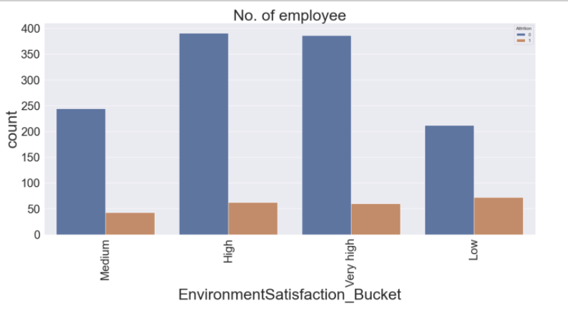
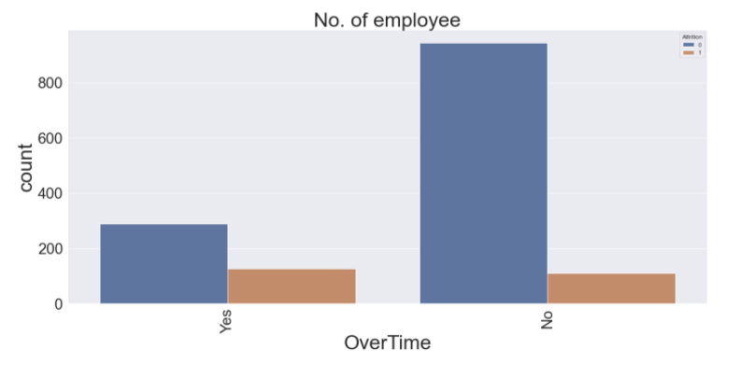
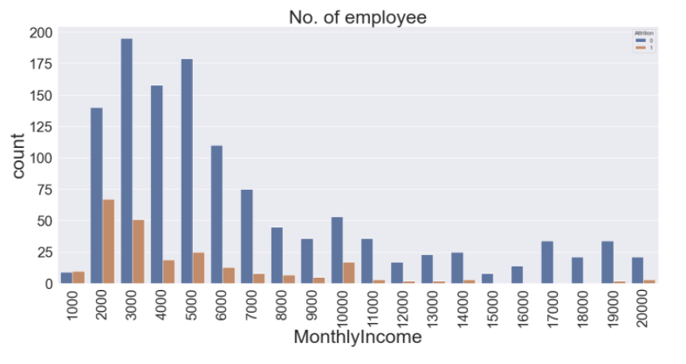
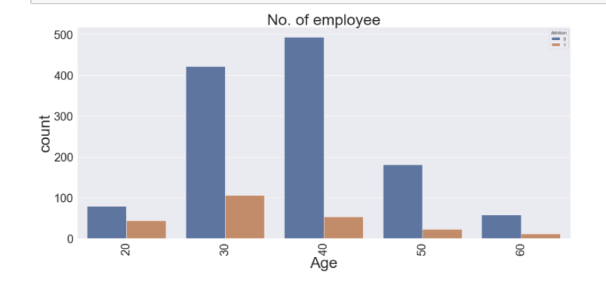
Some Plots

