Slide 1

IMPLEMENTATION OF FOLDER SECURITY USING BLUETOOTH DEVICES
End Term Progress
on
Under guidance of Ms. Shahina Anawarul Assistant Professor
Department of Computer Science & Engineering,
Submitted by
Piyush Tyagi | Samyak Jain | Siddhant Srivastava
500040170 | 500040643 | 500039964
CSE-CSF- VI | CSE-CSF- VI | CSE-OGI- VI

Slide 2
Abstract
Security of the computer files and folders have been a core issue ever since the advent of the windows. Passwords were then introduced to solve this issue but they themselves lend a host of disadvantages.
In this project, we shall study what disadvantages the passwords bring and how we can tackle them. Also we shall propose a Two Factor Authentication [T-FA] system utilizing Bluetooth as a factor coupled with the powerful Rijndael Encryption Algorithm. Bluetooth is the most commonly used technology for Point to Point short range of communication of devices. Besides from being commonly used, it also offers multi connection.
Rijndael algorithm is an Advanced Encryption standard, believed to be the most effective encryption and decryption cryptographic algorithm. Its minimum 10 rounds of encryption and variable key size with a minimum of 128 bits makes it difficult to crack. Coupling the widespread accessibility of Bluetooth and powerful encryption of Rijndael, a Two Factor Authentication System [T-FA] can be created which will not only efface the disadvantages of passwords, but also create a user friendly security system.
Keywords: Bluetooth, Rijndael, protection, computer, folders, two, factor, authentication, security

Slide 3
Introduction
In present day, the increasing reliance on computer systems has led to the dependence on confidential security measures. Various methods used to identify a user are Digital signature, Challenge-Response, Biometrics, IPSec (Internet Protocol Security), SingleSign On and Password.
Password has become one of the most efficient modern day security tool and is very commonly used for authentication. These passwords are string of characters used for authentication or user access. Unfortunately users set passwords that can be easily memorized, in turn increasing threats.
Biometrics on the other hand requires the assumption of unrealistic preconditions for performance gain. Access control systems require time-trusted and reliable personal recognition.
To overcome the problems faced by these processes individually, we can use a combination of two or more security processes. Two-factor authentication has ameliorated security in authentication systems. Sensitive files can be provided double protection using Rijndael security extension and Mobile Bluetooth tokens.

Slide 4
Problem Statement
Attacker can access the system to steal or make unauthorized changes in sensitive information, commit fraud, or disrupt operation.

Slide 5
Literature Review
File Encryption XP system that encrypts files by Blowfish algorithm. It protects information from being viewed or modified from unauthorized person. It uses 384-bit key, and no encryption passwords are saved within the encrypted files [1].
SafeHouse Pro helps in data privacy. It is unpredictable that your sensitive data will be at risk. The more transportable your data becomes, the more cautious you need to be. And hence SafeHouse is used for file encryption [1].
AES: In AES raising the key size by 64 bits leads to increase in energy usage of about 8% without any data transfer. In case of AES higher key size leads to modification in the battery and time usage [2]. DES:
DES is 64 bits key size with 64 bits block size. Many attacks and methods helped in recording the weaknesses of DES, which made it a timid block cipher [3].

Slide 6
Literature Review (Contd…)
In computer security, vulnerability is a weakness which allows an attacker to reduce a system's information assurance. Vulnerability is the intersection of three elements: a system susceptibility or flaw, attacker access to the flaw, and attacker capability to exploit the flaw. Attacker can access the system to steal or make unauthorized changes in sensitive information, commit fraud, or disrupt operation computer device is inactive. But this is not feasible, as the user may be in proximity to the computer device but may happen to not use the device. In such cases also the computer device will get locked, creating an overhead.[5]
Windows uses simple login authentication process for the authentication of valid users. But this login validation and authentication process is not so strong. User passwords are easily cracked by hackers as the passwords are generally user specific and related to users. The passwords kept by the users are easy to remember passwords and not so strong. These policies are often broken down by hackers to gain system access and update content of user files.[6]

Slide 7
Literature Review (Contd...)
The cryptographic keys are used in data encryption to make the file more secure. The same key must be used to decrypt the data. This means that we have to either memorize the key or store it somewhere. Memorizing it isn’t practical, so we must store it so that we can recall it when we want to decrypt the data back into its meaningful form, but no one else can[7].

Slide 8
Objective
To develop a program for enhancing the security of Folders with the help of Bluetooth devices

Slide 9
Methodology
A software shall be developed for the systems using windows.
The software development shall begin within 1 week from the confirmation of proposal.
The software will be using Rijndael algorithm for the encryption of folders.
The software will be developed in 4 phases.
In first phase, all the details about the Rijandael Encryption and Bluetooth communication will be gathered.
Second phase will be of software development.
Third phase will be of testing the software on our own systems.
In fourth phase, all the bugs and problems will be fixed that will be found in testing phase.

Slide 10
Algorithm
Create a class to scan all the Bluetooth devices by using “Bluecove” as the library and using Bluetooth API for JAVA.
LocalDevice localDevice = LocalDevice.getLocalDevice();
DiscoveryAgent agent = localDevice.getDiscoveryAgent();
agent.startInquiry(DiscoveryAgent.GIAC, listener);
try {
name = btDevice.getFriendlyName(false);
} catch (Exception e) {
name = btDevice.getBluetoothAddress();
}
Get MAC Address of the selected Bluetooth Device.
for (int i --> 0 to servRecord.length) {
String url = servRecord[i].getConnectionURL(ServiceRecord.NOAUTHENTICATE_NOENCRYPT, false);
if (url == null) {
continue;
}

Slide 11
Algorithm Contd…
DataElement serviceName = servRecord[i].getAttributeValue(0x0100);
if (serviceName != null) {
System.out.println("service " + serviceName.getValue() + " found " + url);
}
else {
System.out.println("service found " + url);
}
Create a method to select the folder to be secured with respect to the selected Bluetooth Device.
Encrypt and hide the folder

Slide 12
Algorithm Contd…
5. Decrypt and unhide the folder, if bluetooth devices is in range, otherwise encrypt and hide.
if(bluetooth.Device found)
Decrypt()
Unhide()
else
Encrypt()
Hide()
6. Keep running the program as a background process.

Slide 13
System Requirements
Hardware Requirements:
Mobile phone with Bluetooth
Bluetooth facilitated PC or laptop
CPU : Minimum 256 MB RAM, 1GB free HDD space
Software Requirements:
Operating System :- Windows 7 and above
IDE :- NetBeans

Slide 14
Flow Chart
Start
Schedule: PERT Chart
Scan For Bluetooth Devices
Select Bluetooth device
Encrypt or Decrypt?
Encrypt
Enter the Path of the folder to be encrypted
Decrypt

Slide 15
Enter the path of the folder
Encrypt the folder
Decrypt the folder and ask for encryption of the folder
Yes or no
Exit

Slide 16
UML Diagram
MyDiscoveryListener
+ArrayList : Devices +Uuidset : UUID +name : String +arg0 : int +arg1 : int +url : String
+MyDiscoveryLIstener() +deviceDiscovered() +inquirySearchCompleted() +serviceSearchCompleted() +serviceDiscovered()
For Bluetooth Connection

Slide 17
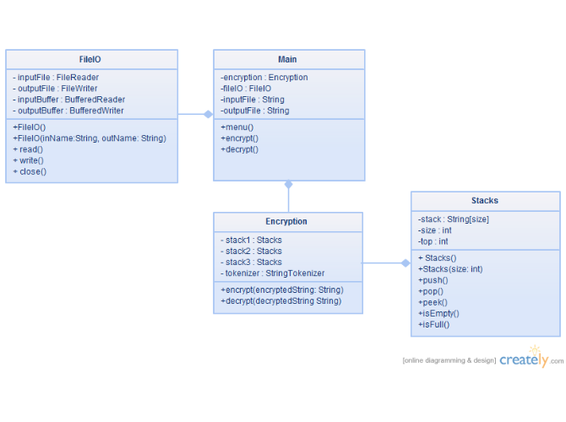
UML Diagram Contd…
For Encryption and Decryption

Slide 18
Use Case Diagram
Encrypt
Scan Devices
Decrypt
Software
User
Folder Disappear

Slide 19
References
[1] Wankhade S.B., Damani A.G., Desai S.J., Khanapure A.V.,”An Innovative Approach to File Security Using Bluetooth.” International Journal of Scientific Engineering and Technology (ISSN: 2277-1581) Volume No.2, Issue No.5.
[2] Bijoy Kumar Mandal,Debnath Bhattacharya,Samir Kumar Bandopadhyay,” Designing and Performance Analysis of a Proposed Symmetric Cryptography Algorithm” 2013 International Conference on Communication Systems and Network Technologies.
[3] M.Umaparvathi1, Dr.Dharmishtan K Varughese,” Evaluation of Symmetric Encryption Algorithms for MANETs”.
[4] O P Verma, Ritu Agarwal, Dhiraj Dafouti, Shobha Tyagi,” Performance Analysis Of Data Encryption Algorithms”.
[5] Mr. Jay.D.Dalal, Ms. Safiya.S.Dayala,Prof. Nehal Shah,”Optimized AES Algorithm Using Galois Field Multiplication and Parallel Key Scheduling”.
[6] Dr. Zahir Zainuddin ,Evanita V Manullang,” E-Lerning Concept Design of Rijndael Encryption Process.
[7] http://www.cp-lab.com/filecrypt/index.html

Slide 20
Thank You
☺

