Slide 1

Emotions, ENGINEERED INTO A PRODUCT.
SHEER DRIVING PLEASURE

Slide 2

THE PRODUCT MANAGEMENT Universe.
Brand
Engineering
Markets / Sales
PRODUCT
MANAGEMENT
Customer
Competition

Slide 3
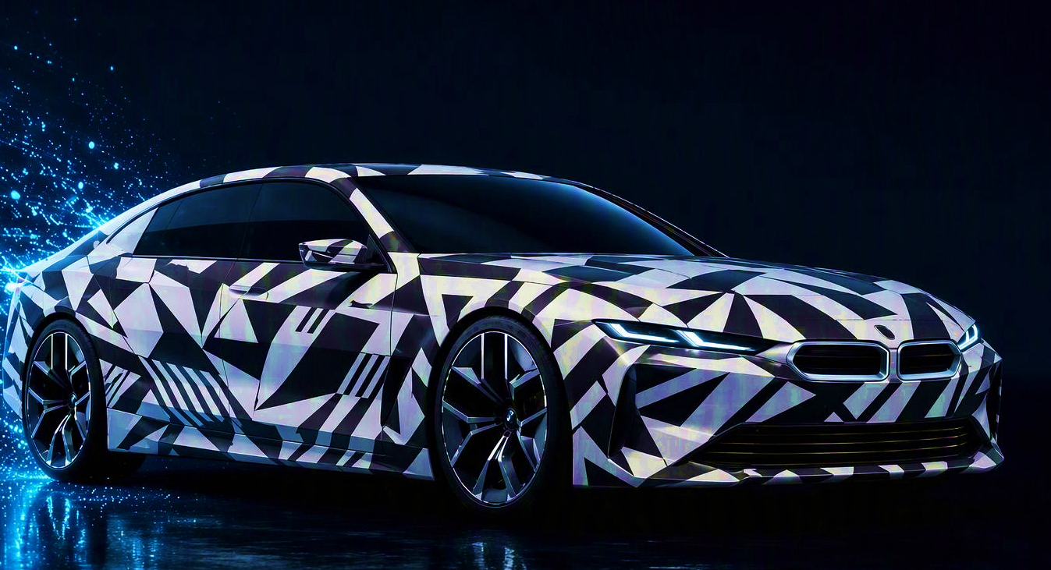
FROM billions of findings to one BMW Vehicle.
1 BILLION
1,000
ONE
FINDINGS
REQUIREMENTS
CAR
“Charging takes too long.”
AFFORDABLE
EASY UPDATES
DATA PRIVACY
“The NEW XPENG.”
SAFETY
JOY OF DRIVING
FLEXIBLE STORAGE
“Too many menus.”
EVERYDAY SPACE
EFFICIENCY
CONNECTED
DESIGN
“Ugly kidney grille.”
GREAT SOUND
EASY CHARGING
RELIABLE SOFTWARE
CLEAR DISPLAYS
EASY ENTRY
SEAT VENTILATION
“I love the design.”
HOME CHARGING
ART APP
INTUITIVE UX
“Too much plastic.”
ICONIC DESIGN
COMFORTABLE SEATS
SMOOTH RIDE
“More rear space, please.”
FAST CHARGING
FAST APP RESPONSE
“Uncomfortable seats.”
SPORT WHEELS
REAL-WORLD RANGE
EASY PARKING
HEATED SEATS
LONG BATTERY LIFE
PERSONALIZED
“The app should just work.”
CARBON ROOF
SIMPLE MAINTENANCE
CLEAR NAVIGATION
“Very nice exterior colors.”
LOW RUNNING COSTS
DYNAMIC
ROOM FOR FAMILY
“Tesla and GROK“
SUSTAINABLE
EASY CHILD SEAT FIT
ELECTRIC
FUTURE BMW SEDAN
PHYSICAL CONTROLS
PREMIUM FEEL
RANGE
AI CONCEPT VISUAL
Customer Requirement = Customer Relevant Attribute of a Car

Slide 4
The Process.
Situation analysis
Structure & context
Requirements
definition
Prioritization
Documentation
Classify, cluster, contextualize
AI standardizes findings, identifies duplicates, groups themes and connects insights
Specification and quantification
Define measurable targets and acceptance criteria
Baseline:
Previous BMW model
BMW portfolio
Sales volume
Competition
Customer
Exterior
Interior
Customer / public
feedback
All potential requirements (0/1)
BEV powertrain
Cooler
Seat ventilation
…
Metric
specification
Range: 600 or 700 mi?
Cooler for
how many bottles?
Seat ventilation: fast enough?
...
Business
Powertrain
Requirements
tracking
Driver
assistance
…
Product and global trends
…
Implement
requirement?

