Slide 1
Smart Light With Sound Control

Slide 2
Content
Introduction
Objective
Hardware Required
Circuit Design
Advantages
Conclusion

Slide 3
Introduction
Welcome to Smart Light With Sound Control , where innovation meets illumination! Our smart light with a sound sensor brings a new level of convenience and efficiency to your space. By harnessing the power of sound detection, this system activates lights in response to auditory cues, providing hands-free lighting control. With intuitive indicators and reliable relay technology, [Your Project Name] ensures seamless operation while enhancing both functionality and ambiance. Say goodbye to manual switches and hello to a smarter, sound-responsive lighting solution!

Slide 4
Objective
The primary objective of our project is to create an intelligent lighting system that responds to sound cues, offering hands-free operation and enhancing convenience and efficiency in various environments. By integrating a sound sensor with relay technology, our goal is to develop a reliable solution that automatically activates lights in response to detected sound, providing users with an intuitive and responsive lighting experience. Additionally, we aim to incorporate indicator lights to clearly communicate the status of the system, ensuring user awareness and ease of use. Through this project, we seek to showcase the potential of sound-sensing technology in enhancing everyday devices and promoting a more connected and automated living environment

Slide 5
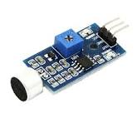
Hardware Required
Sound Sensor:
A sound sensor, also known as a sound detector or microphone sensor, is an electronic component that detects sound waves in its vicinity and converts them into electrical signals. These sensors typically consist of a microphone element and associated circuitry that amplifies and processes the detected sound signals. Sound sensors are commonly used in various applications, including voice recognition systems, security alarms, noise monitoring devices, and in your case, smart lighting systems. They provide a means of capturing audio input from the environment, enabling devices to respond to sound stimuli and perform designated actions based on predefined criteria.

Slide 6
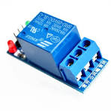
Hardware Required
2. Relay Module:
A relay module is an electromechanical device that acts as a switch to control the flow of electrical current in a circuit. It consists of a coil, which when energized, generates a magnetic field that pulls a switch mechanism (usually contacts) to make or break electrical connections. Relay modules typically include input terminals for connecting to a control signal (such as from a microcontroller or sensor), and output terminals for connecting to the circuit being controlled (such as lights, motors, or other devices). They provide isolation between the control circuit and the circuit being controlled, allowing for safe and reliable switching of high-power or high-voltage loads using low-power control signals. Relay modules are commonly used in automation, robotics, home automation, and various electronic projects to interface between different electrical systems and components.

Slide 7
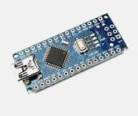
Hardware Required
2. Arduino Nano:
A sound sensor, also known as a sound detector or microphone sensor, is a component that detects sound waves in its environment and converts them into electrical signals. It typically consists of a microphone element, which converts sound waves into electrical impulses, and associated circuitry that processes these signals. Sound sensors are widely used in various applications such as voice recognition systems, security alarms, and sound-activated devices. They enable electronic systems to respond to sound stimuli by detecting changes in sound intensity, frequency, or patterns, and can be integrated into projects like yours to enable sound-triggered actions, such as activating lights or alarms.

Slide 8
Circuit Diagram
2. Arduino Nano:
A sound sensor, also known as a sound detector or microphone sensor, is a component that detects sound waves in its environment and converts them into electrical signals. It typically consists of a microphone element, which converts sound waves into electrical impulses, and associated circuitry that processes these signals. Sound sensors are widely used in various applications such as voice recognition systems, security alarms, and sound-activated devices. They enable electronic systems to respond to sound stimuli by detecting changes in sound intensity, frequency, or patterns, and can be integrated into projects like yours to enable sound-triggered actions, such as activating lights or alarms.

Slide 9
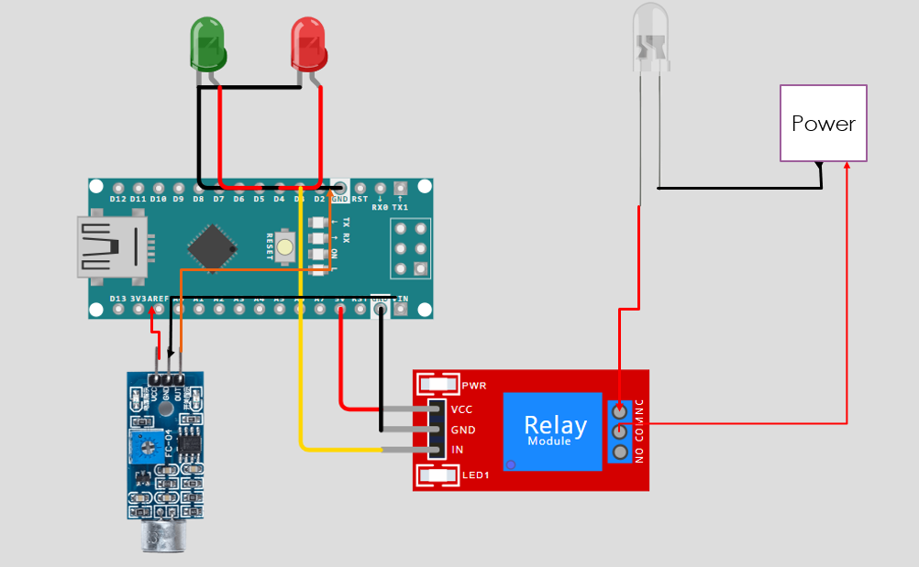

Slide 10
Explanation
The "Smart Light with Sound Sensor" project is a sophisticated lighting system designed to offer seamless illumination in response to sound cues, effectively enhancing convenience and energy efficiency across diverse environments. At its core lies the sound sensor, a pivotal component that detects auditory stimuli within its vicinity. Comprising a microphone element and integrated circuitry, the sound sensor swiftly translates sound waves into electrical signals, initiating a chain of responsive actions within the system.
To enable the automated activation of lights, the project incorporates a relay module responsible for regulating the power supply. Functioning as a switch, the relay module governs the flow of electricity to the lights based on signals received from the sound sensor. When sound levels surpass a predetermined threshold, the relay promptly triggers the illumination, facilitating hands-free operation and eliminating the need for manual intervention.

Slide 11
In addition to its functional prowess, the project integrates indicator lights—red and green— to convey the operational status of the system at a glance. The red indicator light denotes standby mode or system inactivity, ensuring clarity in discerning the system's state. Conversely, the green indicator light signifies active operation, confirming the system's responsiveness to sound cues and the successful activation of the lighting mechanism.

Slide 12
Explanation
Enables hands-free operation of lights, reducing the need for manual switches.
Lights are activated only in response to sound cues, minimizing unnecessary usage and conserving energy.
Particularly beneficial for individuals with limited mobility or disabilities, providing easier access to lighting control.
Offers automated lighting control, increasing efficiency and streamlining daily tasks.
Simple and intuitive operation with indicator lights for clear system status indication.
Can be implemented in various environments, including homes, offices, and public spaces, enhancing convenience and functionality across different settings.
Provides added security by automatically illuminating spaces in response to sound stimuli, potentially deterring intruders or enhancing visibility during emergencies.

Slide 13
Thank You

