Slide 1
CUSTOMER SHOPPING BEHAVIOUR
Customer growth matters more than basket size
The path to growth is more customers and repeat purchases, not higher basket size.

Slide 2
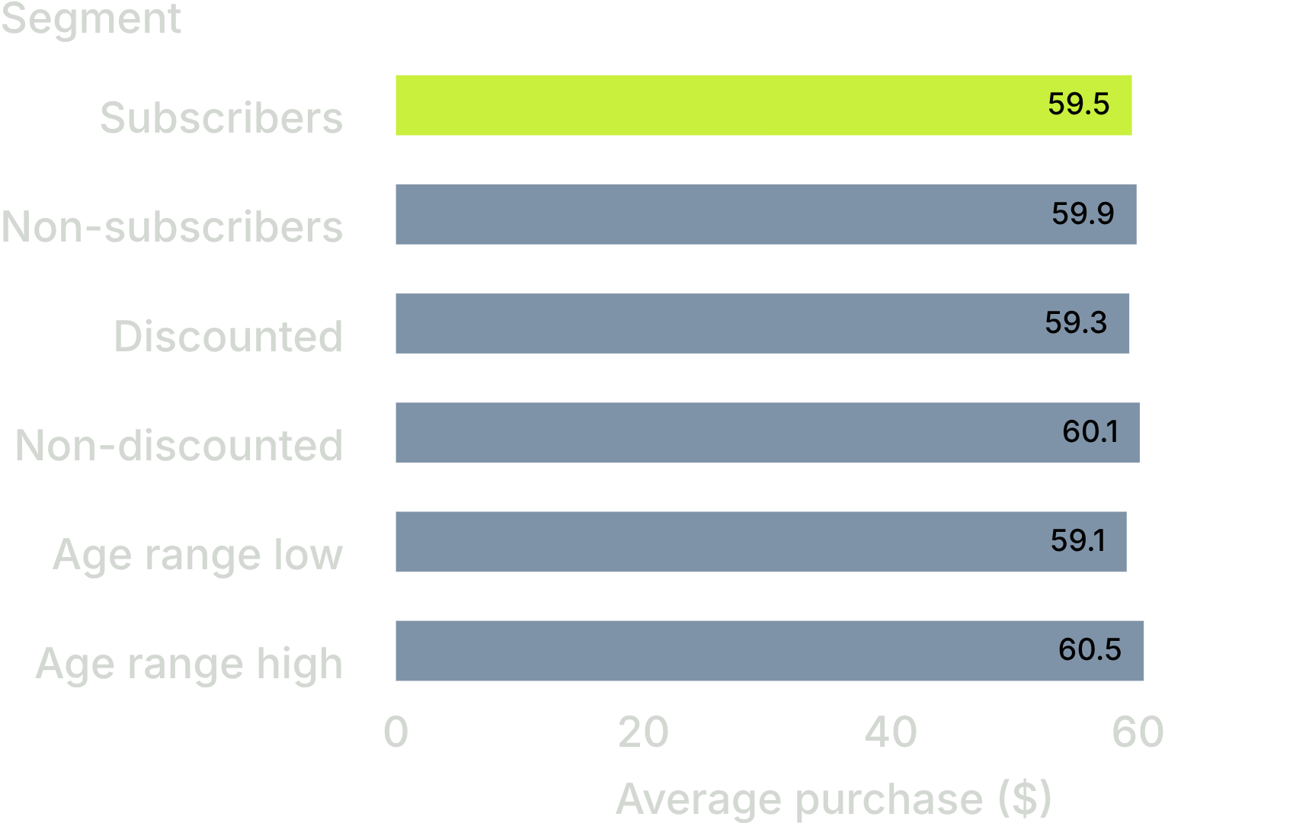
Spend stays near $60 across every segment
Average purchase is essentially flat across subscription, discount and age segments.
Average purchase: $59.76 across 3,900 customers.
02

Slide 3
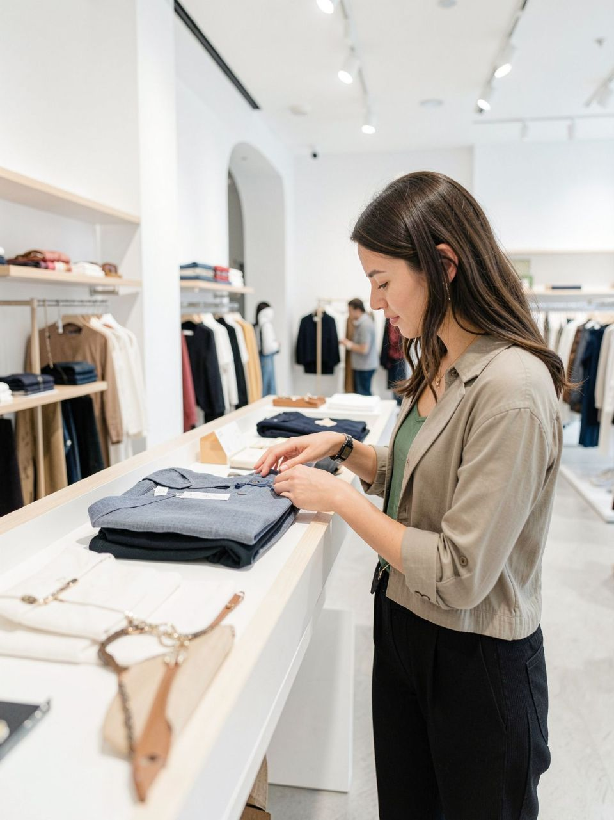
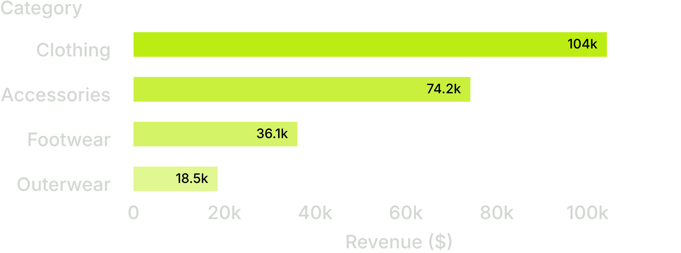
Revenue concentration comes from who buys and what they buy
Men are 68% of customers and contribute 67.7% of revenue, but spend almost the same per purchase as women: $59.54 vs $60.25.
Clothing generates 44.7% of revenue ($104,264), followed by Accessories at 31.8%.
The opportunity is to widen the customer base and category reach, not to chase a high-spending segment.
03

Slide 4
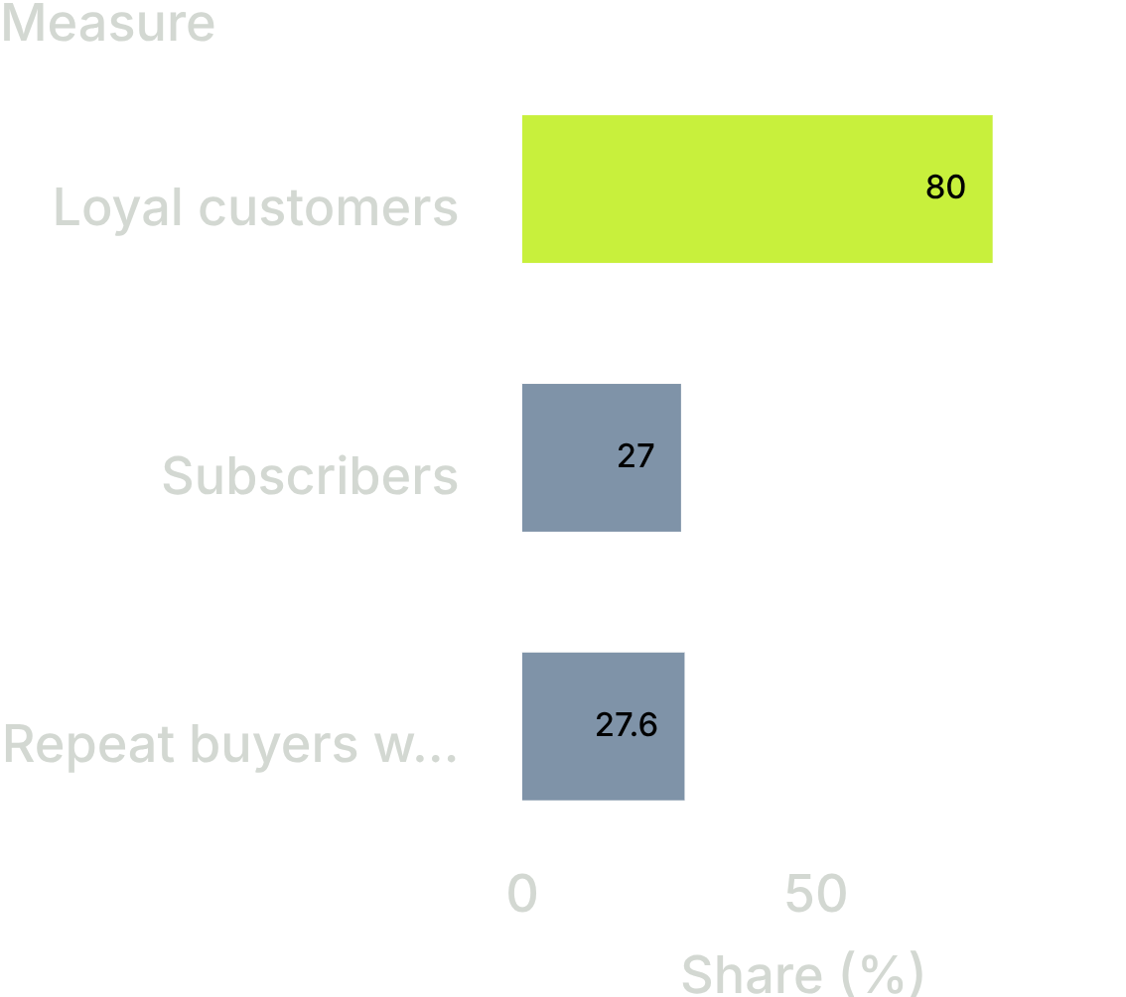
Loyalty is strong, but subscriptions are under-converted
3,116 customers, or 80%, have more than 10 previous purchases.
Only 27% of customers subscribe, despite every subscriber receiving a discount. Repeat buyers subscribe at 27.6%, barely above the 27.0% overall rate.
The customer base is already loyal, but repeat buying is not converting into subscriptions.
04

Slide 5
Broad discounts are expensive without lifting basket size
43%
839
of purchases carry a discount
discounted purchases were still above the $59.76 average
1,677 of 3,900
50% of discounted purchases
That suggests discounts may be reaching customers who would have spent above average anyway.
Test withholding discounts from a sample and compare spend plus repeat rate.
05

Slide 6
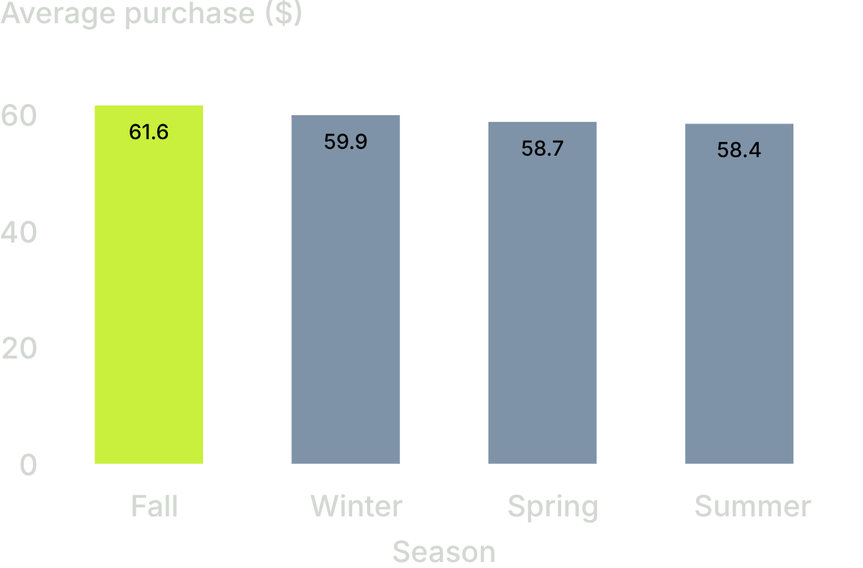
Seasonality gives promotions a better timing signal
Fall has the highest average purchase at $61.56 and revenue of $60,018. Summer has the lowest average purchase at $58.41 and revenue of $55,777; Spring averages $58.74.
Protect margin in Fall; use targeted promotions when average spend is lower.
Outerwear contributes 7.9% of revenue and contains only two products, making it a range-review candidate.
06

Slide 7
The method is reusable, but the next dataset needs better business context
01
02
03
Clean and engineer
Store and query
Connect and align
Clean and engineer the data in Python, including category-median rating imputation and age quartiles.
Store one cleaned customer table in PostgreSQL and answer ten business questions with SQL.
Connect Power BI to the same table so KPI cards, charts and slicers agree with the SQL results.
Current limits: one purchase per customer, no dates, no sales channel and no cost or margin data.
07

Slide 8
THE DECISION
Three actions turn the analysis into growth
Convert loyalty
Target promotions
Widen the base
Offer subscribers more than a discount, starting with customers who have 10+ previous purchases.
Run a discount holdout test and measure spend, repeat rate and margin.
Prioritise female acquisition while protecting the Clothing core and reviewing Outerwear's role.
Next data ask: add dates, channels and costs so future decisions can optimise profitability, not just spend.

