Slide 1

TCP CLIENT SERVER CHAT APPLICATION
TEAM - 5
PRASAD SIMHADRI - CB.EN.U4CSE22438
SIDDARDH REDDY – CB.EN.U4CSE22439
VAMSI KRISHNA – CB.EN.U4CSEE2458
SHANMUKA VARDHAN – CB.EN.U4CSE22461

Slide 2


Project Description
Objective - Creation and deployment of a real-time chat application using Python's socket and threading libraries.
Components
Server: Manages client connections, broadcasts messages, and maintains chat history.
Clients: Multiple clients can connect simultaneously to send messages and execute commands.
Features
Sending messages to the chat room.
Sending private messages to other users.
Executing commands (changing nickname, viewing chat history).
Server administrative functions (kicking users).
Metrics Measured
Latency: Response time for each message.
Bandwidth Usage: Data consumption during communication.
Message Loss: Number of messages not delivered successfully.
Data Recording - Metrics are stored in a CSV file for analysis.
Analysis & Visualization
Analyzing the system’s efficiency and responsiveness.
Visualizing data through graphs and tables to evaluate scalability and robustness.

Slide 3

Dual Socket Communication Strategy
Purpose - Ensures reliability and enhances error handling in the chat application.
Implementation
Utilizes two sockets in the client code.
Maintains a connection even if one socket faces issues.
Benefits
Reduces Message Loss: Minimizes the risk of losing messages due to socket errors.
Improves Data Transmission Consistency: Ensures smooth and consistent data flow.
Enhances Stability: Contributes to the overall stability of the chat application.
Effectiveness
Demonstrated through performance metrics.
Shows the system’s capability to handle real-time communication efficiently.

Slide 4

DESIGN REQUIREMENTS OF TRANSPORT SERVICES
Design Requirement | Description | Implementation in the Code
Reliable Data Transfer | Ensures messages are delivered accurately and in the correct order, with minimal loss or duplication. | - The use of two separate sockets (primary and secondary) helps to ensure message delivery even if one connection fails. - Server tracks client connections and re-transmits messages in case of connection disruptions.
Timing | Guarantees that data is delivered within a specified timeframe, crucial for maintaining real-time communication. | - The client records response times for each message sent, allowing analysis of network delays and server responsiveness. - Measured response times are stored and can be analyzed to ensure acceptable latency levels.
Throughput | Refers to the amount of data successfully transmitted over a network in a given time period. | - The system can handle multiple clients simultaneously, broadcasting messages without significant delays. - Efficient handling of chat history and limiting message length to maintain smooth throughput.
Security | Protects data from unauthorized access, ensuring confidentiality and integrity during transmission. | Basic security features like client nickname verification. Peer to Peer private messaging has been implemented. Does not include advanced security measures like encryption.

Slide 5

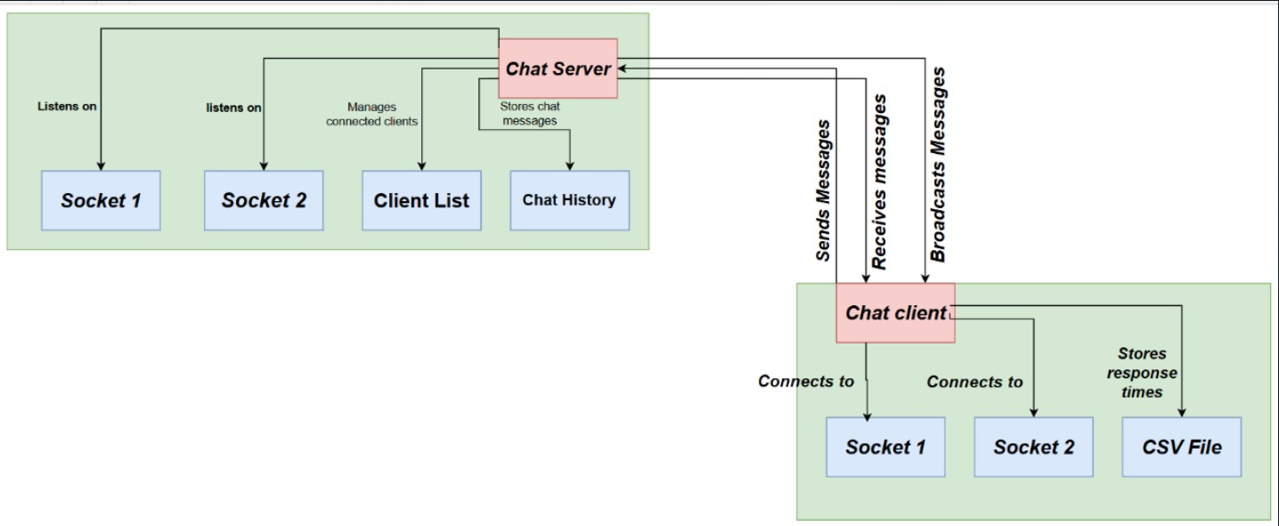
ARCHITECTURE DIAGRAM

Slide 6
CLIENT – SIDE
MODULE
Client Module | Transport Protocol | Number of Connections Required | Description
Primary Client Socket | TCP | 1 per client | Used for sending and receiving messages from the server.
Secondary Client Socket | TCP | 1 per client | Provides redundancy and handles messages or errors if the primary socket fails.

Slide 7
SERVER – SIDE
MODULE
Server Module | Transport Protocol | Number of Connections Required | Description
Server Socket (Primary) | TCP | 1 per client | Listens for primary connections from clients.
Server Socket (Secondary) | TCP | 1 per client | Listens for secondary connections from clients, ensuring redundancy.

Slide 8
ADMIN CONTROL
MODULE
Admin Control Module | Transport Protocol | Number of Connections Required | Description
Admin Input | N/A (local input) | 1 (local server control) | Handled via local input commands on the server for administrative tasks.

Slide 9
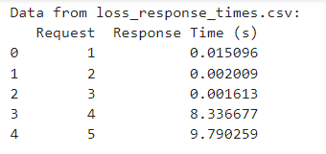
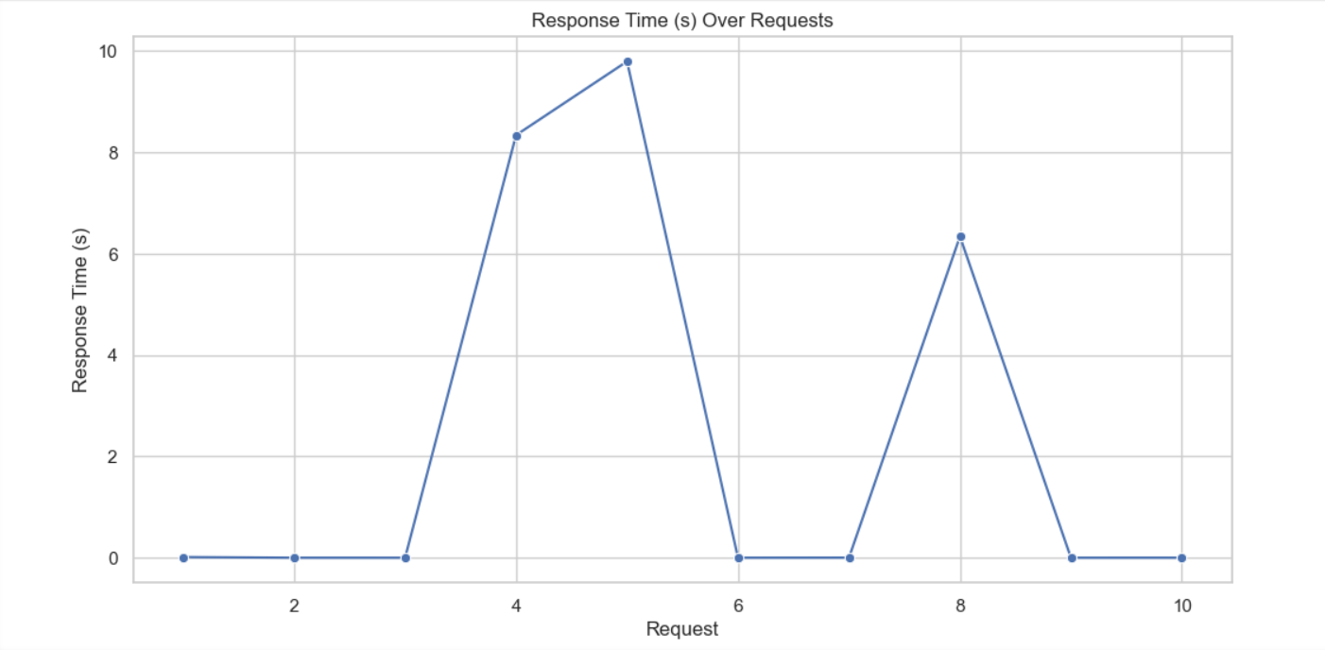
Performance analysis
From loss_response_times.csv

Slide 10
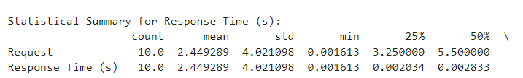

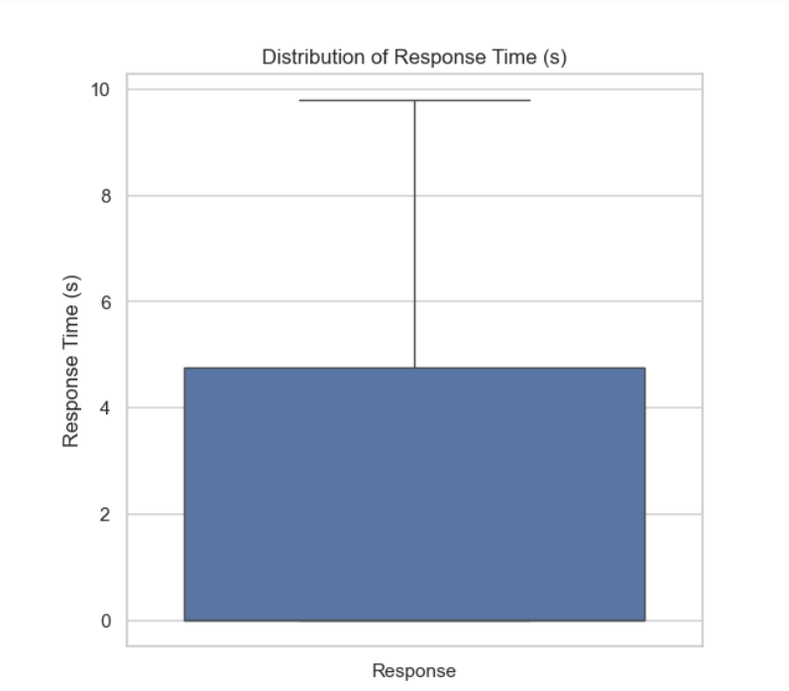
Performance analysis
From loss_response_times.csv

Slide 11
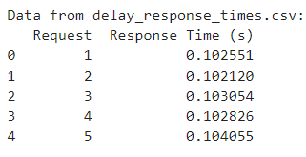
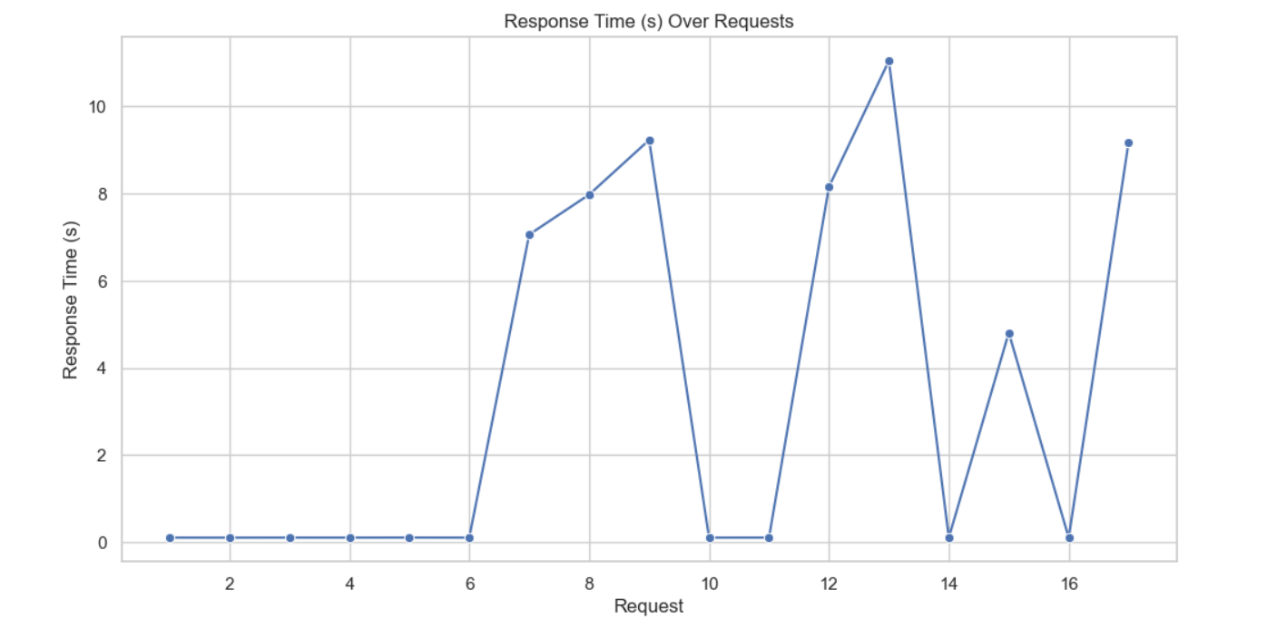
Performance analysis
From delay_response_times.csv

Slide 12
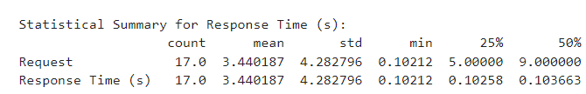

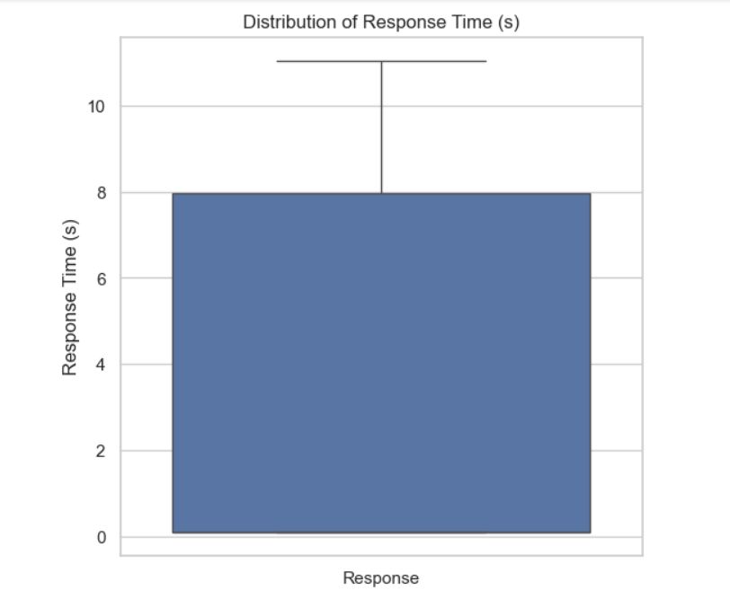
Performance analysis
From delay_response_times.csv

Slide 13
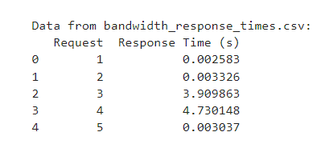
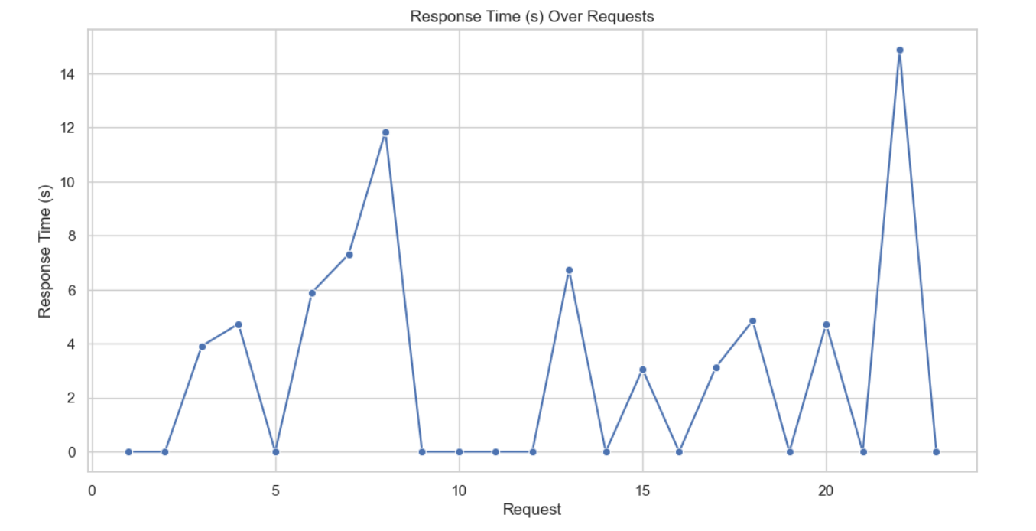
Performance analysis
From bandwidth_response_times.csv

Slide 14
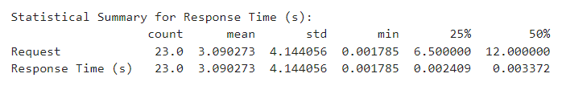

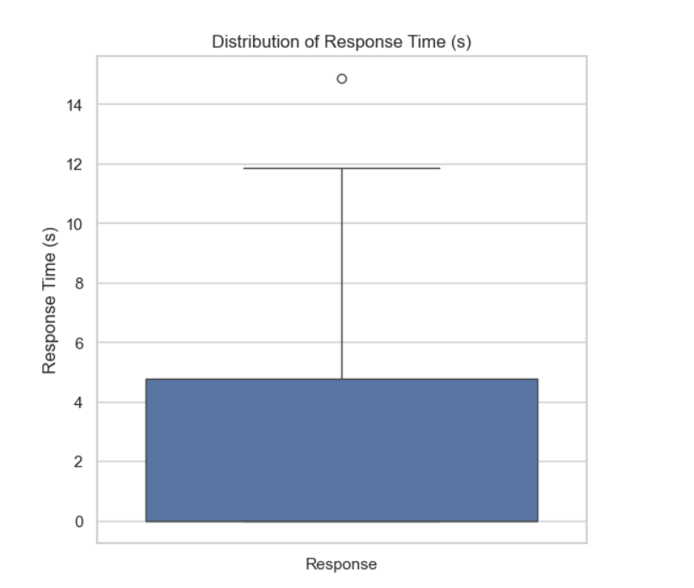
Performance analysis
From bandwidth_response_times.csv

Slide 15
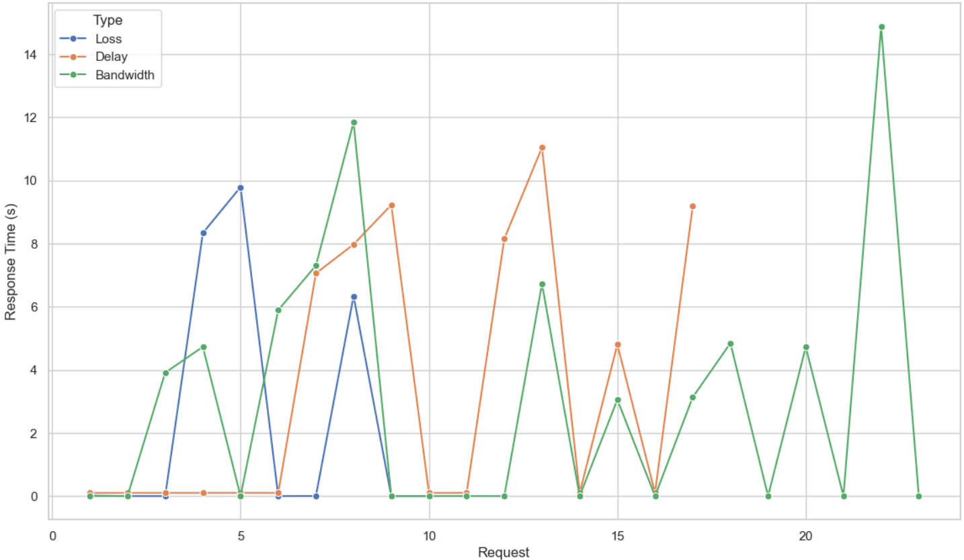
Performance analysis
COMPARISION OF RESPONSE TIMES ACROSS LOSS, DELAY AND BANDWIDTH

Slide 16
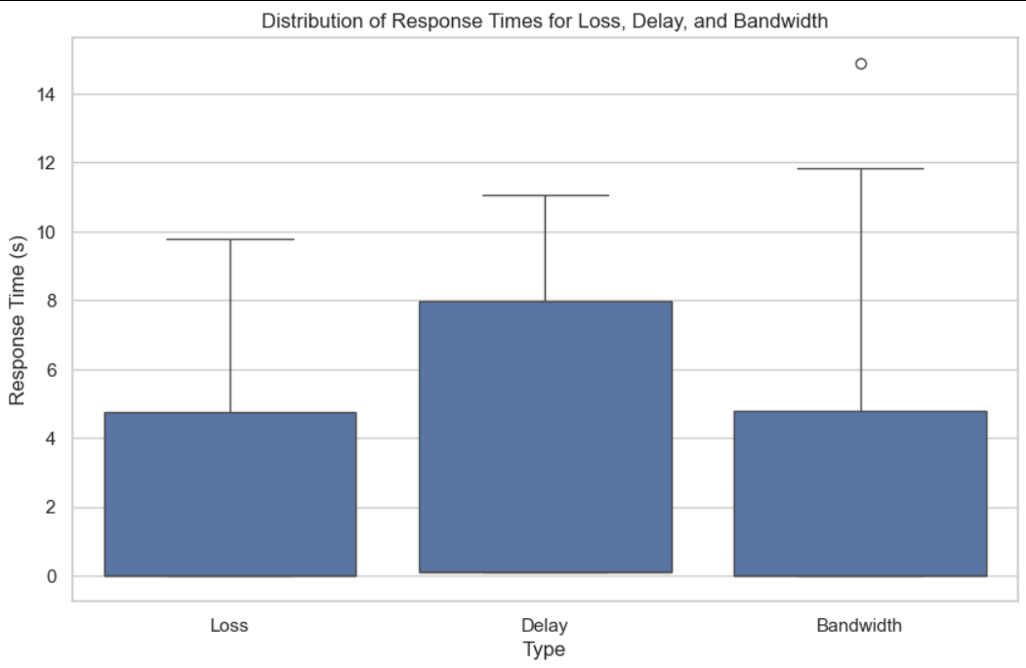
Performance analysis

Slide 17

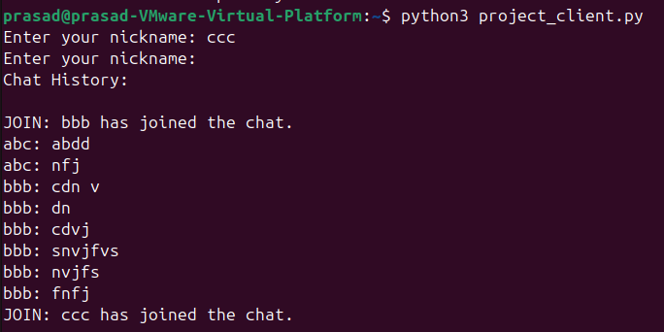
RESULT
When a User joined the group chat:
When user joined the group chat in middle of a conversation:

Slide 18

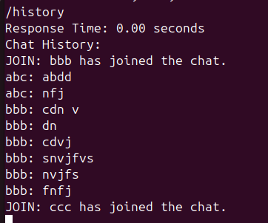
RESULT
/users returns the active(online) users connected to the server:
/history returns the recent 10 messages including the recent activities by the active users:

Slide 19



RESULT
With the help of /nick user can change his nickname :
/msg [uname] [msg]: When user ‘aaa’ wants to send a private message to user ‘bbb’:
(this will not be updated in the chat history)

Slide 20
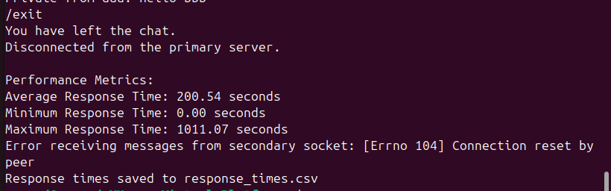

RESULT
/exit is used by the user to disconnect from the server(group chat):
(each other user will be updated with the info)
/kick Server uses this command to kick out any of the user from the group chat:

Slide 21
THANK YOU ☺

