Slide 1
sortmeout
Abhinav Vijaykumar
Aishwarya Iyer
Rohit Khapare
Siddharda Raju

Slide 2
What is sortmeout ?
online grievance forum that allows a user to walk himself through to a resolution of his grievance

Slide 3
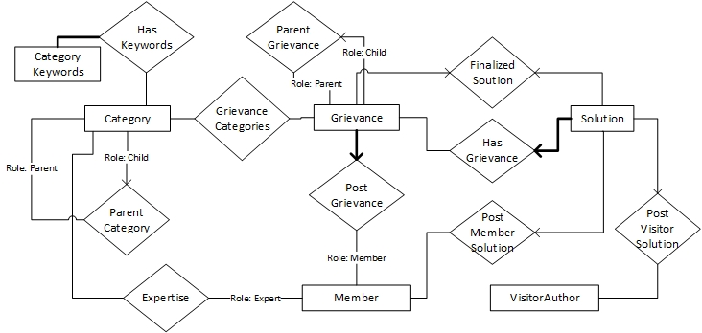
ER Model

Slide 4
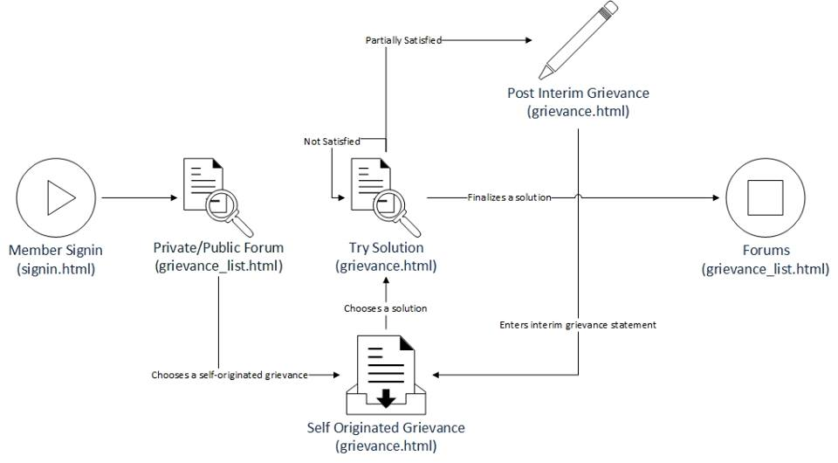
Grievance walkthrough

Slide 5
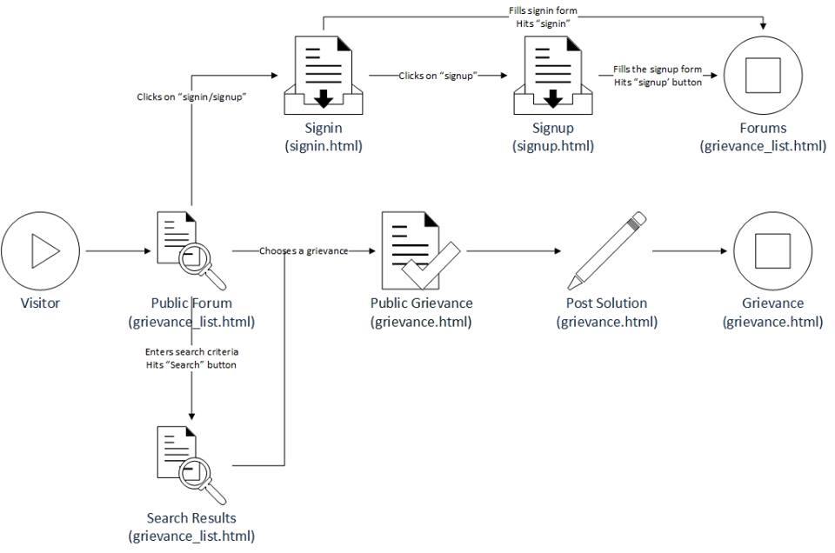
Visiting sortmeout?

Slide 6
Questions ??

